Slide 1

Year 12 and 13

Slide 2

Making choices
Here are some things you need to know, do and think about...
The law says you must stay in learning until the age of 18. This does not mean you have to stay in school.
Learning also includes college, training, or full time work as long as it includes some part time learning e.g. an apprenticeship.
You usually pick your next step in Year 12 on what to do after you are 18.

Slide 3
Think about:
What are you good at?
What do you enjoy?
What might you want to do after you’re 18?
There are resources at school which could help you with these decisions. Ask your teachers or the school librarian to help you.

Slide 4
Building on your strengths
Have a go at the quiz to find out what kind of areas you might want to think about building into your subject choices and future career.
Total up the number of ticks for each colour.
Are you:
Realistic?
Social?
Enterprising?
Conventional?
Investigative?
Artistic?

Slide 5
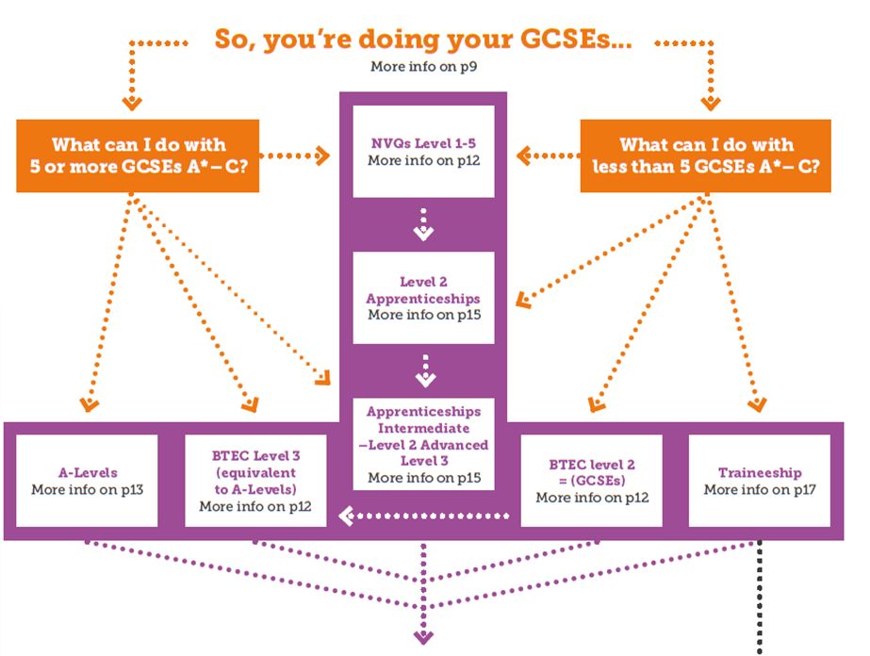
What’s next?
Did you know there are loads of alternatives you can take after your GCSEs?

Slide 6
AS and A Levels
AS and A-Levels are the ‘traditional’ qualification offered by schools and colleges for students aged 16-19.
Most pupils take four AS subjects in Year 12, and continue three of those subjects through Year 13.
Assessed by sitting exams, and sometimes course work, the courses will no longer be divided into modules and there will be no exams in January.
AS and A-Levels have been “decoupled”. This means that AS results will no longer count towards an A-Level, in the way they have done in the past.
A-Levels are great because…
+ They are really well recognised by employers and universities.
+ You can continue subjects you enjoy and are good at, often in a school setting.

Slide 7
What to study
Choose subjects you are good at and you enjoy.
Studying a broad range of subjects including ‘facilitating subjects’ will help you keep your options open. Facilitating subjects are Sciences, English Literature, Geography, French, German and Maths.
Not sure what to study?
If you have a career or university course in mind, check the entry requirements because you may need specific subjects and grades at A-Level.
Not sure where to study?
You don’t have to carry on studying at your current school:
+ Make the choice that’s right for you
+ Don’t just follow your friends and
choose what they choose
+ Don’t put off going somewhere your friends aren’t going – you will make new friends.
There is an informed choices guide to what A-Levels you need for certain subjects at: www.russellgroup.ac.uk/for-students

Slide 8
Alternatives to school
University Technical College (UTC) or Studio School.
You could move to a UTC or Studio School.
+ For 14-19 year olds of all abilities to study subjects linked to specific industrial sectors like STEM ( Science, Technology, Engineering, Maths).
+ They closely involve universities and employers and are designed to be like the workplace.
+ Follow a “9 to 5” day and don’t have the same terms as schools.
+ Offer a range of academic and vocational qualifications including GCSEs in English, Maths and Science.
+ Offer work placements linked directly to employment opportunities in the local area.
Your local UTC is in Berkeley, Gloucestershire
For further information visit: www.berkeleygreenutc.org.uk/about, www.studioschoolstrust.org or www.utcolleges.org

Slide 9
BTECs
Colleges have the widest range of choices and have good links to local employers.
BTECs are great because…
They give you the broad knowledge and skills required to work in a range of jobs within an industry.
BTECs are specialist work-related qualifications that can help you get started in your chosen career.
They combine practical learning with subject specific and theory content.
You will need a GCSE grade 4 or higher in English and Maths before you can progress to either level. These courses will not prepare you for a specific role like an apprenticeship but will provide an insight to an industry and a vocational alternative to A-Levels. They will include some work experience.
BTEC | Equivalent
Level 2 | 5 GCSEs
Level 3 Diploma | 2 A-Levels
Level 3 Extended Diploma | 3 A-Levels
Level 4 + | 1st Year undergraduate degree

Slide 10
NVQs
NVQs are competence-based qualifications.
They give you the specific skills to do a particular job. They focus on the skills you will need in the workplace and assessment is usually
by practical tasks and assignments. They are usually studied part-time alongside work and can be taken as a stand-alone qualification, or as part of an apprenticeship.
NVQs are great because…
You can test out whether you like a job and get ready for working life.
Any experience is good experience – even if you change your mind after
your course. There will still be good skills for you to put on your CV for
the future.

Slide 11
International Baccalaureate
An International Baccalaureate involves studying six subjects,
including languages.
It’s an internationally recognised qualification.
However, it isn’t offered within any Gloucestershire state schools,
so you would have to travel to Bristol, Bath or Swindon to study.
See www.ibo.org for more information.

Slide 12
Apprenticeships
Apprenticeships are about working for an employer and earning as you learn. You get hands-on training in the workplace.
You study part time for an NVQ, BTEC or both, with training at a local college or specialist training provider. At a higher level you can also study for a degree whilst doing an apprenticeship.
There are two types of apprenticeship that you can apply for depending on your GCSE grades:
Intermediate = Level 2 (5 x GCSEs)
Advanced = Level 3 (2 x A-Levels)
Some students start as an intermediate level apprentice but gradually progress to advanced or even higher level as they work. This can give you an edge over school or university leavers later because you have more work experience.
You can also do an apprenticeship after A-Levels, or if you feel you need extra training for your job role later on.
Take a look at: www.apprenticeships.org.uk for information and advice; www.careersbox.co.uk for videos of apprentices talking about their experience; www.yes2jobs.co.uk to search for local opportunities.

Slide 13
Apprenticeships are great because….
You earn while you learn
85% of apprentices stay in employment
once their training ends
67% of apprentices stay with the
same employer
Apprenticeships are available in over 170
industries including aerospace, fashion,
broadcast media and finance – with
1500 job roles available
If your GCSEs go wrong don’t panic! You can often study for a Level 2 Functional Skills in English, Maths and IT.
Alternatively, you can also study an
apprenticeship after BTECs or A-Levels,
entering as a higher level apprentice, and
going on to obtain a degree.
You have to be 16 or over and not in full-time education to start an apprenticeship but you can register and search for opportunities on the National Apprenticeship Vacancy Matching Service (NAVMS) at www.apprenticeships.org.uk

Slide 14
Traineeships
A traineeship is a tailor-made programme of support for young people, aged 16-24, who want to work, but who need extra help to gain an apprenticeship or a job.
This combines a structured, meaningful and substantial work experience placement with training in an area of your choice, to get you ready for a job or apprenticeship. It also gives you a chance to get your Maths and English skills up to a good standard as well as developing the employment skills you need to progress with your career.
Traineeships are unpaid, though
employers can contribute to food and travel costs.
For more information and
to find a traineeship, visit:
www.gov.uk/find-traineeship

Slide 15
Do you need extra support?
There are additional options for
students with special educational
needs/disabilities.
Get in contact with Forwards
career service for advice
about getting a job or work
experience – go to www.
forwardsgloucestershire.co.uk
to find out more.
Speak to your education
link adviser.
Find a college which supports
students with additional needs.
Complete a Transformation Plan
to help you plan where you want
to get to.

Slide 16
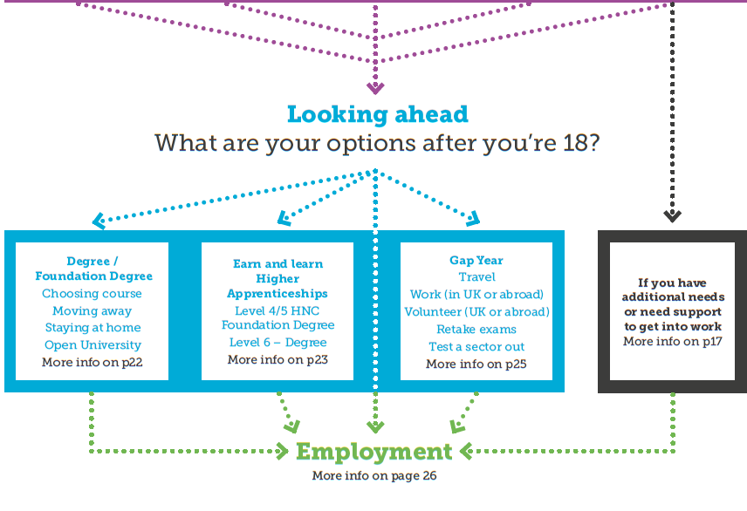
What’s Next?
There are more choices to make when you’re 18.
Have a look at your What’s Next booklet for more info on choices post 18.

Slide 17
University
Why choose university?
+ It’s good if you have a specific career in mind (like being a doctor) but also if you don’t have a career in mind, as it helps to keep your options open.
+ University can be a good step towards living away from home, giving you independence and confidence.
+ You get lots of opportunities to meet new people, learn from professionals and travel.
If you want to go to university you need to think carefully about what you want to do, and the qualifications you need to get there. Check out some university open days – they will tell you what A-Level subjects and grades you need.
Thinking about university?
To get into a university you need to:
+ Head to the UCAS website to start your application
+ Write a personal statement about you and what makes you a good candidate
+ Attend an interview
+ Consider visiting the university at an open day before applying
+ Apply to student finance for your loan.
You could always consider Open University – you do your own study, in your own home, at your own pace.

Slide 18
University
Why choose university?
There is a huge choice of courses you can take – check them out at www.ucas.com
If you want to know more about student finance and applications visit www.gov.uk/student-finance
Graduates in some jobs can expect to make more money than non graduates over a lifetime. Choose your course carefully though, as recent research says this only works for some degrees.
You can expect to pay £36,000 or more for tuition and maintenance which are covered by loans that you have to pay back as you work. Some students can apply for grants if they are eligible for certain benefits, disabled or need help with childcare costs.

Slide 19
Advanced & Higher Level
Apprenticeships
An apprenticeship is a minimum of a year of working and earning while you study.
Normally, you work four days a week and you study at college one day a week.
Apprenticeships come at different levels of difficulty and are equivalent to different qualifications:
You can progress over several years from Level 2 to 4 and beyond, and most of the time your employer will fund your apprenticeship so you don’t have to worry about tuition fees.
Benefits of doing an apprenticeship
+ Earning a salary
+ Training in the skills employers want
+ Excellent progression opportunities, whether
looking to study further or climb the ranks
within the workplace
+ Increased future earning potential
+ Learning at a pace suited to the you
+ Only in a classroom one day a week!
+ Gain practical, hands-on experience.
Level | Equivalent
Higher (4,5,6 and 7) | Foundation degree and above
Degree (6 and 7) | Bachelors or Masters

Slide 20
Gap Years
Gap years can give you the opportunity to:
+ Travel and see the world
+ Get a taste of independence
+ Volunteer and get some work experience
+ Work to fund future studies
+ Study for additional qualifications such
as an Art & Design Foundation Diploma
+ Gain experience in your chosen career
If you choose to do some travelling you might want to go by yourself, with a friend or with a gap year organisation/charity.
The Year Out Group website www.yearoutgroup.org has
information to help you decide if a gap year is right for you.

Slide 21
Getting ready for work
You may feel ready to start full-time work when you are 18, or you may
want to work part time while you study. Here are some things to think about to
improve your chances of getting a job.
Work Experience
Work experience is a great way to test out whether you like a job/sector. It also shows employers that you’ve thought about what you want to do and have a realistic idea of what working life is like.
+ You’ll do work experience with your school or college but you can also arrange your own experience during school holidays or at weekends.
+ Part-time work while you study is also a great way to get experience and learn skills – as long as your education comes first!
You might want to take a look at Job Market Information on the National Careers Service website:
https://nationalcareersservice.direct.gov.uk

Slide 22
Getting ready for work
Volunteering
+ Gain skills that employers are looking for
+ Develop confidence
+ Find out more about what you’re good at
+ Feel valuable
+ Get work experience for your CV
+ Learn new skills and get extra qualifications
+ Support a good cause
+ Meet people
+ Have fun!
To find local volunteering opportunities visit:
www.volunteerglos.org.uk
You can also register for National Citizen Service (NCS) ww.ncsyes.co.uk
NCS is an opportunity for 15 to 17 year-olds to learn new skills, volunteer
and have an adventure.

Slide 23
Getting ready for work
Writing a CV and covering letter
CVs and covering letters are a great way to show your skills and experience. They are the first impression employers get of you. They can be daunting to write at first, but these tips are a good starting point:
+ CVs should be no longer than two
sides of A4.
+ If there’s a job description, read it
+ Write three sentences about your skills and personality
+ List your education and qualifications including what you are studying at the moment
+ List any work experience and volunteering, and what tasks you did
+ Include a bit of information about your skills, hobbies and interests
+ Have a smart and professional layout
+ Remember to include your contact details.
+ A covering letter should be
no longer than one page of A4.
+ One line saying why you are writing
+ A few lines about you and your skills
+ A paragraph about your experience
and what you would bring to the
organisation or role
+ A paragraph about why you want
to work for this organisation and
in this role
+ A few sentences to summarise.

Slide 24
Getting ready for work
How to impress at interviews
Make a good first impression
+ Be on time or if you can, a bit early. It shows you are keen.
+ Dress appropriately for your interview, don’t worry about being too smart.
+ Turn your phone off.
+ Give a firm handshake.
+ Take a deep breath, smile and speak calmly and clearly.
+ Research the role and company – do you understand what they do and what you’ll need to do?
+ Be interested in your job – ask questions about what your employer expects of you.
+ Keep eye contact throughout the interview.
+ Ask the employer some questions
at the end of the interview..
Employers want to see that you can:
+ Work well in a team
+ Solve problems
+ Use a computer (basic Word and Email skills)
+ Turn up on time
+ Motivate yourself
+ Stick with tasks
What are you like at these? Employers often say that it is your willingness to work (your attitude) is every bit as important as your skills and
qualifications. Are you ready for work?

Slide 25
Tips for dealing with stress
Choosing options and taking exams is stressful
Need to relax?
These tips can help:
+ Have a bath to relax
+ Do exercise – it’ll burn off stress and release endorphins
+ Pop bubble wrap! It’ll help calm you
+ Eat some dark chocolate – it releases endorphins
+ Take a break and get outside for some fresh air and hopefully sunshine
+ Spend time with animals – research
shows they reduce stress
Feeling really stressed out?
These tips can help:
+ Take a break from revision
+ Talk to friends and family about
how you’re feeling
+ Talk to a range of people and
teachers about your decision
+ Don’t be embarrassed to ask
for help
+ Try not to procrastinate
– you’ll just feel worse afterwards
Finally:
Remember it’s okay to not
know what you want to do.
If you’re really struggling
and feel really down, talk
to your GP immediately.
There’s a new website for young people in Gloucestershire to find out about mental health and wellbeing:
www.onyourmindglos.nhs.uk

