Slide 1

Supporting Pupil’s Mental Health and Wellbeing
Developing a whole school approach
Santina Iannone – GHLL Lead Teacher
Kate Barnes – GHLL Lead Teacher

Slide 2
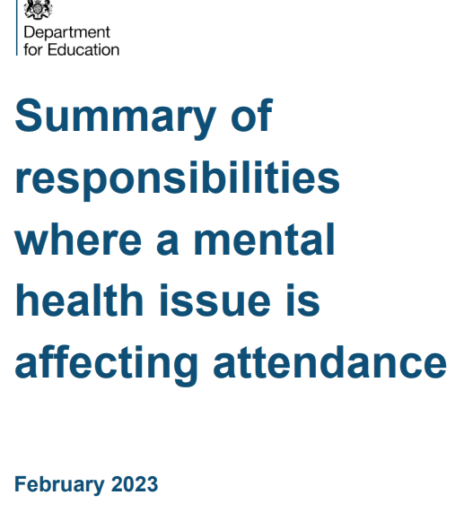
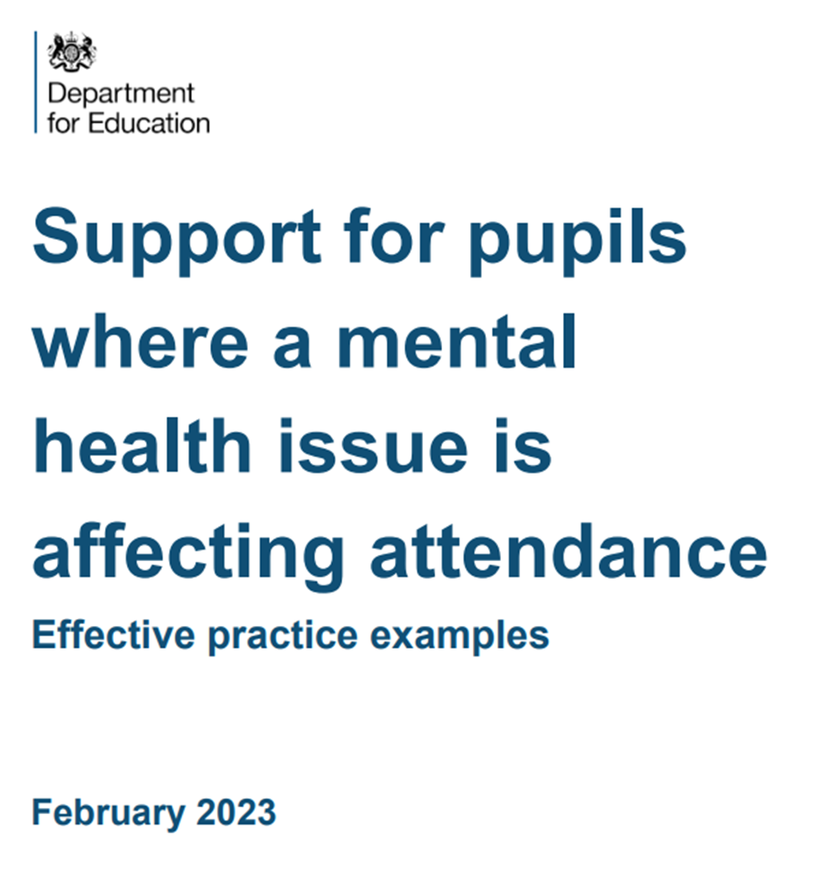
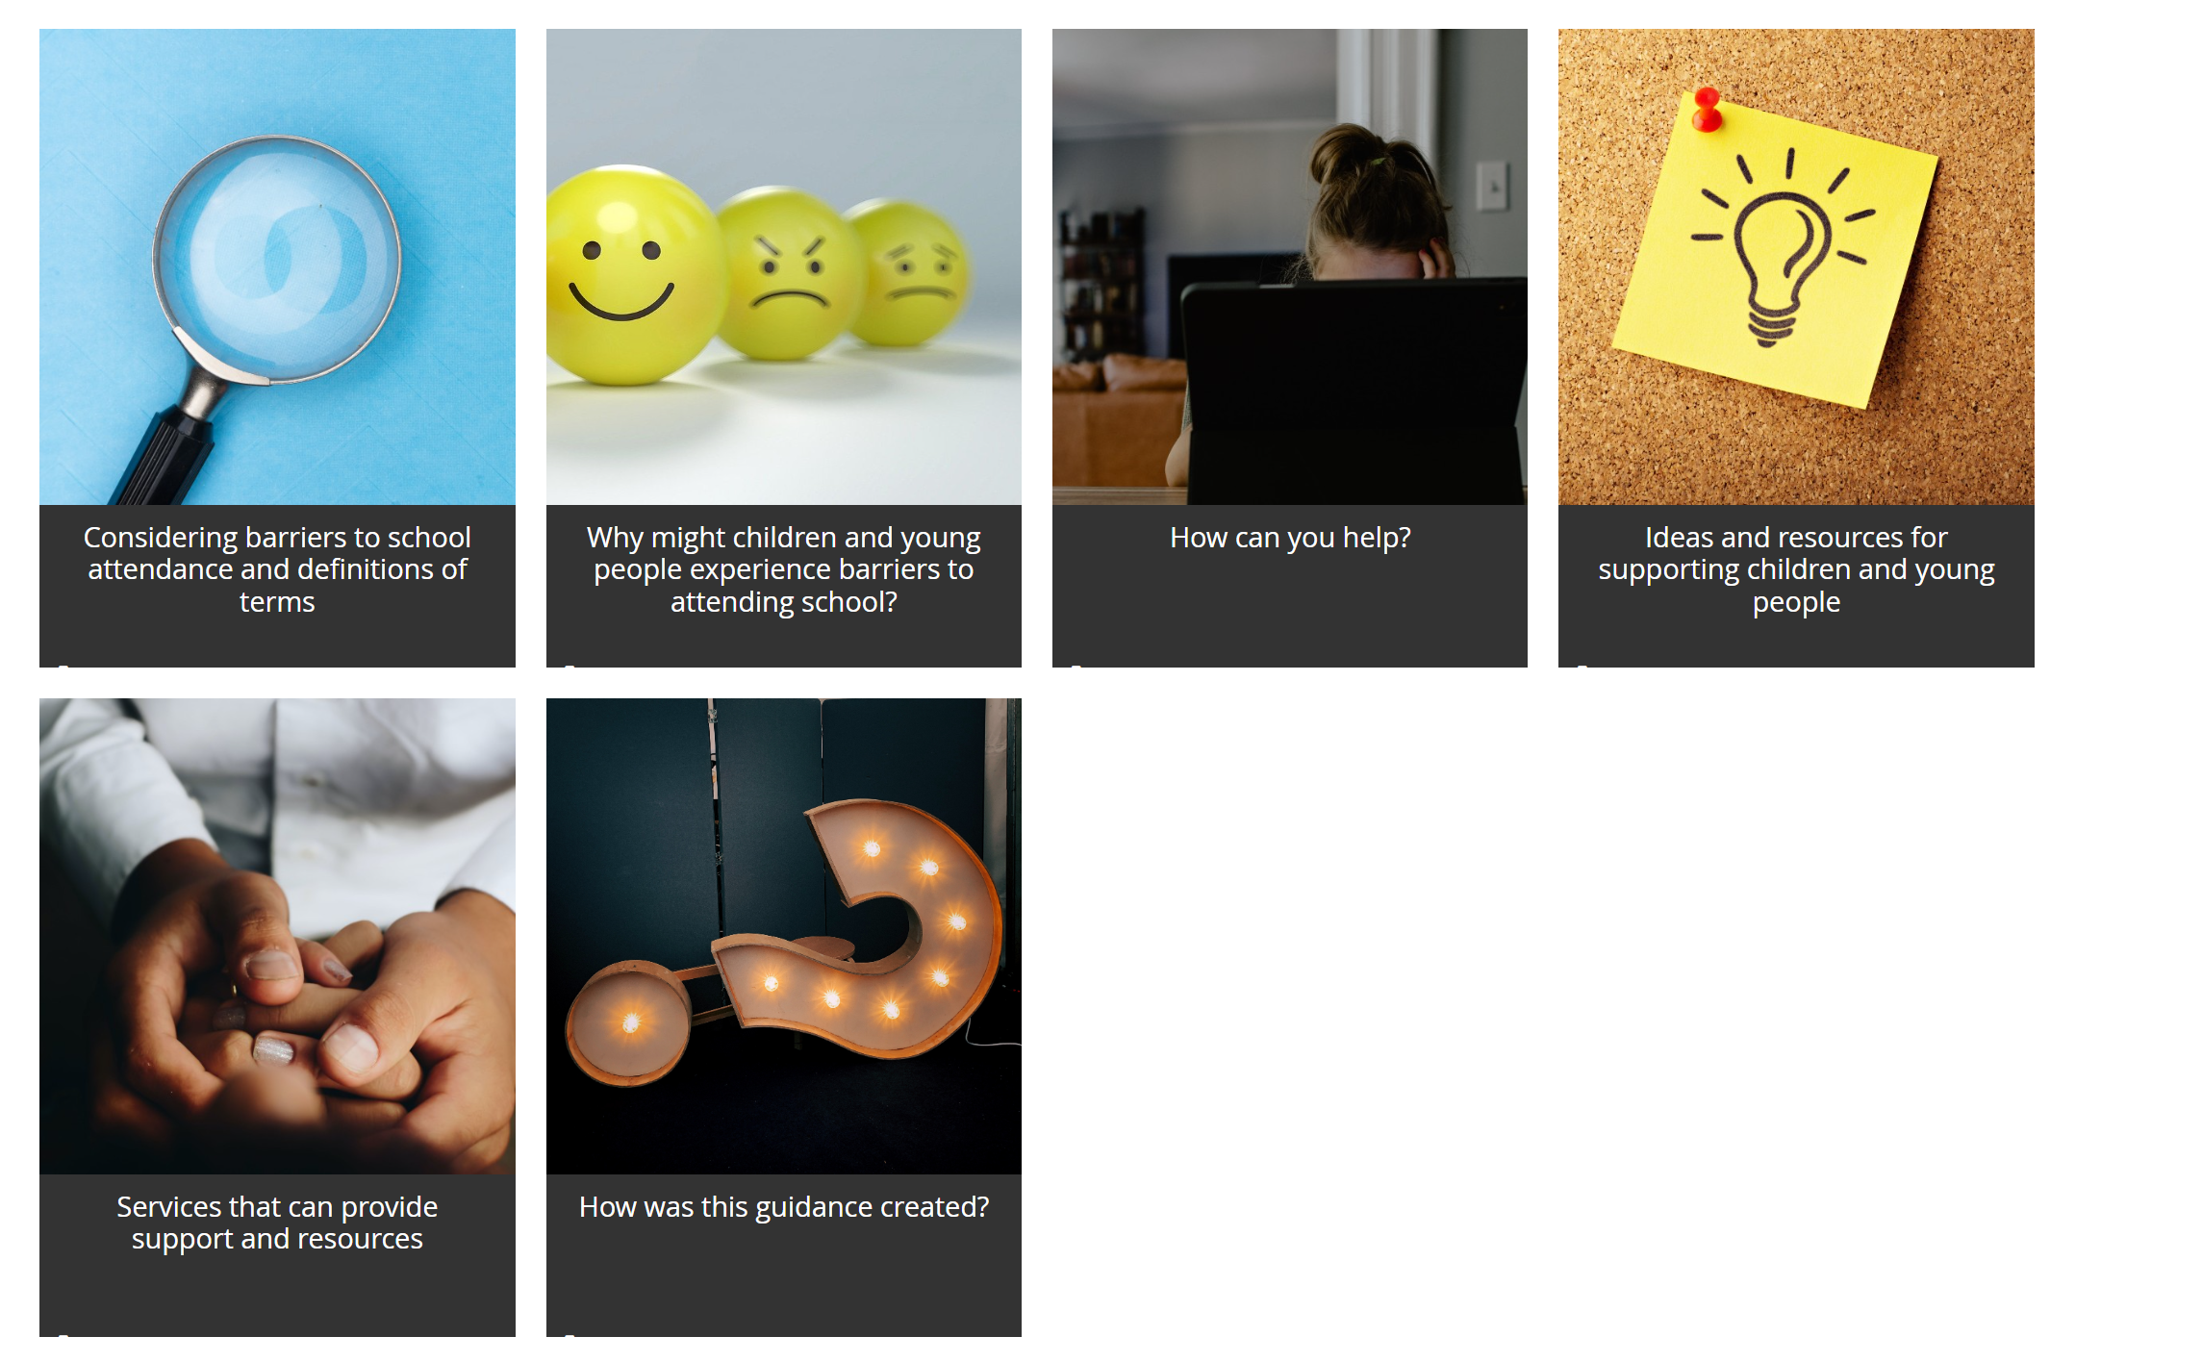
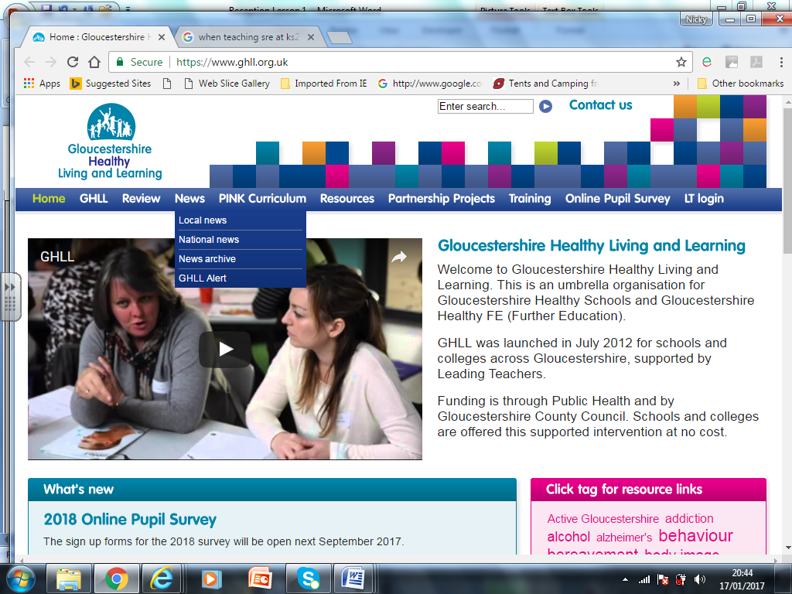
Guidance to support children and young people experiencing barriers attending school
https://www.gloucestershire.gov.uk/education-and-learning/educational-psychology-service-eps/information-for-schools-parents-and-professionals/guidance-to-support-children-and-young-people-experiencing-barriers-attending-school/
Notes:
introduces two statutory subjects, Relationships Education and Health Education
applies to ALL schools, including academies, maintained, special, and independent schools
makes no changes to the status of Sex Education in primary schools
still gives parents the right to request to withdraw their child from Sex Education at primary school
requires schools to be ready to implement the guidance by the end of the academic year 2020-2021 (i.e. starting to deliver the content, at the latest, by the beginning of the academic year 2021) DfE Feb 2021 Update
will be reviewed every three years

Slide 3
Some examples of non-attendance risk factors could include:
Child/young person | Family/home | School
Anxiety, depression or other mental health concerns | High levels of family stress (including financial stress, conflict or domestic violence) | Bullying and microaggressions LGBT+ students SEND students
Difficulties with managing and regulating emotions | Changes to the home environment (including divorce, separation or parent/carer illness | Difficult relationships with staff members
Trauma and adverse childhood experiences (ACEs) | Being a young care | Lack of provision to meet specific learning or wellbeing needs
Separation anxiety or attachment issues with a parent/carer | Family history of difficulties at school | Demanding, pressurised academic environment
Having a special educational need or disability, or being neurodivergent | Poor parental mental health | Transitions: from primary to secondary, or through key stages
What causes non-attendance?
Aspects specific to the child or young person
Factors to do with the family and home
Issues to do with school.

Slide 4
Children’s Commissioner: Briefing on School Attendance 2023
Children with additional vulnerabilities are more likely to be absent from school.
In 2022/23, 37.9% of children eligible for free school meals, 37.8% of those with an Education, Health and Care Plan, and 33.4% of children with special educational needs support were persistently absent
For some, the pandemic has led to disengagement. Schools and families have said that they feel like the social contract between parents and schools has been broken.
Many children detailed their wait for specialist support such as mental health support or an Education, Health, and Care Plan.
In some instances, children are struggling with issues in their home environment. In the Attendance Audit, the Children’s Commissioner heard from young carers who struggled to attend school regularly.

Slide 5
What should school staff be doing to support pupil mental health?
School staff are not expected to diagnose mental health conditions or perform mental health interventions, but they are expected to work to ensure regular attendance for every child, as per the Working together to improve school attendance.
Broadly speaking, the role of school staff is to ensure that the school is a calm, safe, and supportive environment where all pupils want to be and are keen and ready to learn, which is the foundation of securing good attendance.
Generally, schools will achieve this by promoting children and young people’s mental health and wellbeing through a whole-school approach to pupil mental health, and by developing a trusted relationship with parents/carers and families that involves them in the conversation about the school’s ethos and emphasises the importance of supporting mental health and regular attendance.
Schools also play an important role in teaching pupils about respectful relationships, emotional wellbeing, mental health and supporting social and emotional development, such as through a high quality, evidence-based and age-appropriate RHSE curriculum
Support for pupils where a mental health issue is affecting attendance February 2023 DfE

Slide 6
Creating a Culture
Promoting positive mental health and wellbeing

Slide 7
Definition of Mental health and wellbeing
The World Health Organisation (WHO) defines mental health as 'a state of wellbeing in which the individual realises his or her abilities, can cope with the normal stresses of life, work productively and fruitfully, and is able to make a contribution to his or her community’.

Slide 8
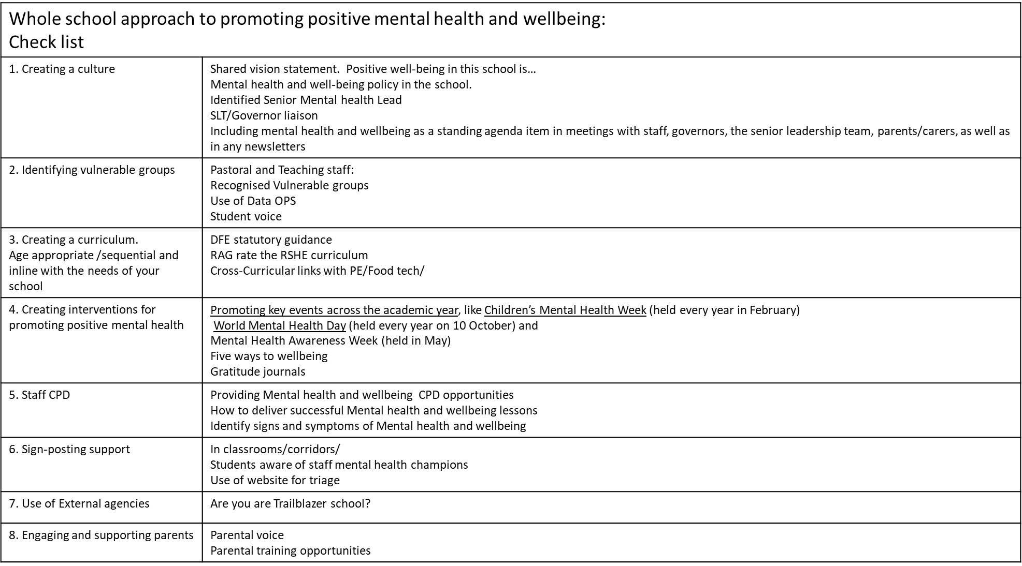
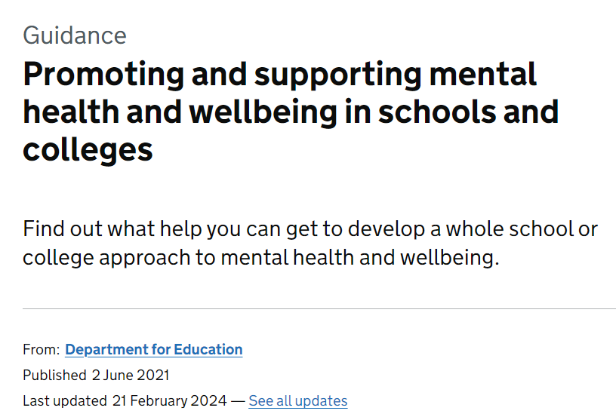
Shared vision statement: It is important that all staff have a shared definition of what mental health is.
It does not have to be the WHO definition it can be agreed by student and staff voice.
This will enable you to have shared vision in the institution of what positive mental health is and the signs and symptoms of poor mental health

Slide 9

Senior Mental Health Lead
Identifying a senior mental health lead
Schools and colleges can decide who is best placed to take on the role of senior mental health lead and undertake the training as every setting’s circumstances are different.
Training could be for your: headteacher, deputy headteacher, member of the senior leadership team (SLT)
If not a senior leader, an appropriate member of staff, working with colleagues, who is empowered to develop and oversee your setting’s whole school or college approach to mental health and wellbeing
Second DfE grants now available if SMLH has left the post.

Slide 10


GHLL: Awards
Healthy school & Mental Health champion award
It has been designed by teachers for teachers in all educational settings to collate, showcase and celebrate their policy and practice in relation to health and well-being
The Mental Health Champions Award has been created to acknowledge the high-quality provision that some schools make to support the mental health and wellbeing of their school community.
This award gives schools the opportunity to showcase good practice and to help them identify areas in their provision that would benefit from further development

Slide 11
RSHE Curriculum
Developing a robust Relationships, Sex and Heath Education Curriculum

Slide 12


We are not here to diagnosis Mental Health disorders
PSHE education equips pupils to adopt healthy behaviours and strategies, and to seek appropriate and timely support when they or a friend need it, rather than explicitly teaching about mental ill-health.
Protective factors (including good communication, problem-solving, healthy coping skills, resilience and the ability to name, describe and understand a range of emotions) can reduce the risk of pupils turning to unhealthy coping mechanisms. These protective factors can also be developed from an early age, laying the foundations for more specific learning later on

Slide 13
Identification of issues
Early identification & intervention: The onset of EBSA behaviours is often perceived to
be gradual. Therefore, early identification & intervention is essential.
Data
1. Transition: Research has shown that peaks in the number of pupils with EBSA correspond with transition in educational phases.
2. Patterns of attendance/subject/daily/weekly/seasonally
Co-production
Ask what they don’t like about school. Connect, listen acknowledge. Don’t blame, accuse make them wrong.
School council: Pupil voice opportunities – School council, suggestion boxes, worship, circle time.
Involve Parents and Carers

Slide 14
‘Emotionally based school avoidance’ (EBSA)
Students with caring responsibilities
According to Action for Children over a quarter of young carers aged 11-15 regularly miss school and 23% of young carers in the UK say their caring role has stopped them making friends.
Bullying and friendship difficulties
The Anti-Bullying Alliance estimates the proportion of pupils who were absent from school due to anxiety or mental health problems was higher among pupils that had been a victim of bullying – 32% compared with 16% of pupils that had not been bullied.
Pressure to achieve in schoolwork and exams
Students often feel high levels of stress about their academic performance. In some cases, young people put themselves under pressure, while for others it’s the weight of family expectations that makes them anxious to achieve.

Slide 15

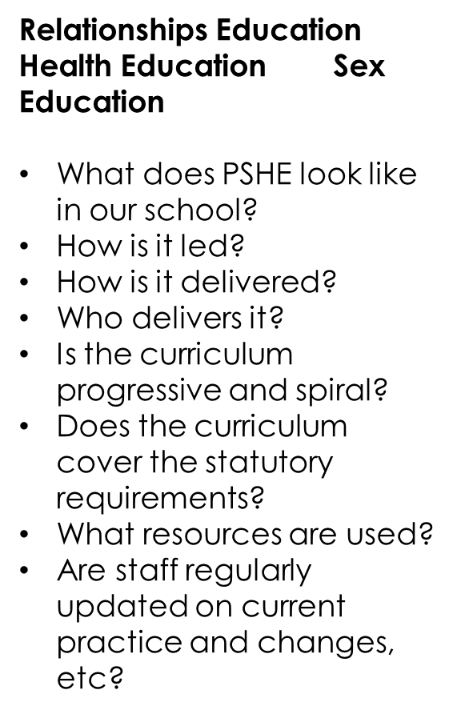

RSHE Curriculum
Relationships Education
Health Education
Sex Education

Slide 16
PSHE is a combination of…
Relationships and sex education RSE
The aim of RSE is to give young people the information they need to help them develop healthy, nurturing relationships of all kinds, not just intimate relationships
Health Education
The aim of teaching pupils about physical health and mental wellbeing is to give them the information that they need to make good decisions about their own health and wellbeing.
Non-Statutory
Statutory content
Economic Wellbeing and careers: Living in the Wider World
This includes
This includes
Mental wellbeing
Internet safety and harms
Physical health and fitness
Healthy eating
Drugs, alcohol and tobacco (Vaping)
Health and prevention
Basic first aid
Changing adolescent body
This includes
Financial education (Math's)
Personal safety
Careers (Careers lead) And DfE data reflects this, showing that the most common approach to careers education was delivery through PSHE lessons (87%).
Being a responsibly citizen (Citizenship)
Families
Respectful relationships, including friendships
Online and media
Being safe (Digital literacy)
Intimate and sexual relationships, including sexual health

Slide 17
Example of an appropriate and sequential curriculum
Children's Mental health week takes place between the 6-12th February 2022
To mark this, we dedicated Term 3 (January-February) half term to Mental health and wellbeing sessions
Session | Year 7 | Year 8 | Year 9 | Year 10 | Year 11
1. | What is mental health and well-being? | What are people attitudes to mental health and wellbeing? | How are Physical and mental health linked? | How will new challenges impact on mental health and wellbeing? | What are the signs and symptoms of stress?
2. | How can I manage change and transition? (Healthy coping strategies) | How can I promote my own and others emotional wellbeing? (Healthy coping strategies) | What is the impact of substance misuse on mental health and wellbeing? | How can I reframe negative thinking? | How can I overcome the idea of failure?
3. | How can I become more resilient? | Unhealthy coping strategies and where to get help? | How can I become more digitally resilient? | Recognising mental ill-health and when to get help | How does the wider world impact on my Mental health and wellbeing?
Books available for the children to read

Slide 18
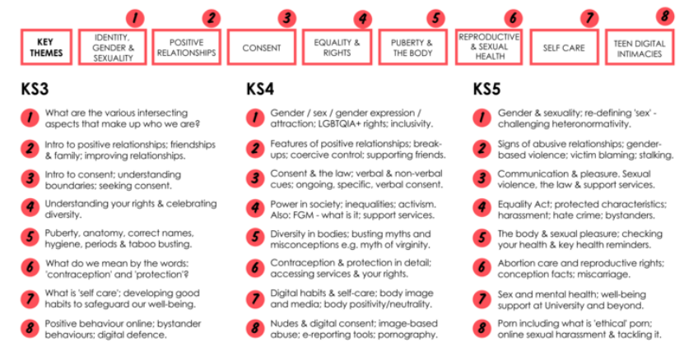
RSE curriculum: Building relationships

Slide 19
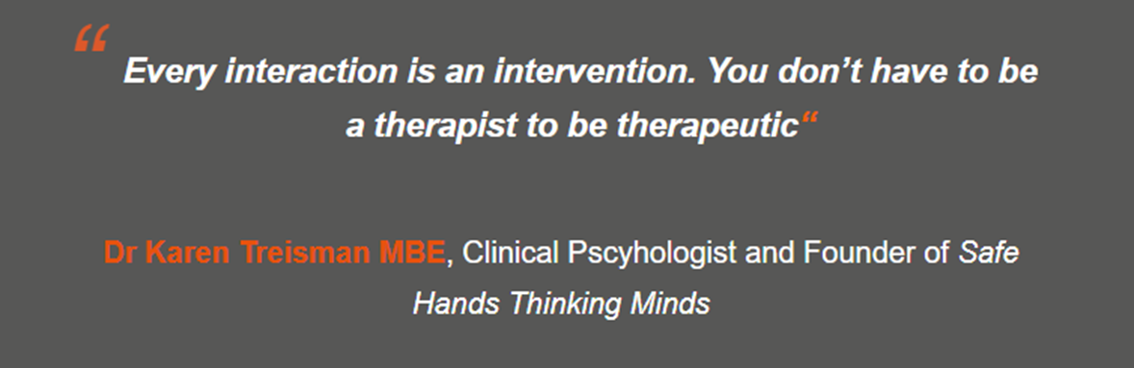
Interventions
Developing interventions to support positive mental health

Slide 20
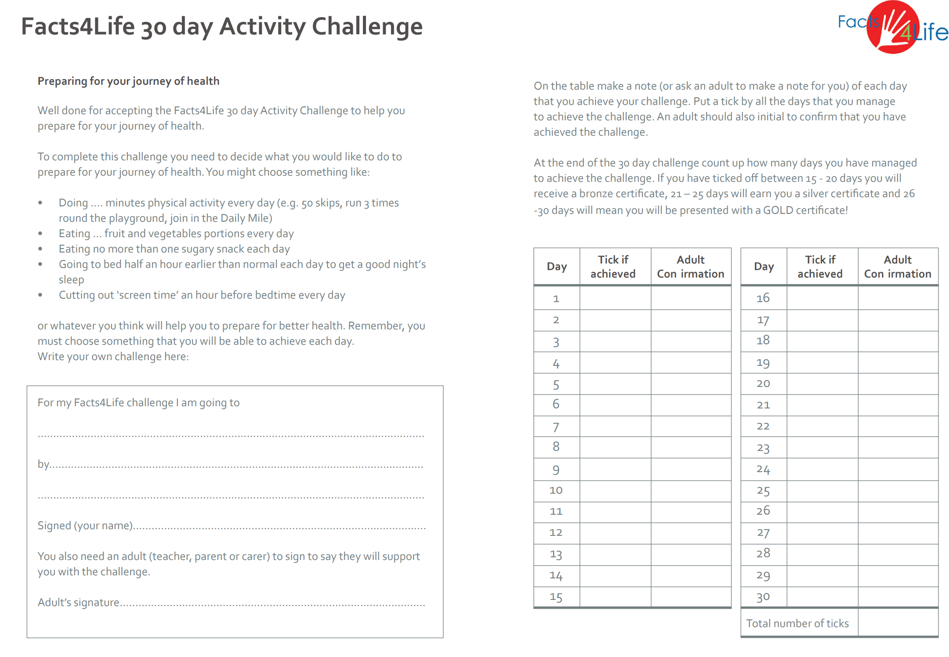
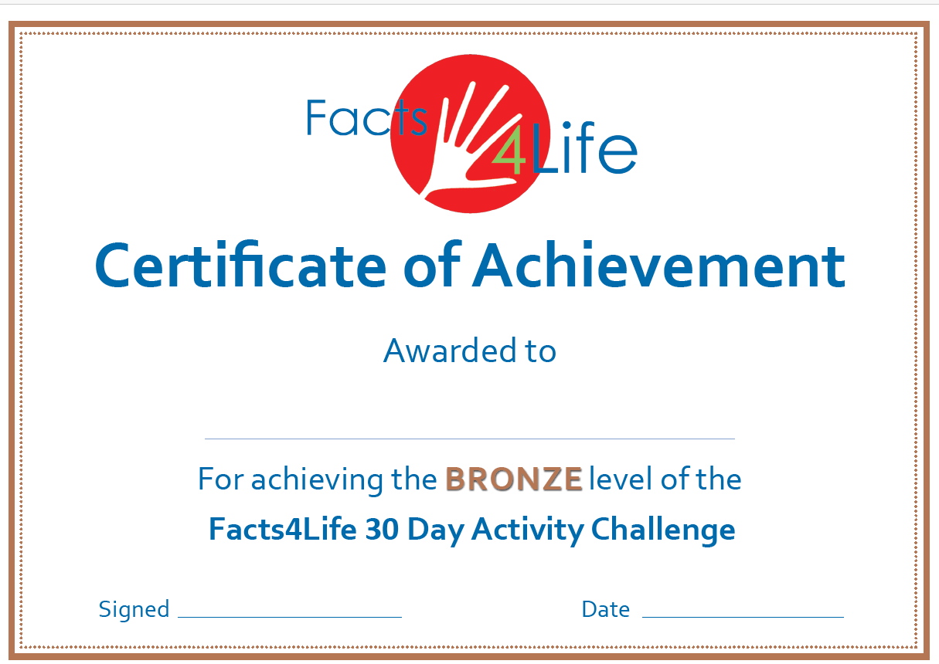


Tier 1:
Trusted adult: Tutor check-in Tutor mentoring.
Factsts4life: Exploring the continuum of health with students and parents. Year 7 focus https://facts4life.org/
Five Ways to Wellbeing The Five Ways to Wellbeing Framework was developed by the New Economics Foundation Based on the latest scientific evidence the simple actions, if taken regularly, can improve wellbeing and enhance quality of life. Connect – connecting with others Give – giving – looking outward as well as inward Be active – doing something active Take Notice – taking notice of the world around you Keep Learning – learning new things GHLL Five Ways to Wellbeing resource
Beyond Fed-up
Mental health day 10th October download toolkit Anti-bullying week 13th-17th November Children Mental health week (Place2b) 5th-11th February Young cares action day 15th March 2024 Neurodiversity Celebration Week. 18 and 24 March 2024.
Signposting around school e.g. Childline posters
External agencies Assemblies Group sessions

Slide 21
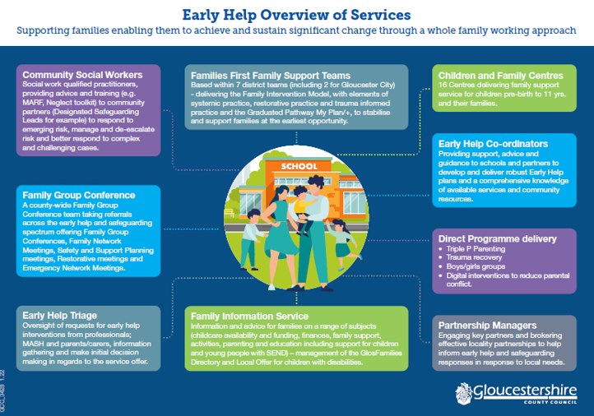
Tier 2:
Find tailored solutions https://mentallyhealthyschools.org.uk/getting-started/how-to-start-a-conversation-with-children-and-young-people-about-mental-health/ Arrange to talk in a non-threatening space , eg café, outside area, quiet classroom (private) etc Get the students back into the building at quiet times outside of normal school hours Realistic steps they can manage. P/t timetables
Young Mind Matters school (YMM) Mental health practitioners will run small group sessions for low mood and anxiety.
YMM schools Bespoke mentoring
Early help coordinator Social prescribing in the school/community: Connects young people to activities, groups and services in their community to meet the practical, social and emotional needs that affect their health and wellbeing.

Slide 22

Lumi Nova
A therapeutic digital intervention (game) for childhood anxiety
For 7–12-year-olds
Therapeutic basis: Psychoeducation and Exposure therapy
Is recommended by NICE (National Institute for Health and Care Excellence) for use across healthcare to support children with anxiety​
Is co-developed with children, families, educators, clinicians and academics​
Can be used by children with mild to moderate needs across various parts of the UK, where they may not meet thresholds for CAMHS, are on the waiting list, or alongside other therapeutic support.​
Self-sign up: Families can sign up themselves by visiting http://luminova.app/glos (or by scanning the QR code on the poster)
Case studies of families who have used Lumi Nova: https://www.bfb-labs.com/case-studies ​
You can find more information about Lumi Nova by visiting Lumi Nova : Gloucestershire Healthy Living and Learning (ghll.org.uk) but please feel free to contact GHLL if you have any queries – ghll@gloucestershire.gov.uk ​

Slide 23

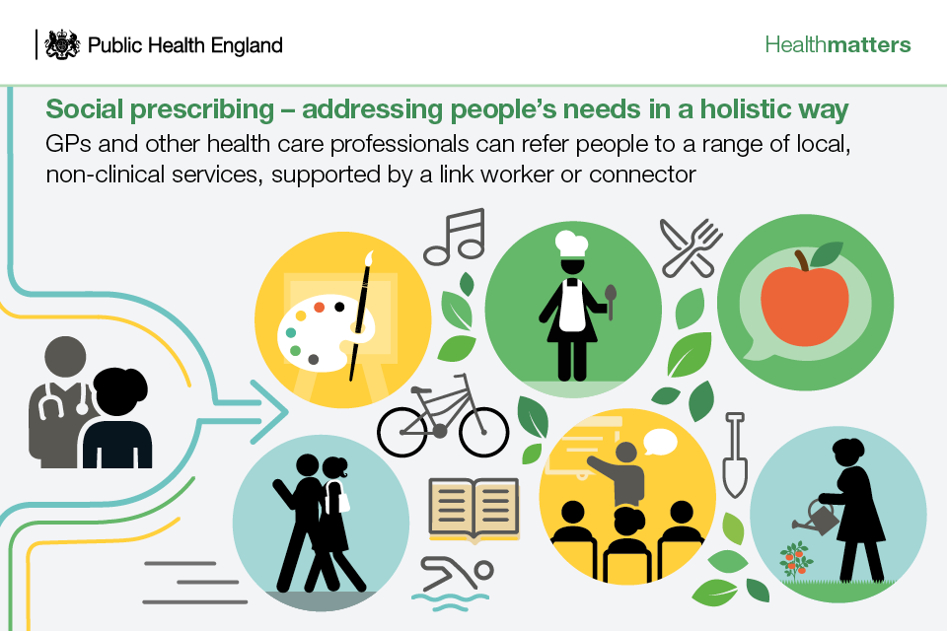
On Your Mind Glos (OYMG)
A mental health support finder for young people in Gloucestershire. The website includes a support finder, a directory of trusted local mental health services, self-help resources, and self-referral access to many NHS services in the county.
The way that this service looks, feels and works been informed by extensive research and testing with children and young people. This is an innovative and exciting step for children and young people’s mental health services in Gloucestershire.
Can be accessed by anyone up to the age of 25.
Link to further information
Link to website
Notes:
Equality Act 2010 Protected characteristics
These are age, disability, gender reassignment, marriage and civil partnership, pregnancy and maternity, race, religion or belief, sex, and sexual orientation.

Slide 24
CPD and Resources

Slide 25
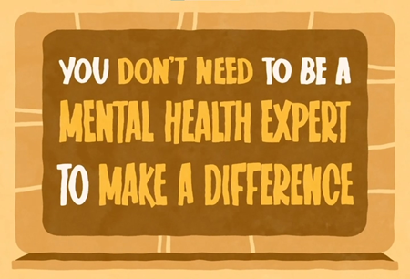
Possible CPD
Senior Mental health Lead funded by the DFE grant for £1200
Mental Health e-package GHLL
Mental Health Lite
Mental health First Aid (Two-day training)
Beyond Fed Up course (GHLL) Teacher resource
Self-harm awareness training GHLL
Trusted Emotionally Available Adult (TEAA) Universal Training
PSHE Association training/Conference
Place2be
https://www.youngminds.org.uk/professional/find-a-course/
https://beingmankind.org/education/educational-programme/
ACES awareness training (mental health tab GHLL website)
Educational Phycologist and Teaching advisory service training; Emotional Literacy/ Emotion Coaching
Virtual school:

Slide 26
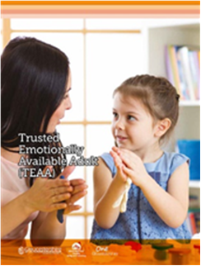
Trusted Emotionally Available Adult TEAA
TEAA Resource and Training​
​
GHLL have recently produced the TEAA (Trusted Emotionally Available Adult) resource. The TEAA is a resource that aims to support practitioners in delivering mental health interventions. Schools need to attend the free TEAA training before receiving the resource. ​
​
To find out more about the TEAA Resource and training, visit the GHLL website – ​
Training Calendar and Search : Gloucestershire Healthy Living and Learning (ghll.org.uk)​

Slide 27
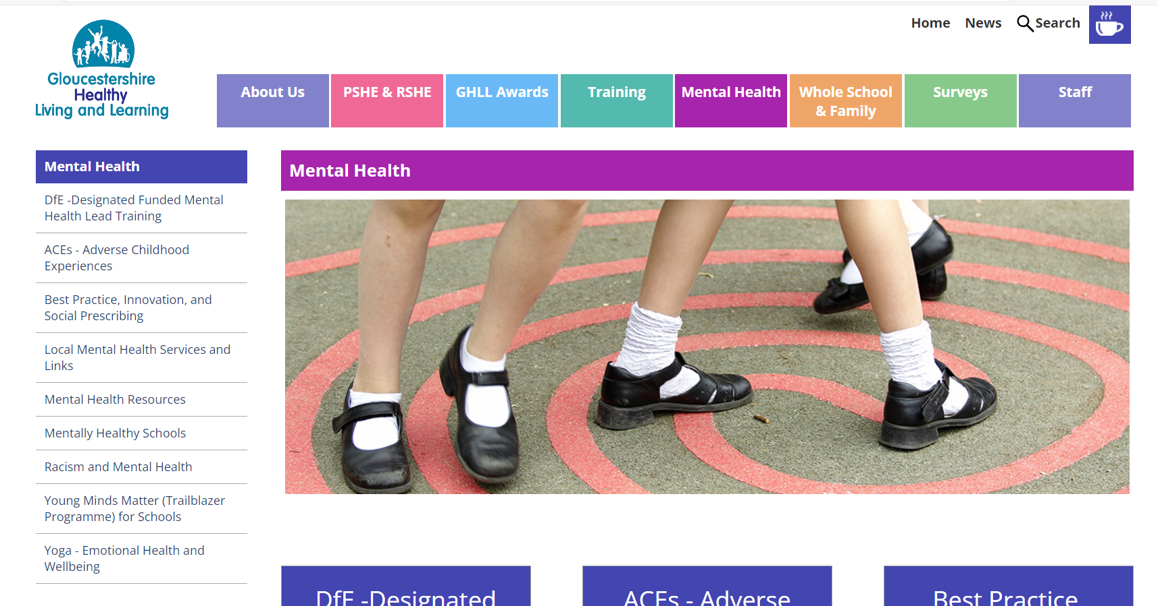
GHLL Website

Slide 28


Anna Freud
This toolkit will help education staff review, refresh and develop effective targeted support for social, emotional and mental wellbeing.
The toolkit is split into two sections:
Guide: a practical guide to developing effective targeted support in schools or colleges, exploring how to identify the right type of targeted support and how to implement it successfully
Tool: a filterable tool with multiple types of targeted support options, which education staff can filter by options including which outcomes they want to address, the phase of education and delivery method
This guidance can help school staff to:
Understand the links between mental wellbeing and school non-attendance
understand the potential risk factors that may cause pupils to become absent from school
Develop strategies to support children and young people in your setting.
It also includes a case study from a clinician at Anna Freud who works directly with young people experiencing difficulties with non-attendance.
https://www.mentallyhealthyschools.org.uk/media/ivtirzo0/guide-to-targeted-support.pdf
https://www.annafreud.org/resources/schools-and-colleges/addressing-emotionally-based-school-avoidance/

Slide 29
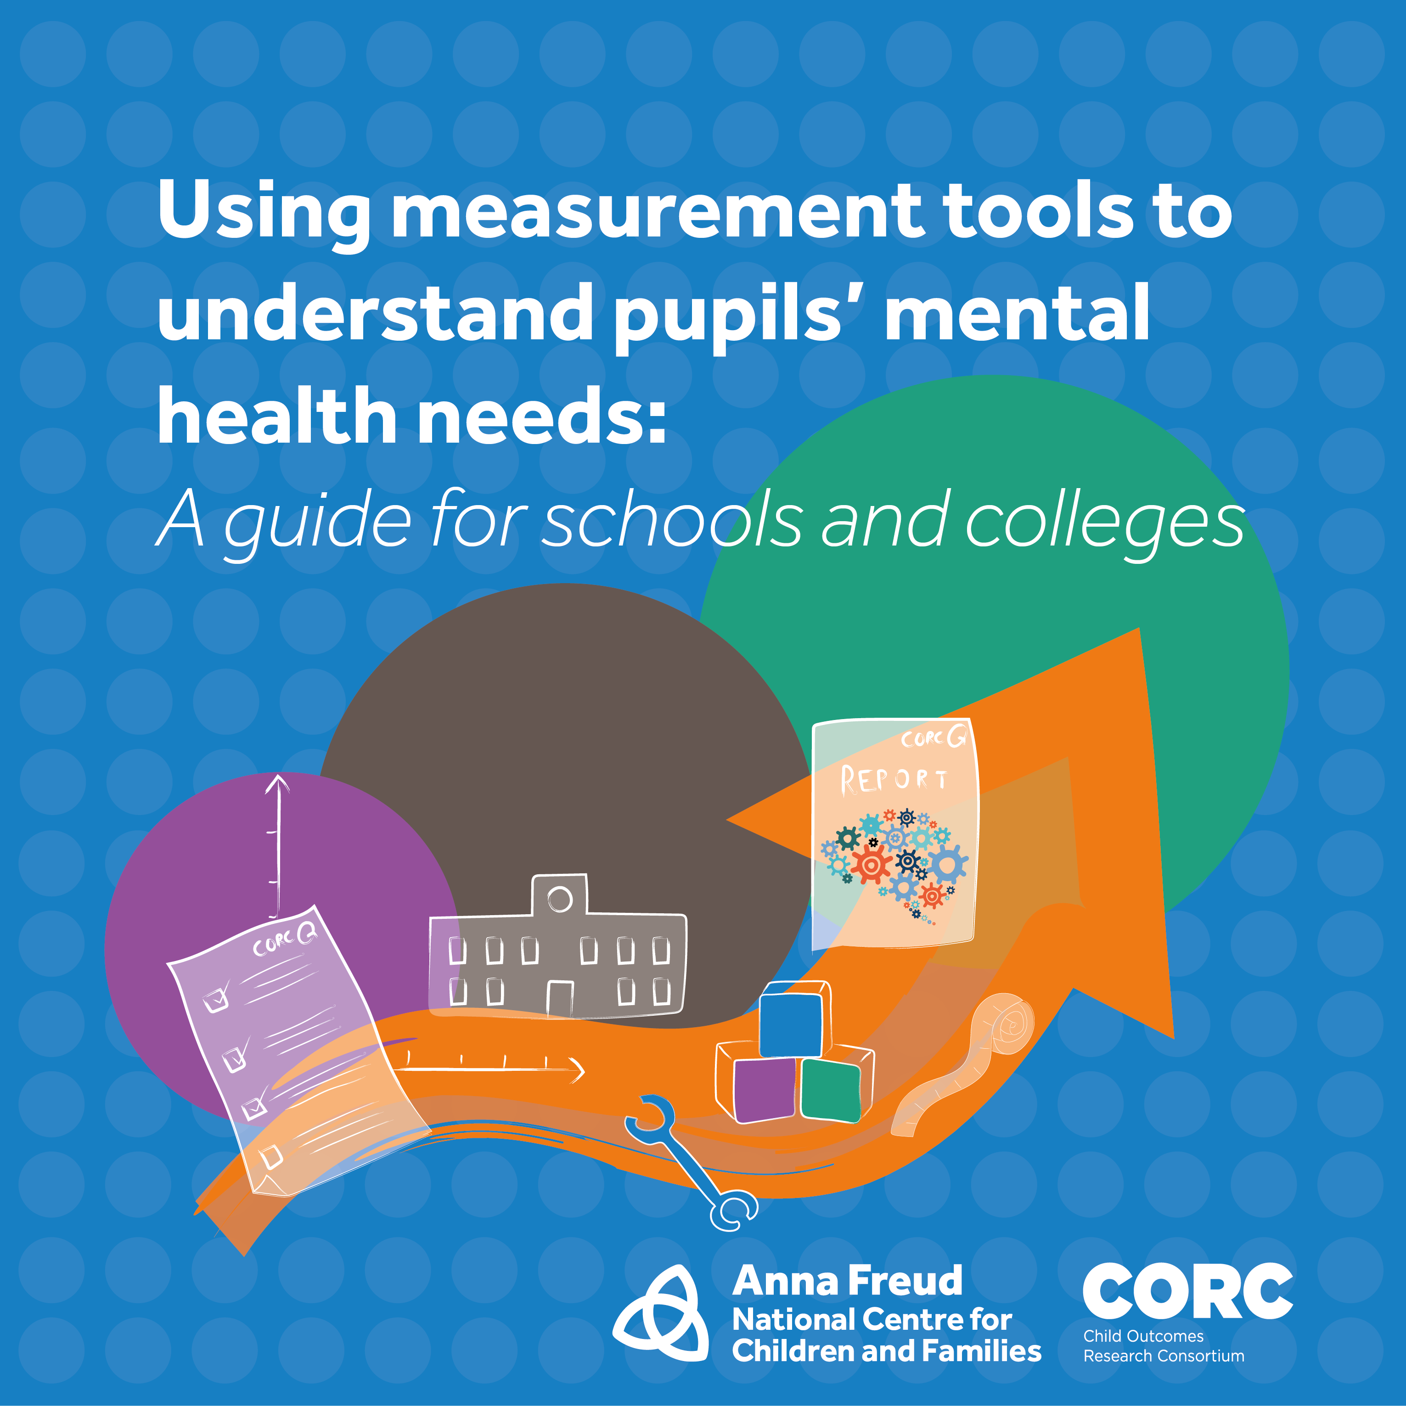
Anna Freud: CORC Child Outcomes Research Consortium
Using measurement tools to understand pupils' needs
A resource helping schools and colleges understand the mental wellbeing needs of their pupils using a simple step-by-step approach.

Slide 30
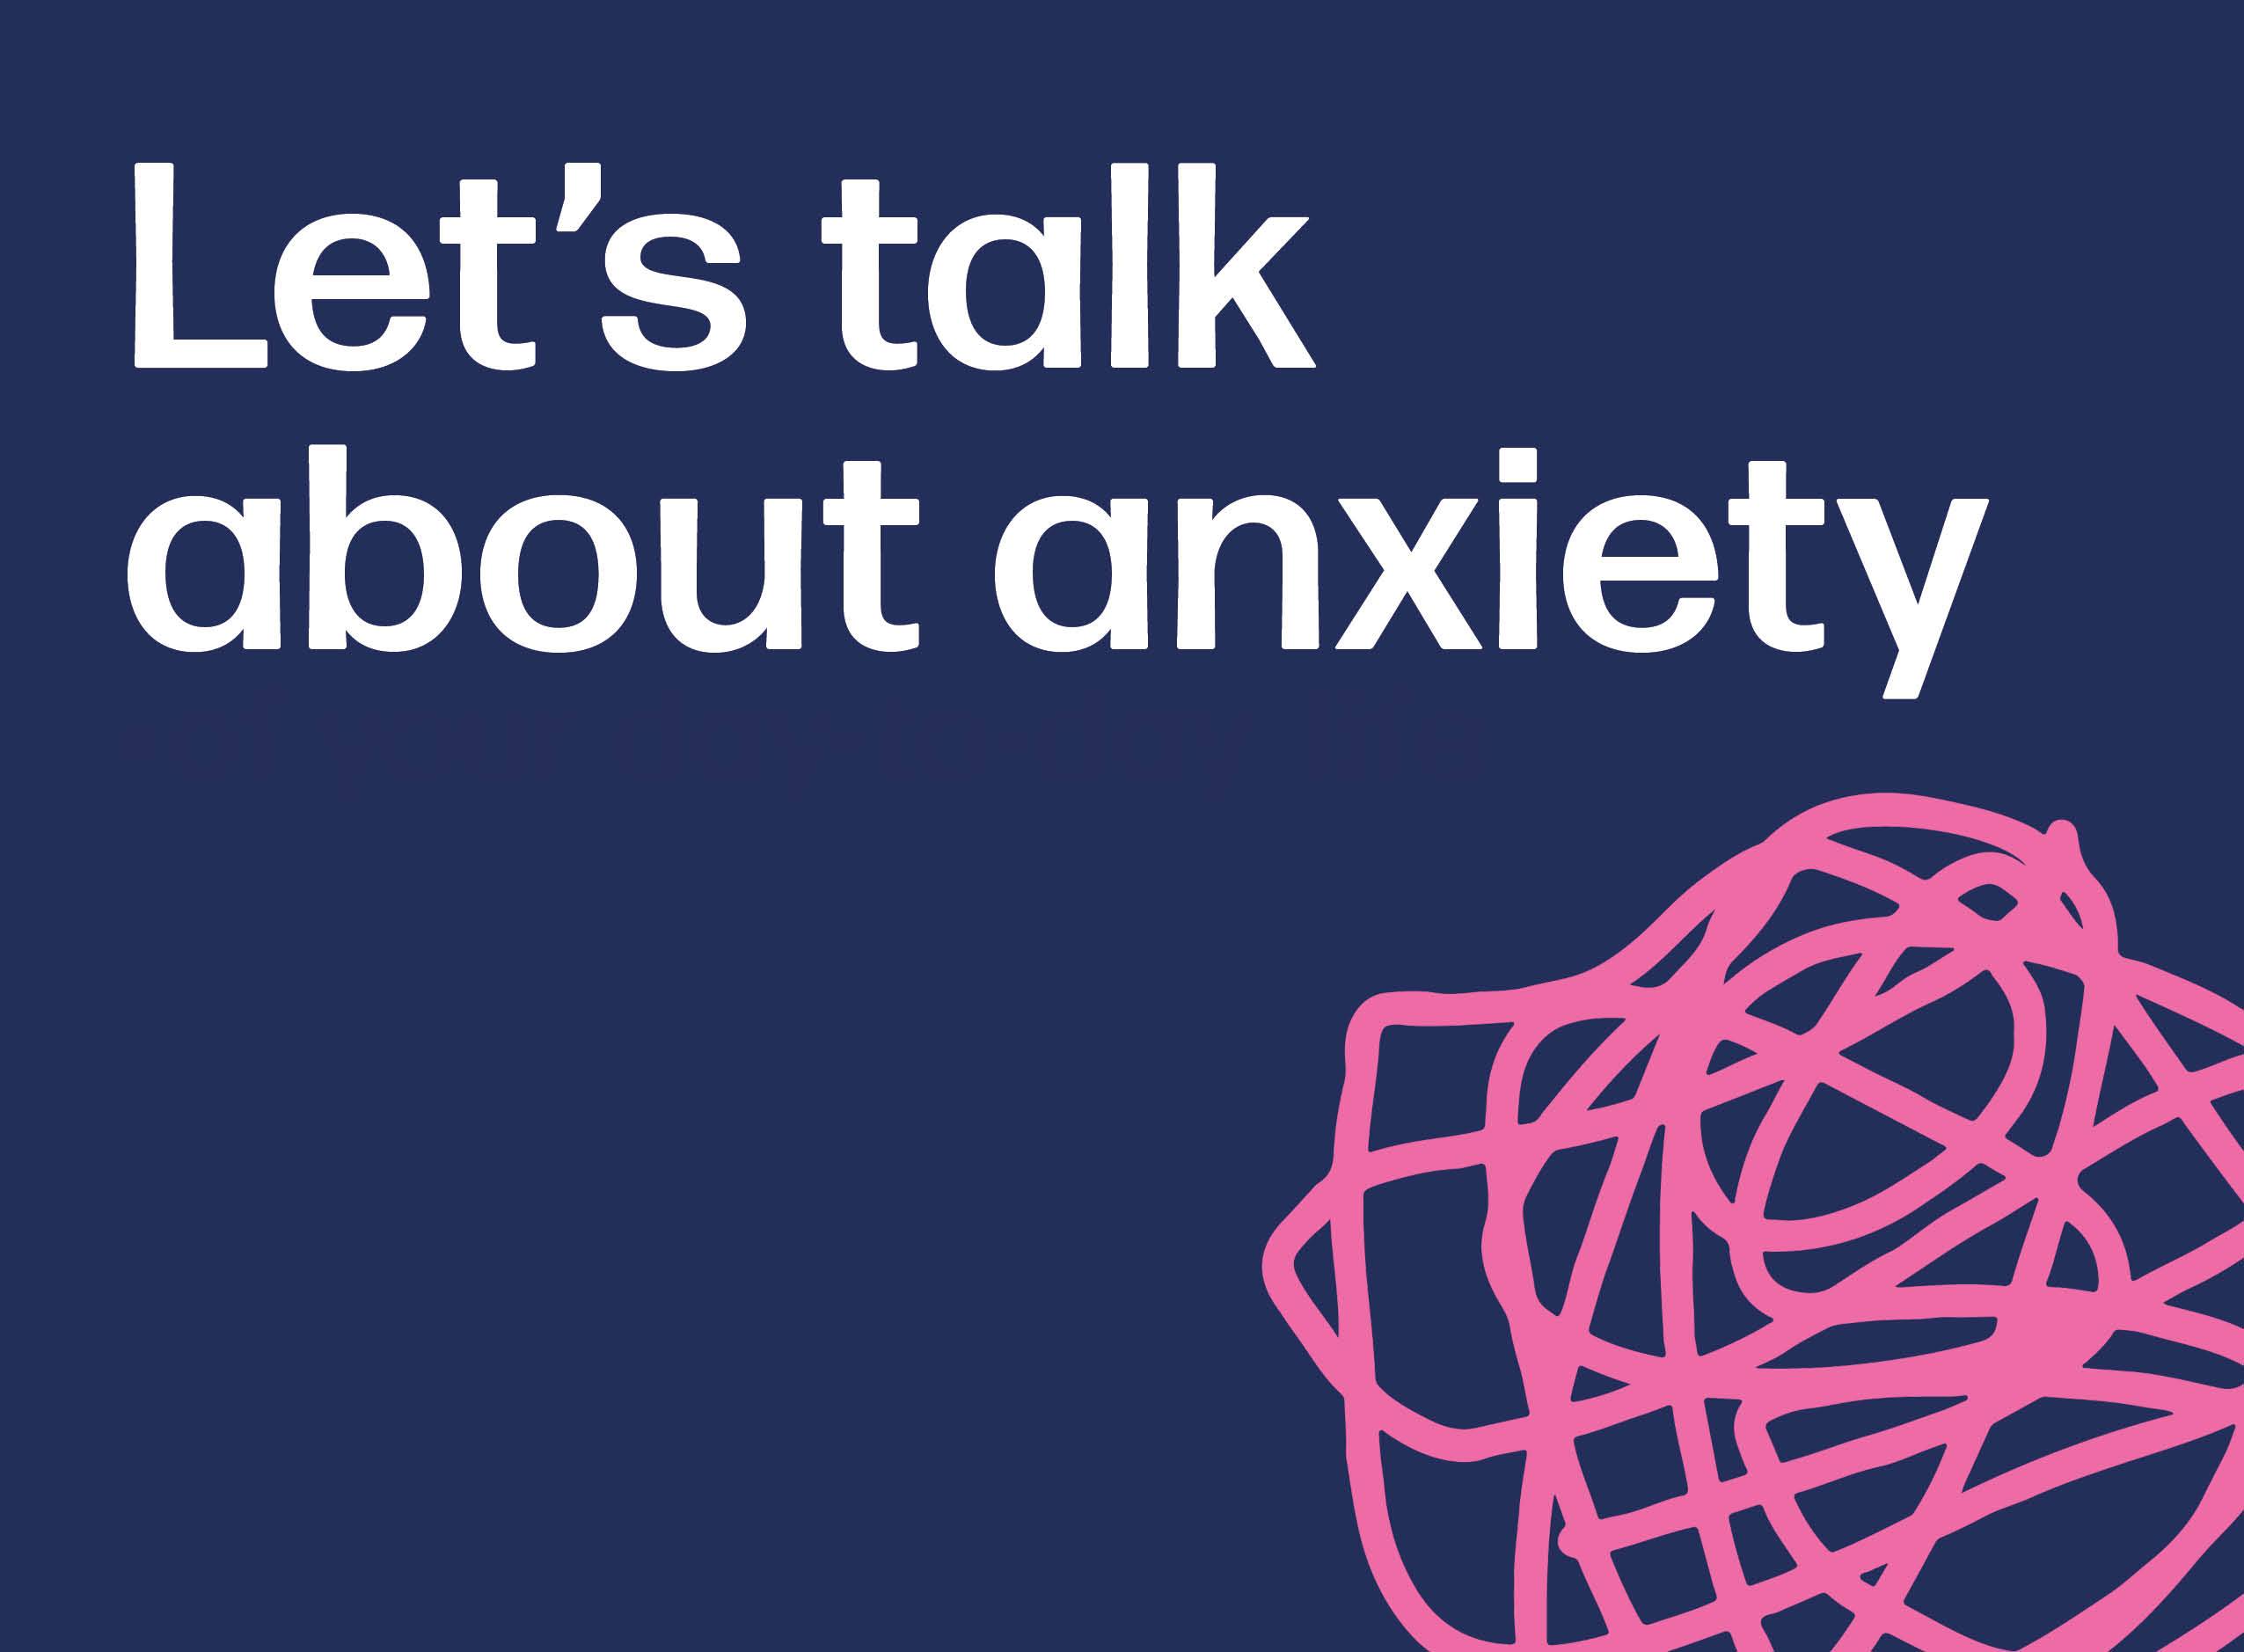
Lets talk about anxiety
Let's talk about anxiety: animation and teacher toolkit
The Let’s talk about anxiety animation and resource toolkit helps students aged 11 to 13 to normalise, understand and manage anxious feelings.

Slide 31

https://onedrive.live.com/?cid=5431FD1D45A110CA&id=5431FD1D45A110CA%2113156&parId=5431FD1D45A110CA%2113155&o=OneUp

Slide 32
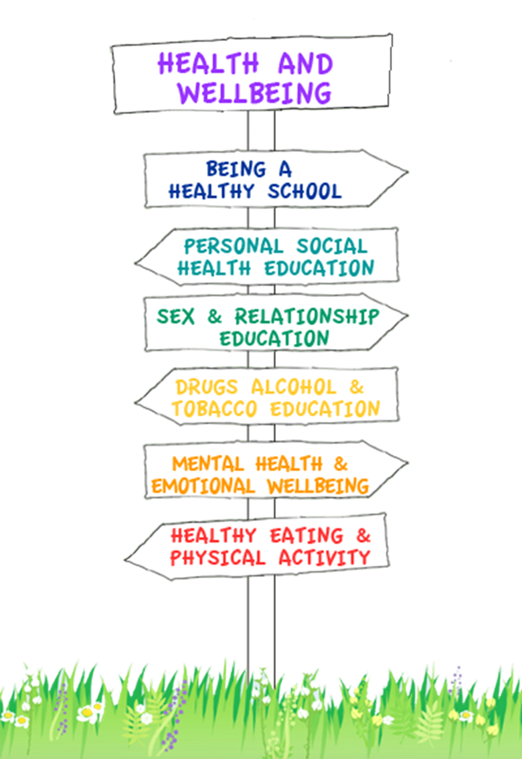
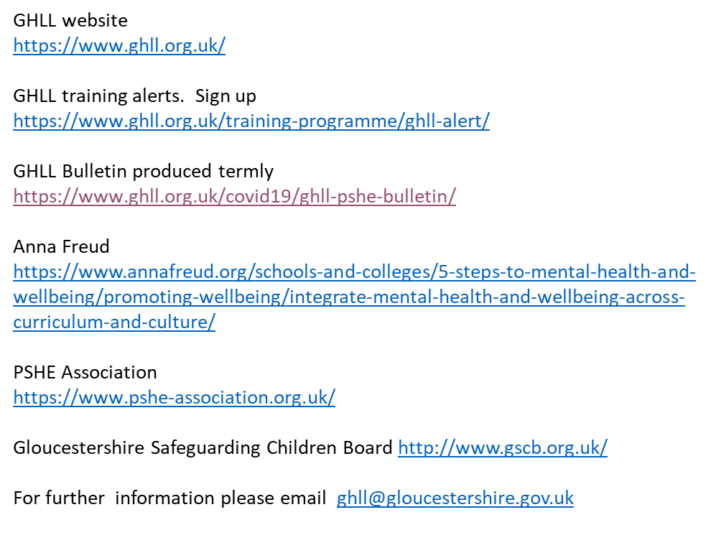

Useful sites

