Slide 1
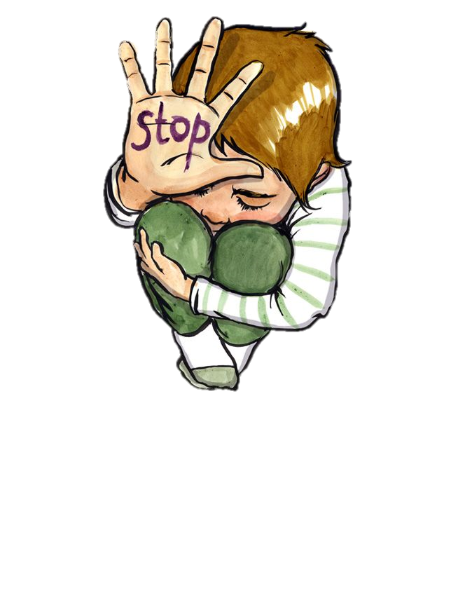
Neglect
Early Help
A multi-agency co-ordinated approach

Slide 2





Housekeeping
Notes:
Introduce yourselves.
Go through each slide.
Fire Exit and alarms
Mobile phones on silent
When the breaks are and how many there will be
Confidentiality also making sure that you talk about online security such as egress.
Toilets

Slide 3
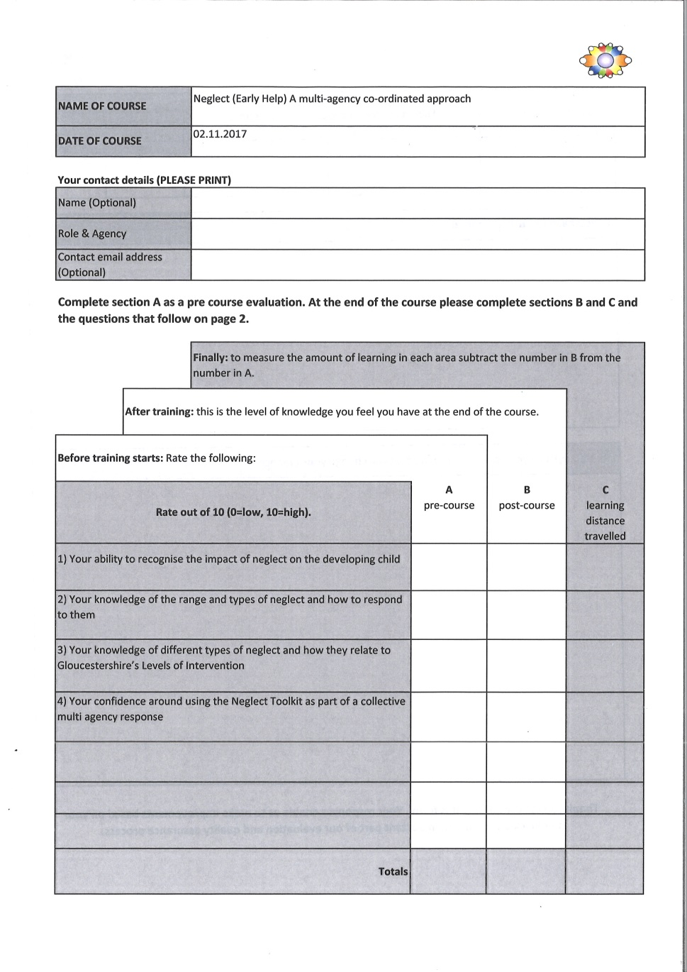
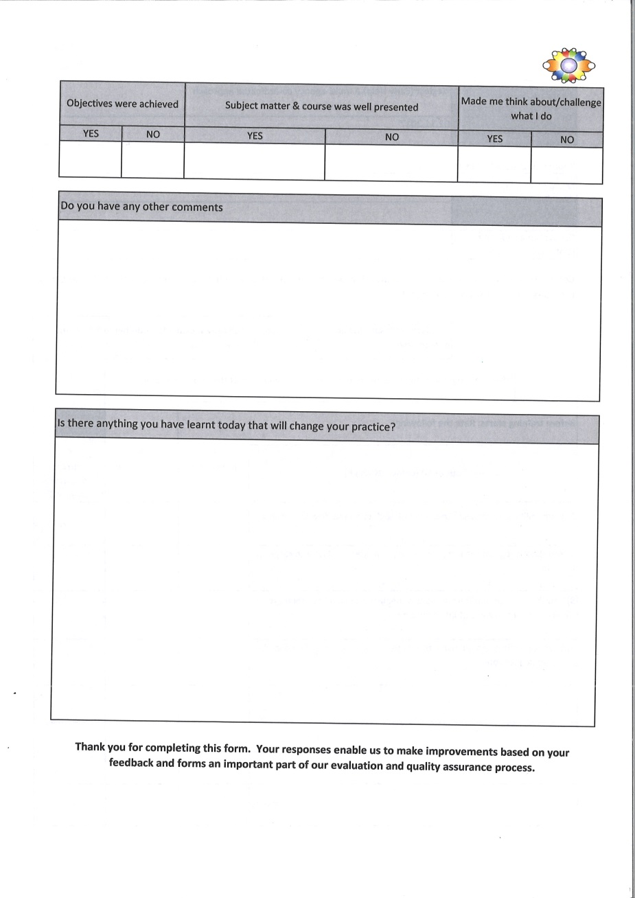
Evaluation Forms
Notes:
Can you fill in part A prior to the training and then fill in part B out at the end of the training.

Slide 4
Neglect
Gloucestershire Child Neglect Strategy
( Launched May 2017 )
National and Local learning and the wider context
Recognising the impact on the developing child
The range and types of neglect – ( Dr Ray Jones )
Using the Gloucestershire Neglect Toolkit, Threshold documents and other practical tools to structure your judgement
Notes:
These are the learning objectives for the session and they will bold reveal at each click.

Slide 5


Gloucestershire
Child Neglect Workshop
National and Local learning of
Child Neglect and the wider context

Slide 6
WHY NEGLECT
1 in 10 children have experienced neglect. (NSPCC 2009) now dated but there has been no other research we are aware of on scale 4000 since.
9% of young adults report being severely neglected by parents or guardians during their childhood
41% of the concerns that were referred to police or children’s services, related to neglect and 42% of all children who are subject of child protection plans

Slide 7
WHY NEGLECT
41% of the concerns that were referred to police or children’s services, related to neglect
Neglect accounts for 42% of all children who are subject of child protection plans.
In the last five years offences recorded by the police where a parent (carer) ‘wilfully assaults, ill-treats, neglects, abandons, or exposes a child under 16 in a manner likely to cause them unnecessary suffering or injury to health’ has doubled (NSPCC, 2017, p32)

Slide 8

What do all these SCRS tell us
Neglect is in 6 out of 10 Children Subject of a SCR.
(Brandon et Al 2012), (Sidebotham et al 2016)
While SCRs indicate that a small % where Neglect is the primary factor; it is a secondary factor in all others,
60 % INCLUDE NEGLECT as a factor of abuse.
NEGLECT suffered by Adolescents at the centre of SCRs was not often acknowledged – that is young people were seen as troublesome rather than troubled.
(Wilkinson and Bowyer 2017)

Slide 9
What do Gloucestershire reviews tell us
Identification of neglect remains a challenge.
CP conference outcomes ‘neglect’ is not cited as much as emotional abuse.
DHRs, IMRs, SCRs – Neglect remains a hidden,
Deep dives highlighted historical avoidance of neglect and impact on child.

Slide 10

Attachment and Bowlby Still Relevant
Neglect has been called the ‘Cinderella’ of child welfare topics due to there relative lack of attention the subject has attracted (Tanner and Turney,2006).
It is often subsumed with physical or sexual abuse into a generalised category of child maltreatment and is rarely the focus of research in its own right. And yet recent UK social care statistics indicate that cases of neglect are on the increase (NSPCC, 2007).

Slide 11

Identifying Neglect
Persistence, Change and Cumulative Neglect
What other kinds of abuse is neglect enabling –
self Harm, CSE, Missing, lack of self worth
Aspects/elements of Neglectful Care giving: Physical Care/Health/Safety and supervision/Love and care/Stimulation and education
What is the Impact – from child’s point of view what can we predict using the evidence base for the future
Are there any clear Causes we can identify?
Is this an act of omission or commission

Slide 12

Omission versus Commission
Important to recognise both - critical to understanding
Talking about parental attitude and sense of responsibility
Both have negative outcomes
  BUT
Commission – holding the child responsible for the care they receive – blame – do not deserve/cannot be parented because too difficult/too damaged
Parents have fallen out of love or care – do not accept they need to care
Omission – parent sees their responsibility but passive

Slide 13
Impact of neglect on a child.
Neglect can have a damaging affect on all of the developmental needs of a child, including physical, socio-emotional, cognitive and behavioural development. Horwath (2007)
Recent research has focused on the way in which neglect affects the developing
brain, and subsequently influences
all areas of development.

Slide 14
Persistence – Cumulative Neglect.
What does ACTUALLY this mean?
Seen as over time “cannot do anything because it has not been going on for long enough”
What about the Child’s Timescale
First 2 years and adolescence
When does history start?
If we are reluctant professionally to name neglect early then how do we see cumulative pattern and impact?
“Low level neglect” or “early signs”

Slide 15

Professionals as change agents
Modeling an authoritative approach
Multi-agency working
Notice not sharing because no permission from parents/sensitive/ common sense – assessments
Share THINKING and ANALYSIS – and EXPERTISE Nuances

Slide 16

Professionals as change agents
Professional disagreements
  Passive “they are the expert”
  Active anger “they are wrong/we are right” ( if we disagree fundamentally about the nature of a child’s world neither of us are right!
  Collusion: with parent against one professionals or a whole group
  Being the special one
Professionals only meetings- “it can be OK”
Do we discuss whether perpetrators of harm should be at meetings – “What is the role of power, status and grooming?”

Slide 17
Parenting Skills Matrix
Authoritative
Authoritarian
Permissive
Neglectful
DEMANDING
UNSUPPORTIVE
SUPPORTIVE
Baumrind 2000
Hacket 2006
  UNDEMANDING

Slide 18

Professional is clear about what is required of parents/carers DEMANDING
Authoritative
Authoritarian
Permissive
Neglectful
Professionals provide appropriate level of support to achieve and maintain change: recognise the importance of relationships
SUPPORTIVE
Professionals provide little support. Do not recognise importance of building consistent relationships
UNSUPPORTIVE
Professionals are unclear worried about relationships
UNDEMANDING

Slide 19
The Issue of change is critical
Understanding change as a process
Clear plans from early stages (simple not complex) – to see success and failure
Be clear who is responsible for the neglect of children =- often unclear

Slide 20
RESPONSE TO CHANGE
EFFORT
 | HIGH | LOW
 | Genuine commitment Talk the talk and walk the walk | Tokenism Talk the talk
 | Compliance Imitation Approval seeking Walk the walk | Avoidance Walk away
COMMITMENT TO CHANGE
HIGH
LOW
Horwarth, 2001

Slide 21

Effects on Children’s development
Injuries arising out of lack of supervision
Disabled children are 3.8 times more likely to be neglected
Educational difficulties including behavioural problems, discipline and school exclusion
Resilience impacted upon
Emotional and behavioural difficulties and problems with identity
Family and social relationships disrupted

Slide 22
The impact of neglect on adolescents
Feel out of control and out of parent’s control
Trauma related behaviour – know what the issues are but not how trauma will manifest
Lack of a holistic approach- treat each problem as it comes along
Oppositional anti-social behaviour; in trouble with teachers and police
Friendships disrupted

Slide 23
The impact of neglect on adolescents
Disruptive behaviour/poor concentration in school; low academic achievement
Depression/low self esteem; Felt inferiority; felt helplessness; Shame; Loneliness
Impairment in interpersonal relationships, impulse control, regulation of aggression
Running away; street wise; self reliant vs immature; needy
Compulsive stealing or scavenging
CSE
Very structures/skills required to survive adolescence stripped away

Slide 24
Disability and neglect
International research shows that disabled children are more likely to be maltreated than others
city may be diminished
Growth, behaviour and other problems may be seen to be the result of the disability
Disabled children are over – represented among children who are Looked After because of abuse and neglect Children in Need Census, 2004
Feeling sorry for parents/heroic carers/part time professionals

Slide 25
What is the Impact on the child
Start with what child says/feels
Are they defined by it - is it internal to them?
What is short term lived experience
What is developmental impact in the long term?
Impact on attachment relationships – what is the observed interactions between child/parent
Notice blame – again particular issue for adolescents – needs challenging
Lived experience – try and be empathetic to child
Preserve children and young people’s HELP SEEKING BEHAVIOUR
ACTION CONSEQUENCES REPAIR

Slide 26

What other abuse is neglect driving or enabling
Sexual abuse
Physical abuse
Emotional Abuse
CSE

Slide 27

Structured Judgement approach
Number of tools designed to “structure” professional judgements
QOC Tool is one of them
Graded care profile another
Emphasis here on promoting professionals judgement and decision making in partnership with children, young people and their families
Finding of the review of SCRS that practitioners struggle to make judgements because of concern to be “non judgemental”
ACE’s

Slide 28
Finally it is the untold impact that should drive us towards change on neglect
Because we were treated neglectfully and abusively in our young years—when we most needed self-love to be mirrored—it was difficult to hold onto…We take up the challenge of learning to love ourselves…
Healing Childhood

Slide 29
Finally it is the untold impact that should drive us towards change on neglect
All children are born to grow, to develop, to live, to love, and to articulate their needs and feelings for their self-protection Alice Millar

Slide 30
Adverse Childhood
Experience's
(ACEs)
ACTION
ON ACES
Gloucestershire

Slide 31
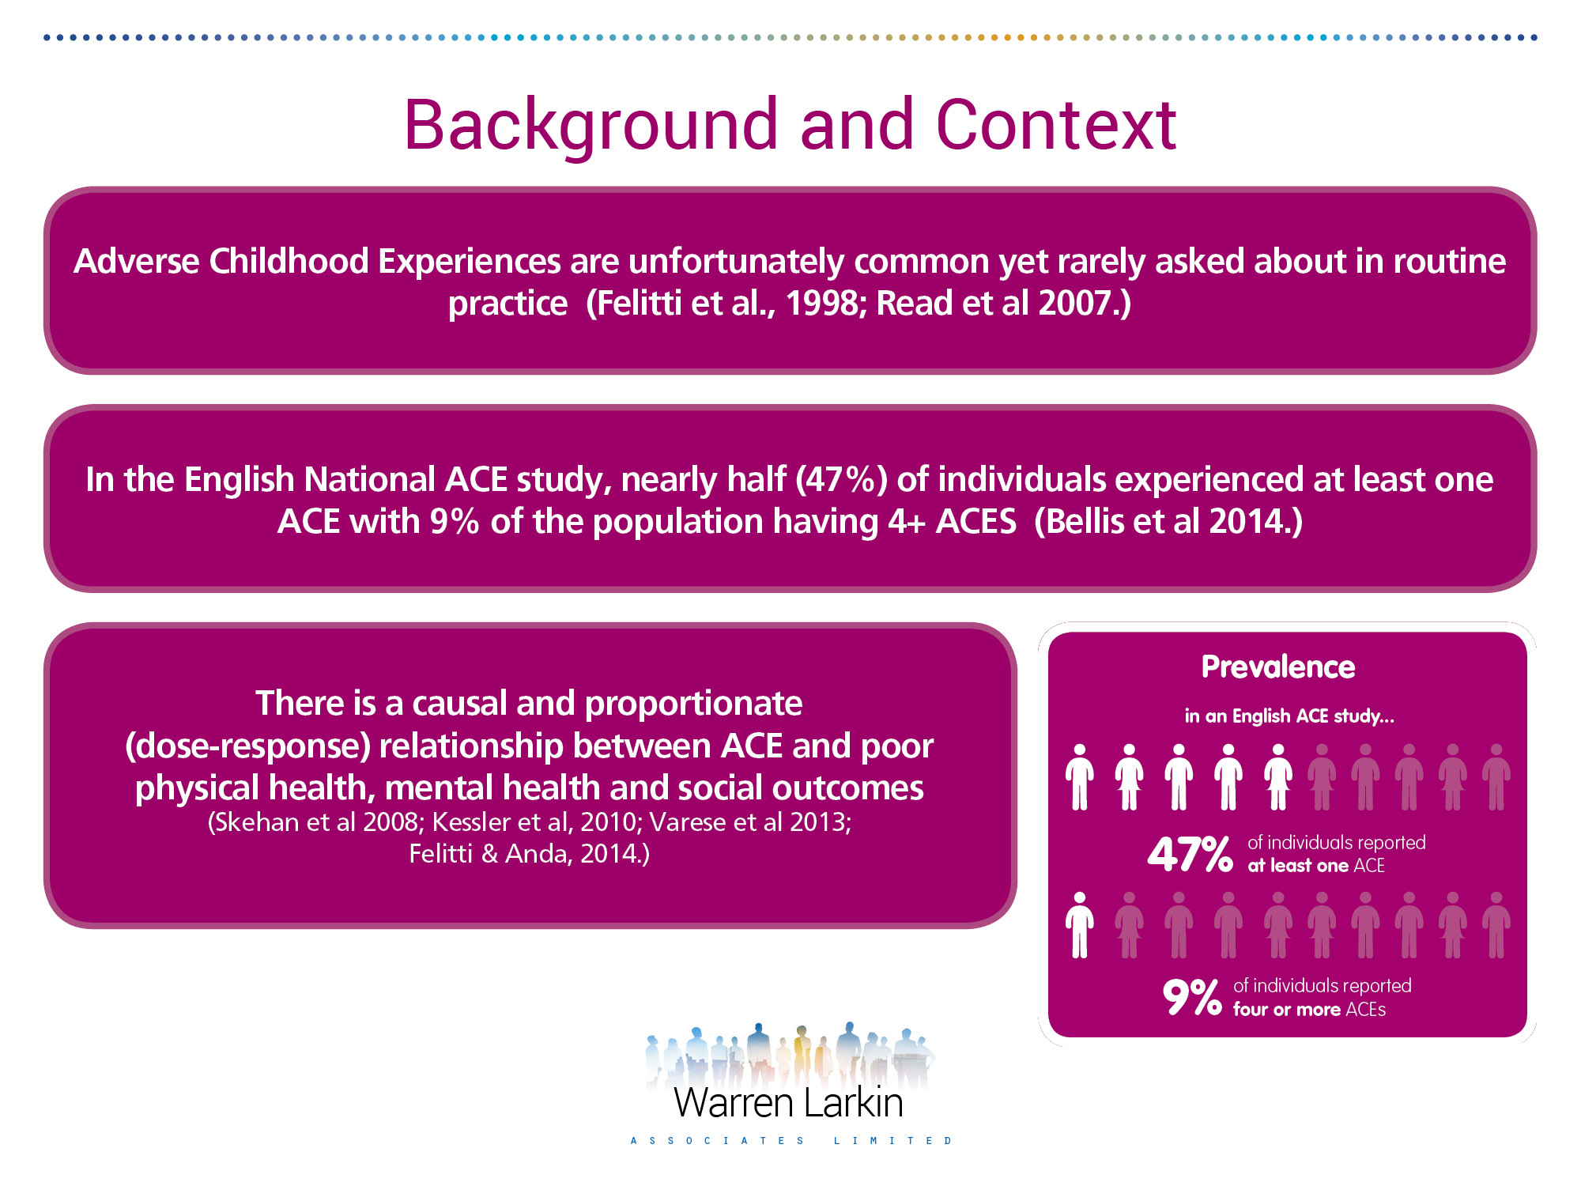
Who is at risk?
Individuals reporting at least one ACE
47%
Individuals reporting 4 ACEs or more
9%
ACTION
ON ACES
Gloucestershire
Notes:
In the English ACE study (n=4010) nearly half of individuals experienced one ACE (47%) and 9 % experienced 4 or more ACEs
Many children are at risk of experiencing ACEs, but it’s only when children begin to experience high ‘doses’ of adversity that neurological stress becomes maladaptive.
How can these children be identified?
will often react unpredictably (fight/flight/freeze response)
More likely to respond defensively/aggressively
may have difficulty concentrating
How can adult service users who experienced ACEs be identified?
Will often be those labelled as ‘complex’ or have multiple needs.
Opportunity to look at the root causes.

Slide 32
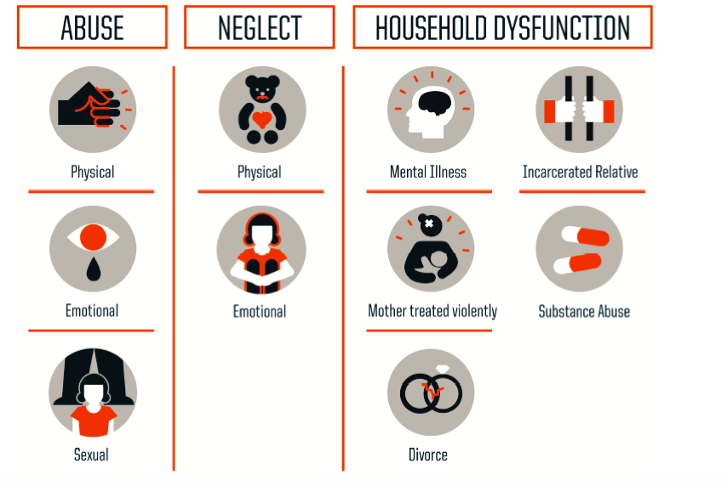
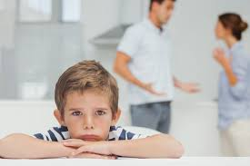
ACTION
ON ACES
Gloucestershire

Slide 33
4 ACEs compared to zero ACEs
4 x more likely to be a high risk drinker
6 x more likely to have had or caused unintended teenage pregnancy
6 x more likely to smoke cigarettes/ e-cigs
11 x more likely to have smoked cannabis
14 x more likely to have been a victim of violence over the past 12 months
15 x more likely to have committed violence
16 x more likely to have used crack cocaine/heroin
20 x more likely to be incarcerated in their lifetime
ACTION
ON ACES
Gloucestershire

Slide 34


Slide 35

…and why would this be?
Pleasure and reward centre of the brain (aka Nucleus Accumbens) dopamine and seratonin
Shrinks the Pre-frontal cortex = cognitive behaviour, personality, expression, moderating social behaviour
MRI scans show measurable difference in the amygdala – the brains fear response centre
Neurological reasons when faced with adversity = adopt risky behaviours

Slide 36
Adaptive and Life Saving
to
Maladaptive and Health Damaging
ACTION
ON ACES
Gloucestershire

Slide 37
ACEs
The single greatest unaddressed public health and social threat to society.
It’s particular affect is on:
Attachment
Persistent fear response
Dissociation
Behaviour problems
Addictions
Adult illnesses
ACTION
ON ACES
Gloucestershire

Slide 38
ACE’s study
The original ACE study was completed in the USA, but this evidence is getting a much higher profile now in the UK.
Ace’s video:
Wales:https://www.youtube.com/watch?v=YiMjTzCnbNQ
https://www.youtube.com/watch?v=XHgLYI9KZ-A
ACTION
ON ACES
Gloucestershire

Slide 39
Resilience
Developing resilience has been shown to improve outcomes even in those who experience high levels of ACEs.
Some people have innate resilience, but it is a skill that can be learned and strengthened. Protective experiences and coping skills counterbalance significant adversity, and these capabilities can be strengthened at any age.
By focusing on developing resilience, we can help to mitigate against the potential harm from ACEs.
ACTION
ON ACES
Gloucestershire

Slide 40
Resilience
In the Gloucestershire, ‘Action On ACEs’ Strategy, resilience is defined as the ability to adapt well in the face of adversity.
The domains of resilience that can be adapted to build resilience in individuals these include:
building a sense of self efficacy and perceived control
providing opportunities to strengthen adaptive skills and self-regulatory capacities
mobilising sources of faith, hope, and cultural traditions
opportunity to contribute to family or community life
good educational experience
ACTION
ON ACES
Gloucestershire

Slide 41
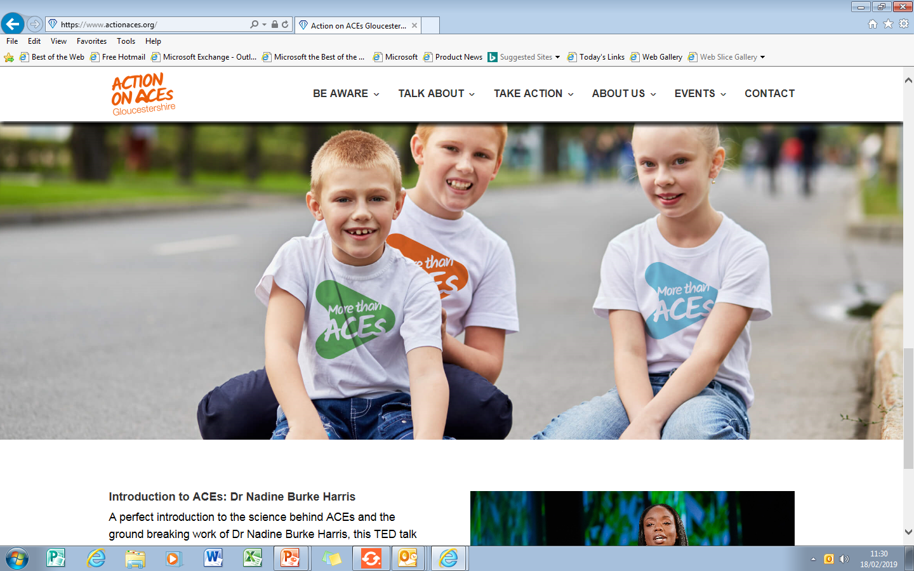
ACTION
ON ACES
Gloucestershire

Slide 42

ACTION
ON ACES
Gloucestershire
More than our
ACES www.actionaces.org

Slide 43

What is Early Help?
Early help is about children, young people and families getting the right help at the right time, before issues get worse.
Notes:
Click to animate.
Early Help is an umbrella term that describes work of many agencies engaged with children and families (NHS, schools, learning providers, voluntary sector, police, housing providers, etc.).
We are ALL engaged to a greater or lesser extent in work that seeks to avert a problem developing and preventing the escalation of difficulties or the deterioration of circumstances which could adversely affect children, young people and families.
Due to the increased risk of honour based violence and prevalence of CSE and the online world that we live in. We need to show to Evidence Based Pracice and Impact on what we are doing.
Early Help is something that we already do.

Slide 44
Why Do Early Help?
FROM THIS…
TO THIS…
Reactive and Specialist Services
Reactive and Specialist Services
Early Help
Early Help
Universal Services
Universal Services
Notes:
Ensuring that children’s needs are met at the earliest possible stage and reduce the need/demand for higher level statutory services, reduce re-referrals and stop the revolving door syndrome.
Mental health, CYPS and health services amongst others
To help to facilitate the reduction of referrals into social care when the needs can be met outside of this agency if reached sooner and in a more timely manner.
The demand for early years educational provision for children with SEN/disability will continue to increase as a result of many factors: including increasing numbers of premature babies surviving due to medical advancements, greater awareness of likely prevalence of various disabilities and additional needs such as autistic spectrum disorders (ASD) and Foetal Alcohol Spectrum Disorder (FASD).
The DfE also estimate that 7% children are disabled, which equates to 2,345 0-4 year olds in Gloucestershire
Gloucestershire has, proportionately, more children in special school places than it’s comparative counties
Historically the attainment of children identified with SEN in Gloucestershire is consistently poorer than achieved on a national or statistical neighbour basis (known as the SEN/non SEN gap).

Slide 45
Schools
Alternative Provision
Early Years
Families First
FAMILY
Police
YST
Health
HV Midwife
CYPS
Mental Health
Who is
Early Help
Community & Voluntary
Sector
C&F Centres
targeted family
support
Housing
Notes:
Who makes up the Early Help Partnership – including you!
Brief overview of partners – can they think of any others?

Slide 46
Families First Teams
Early Help Coordinators
Offer advice, guidance and support around all aspects of the Graduated Pathway of Early Help and support including supporting with TAF meetings, commissioning and developing settings Early Help offers
Community Social Worker
Support practitioners with assessing levels of risk using Gloucestershire Levels of Intervention guidance. CSW’s will support at TAF meetings where it is felt that a family may be moving between levels 3 and 4.
Family Support Workers
FSW’s work directly with children, young people and their families offering support around issues which are impacting on the well-being of the young person when those needs sit at level 3 and 4 of the LOI Guidance
DWP worker
Offer advice to practitioners and families around benefits and back to work issues. They can come into settings to advise staff or visit families at home along with the Lead Practitioner to offer individual support
Notes:
Take questions about job roles and the functions of the team

Slide 47
Working Together
Working Together to Safeguard Children July 2018 - A guide to inter-agency working to safeguard and promote the welfare of children
“We want a system that responds to the needs and interests of children and families and not the other way around. In such a system, practitioners will be clear about what is required of them individually, and how they need to work together in partnership with others.
Whilst it is parents and carers who have primary care for their children, local authorities, working with partner organisations and agencies, have specific duties to safeguard and promote the welfare of all children in their area.” p6.
Notes:
Point learners to the ‘Importance of Early Help’ outlined in the revised 2018 Working Together Document
Agencies working together to build up a more accurate picture of what is happening for that family
The objective is to work smarter not harder – one meeting of five professionals giving one hour v one professional giving five hours
Consent to share should not be a barrier
Serious Case Reviews time again stress the importance of joined up working practices to overcome poor engagement or disguised compliance

Slide 48

Team Around the Family Meetings – TAF
Notes:
Why do we have TAF meetings
Who should be invited
How do we include children and young people in them
What do we do when the right people are not around the table

Slide 49

Role of the Lead Practitioner
Notes:
Be clear that the LP is the coordinator but does not have to do all of the actions identified
The Lead Practitioner should be the practitioner who is most relevant to the child or young person’s plan, and who has the skills to carry out the Lead practitioner functions. To help choose the most appropriate person to be Lead practitioner, the following criteria can be used:
• The wishes of the child or young person, or their family
• The predominant needs of the child or young person, or family
• The level of trust built up with the child or young person, or family
• The person with primary responsibility for addressing the needs of the child or young
person, or family
• A clear statutory responsibility to lead on work with the child or young person, or
family, e.g. a key worker or social worker
• A previous or potential ongoing relationship with the child or young person
• The skills, ability and capacity to provide leadership and co-ordination in relation to
other practitioners involved with the child or young person, or family
• An ability to draw in and influence universal and specialist services
• An understanding of the surrounding support systems which are available to manage
and sustain this
A Lead Professional is accountable to their home agency for their delivery of the Lead
Professional functions. They are not responsible or accountable for the actions of other
practitioners or services.

Slide 50
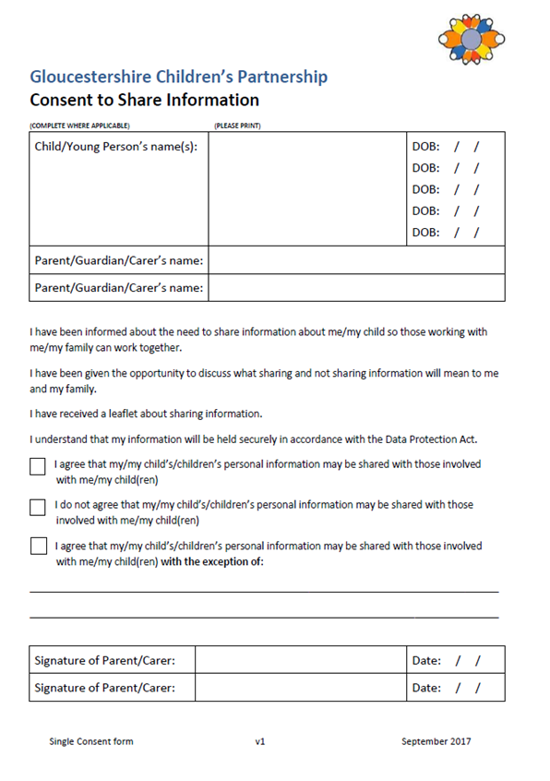
Consent to Share
What is informed consent?
Notes:
And this is the form
The form is the same for both Early Help and Social Care

Slide 51

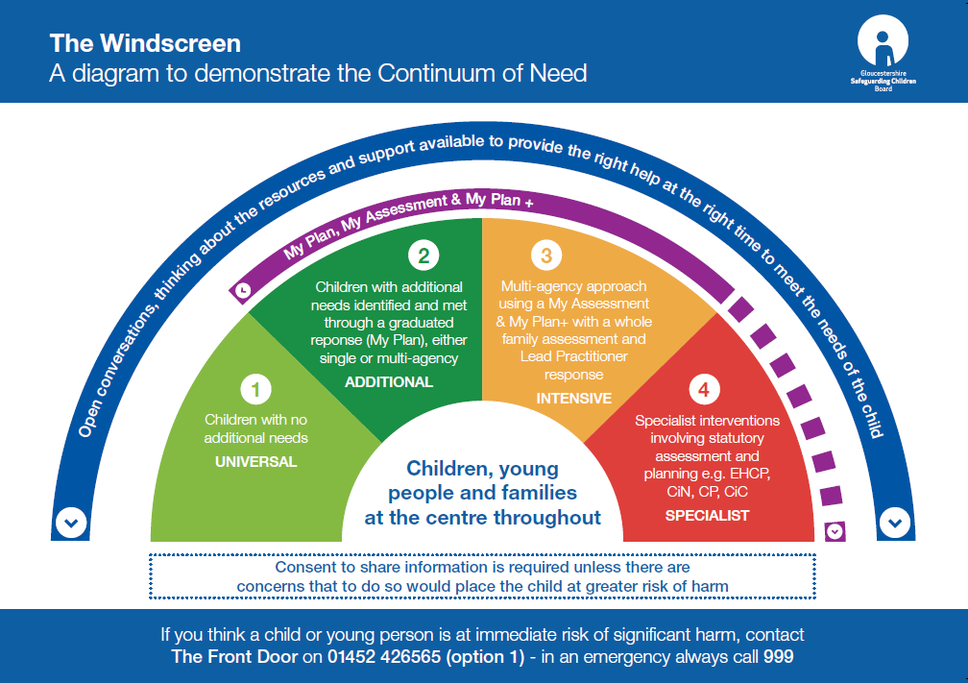
TAF
TAF
TAF
The Graduated Pathway and the Levels of Intervention sit alongside one another and enable us to assess risk and help us to decide how to respond to the individual needs of children, young people and their families.
Notes:
Seeing them as documents that work together to let us think about what are the risks and needs within a family and then how we will respond to that.
Go through the levels of intervention briefly and the link with the graduated pathway:
Level 1 – universal – My Profile
Level 2 – Additional – My Plan
Level 3 – Intensive – My Assessment and My Plan +
Level 4 – Specialist – EHCP/CIN/CP – Make the point that My Plan can run alongside to look at shorter term outcomes or those not covered within the statutory plan.
TAF meetings sit at each point and allow us to have multi agency conversations and work in collaboration with the family to draw up holistic plans
Levels of intervention
The windscreen diagram demonstrates the continuum of need , and that children and families needs can move up and down through the different levels at different times in their lives .
What is most important to note from the diagram is that help and support that starts at lower levels does not get stopped or abandoned because the family has moved up a level. The likelihood is that with support the family will move back down again. Often , referrals to social care do not result in a service from them and therefore we must not cease or end any support that we or our agency are providing.
Children with Statutory plans may still need the support of underlying plans and work, for example, children that have an EHCP may still require the support of a regularly reviewed my plan plus because the EHCP still focuses on educational targets and is only reviewed yearly, You can see that this would not be helpful for a need that requires more regular monitoring and reviewing.
My Plans and My Plan + working alongside statutory plans – EHC (review regularly and link with annual review) and Single Assessments/Social Care (sharing of plan and joint reviewing of plans).
The Levels of intervention are discussed thoroughly in the GSCB DOCUMENT “ Levels of intervention Guidance “
There are copies on your tables for you to look at.
( describe document , look at pages of different levels )
This document provides clear guidance about what level the child and families needs come into and there are describing factors on each level to help professionals decide. There is also clear guidance about which agencies and what support should be available at each level.
This document can help you to make appropriate referrals as you can be very clear about which level of need the family has.
We shouldn’t be referring to social care unless immediate safeguarding concern. Where we are concerned about a child we should be using the graduated pathway to respond.
Effective early help relies upon local agencies working together to:
Identify children and families who would benefit from early help
Undertake an assessment of the need for early help; and
Provide targeted early help interventions based on the assessed needs of a child and their family in order to significantly improve outcomes for the child

Slide 52
Neglect
A multi-agency co-ordinated approach

Slide 53
What is neglect?
Notes:
TASK:
Open up to the room – in tables ask them what they think the definition of neglect is

Slide 54
Working Together to Safeguard Children 2018
‘The persistent failure to meet a child’s basic physical and/or psychological needs, likely to result in the serious impairment of the child’s health or development. Neglect may occur during pregnancy as a result of maternal substance abuse. Once a child is born, neglect may involve a parent or carer failing to:
- provide adequate food, clothing and shelter (including exclusion from home or abandonment);
- protect a child from physical and emotional harm or danger;
- ensure adequate supervision (including the use of inadequate caregivers); or
ensure access to appropriate medical care or treatment.
It may also include neglect of, or unresponsiveness to, a child’s basic emotional needs’
Notes:
In Working Together to Safeguard Children 2018, neglect is defined as: read out slide as you click each point…
This is just one definition and we have a hand out with other definitions on also for you to look at. Give our hand out.

Slide 55
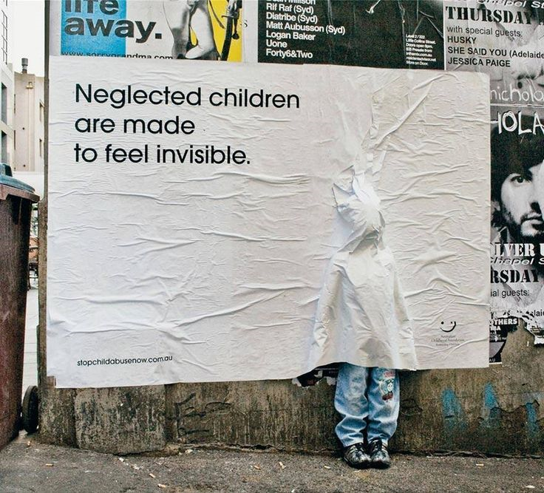
The impact on the health of the developing child
Notes:
The impact on the health of the developing child

Slide 56
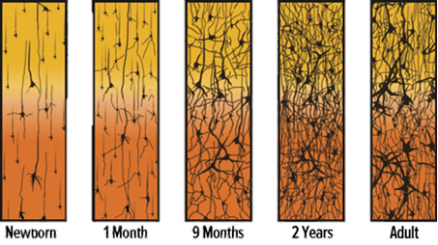
“Blooming and Pruning”
Notes:
What difference do you see between the 2yr and Adult pictures?
Between conception and age three, a child’s brain undergoes an impressive amount of change. At birth, it already has about all of the neurons it will ever have. It doubles in size in the first year, and by age three it has reached between 80 and 90 percent of its adult volume. Even more importantly, synapses are formed at a faster rate during these years than at any other time. In fact, the brain creates many more of them than it needs: at age two or three, the brain has up to twice as many synapses as it will have in adulthood. These surplus connections are gradually eliminated throughout childhood and adolescence, a process sometimes referred to as blooming and pruning.
e.g. a child that experiences little empathy will lose the ability to empathise with others and to respond to such care in healthy ways when it is shown to them in later life
Damage in the early years can be largely repaired, but therapeutic input needs to be consistent and begun as soon as possible

Slide 57
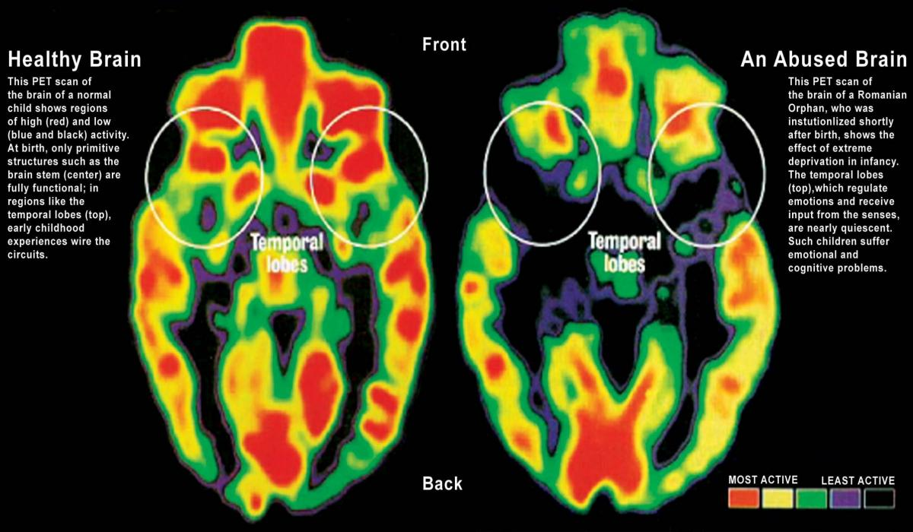

Slide 58




Peri-natal (pregnancy and early infancy)
A baby whose physical needs are met, but emotional needs are neglected will fail to grow and develop properly and may even die.
Notes:
Click 1: Maternal physical health has significant impact on the developing foetus e.g. diabetes
Click 2: Environmental factors e.g. cigarette smoke, alcohol & domestic abuse
Click 3: Emotional stress can also have physical effects e.g. “double dose” of cortisol pre-birth
Cortisol the “stress hormone” crosses the placenta to enter the baby’s bloodstream, and triggers the baby’s own production too. Cortisol has physical effects and can result in a baby born to a couple in a volatile or abusive relationship being very unsettled and crying excessively i.e. the sort of behaviour they are least able to cope with.
Studies on monkeys have demonstrated their need for emotional support and physical comfort/affection. 2nd generation study monkeys who were not parented by their mother were unable to parent as adults
Click 4: Some children severely deprived of love and stimulation in Romanian orphanages during the 1980s appeared to be disabled (global developmental delay) when adopted by families in other countries e.g. USA. Most of them eventually became “normal” children and adults, but it took many years of excellent care and sometimes therapeutic input.

Slide 59
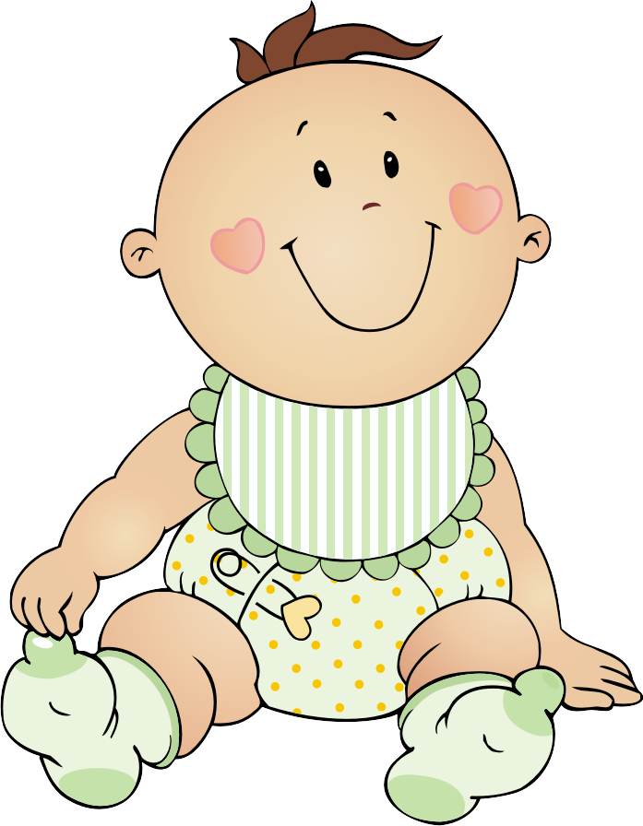

Clues: Baby to Pre-school
Withdrawn or lethargic
Self-stimulating behaviour (rocking)
Delay in Learning New Skills
Dirty or Unkempt
Short Stature
Nappy Rash
Infections
Lacking Social Skills
Socially unresponsive
Oral Health
Hungry
Failure to thrive
Indiscriminate friendliness
Lack of Confidence
Notes:
First Click:
Baby/Toddler: under-stimulation, nappy rash, infections, withdrawn or lethargic, failure to thrive, self-stimulating behaviour e.g. rocking.
Is the baby registered with the GP?
Second Click:
Pre-School: short stature, dirty or unkempt, delay in learning new skills, lacking social skills (aggressive or withdrawn), indiscriminate friendliness, shame or self-doubt, lack of confidence, expectation of failure.
Frequent minor illnesses, especially D&V OR never attends health services; D&V = diarrhoea and vomiting i.e. gastroenteritis

Slide 60

Developmental delay in an under-stimulated child is rarely measurable before 2 1/2 or 3 unless the neglect is very severe.
“Normal” development or meeting milestones when assessed before 3 must NOT be taken as evidence that the child’s needs are all being met.
Notes:
Click 1: first paragraph comes up
Click 2: Second Paragraph comes up
Looking at external factors not just the obvious milestones in isolation as this does not prove everything is fine.
What should we do when we only have limited visits?
Highlight multi-agency working needs to be highlighted as well as the graduated pathway or children with additional needs.

Slide 61

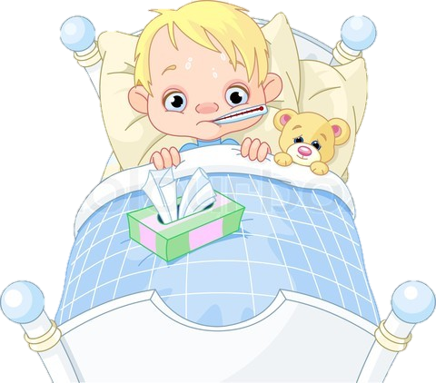
Clues: The Primary School Years
Notes:
Click One: Dental decay, dirty/unkempt/smelly, poor problem solving, poor reading and writing, encopresis, enuresis, guilt/self-blame, poor eating patterns, poor lunch boxes. (Encopresis – soiling/messing/ “pooing pants”, Enuresis – wetting/ “accidents”. (Bedwetting is correctly called nocturnal enuresis and is rarely an issue before 6 or 7) Either may be due to a range of physical/medical causes, poor or lack of toilet training or emotional factors. Unpleasant toilet facilities may be a factor
Click Two: A child who seems to always be unwell OR Health appointments not kept
Click Three: A child who is over-friendly and eager to please OR withdrawn and unresponsive OR angry and disruptive
A child who will not talk about home OR fantasises and tells improbable stories

Slide 62

Head Lice
When does a head louse infestation suggest neglect?
The difference between
lice and “nits”.
Notes:
Not always – any child can acquire an infestation and some well-cared for children do so frequently
SEVERE infestation suggests that parents/carers have not addressed the infestation early enough or consistently. Regular or frequent sightings of head lice e.g. falling onto book or desk from a child’s head are strongly suggestive of neglect, but it should be checked first that parents/carers have current and accurate information of evidence-based methods of control i.e. Prescribable insecticidal products and wet-combing
Nits are white or pale and are empty egg-cases usually stuck to the hair shaft close to the scalp. They are completely harmless but may be unsightly if there are lots left after a heavy infestation. They should not be confused with live lice or viable eggs which are dark – brown or black
Irritation and scratching can become very uncomfortable, distract a child in class and disturb sleep. Children (and their families) may be ostracised by peers. Severe untreated infestations can lead to anaemia because the lice feed on blood in the scalp capillaries. Some parents mistakenly keep infested children off school, depriving them of their education – as long as treatment is underway they should NOT be kept off school.
Scratching occurs when children have had head lice for a while as a fresh infestation will inject an anaesthetic like toxin so you don’t feel them at first, it is only when the body becomes immune to that toxin does the scratching stop.

Slide 63
Effects on Children’s development
Cumulative neuro-developmental consequences
Children may survive but not thrive
Poor cognitive development
Poor behaviour disrupting education
Smashed attachments leading to…
Poor relationships – family and friends - isolation
Injuries through lack of supervision
Poor sense of identity and poor resilience
Notes:
Persistent neglect produces significant neuro-developmental consequences for young babies which seems to be cumulative in nature – impact on developing brain
Physical wellbeing – inattentive or unresponsive care produces failure to thrive
Poor cognitive development
Educational difficulties including behavioural problems, discipline and school exclusion
Smashed attachments
Poor friendships
Family and social relationships disrupted
Social isolation
Injuries arising out of lack of supervision
Emotional and behavioural difficulties and problems with identity
Resilience impacted upon

Slide 64
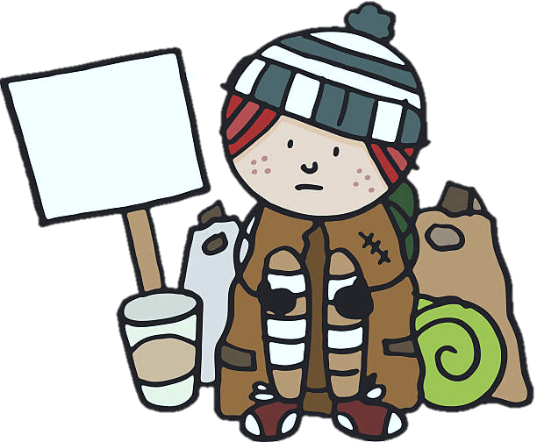

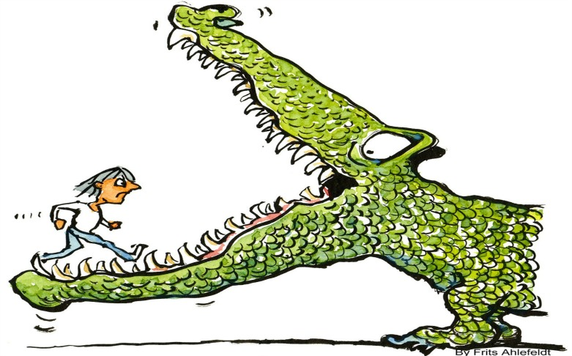
Pre-Teens, Teens and beyond…
Notes:
Adolescents – Risk taking behaviour.
Trauma related behaviour
Feel out of control and out of parent’s control
Running away; street wise; self reliant vs immature; needy
Compulsive stealing or scavenging
Lack of a holistic approach- treat each problem as it comes along
Oppositional anti-social behaviour; in trouble with teachers and police
Friendships disrupted
Disruptive behaviour/poor concentration in school; low academic achievement
Depression/low self esteem; Felt inferiority; felt helplessness; Shame; Loneliness
Impairment in interpersonal relationships, impulse control, regulation of aggression
Very structures/skills required to survive adolescence stripped away
Even with Fraser/Gillick competence, support with health appointments and treatment may be needed. This is parents’ responsibility!
CSE
Young Adults – social isolation, homelessness, poor diet, poor mental health, early/unplanned parenthood.
It is normal and to some extent healthy for adolescents to take some risks, but young people who are (emotionally) neglected are more likely to take the sort of risks that result in harm to their health or to their long-term life prospects
What types of behaviour might you see?:
Substance misuse
Unhealthy relationships/sex
Anti-social/Criminal behaviour
For “Street-wise” read “Vulnerable”
The reasons for this are primarily 1. low self-esteem and 2. lack of parental/adult guidance
Poor role models in their parents and other adults can lead to difficulties in establishing and maintaining healthy friendships, couple relationships and relationships with older adults who could supplement the guidance and support from their own parents.
Similarly if they become parents very young they are unlikely to have acquired the skills they need to keep well physically or mentally and to run a home and parent children
How we word records and reports matters. The NSPCC advise that we always give responsibility for health appointments being kept to the parents/carers e.g. “John not taken to asthma review appointment” rather than “did not attend” or even “appointment not kept”. For teenagers and young adults “John not supported to attend” may be appropriate wording.

Slide 65
Disability and neglect
Disabled children x3.8 more often neglected
Parenting capacity may be diminished
Other problems may be attributed to disability
Disabled children are over-represented among children who are Looked After
Unwitting collusion out of sympathy
Notes:
Disabled children are 3.8 times more likely to be neglected
International research shows that disabled children are more likely to be maltreated than others
Parenting capacity may be diminished by denial, “chronic sadness” or sheer exhaustion
Growth, behaviour and other problems may be seen to be the result of the disability
Disabled children are over – represented among children who are Looked After because of abuse and neglect Children in Need Census, 2004
Feeling sorry for parents/heroic carers/part time professionals
Children with disabilities need exceptionally skilled and committed parents in order to achieve their potential. If we are truly focused on the Best Interests of the child, our threshold for offering support will be lower, but too often it is higher as we fear being seen as judgmental

Slide 66
“Tackling neglect may be more difficult than tackling physical and sexual abuse. With physical and sexual abuse, events have happened and there are accounts to be gained and evidence which may support the accounts. They are likely to be acute episodes, albeit possibly repeated, rather than chronic and continuous experiences”.
(Jones 2016)
Notes:
We need to recognise that tackling neglect is often more difficult than tackling other forms of abuse

Slide 67

Physical and Sexual Abuse
Neglect and Emotional Abuse
Notes:
Where there is an injury, a mark, bruise or disclosure this is ‘visible’ however, neglect is often not so visible and constitutes a larger portion of abuse cases.
In 2008 73% of child protection plans were because of concerns about neglect or emotional abuse and this rose to 78% in 2015.
SCR have identified that 60% of their findings include neglect as the main concern.

Slide 68
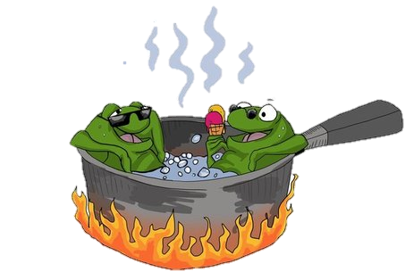

Recognising neglect and providing the right level of intervention at the right time
The effects of neglect may be gradual, continuous and cumulative
Notes:
Click 1 will make the first image disappear If you dropped a frog in a saucepan of boiling water it would jump out immediately.
Click 2 If you put a frog in cold water and gradually heat it up it will not jump out. Like the frog in the saucepan, the impact of neglect may be gradual, continuous and cumulative, not noticeably changing over time, but for the frog still in the saucepan, it gets too hot and too late and the frog is boiled and dies.
As with neglect when to act to turn down the heat or when to be decisive and to decide it is no longer tolerable, is always difficult – if nothing noticeably substantial has changed why intervene now when several months ago it was tolerated? (Jones, 2016)

Slide 69


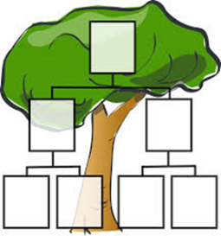




A Multi-agency co-ordinated approach
* Regular ‘Team around the Family’ meetings
* Chronologies and Genograms
* Lead Practitioner
* Timescales
* Contingency Plans
* New partners and absent fathers
* Housing
Notes:
1. Have regular ‘Team around the Family’ meetings CLICK 1
2. Identify a Lead Practitioner CLICK 2
3. Be mindful of timescales, drift and impact on child development CLICK 3
4. Integrated chronology and genogram CLICK 4
5. Be clear on the contingency plan CLICK 5
6. Include Housing CLICK 6
7. Explore new partners and involve absent fathers CLICK 7

Slide 70
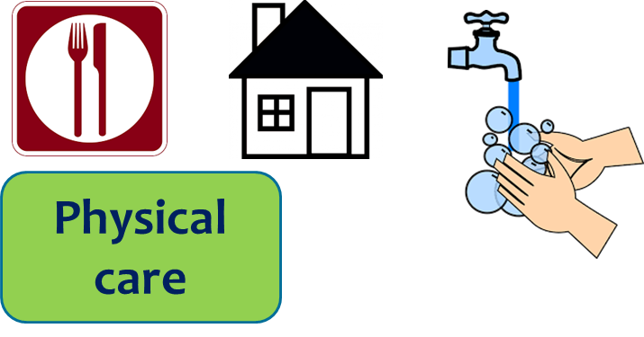




Toolkit: Five Key Areas
Notes:
The five key areas of need are:
1. Physical care (including food, housing and hygiene) CLICK 1
2. Health (including safe sleeping and seeking medical advice) CLICK 2
3. Safety and supervision CLICK 3
4. Love and care (including boundaries) CLICK 4
5. Stimulation and education CLICK 5

Slide 71
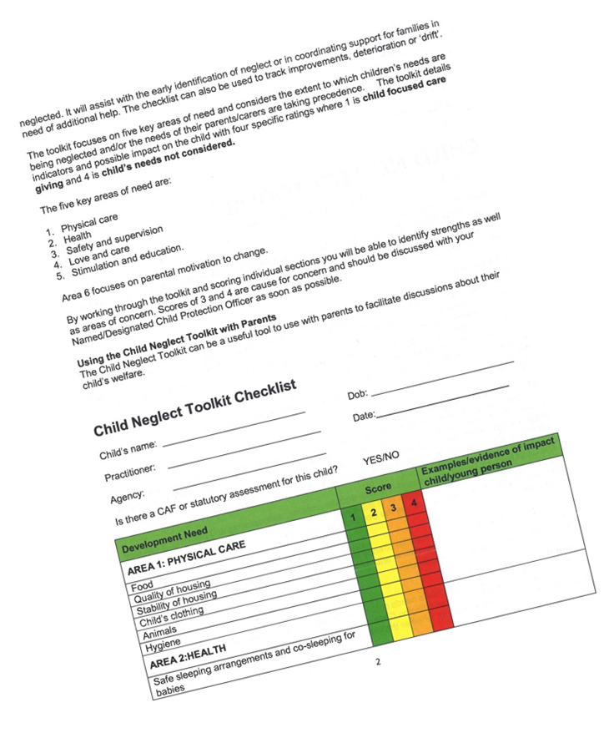
Using the Multi-Agency Neglect Toolkit
* A simple tool to organise your thinking
* Supervision
* Multi Agency meeting
* One-to-one with parent
Notes:
1. A simple tool to organise your thinking
2. Within supervision
3. Within or following a multi-agency meeting (with parents engagement or consent)
4. One-to-one with parent/family

Slide 72
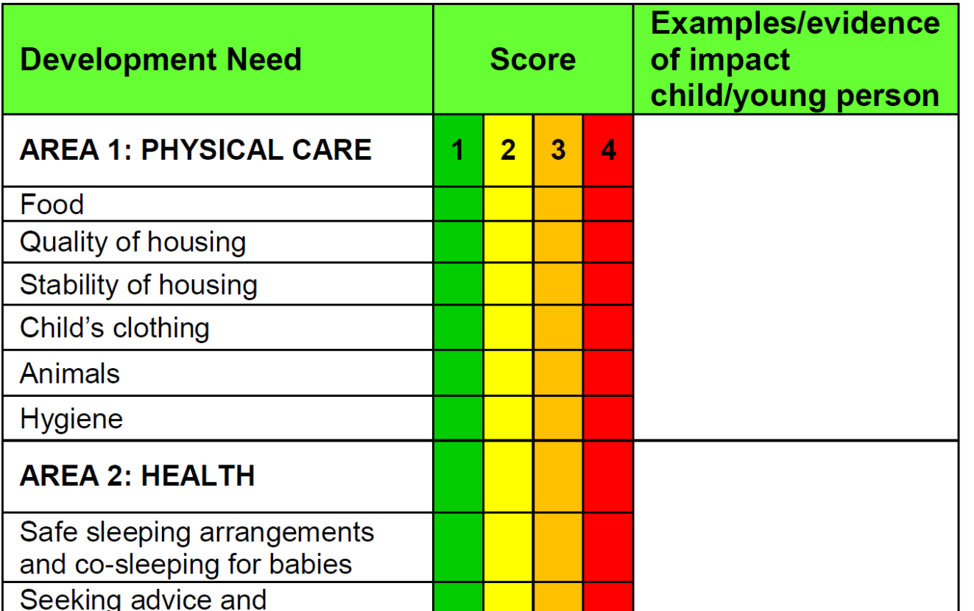

Child presents as hungry about once a week and reports they have not had breakfast as they slept in.

Slide 73
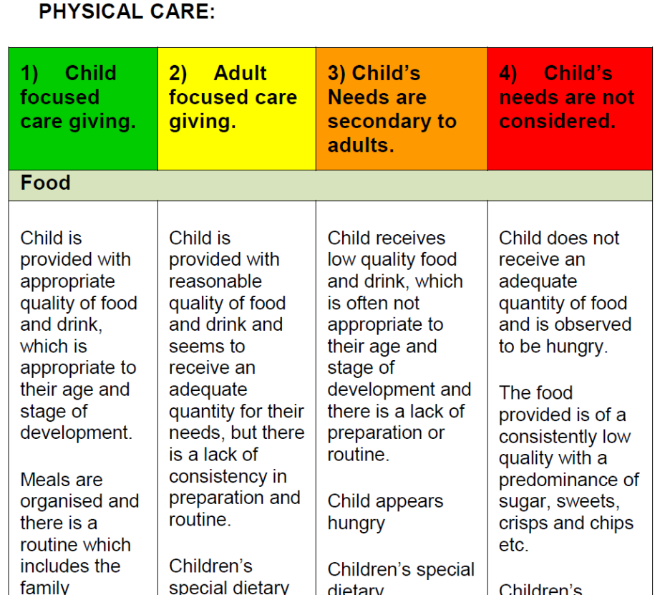

Slide 74

Parental Motivation to Change
Notes:
Area 6 focuses on parental motivation to change. CLICK 6

Slide 75
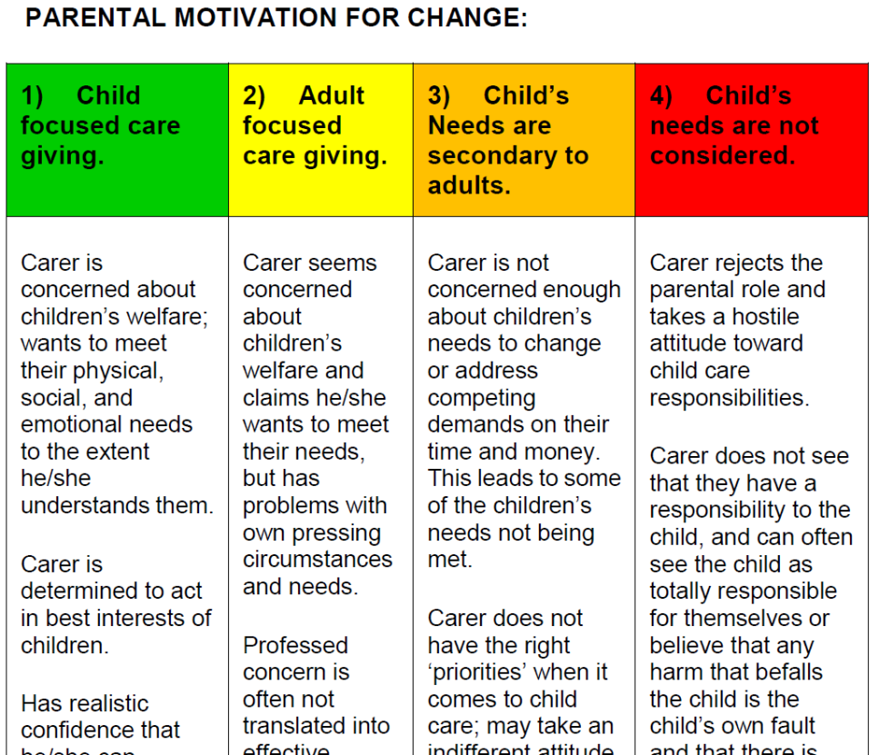


Slide 76
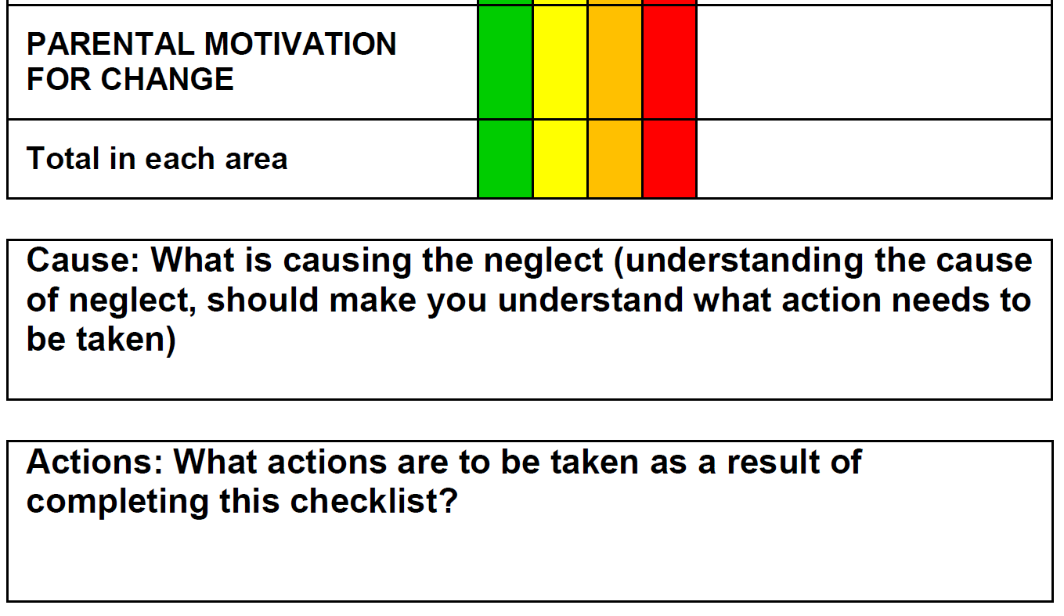

Parent struggles to maintain routines when their mental health is poor

Slide 77
Understanding Neglect
Difficulties in deciding how to respond to neglect arise because there may not be the understanding or clarity about the range and types of neglect. (Jones 2016)
Notes:
Difficulties in deciding how to respond to neglect arise because there may not be the understanding or clarity about the range and types of neglect.
(Jones, 2016) .

Slide 78
Typologies of Neglect
Type 1 Passive
Type 2 Chaotic
Type 3 Active
Ray Jones – Emeritus Professor of Social Work 2016
Notes:
The conundrum of neglect
In all of these serious case reviews the predominant factor was neglect – so although these children were physically abused (usually towards the end of their lives) they were actually known to services under the category of neglect and they all had neglect as a factor. There are three types of neglect categories. What we need to be thinking about when we have a good chronology is to see the patterns.
What does this actually mean? These types present not only at social care level but they are very evident in Early Help.

Slide 79

Type 1 - Passive
Poor Health
Debt
No Boundaries
No Care for Children
Previous Experience of Domestic Abuse
Poverty
No family support
Exhausted & overwhelmed by circumstances
Alcohol
Poor Housing
Depression
Young Carers
Notes:
Parents:-
Often single parent mothers, are ground down and exhausted by previous and current circumstances
Overwhelmed by chronic poverty, damp, poorly furnished, poorly maintained housing
Poor physical and mental health
Debt – unpaid bills, unopened letters, threats from debt collectors, rent arrears
No extended family support
Previous experience of domestic abuse
Involvement from multiple agencies – demanding of parents time
Isolated
Anxious and depressed
Finds it difficult to get up in the morning so seeing children often late for school
May be using alcohol and/or anti depressants
Lethargic with no routine and no energy
Children
Lacking in boundaries
School attendance issues
Caring for parent – worried about parent and sometimes angry about this responsibility
Example of type 1 may be death of Hamza Khan in Bradford with what is understood may have been an exhausted, isolated and previously abused mother just giving up

Slide 80
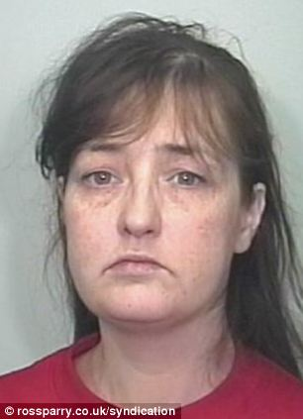
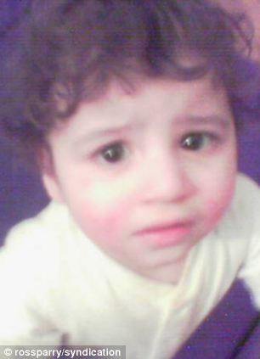
An example of type one:
Hamza’s death may be an example of type one; with what we understand was an exhausted, isolated and previously abused mother “just giving up”.
Notes:
His death may be an example of type one with what we understand was an exhausted, isolated and previously abused mother just giving up.

Slide 81

Type 2 - Chaotic
Poor parenting experience of the parent
Children come a distant second
Parent focused on their own needs
Parents have little understanding of children’s needs.
No Good Parenting Models
Active and Demanding but Chaotic and Unpredictable
Notes:
Parents:-
May have had poor parenting experiences themselves
Have little understanding of the needs of their children and how to parent well
Parents focussed on their own needs
Little tolerance and no routine
Not lacking in energy and may be very active but with the focus on themselves and not their children
Not necessarily intentionally uncaring, and may fight hard for their children in disputes with schools, neighbours and social care
Children:-
May be unsupervised as parents craves excitement and friendship with others
Tracy Connelly and her care of Peter and his 3 sisters may be an example of type 2

Slide 82
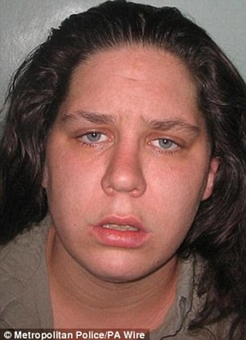
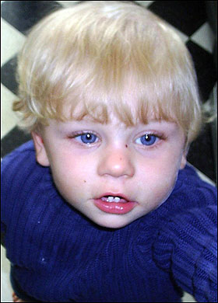
An example of type two:
Primarily presented as physical abuse in the media but neglect was a factor for most of his life. Maybe it was the dynamic of new partners that escalated this neglect to the horrific and severe physical abuse that led to Peter’s death.
Notes:
Peter’s story was primarily presented as physical abuse in the media but a level of neglect was a factor for most, if not all of his life. Maybe it was the dynamic of new partners that escalated this neglect to the horrific and severe physical abuse that led to peter’s death in 2007. Another example of this typology may be Daniel Pelka in Coventry.

Slide 83
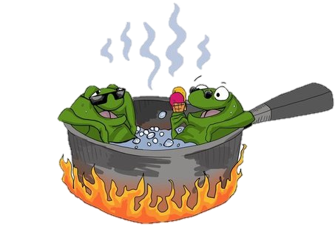
Both Type 1 and Type 2 neglect are examples of the slow-burning frog in the saucepan
Neglect can become “normalised”.
Notes:
They raise the very difficult issue of if and when to conclude that it is not getting better, despite interventions, and is no longer to be tolerated for the child.

Slide 84
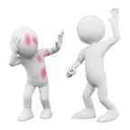
Type 3 - Active
High Professional Status
May be linked to jealousy of previous partnerships of which child is a reminder
Power & Control
Excitement from being dominant
Danger of escalating
abuse and violence
Associated with domestic violence
Deliberate & Intentional
No social class bias
Notes:
Deliberate and intentional
This is not about poverty or lack of competence this is about power and control!
Socially powerful people also need to be challenged.
BEAR IN MIND THIS IS A FORM OF NEGLECT WITH NO NECESSARY SOCIAL CLASS BIAS WITH SOCIALLY POWERFUL AND WELL-CONNECTED PEOPLE THAT NEED TO BE CHALLENGED AND CONFRONTED – IT REQUIRES CONFIDENT AGENCIES AND CONFIDENT PRACTITIONERS
Unlike 1 and 2 it is not about an exhausted parent or a parent lacking competence – its about anger and control
Its where a parent or parents turn on and scapegoat a child/children and it might involve only one child amongst several children in the family – this child becomes the focus and target of parental anger.
The child might be seen by the parent to be linked with memories of traumatic or hated events or relationships
The adult may be excited by feeling powerful and controlling
Might also be associated with domestic abuse
THE REAL DANGER IN TYPE 3 IS THAT THERE MIGHT BE A RAPID AND UNSEEN ESCALATION TO SEVERE ABUSE
STEP PARENT OR NEW PARTNER ABUSE OF A CHILD AS PROVOKED BY JEALOUSY OF A PARTNER’S PREVIOS RELATIONSHIP
MAYBE IT WAS THE DYNAMIC OF NEW PARTNERS THAT ESCALATED NEGLET TO HORRIFIC AND SEVERE PHYSICAL ABUSE THAT LED TO PETER CONNELLY’S DEATH AND DANIEL PELKA’S DEATH IN COVENTRY
THINKING ABOUT VICTORIA CLIMBIE – ABUSE AND NEGLECT APPARENTLY MOTIVATED BY RELIGIOUS AND CULTURAL VIEWS ABOUT PUNISHMENT OF CHILDREN
NOT ABOUT POVERTY OR LACK OF COMPETENCE – IT’S ABOUT POWER AND CONTROL

Slide 85
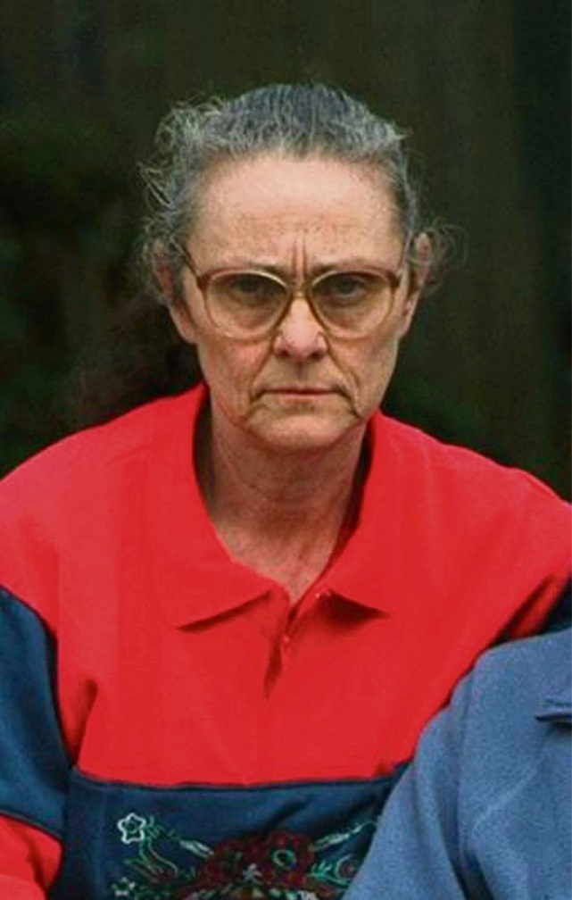
An example of type 3:
Eunice Spry was a longstanding adoptive parent and foster carer who would use her dominant personality and social status as a Jehovah’s Witness to intimidate professionals.
Notes:
A Gloucestershire case – 5 children placed in her care – recently released from prison

Slide 86
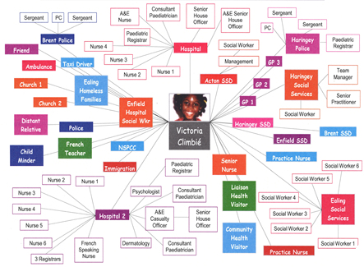
There was no co-ordinated response
Notes:
What do you think of this?
There was no co-ordinated response!!!

Slide 87
Case Study
Notes:
5 mins to read the information and 2 mins to feedback.
Give out part one.
Discuss questions.
Universal service
Childrens Centre
FIS
Chronology
Genogram
My Journey
Graduated Pathway
School support
Consent
Delegates to give feedback on each child individually: Read out their scenario and to be recorded by the trainer on the flip chart. To show that working at multiagency shows a real difference.
Toby (9 months) = Where on the windscreen? Universal Services
Appropriate Intervention = Nursery Nurse input keeping in one agency maybe?
Charlotte (5 years) = Where on the windscreen? Universal Services
Appropriate Intervention = School to speak to Mum about the concerns
Pastoral support worker at school.
Harry (14 years) = Where on the windscreen? Vulnerable
Has people already working with him at present – needs to be in a more multiagency way.

Slide 88

Stuart (Dad to Harry)
Stephanie (Mum)
Angus (dad to Charlotte and Toby)
(Stephanie and Stuart separated before Harry was born and he has never met his son)
(There was historical domestic abuse between Stephanie and Angus He left the family home recently but continues to see the children)
Harry (14 years)
Charlotte
(5 years)
Toby (9 months)

Slide 89
MARF
www.gscb.org.uk and follow link to Liquid Logic Portal
Complete as clearly and FULLY as possible – use levels of intervention
Be contactable – follow up
Inform the family
Bullet points
So what/impact?
Highlight strengths
Additional information – neglect toolkit, chronology, genogram, assessment.
Outcome
Notes:
Mention Advice Line and getting advice from CSW
Word document MARF remains on www.gscb.org.uk but if using this due to difficulties with portal then please report to ICT as advised.
Complete as clearly and FULLY as possible. You need to be contactable 48 hours after the MARF is submitted and you need to follow up.
Use Levels of intervention and quote the level in your MARF
Inform parents
Bullet points
So What? – What is the impact on the child/ren?
Highlight strengths
Attach any additional information (Neglect Toolkit, Chronology, Genogram, Assessments)
Describe the service that you consider may help the family
Childrenshelpdesk@gloucestershire.gov.uk

Slide 90

Gloucestershire
Re-design - the term “Front Door” is no longer used. All referrals come into the multi-agency safeguarding hub (MASH)
Practitioner advice line is no longer operational. Ring the MASH – 01452 426565
On-line portal for multi-agency referrals (MARFs) – make sure you register
Notes:
We are also creating a better more coordinated system for receiving contacts into the social care system. The ‘Front Door’ staffing has been increased, new advice line in place and online MARF will be coming in from February this year. From September 2018 we are building a single multi agency front door to handle the majority of contacts concerning social care issues. This new service is already being developed ‘virtually’ but will be physically based in County Hall once building works are completed later this year. Our existing contact, triage centre and multi agency safeguarding hub will be co located and brought together as one service including the single help line for professionals.

Slide 91
Gloucestershire
New strategy discussions held in the multi-agency safeguarding hub
Video/teleconference strategy discussions
Referral & Assessment teams now called Child Assessment Teams. Children & Families teams now called Safeguarding Teams. Teams are now smaller.
Notes:
We are also creating a better more coordinated system for receiving contacts into the social care system. The ‘Front Door’ staffing has been increased, new advice line in place and online MARF will be coming in from February this year. From September 2018 we are building a single multi agency front door to handle the majority of contacts concerning social care issues. This new service is already being developed ‘virtually’ but will be physically based in County Hall once building works are completed later this year. Our existing contact, triage centre and multi agency safeguarding hub will be co located and brought together as one service including the single help line for professionals.

Slide 92
Early Help Support
Information, advice and guidance – Family Information Service, Glos Families Directory
Single early help assessment – the graduated pathway
Early help coordinators and community social workers based in Families First teams providing advice, support and training
Family support, whole family work, parenting, employment support - provided by Families First, Children and Family Centres and the voluntary sector
Access early help through the MASH
Notes:
We are also working on improving our early help offer, this slide shows the range of options/support available via GCC. Support is also available from commissioned services for e.g. domestic abuse, substance misuse, housing etc. There is ‘pilot work’ already underway in Gloucester to see if we as partners can work even more closely to meet need before they escalate to the level that requires serious intervention. Prevention is definitely better than cure when it comes to social care and safeguarding. We will retain our current system of my plan, my assessment and my plan plus to focus our planning and we intend to ensure the range of early help services is maintained and widely publicised.

Slide 93
Gloucestershire Social Care Referral Process
Professional has concerns about child, or unborn baby
Consultation with supervisor / manager
Discussion with parents
(as long as it does not put anyone at risk, or affect police investigation)
Make a request for service through the online portal. If you do not hear back – follow it up
Notes:
93

Slide 94
Multi-agency Safeguarding Hub
6 social work managers
12 social workers
Family Information Service
Gloucestershire Domestic Abuse Support Service
Police, 2 officers, researchers and domestic abuse officers
2 education researchers
2 specialist safeguarding nurses
Notes:
We are also creating a better more coordinated system for receiving contacts into the social care system. The ‘Front Door’ staffing has been increased, new advice line in place and online MARF will be coming in from February this year. From September 2018 we are building a single multi agency front door to handle the majority of contacts concerning social care issues. This new service is already being developed ‘virtually’ but will be physically based in County Hall once building works are completed later this year. Our existing contact, triage centre and multi agency safeguarding hub will be co located and brought together as one service including the single help line for professionals.

Slide 95
Multi-agency Safeguarding Hub
As well as referrals they also deal with referrals to the Local Authority Designated Officer, private law cases, children who go missing, out of county cases and many other general enquiries
Notes:
We are also creating a better more coordinated system for receiving contacts into the social care system. The ‘Front Door’ staffing has been increased, new advice line in place and online MARF will be coming in from February this year. From September 2018 we are building a single multi agency front door to handle the majority of contacts concerning social care issues. This new service is already being developed ‘virtually’ but will be physically based in County Hall once building works are completed later this year. Our existing contact, triage centre and multi agency safeguarding hub will be co located and brought together as one service including the single help line for professionals.

Slide 96
How many contacts does the MASH get a month?
  2000 - 2500
Notes:
We are also creating a better more coordinated system for receiving contacts into the social care system. The ‘Front Door’ staffing has been increased, new advice line in place and online MARF will be coming in from February this year. From September 2018 we are building a single multi agency front door to handle the majority of contacts concerning social care issues. This new service is already being developed ‘virtually’ but will be physically based in County Hall once building works are completed later this year. Our existing contact, triage centre and multi agency safeguarding hub will be co located and brought together as one service including the single help line for professionals.

Slide 97
Multi-agency Safeguarding Hub
RAG rate every referral:
Red – child protection
Amber – need further enquiries – only have 24 hours to respond
Green – early help
Notes:
We are also creating a better more coordinated system for receiving contacts into the social care system. The ‘Front Door’ staffing has been increased, new advice line in place and online MARF will be coming in from February this year. From September 2018 we are building a single multi agency front door to handle the majority of contacts concerning social care issues. This new service is already being developed ‘virtually’ but will be physically based in County Hall once building works are completed later this year. Our existing contact, triage centre and multi agency safeguarding hub will be co located and brought together as one service including the single help line for professionals.

Slide 98
Making a referral
CONSENT
Are referrals accepted without consent?
Seeking consent
Time vs risk to child
Parents’ understanding
Notes:
Yes and No!
When do it without consent – is rare – but can be due to s.47
Seeking consent – call,text, email, post, home visit – grab parents at school gate – liaise with other professionals
Consent is SPECIFIC - cannot use previous EH forms as indication of consent
Parents understanding – do they know what they are consenting to – explain in detail
If decline explore this with them and develop plan as to how to alleviate concerns

Slide 99
What Makes a Good Referral
Explicit language (never appropriate, inappropriate, attachment, resilience, bond, love, challenging behaviour, sexualised behaviour, dirty, outcomes)
Make it clear what is fact and what is professional opinion
Make it clear how you know something – different if you have seen something, rather than have been told it by someone else
Make it clear how long you have had the concerns and have they escalated?
Have there been any recent changes – new partner/parents separating etc
Notes:
We are also creating a better more coordinated system for receiving contacts into the social care system. The ‘Front Door’ staffing has been increased, new advice line in place and online MARF will be coming in from February this year. From September 2018 we are building a single multi agency front door to handle the majority of contacts concerning social care issues. This new service is already being developed ‘virtually’ but will be physically based in County Hall once building works are completed later this year. Our existing contact, triage centre and multi agency safeguarding hub will be co located and brought together as one service including the single help line for professionals.

Slide 100
What Makes a Good Referral
How have the parents’ responded to you - after saying you are going to make a referral?
Social workers will discuss with the parents whatever you have written in the referral, unless there is an extremely good reason why they would not, so make sure you have shared all your concerns with the family before you make the referral
Notes:
We are also creating a better more coordinated system for receiving contacts into the social care system. The ‘Front Door’ staffing has been increased, new advice line in place and online MARF will be coming in from February this year. From September 2018 we are building a single multi agency front door to handle the majority of contacts concerning social care issues. This new service is already being developed ‘virtually’ but will be physically based in County Hall once building works are completed later this year. Our existing contact, triage centre and multi agency safeguarding hub will be co located and brought together as one service including the single help line for professionals.

Slide 101
Making a Referral
Do not use children as interpreters
Use any tool available to build your evidence – child sexual exploitation screening tool, neglect toolkit, Brook sexual behaviour tool https://www.brook.org.uk/our-work/the-sexual-behaviours-traffic-light-tool
Use the language in the threshold document and the definitions of abuse in Working Together
Notes:
We are also creating a better more coordinated system for receiving contacts into the social care system. The ‘Front Door’ staffing has been increased, new advice line in place and online MARF will be coming in from February this year. From September 2018 we are building a single multi agency front door to handle the majority of contacts concerning social care issues. This new service is already being developed ‘virtually’ but will be physically based in County Hall once building works are completed later this year. Our existing contact, triage centre and multi agency safeguarding hub will be co located and brought together as one service including the single help line for professionals.

Slide 102
Making a referral
Before sending in your referral…
Put yourself in parents’ position
Get someone else to check what you have written
Once you have sent in your referral
Make yourself/colleague available if we need to ask questions.
Don’t be afraid to chase up a response from ourselves.
Don’t be afraid to challenge us - Escalation Policy

Slide 103
www.gscb.org.uk
Notes:
103
103

Slide 104
Escalation of Professional Concerns Guidance
Stage 1 - Professional to Professional
Stage 2 - Line Manger to Line Manger
Stage 3 - Team Manger to Team Manager GSCB notified at this stage
(If Child Protection Plan /Child In Care Independent Reviewing officer to be notified)
Stage 4 - Resolution Panel
Notes:
Aim is to resolve concerns in the shortest timeframe possible to ensure the child is protected
Escalation of Professional Concerns Guidance

Slide 105

Don’t drop the child!
It is YOUR professional responsibility to continue to:
Support
Monitor
Record
This transition period is the most vulnerable time for children
Notes:
Click 1 the hands and the blue writing will come in
Click 2 the red writing will come in

Slide 106
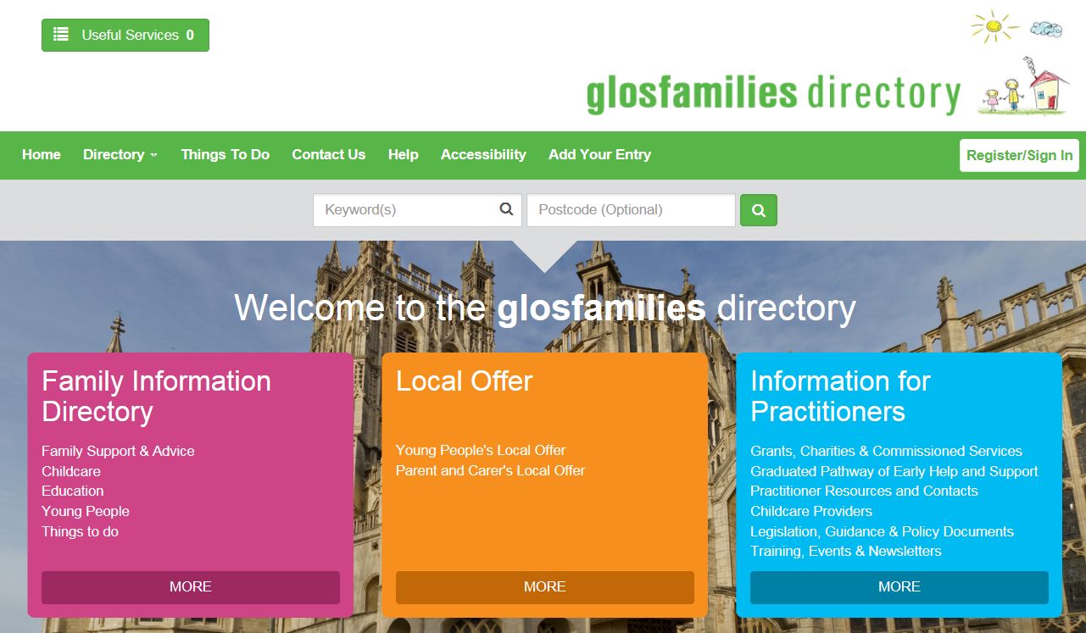

Family Information Service
www.glosfamiliesdirectory.org.uk

