Slide 1

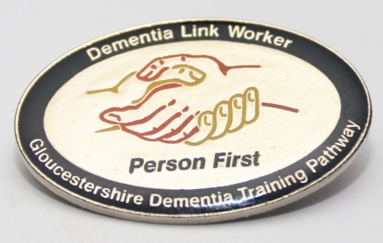






Tier 1 Self- Assessment
Dementia Awareness Training
1 ½ Hours
Working Together in
Partnership with:
Notes:
Intro today’s session

Slide 2
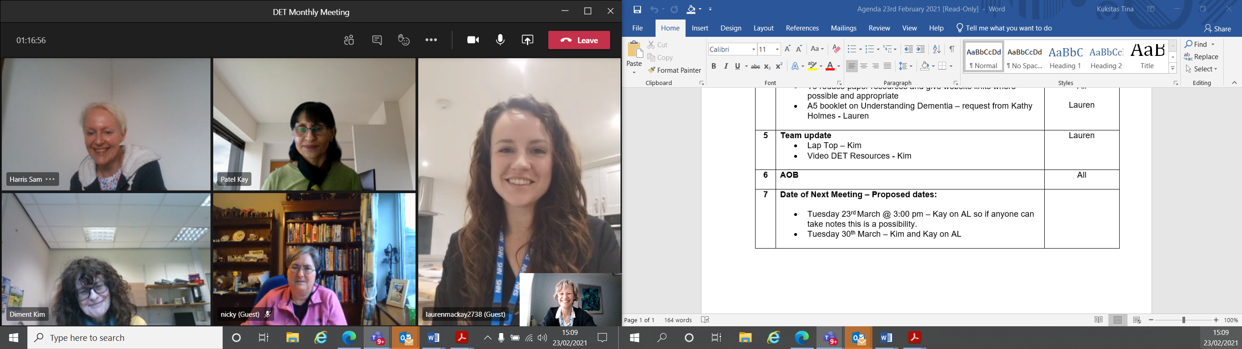
Welcome from the
Dementia Education Team.
Please work your way through the slides of the presentation, and where needed come out of the presentation to watch the 2 videos which form part of the course.
It will take around an hour and a half to complete.

Slide 3
Self Assessment Quiz:
(answers will be revealed at the end of the presentation)
Have a go at the quiz now, you will find answers as you go through the presentation and the 2 videos (there are links to the videos)
How many people in the UK have dementia?
Who discovered Alzheimer's Disease?
What are the 3 main types of dementia?
Name the 4 main symptoms of dementia?
Name 4 communication tips when supporting people with dementia
Where would you signpost someone for support if they or a family member had dementia?
What did Barbara do as her job in the past?
Notes:
9000 in glos
67%

Slide 4

What is Dementia?
We often say dementia is an ‘umbrella term’ ….

Slide 5

Dementia is an umbrella term to describe:
………. a progressive and irreversible syndrome that is characterised by widespread damage to the brain.
Dementia is caused by a number of different diseases, so sometimes you may hear about ‘types’, or ‘causes’ of dementia.
Dementia is sometimes described as a ‘hidden disability’
Notes:
This is a key point for the group and it is useful to stop and consider how useful the term dementia is. Comes from the Latin ’de mens’ : ‘out of mind’
Someone might ask what is the difference between Alzheimer’s disease and Dementia ? Alzheimer’s disease is just one type of dementia – there are many more. 2 other main types: Lewy body and vascular.
Neuro cognitive disorder is how the USA describes it- is this an improvement?

Slide 6
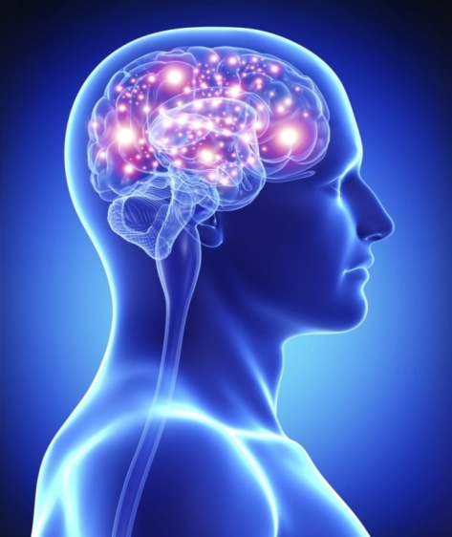
Brain Basics
The brain is our control centre and is made up of billions of cells called neurons.
The brain cells receive messages from our senses to help us to understand and react to the world around us.
Dementia causes brain cells to progressively die.

Slide 7
Common question: What is the difference between Alzheimer’s Disease and Dementia?
Alzheimer’s Disease, named by Alois Alzheimer in 1907 is one of the many diseases that causes dementia and is the most common.
So it is the disease process of Alzheimer's disease that causes dementia, however dementia may be caused by other diseases, the 2 other common diseases being Vascular dementia and Lewy-Body dementia
The term dementia comes from Latin: ’de’ and ‘mens’ literally means ‘out of mind’ which can lead to negative views about people with dementia
Notes:
dementia (n.)
"extremely low condition of mental function, mental incapacity," 1806, from Latin dementia "madness, insanity," literally "a being out of one's mind," from dement-, stem of demens "mad, raving" (see dement) + abstract noun suffix -ia.
dement | Origin and meaning of dement by Online Etymology Dictionary (etymonline.com)
Neurocognitive Disorders (Mild and Major) | Psychology Today
4/4/2019

Slide 8
Types of DEMENTIA
Alzheimer’s
Disease
Young Onset(<65)
Late Life Onset
Lewy Body Dementia
& many others…..
Huntington’s Disease
Alcohol related Brain Damage
Parkinson’s disease related
HIV/AIDS related
CJD / Prion diseases
Chronic Traumatic Encephalopathy
Vascular
Dementias
(Multi-infarct)
Fronto-
Temporal Lobe Dementias

Slide 9
The Prevalence of Dementia in the UK
There are 850,000 people with dementia in the UK
There is potential for this number to rise to over 1 million by 2025 due to our ageing population
Over 42,000 people under the age of 65 have dementia or severe memory problems
More than 25,000 people from black, Asian and minority ethnic groups in the UK are affected by dementia
https://www.alzheimers.org.uk/about-us/news-and-media/facts-media
www.youngdementia.org.uk
Notes:
Number of people in glos-9000

Slide 10

Each person will experience dementia differently…………
Seeing the person as a ‘person with dementia’, each with an individual lived history, including lifestyle choices, past and present relationships, & everyday preferences is vitally important for person centred approaches
Pd
Notes:
Depends on personality, history, health, type of dementia and social support.

Slide 11

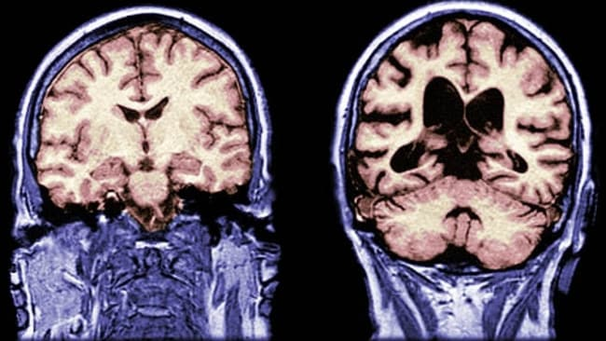
Recap; Dementia is:
Excessive death of brain cells
Loss of cell connections
Progressive damage to the brain that is greater than expected in ‘normal ageing’
Progressive and life limiting
It is a terminal condition
Healthy brain (L) vs
affected by dementia (R)

Slide 12

What do you think are the 4 main symptoms of dementia and what difficulties do people living with dementia experience?-
Write down your thoughts before moving to the next slide

Slide 13
4 Main Symptoms of Dementia
Memory Difficulties: short term at the beginning. Orientating to time, place and person becomes harder
Communication difficulties: finding words, forming sentences and understanding what people are saying.
Functional difficulties: following a recipe or using a debit card, cooking, dressing, writing, washing.
Cognitive difficulties: difficulty thinking things through, planning & making sense of information.
Notes:
Know what is meant by the term dementia
Dementia is a condition resulting from a disease such as Alzheimer’s disease or vascular dementia. The disease causes permanent and progressive damage to the brain.
Cognitive functioning becomes impaired in many different ways, and people experience a range of difficulties in everyday life. However it is vitally important to remember that there is much that can still be positive in the lives of people living with dementia. Although the person may lose certain skills other skills and abilities will remain.
There are definitions of dementia at varying levels of complexity. They will mostly include the four symptom areas
To diagnose dementia more than one of the above symptoms needs to be present and severe enough to impact on day to day life.
An important point to make is that dementia is a term that describes a group of symptoms common to a range of diseases. It is not a disease in it’s own right.
The dementias are progressive over time, beginning with subtle changes but eventually leading to severe disruption of function
The course of progression depends not solely on the type of dementia but on psychological and social factors unique to the individual
Dawn Brooker and Sue Lillyman (2013) Nursing and Health Dementia Care Survival Guide
TIP : Disorientation and Cognitive difficulties are more helpful descriptions than the constant use of the term confusion – The word confusion can be confusing - it describes so many different things & can be a catch all term to describe symptoms of dementia and delirium.

Slide 14
Other conditions can have similar symptoms but are not dementia
Delirium
(also known as ‘toxic confusional state’)
It usually is acute
(changes happen suddenly)
What causes delirium?
See next slide for an acronym that helps you remember the possible causes of delirium when a person presents with:
Difficulty focussing attention
Hallucinations- usually visual
Disorganised thinking
Altered level of consciousness
Depression
Anxiety conditions
Bereavement
Thyroid changes Diabetes
Vitamin B12 deficiency
Brain tumour
Failing sight
Loss of hearing

Slide 15
Possible Causes – P.I.N.C.H M.E is a useful way to remember them
PINCH ME
Pain
Infection
(Poor)
Nutrition
(Lack of)
Hydration
Constipation
Medication
(intolerance)
Environment

Slide 16
Be Aware……..
Some people with dementia may also have delirium
Delirium can be hard to spot when a person is living with dementia and the person already may be having difficulties with cognitive abilities
Some people with delirium may also have dementia that has not yet been diagnosed

Slide 17
People with dementia may have unmet needs;
These may be physical and/or psychological
Think Psychological Needs:
Sense of belonging- feeling included within a group
Esteem needs- feeling respected
Need for fun
Need for occupation
Need for close relationships with significant others
Think Physical Needs:
Eating and drinking
Sleep
Freedom from pain
Physical comfort
To feel physically safe
Notes:
Fundamental needs in dementia - an animation from the CAIT and Newcastle Model series - YouTube

Slide 18
Watch the following utube clip:
Fundamental needs in dementia - an animation from the CAIT and Newcastle Model series – YouTube
It takes 5 minutes to watch- look out for the needs identified in the previous slide
Consider:
What was most important to you to have on the desert island?
Which of the needs are most important to you?

Slide 19
Understanding signs of distress
or unmet needs
through behaviours that challenge us
What might the person be FEELING that could cause them to react like this?
We see (incident reports)
‘Shouting’
‘Wandering’
‘Hitting out’
‘Refusing care’
‘Constantly calling out’
‘Aggressive’

Slide 20
Take a few minutes to imagine YOU are experience difficulties in communicating and/or meeting your needs :
Which of the following feelings might you experience?:
Feeling angry?
Upset?
Lonely?
Distressed?
Humiliated?
Frustrated?
Think FEELINGS!

Slide 21
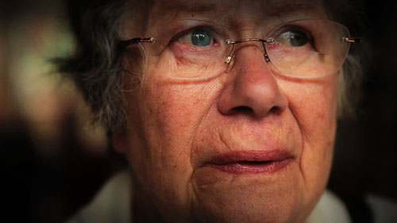
Barbara’s Story
On the next slide is a link to a 13 minute video of a longer story about an older woman called Barbara (played by a very good actress) through her healthcare journey as her dementia gradually advances
This video is well worth watching; it was commissioned in 2012 by Guys and St Thomas NHS foundation Trust with the aim of having an impact on the workforce; ‘we wanted to create something that nobody would ever forget …. to prick the conscience of our workforce…. where people felt emotional when they watched it………I never expected the response it had…’

Slide 22
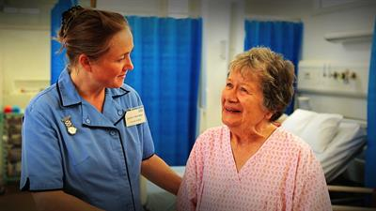
Barbara’s Story - reflections
What contributes to a poor experience for Barbara?
What enhances Barbara’s experience?
Write them down as
you see them
https://www.bing.com/videos/search?q=youtube+barbara%27s+story&&view=detail&mid=25AF09A916E0E7B5FDDE25AF09A916E0E7B5FDDE&&FORM=VRDGAR&ru=%2Fvideos%2Fsearch%3Fq%3Dyoutube%2Bbarbara%2527s%2Bstory%26%26FORM%3DVDVVXX

Slide 23
Barbara’s Story – check your reflections against these:
What enhanced Barbara’s experience?
Nurse Jane;
Introduced herself.
Validated how Barbara was feeling
Was caring and compassionate.
Used touch.
Explored Barbara’s past life experiences.
What contributed to a poor experience for Barbara?
Lack of dignity and respect
Poor communication skills
Physical barriers
Poor signage

Slide 24
How to approach someone with dementia
Public space; over 6 feet away (2 metres)
Check; can the person see me?
Personal space; 3-6 feet, handshaking distance
Check; can the person hear me?
Move to correct level /place
Private space; within 3 feet of the person (1 metre)
Check ; Touch if judged appropriate
Notes:
Talk about fundamentals for approaching a person with dementia- see first , hear second , touch third.

Slide 25


Communicating effectively and compassionately with people who have dementia
Top Tips (1)
Positive approach – your attitude and body language communicate your feelings – be mindful of your facial expressions, tone of voice, physical touch
Limit noise and distractions, address the person by their preferred name. If the person is seated get down to the same level and make a judgment about how the person is feeling before moving into private space

Slide 26
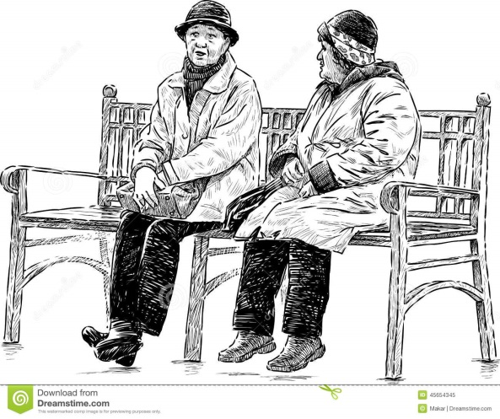

Top Tips (2)
Give the person time and do not rush them for an answer
Support the person with getting comfortable (check needs; hungry, tired / pain??)
Try to introduce one idea at a time. Giving someone a choice is important, but too many options can be confusing and frustrating

Slide 27
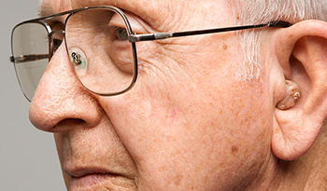
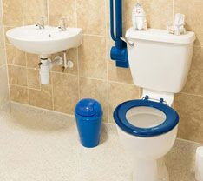
Top Tips (3)
Check the person’s glasses are clean and their hearing aid fitted and working!
Speak clearly and calmly and at a slightly slower pace. Use short simple sentences and don’t raise your voice
Consider the use of visual cues if it helps the individual

Slide 28
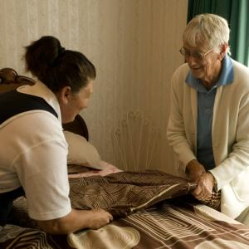
Connect…
Connecting with the person at any opportunity and when engaging in any care task.
Doing things ‘with’ rather than ‘to’
……. and exploring familiar smells, objects and/ or music which are personal and meaningful to each individual
Notes:
Examples- use of polish that might be familiar and reminder of home within a persons room (ref also room centred care – Graham Stokes)

Slide 29
Who is at risk of developing dementia?
The diseases that lead to dementia are complex, and there
is still a lot to learn about the risk factors. In most cases, it
is likely that our age, genes, medical history and lifestyle all
contribute to our risk of the condition.
Some risk factors, like age and genetics, can’t be changed. There are others, including lifestyle factors such as smoking, which you could try to do something about.
Alzheimer’s research UK: https://www.alzheimersresearchuk.org/wp-content/uploads/2016/01/RRD-0515-0517-Risk-Reduction_web-Jan-2016.pdf

Slide 30
How can we reduce the risk of
developing dementia?
Risk factors for cardiovascular disease (like heart disease
and stroke) are also risk factors for dementia. Leading a
healthy lifestyle and taking regular exercise will help lower
your risk of cardiovascular diseases, and it’s likely you
could be lowering your risk of dementia too, particularly
vascular dementia:
Don’t smoke
Maintain a healthy weight
Exercise regularly
Eat a healthy balanced diet
Keep alcohol consumption within safe recommendations
Keep cholesterol and blood pressure at a healthy level

Slide 31
Consider:
What are the advantages of getting a dementia diagnosis?
Write down your thoughts before moving to the next slide

Slide 32
Why is an early diagnosis of dementia important?
Support – for the individual and their family/carers
Understanding – how the dementia may progress and consider what the individual may need
Access to services – voluntary, health and social care
Planning for the future – advance care planning, power of attorney
Supporting people to be able to live as well as possible for as long as possible (simple home adaptations)
Access to treatments where these are possible

Slide 33
Impact on family and friends
Key areas;
Change in role and relationships.
Need help to understand the condition and how to support.
Financial and emotional cost of caring for someone
Need for practical advice.

Slide 34

Signposting individuals, families and carers to dementia advice, support and information; 2 key sources in Gloucestershire…………
GHC Trust
Managing Memory Together Information & Advice
Tel 0800 694 8800
managingmemory@ghc.nhs.uk
Telephone
01452 525 222

Slide 35
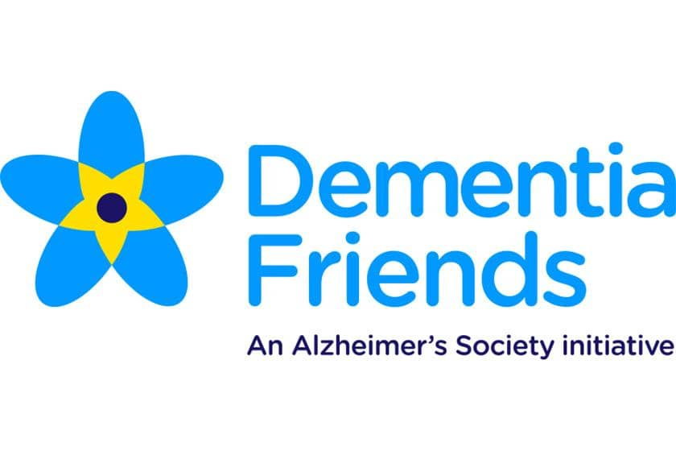
Community Support for people living with dementia, family and carers
Dementia Action Alliance
The Dementia Action Alliance brings together organisations across England committed to transforming health and social care outcomes for people affected by dementia.
www.dementiafriends.org.uk
The Dementia Friendly Communities programme aims to meet the targets outlined by the Prime Minister's Challenge on Dementia 2020 in order to create communities around the UK which make daily living and activities easier and more accessible to people living with dementia.

Slide 36
Community Support for people living with dementia, family and carers
Gloucestershire Adult Social Care Helpdesk: 01452 426868
Gloucestershire County Council Your Circle website - an online directory to help you find your way around health and care and connect with people, places and activities in Gloucestershire : www.yourcircle.org.uk
Gloucestershire Carers Hub –0300 111 9000 carers@peopleplus.co.uk
information, advice, carers support, counselling and carers assessments

Slide 37
Self Assessment Quiz: Check your answers
How many people in the UK have dementia? 850,000
Who discovered Alzheimer's Disease? Alois Alzheimer
What are the 3 main types of dementia?
Alzheimer’s, Vascular dementia, Lewy-Body Dementia
Name two of the symptoms of dementia?
Memory difficulties, communication difficulties, functional difficulties, cognitive difficulties
5. Name 4 communication tips when supporting people with dementia
Refer back to slides 25, 26 & 27; choose 3 favourite tips
Where would you signpost someone for support if they or a family member had dementia?
Managing memory together 0800 694 8800
Alzheimer's Society:01452 525 222
7. Go back to Barbara’s story if you still haven’t found the answer
Notes:
9000 in glos
67%

Slide 38
Toolkit of approaches ;
https://youtu.be/uQub5iuxAeA

Slide 39
Tier 1 Learning Outcomes
Have an awareness of dementia; signs/symptoms and prevalence
Recognise the person with dementia as a unique individual
Be aware of the impact of dementia on the individual, families and society
Be aware of some top tips for communication
Understand that unmet needs for people with dementia can cause distress and potentially lead to behaviours that may challenge us
Have an awareness of the risk factors for dementia
Understand the benefits of early diagnosis
Be mindful of the impact of dementia, both for the person and their family/carers, and how to signpost for advice, support and information

Slide 40
Dementia Training and Education Strategy for Gloucestershire
Dementia Training and Education Strategy for Gloucestershire - Gloucestershire County Council
For further information on Dementia Training please contact the 01452 324306 or email proudtolearn@gloucestershire.gov.uk .

