Slide 1
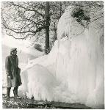
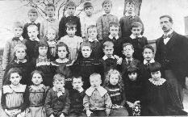


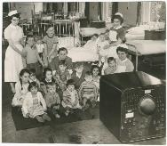
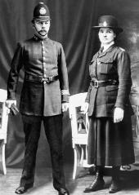

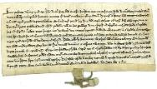
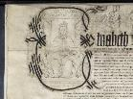
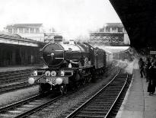
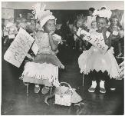
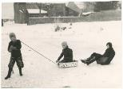
Where we live
NC Link:
KS2 History:
Local History over time
&
A study of a specific area beyond 1066
You will learn about:
Gloucestershire’s local history
Chronology
Historical terms
Use of sources
Significant events & people
A Local History Project for Gloucestershire
Schools Pack
by Gloucestershire Archives at the Heritage Hub

Slide 2
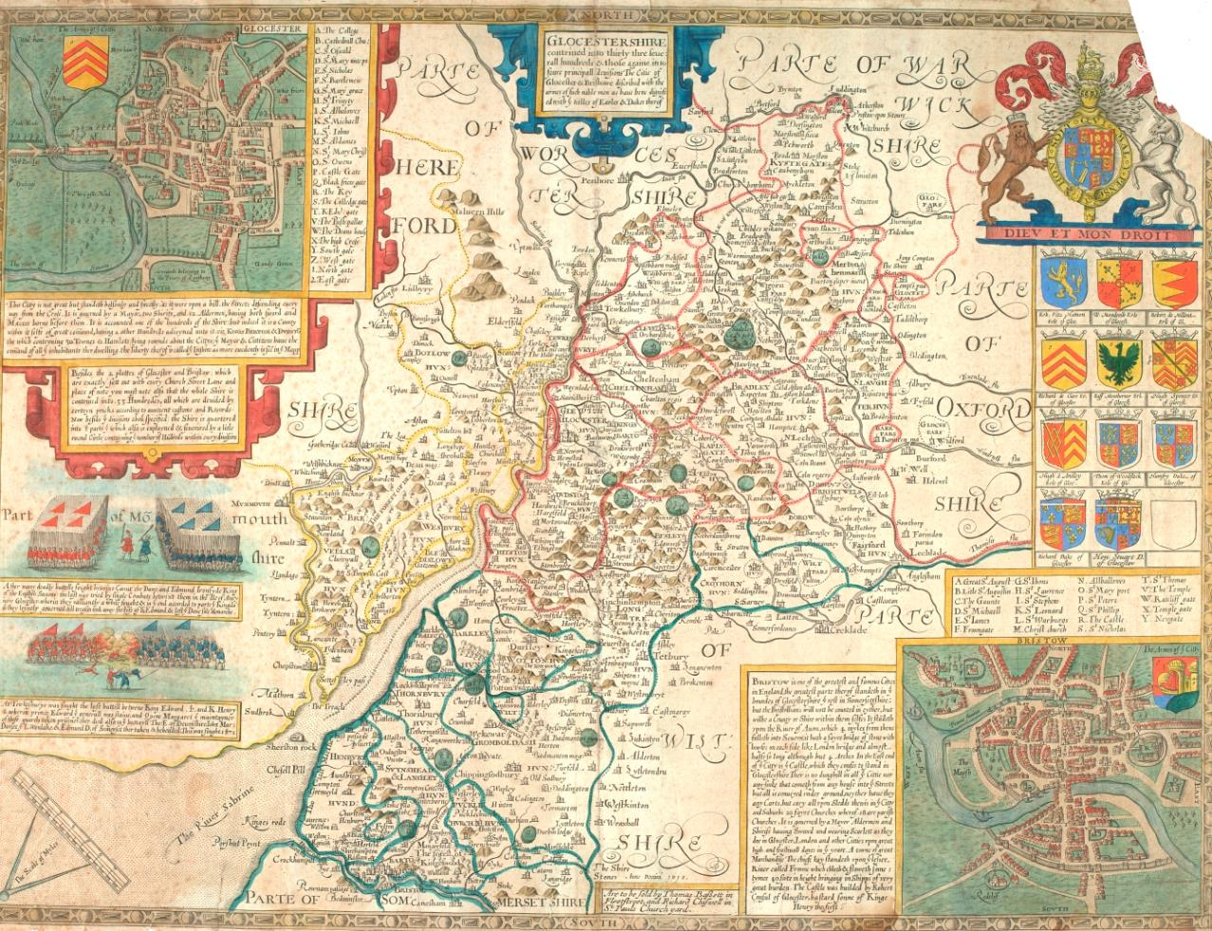
Where do you live?
What does ‘local’ mean?
Do you want to add any other descriptions?
Your county
Your town
Your street
Your house

Slide 3
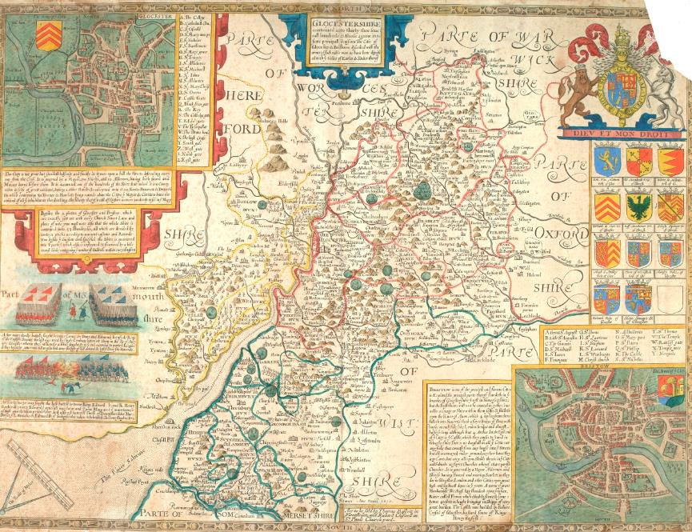
Where do we live?
This map was made in 1604.
It shows the county of Gloucestershire.
England is divided into 48 counties.
Each county has a main city, and Gloucestershire’s is the city of Gloucester.
In this lesson, you are going to be finding out about Gloucestershire, your local area and its history.

Slide 4
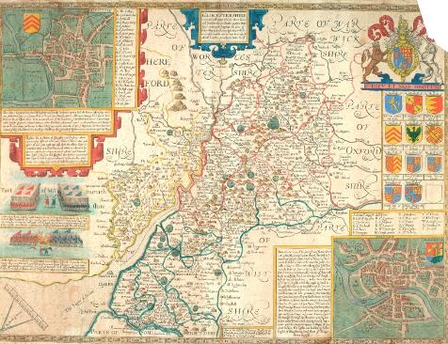
Map of Gloucestershire, 1604
Documents can tell us about the past. Some tell us more than others.
When learning about local history, a map is a great place to start!
What can this map tell us?
A plan of the city of Gloucester including the churches, and a description of the city
A shield bearing the Royal coat-of-arms of the United Kingdom flanked by a lion and a unicorn.
The motto, written in French, says ‘God & my right’.
2 pictures of famous battles which took place in Gloucestershire.
The top picture shows a battle at Alney Island near Gloucester, which took place in 1016. King Cnut, the Danish King, defeated Edward Ironside, the English King.
The bottom drawing shows the Battle of Tewkesbury which took place in 1471. It was part of the Wars of the Roses.
The coats of arms of local Earls and Dukes as well the Royal arms
A plan of the city of Bristol including the churches, and a description of the city
Places, boundaries, some roads, rivers and some features like mountains

Slide 5

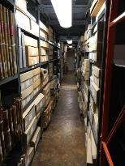
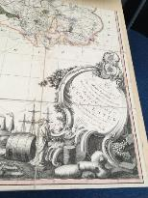
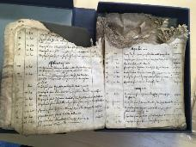
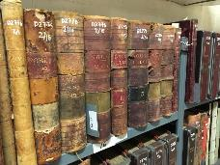
How do we find out about local history?
Where is the information in this lesson from?
All of the items in this lesson are pictures of documents kept at Gloucestershire Archives
Gloucestershire Archives holds the records for the historic county of Gloucestershire
The Archives has about 10 million records and miles of shelving!
Gloucestershire Archives is based in a very large building, the Heritage Hub, in Gloucester . The documents are so precious, they are not allowed to leave the building.
The records include letters, property deeds, maps, photographs, films, books, newspapers, business records, poems, sketches and plans. Plus many other kinds of items.
People can visit the Archives and order documents to look at. Many people are doing research, or learning about the local area.
There are many interesting and important items at the Archives. Here are just a few…

Slide 6
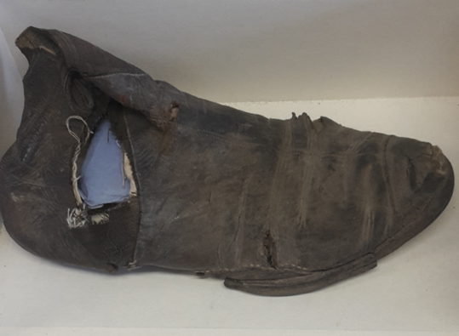
Gloucestershire Archives unique items
This is a Victorian shoe found full of letters from around 1860
No one knows why or where it came from!

Slide 7
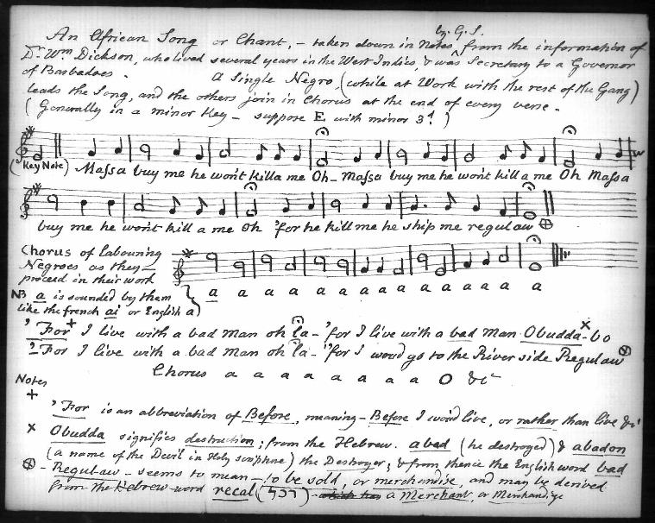
This is a work song from the sugar plantations of Barbados at the height of the transatlantic slave trade (1700s)
It features the voices of enslaved people as they tell of their brutal treatment at the hands of their master
You may wonder why such an item is in an Archives for Gloucestershire when it was created in Barbados. This is a very good question! It was written down in late 18th century by an anti-slave trade campaigner called Granville Sharp. Mr Sharp’s niece lived in Gloucestershire and we ended up with his personal papers. This is why we have this very important item.
It has been inscribed on the UNESCO memory of the world

Slide 8
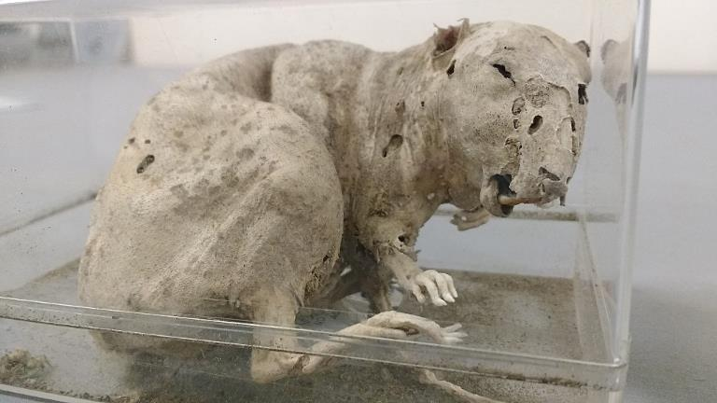
Unique items
This is a mummified rat.
It was found in a kettle amongst a pile of documents in someone’s house!
It doesn’t tell us much about local history but it is one of our most popular items.

Slide 9
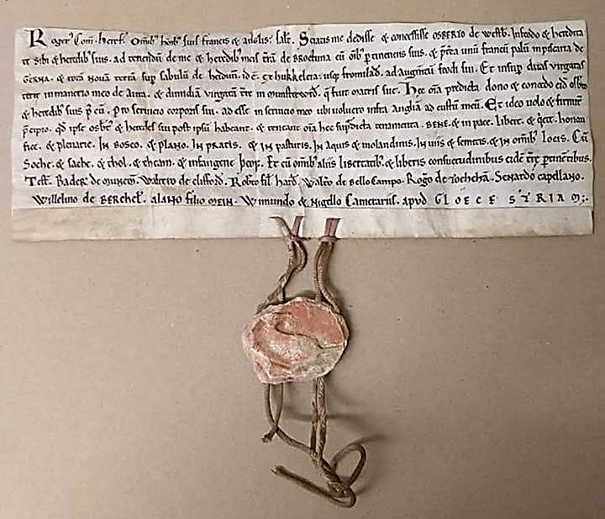
Unique items
This is probably the oldest item in Gloucestershire Archives
It is a deed for land in Westbury-upon-Severn. A deed is a legal document. It deals with ownership & use of land
It dates to between 1143 and 1149 – nearly 900 years old!
Like many older documents, it is written in Latin
The wax seal originally had a picture of a horse on it but age has made it impossible to see it clearly anymore

Slide 10
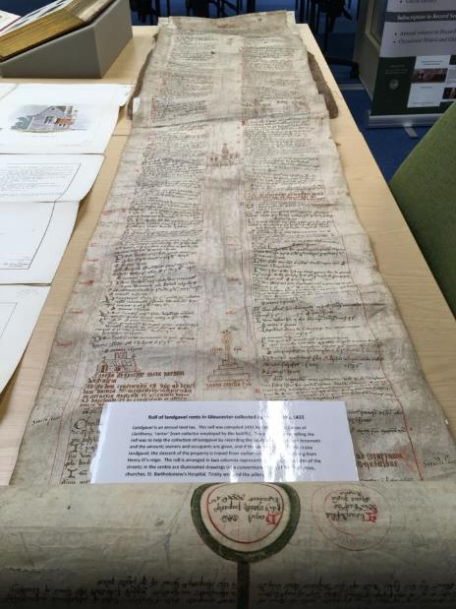
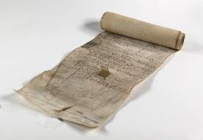
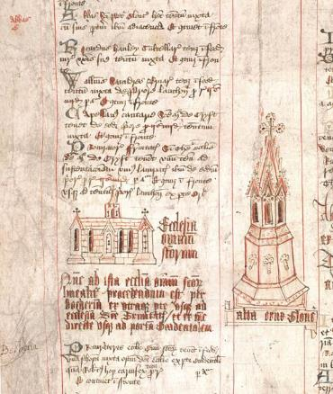
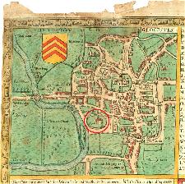
Unique items
This is the Gloucester Castle accounts roll from 1455.
It is very long and lists how money was spent, such as repairing the walls and buying weapons.
Gloucester Castle was built between 1066 and 1087.
It was demolished in 1787 and Gloucester Prison was built in its place.
In this detail from the map you saw earlier, you can see the Castle, circled in red – it was still standing when the map was made in 1604.
Without this roll and the 1604 Map, how would we know that Gloucester once had a castle?

Slide 11
Where we live
– a local history project
What will you be doing next?
You are now going to find out about Gloucestershire in the past
You will be looking at lots of documents and photographs of your local area
You will be in small groups of 3-4 pupils.
There will be 9 different tables and on each will be lots of pictures
Each table will have a different theme: In the Home, At Work, Health & Hospitals, Holidays & Festivals, Leisure Time, Police & Crime, Schools & Education, Transport & Communication and War
You will have just a few minutes on each table to look at all the pictures and make a few notes on your investigation sheet. Use the back if you run out of space.
Your Teacher will then tell you to move to a different table
You will do this until you have looked at all the pictures on all the tables
As you go round, note down any questions you think of in the box on the sheet
Are you ready?

