Slide 1
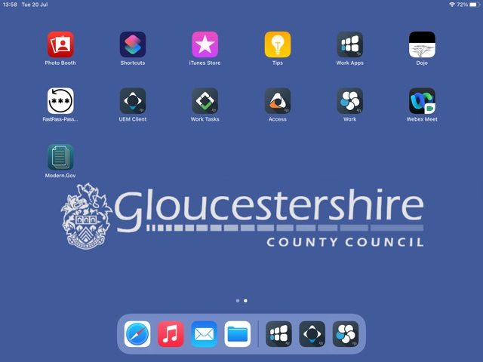
Webex
On the home screen, select the webex icon

Slide 2
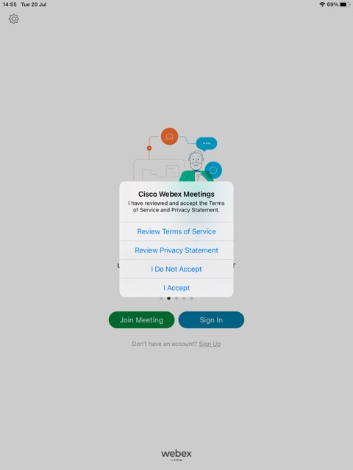
Webex
Upon opening you may have a pop up. Select the “I Accept” option

Slide 3
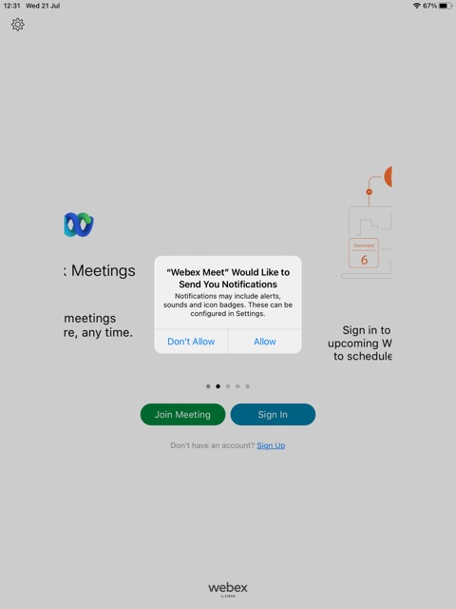
Webex
You may also be faced with this pop up, select the “Allow” option

Slide 4
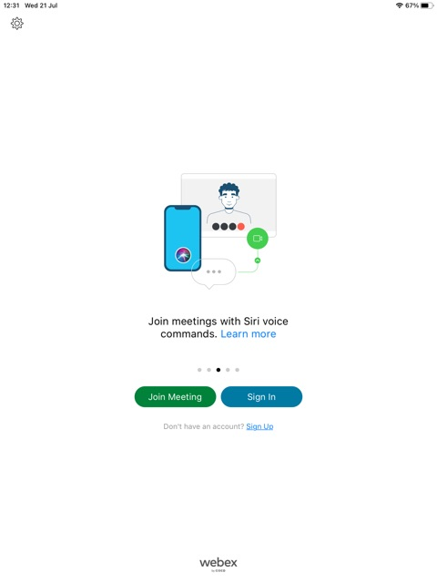
Webex
You will next be faced with this screen, asking you to select either “Join meeting” or “sign in”
If you are trying to join a meeting, selecting “Join Meeting” is the quickest way to do this

Slide 5
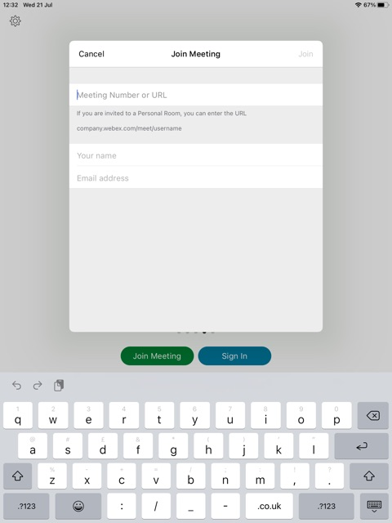
Webex
Upon selection of “Join Meeting” you will now see this. You will need to put the meeting number or URL into the top box.
You will also need to put your name in this box
You will also need to put your work email in this box
When this information is complete, select “Join”

Slide 6
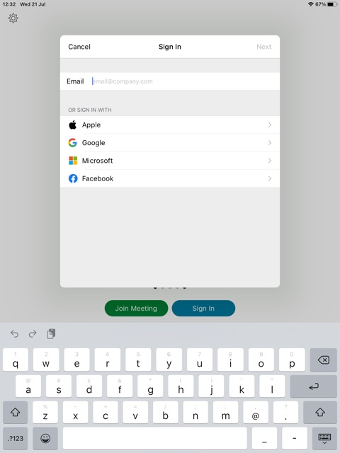
Webex
Upon the selection of “Sign in” you will be faced with is page, just enter your work email address into this bar.
Then select “Next”

Slide 7

Webex
You will now need to enter the meeting URL here
Then when it has been entered correctly, select “Next”

Slide 8
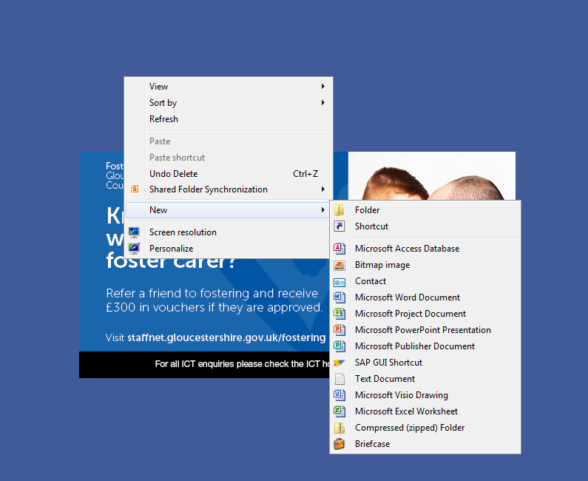
Creating Folders
On the desktop screen of your laptop, right click the mouse and go down to new. From her you will have the option the says “Folder”

Slide 9
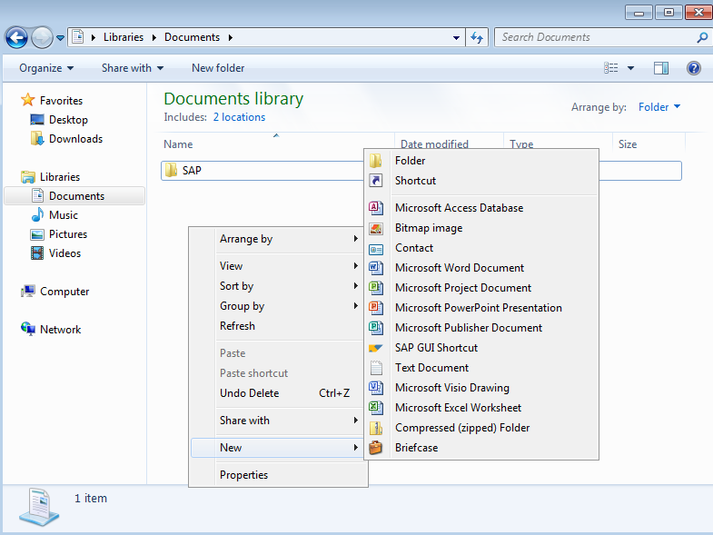
Creating Folders
You can also do this when in your document libraries and create folders wherever you need, folders can also be created inside of other folders too.

Slide 10

Creating Folders
To create folders on your iPad, hold your finger on one of the icons that you want to add to a folder. You will need to on this icon for about 2-3 seconds. You will see the icons start to jiggle, this how you know the app you are moving is ready to move.

Slide 11
Creating Folders
Now drag your app towards another app you wish to make a folder with.
I am only using these 2 apps as an example!

Slide 12
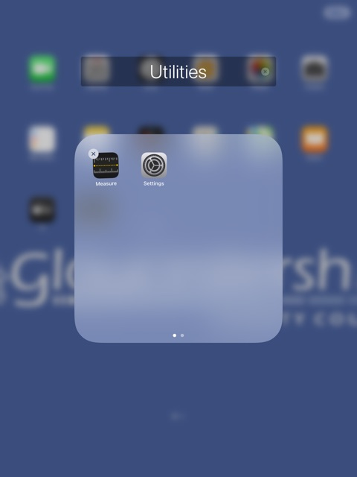
Creating Folders
You will now see the 2 apps together in a white box, these two apps are now in a folder
You can name the Folder if you wish

Slide 13
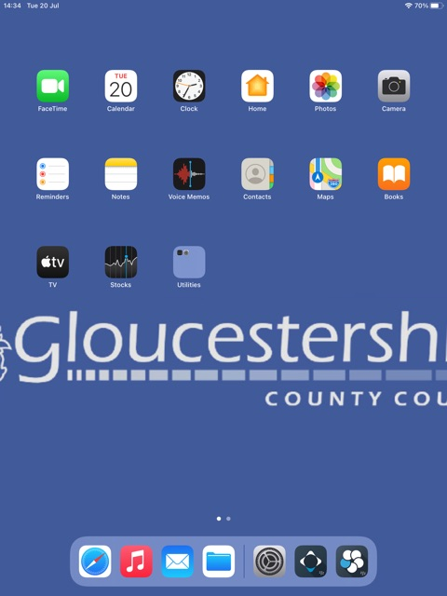
Creating Folders
Back on the Home Screen, you will now have a box like this, This is the folder you just created. To access this, just tap on the box and it will display the apps inside, ready to access.

Slide 14
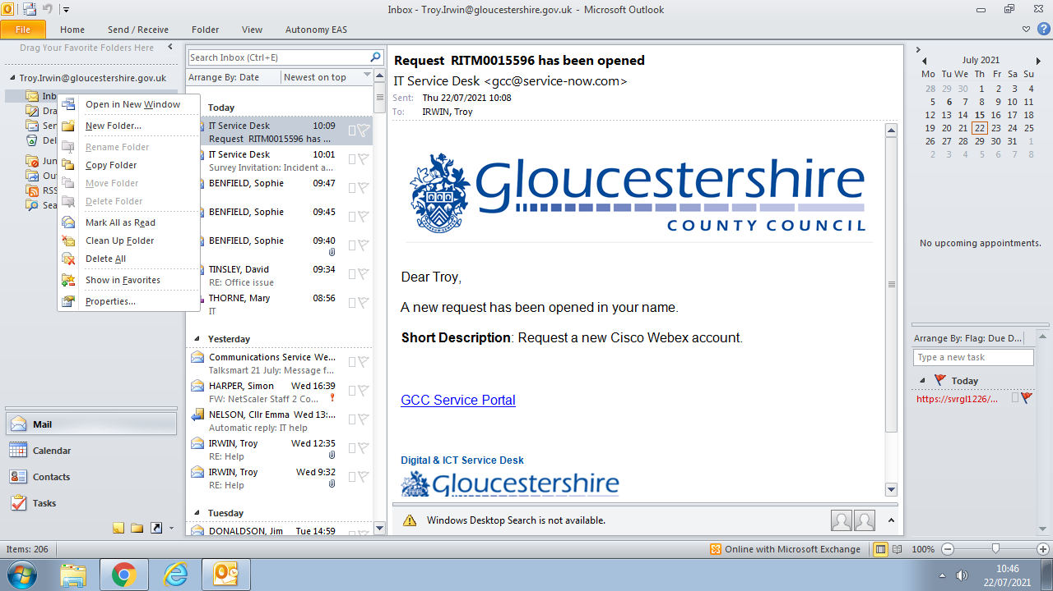
Creating Folders: Outlook
When inside outlook, hover over your Inbox folder on the left side of the screen and right click, from here you will see the “New Folder” option
Censored

Slide 15
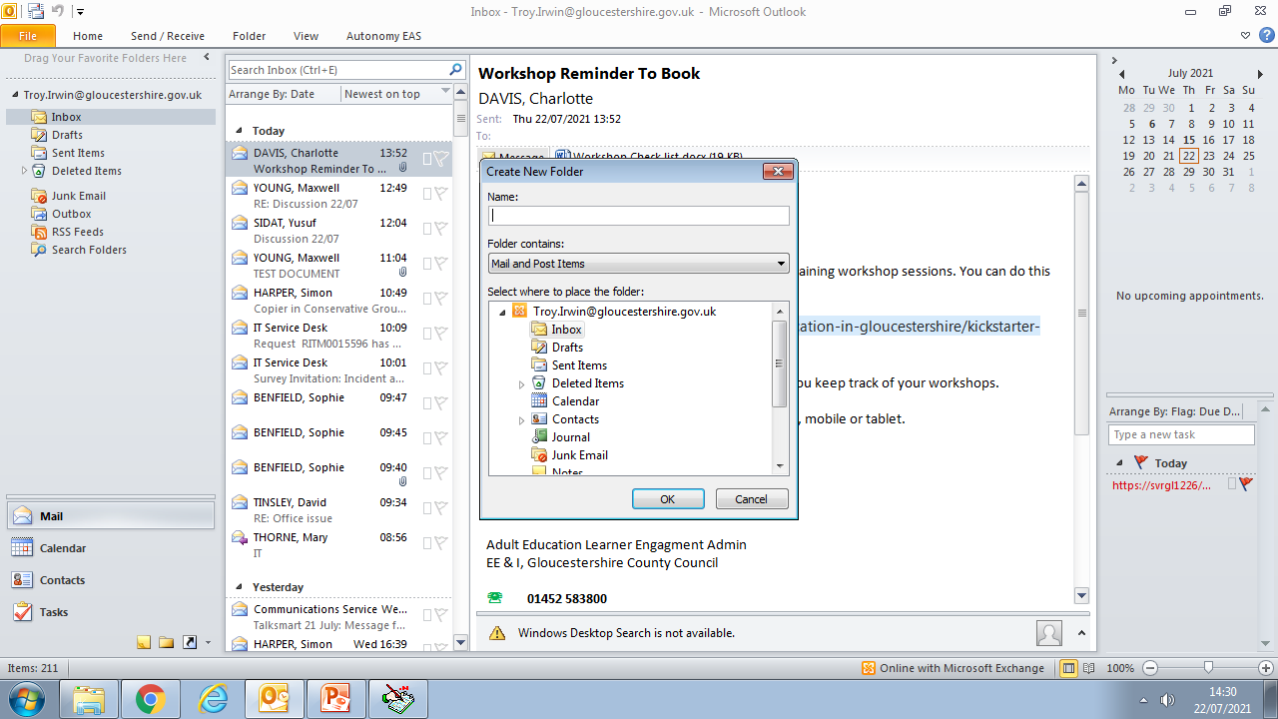
Creating Folders: Outlook
You will now see the option to name the folder, you can name this in relation to the emails you wish to place inside – example “Meetings”. Then click “OK”

Slide 16
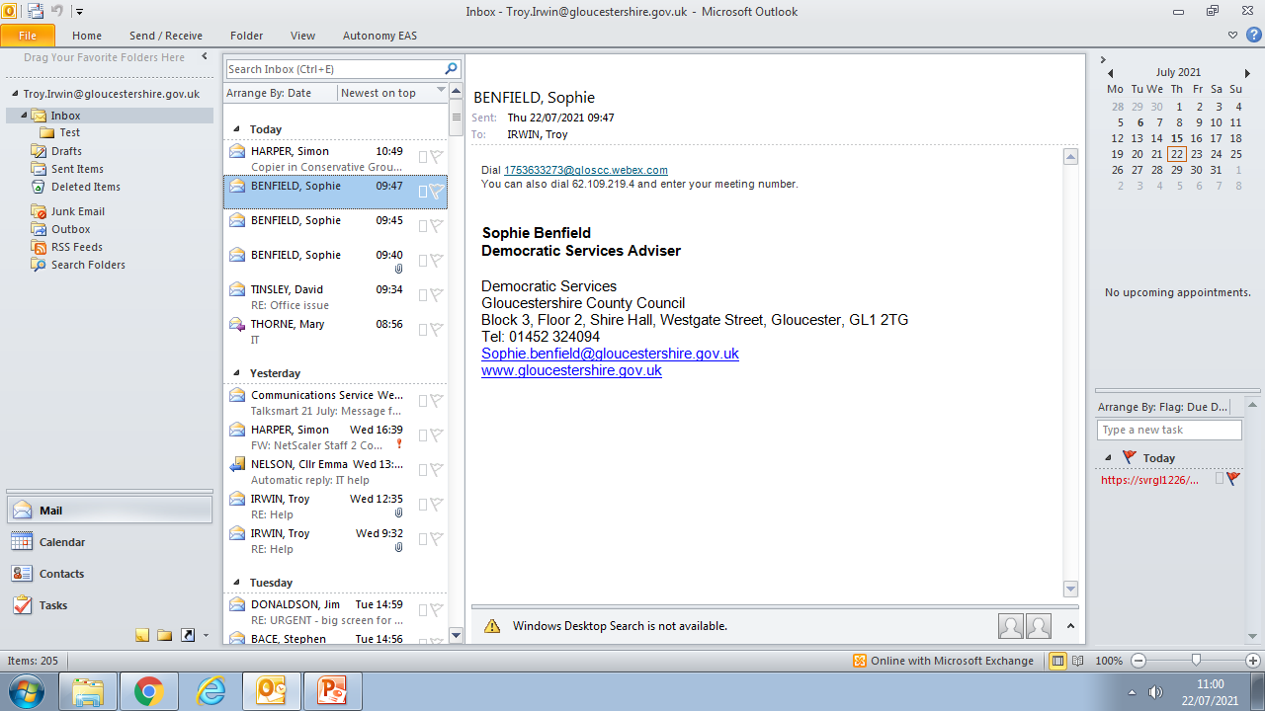
Creating Folders: Outlook
You will now see this new folder under the “Inbox” folder, From here, left click and drag the emails that you would like in to this folder

Slide 17
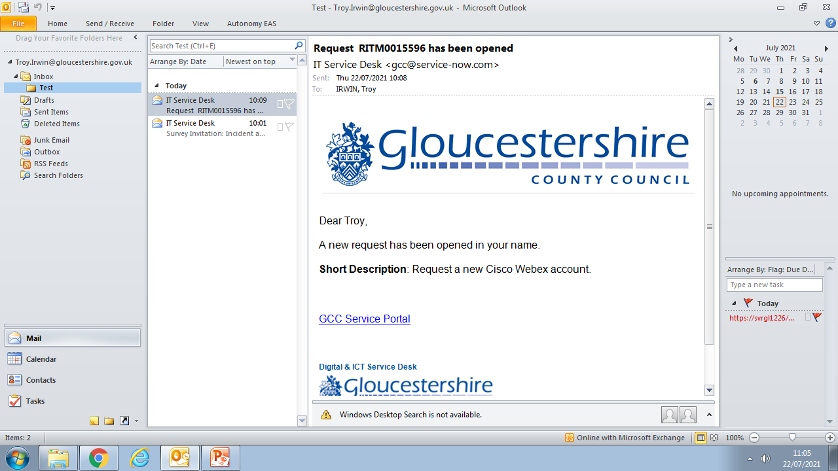
Creating Folders: Outlook
Upon selection of this new folder, you will now see the emails that you dragged here.

Slide 18
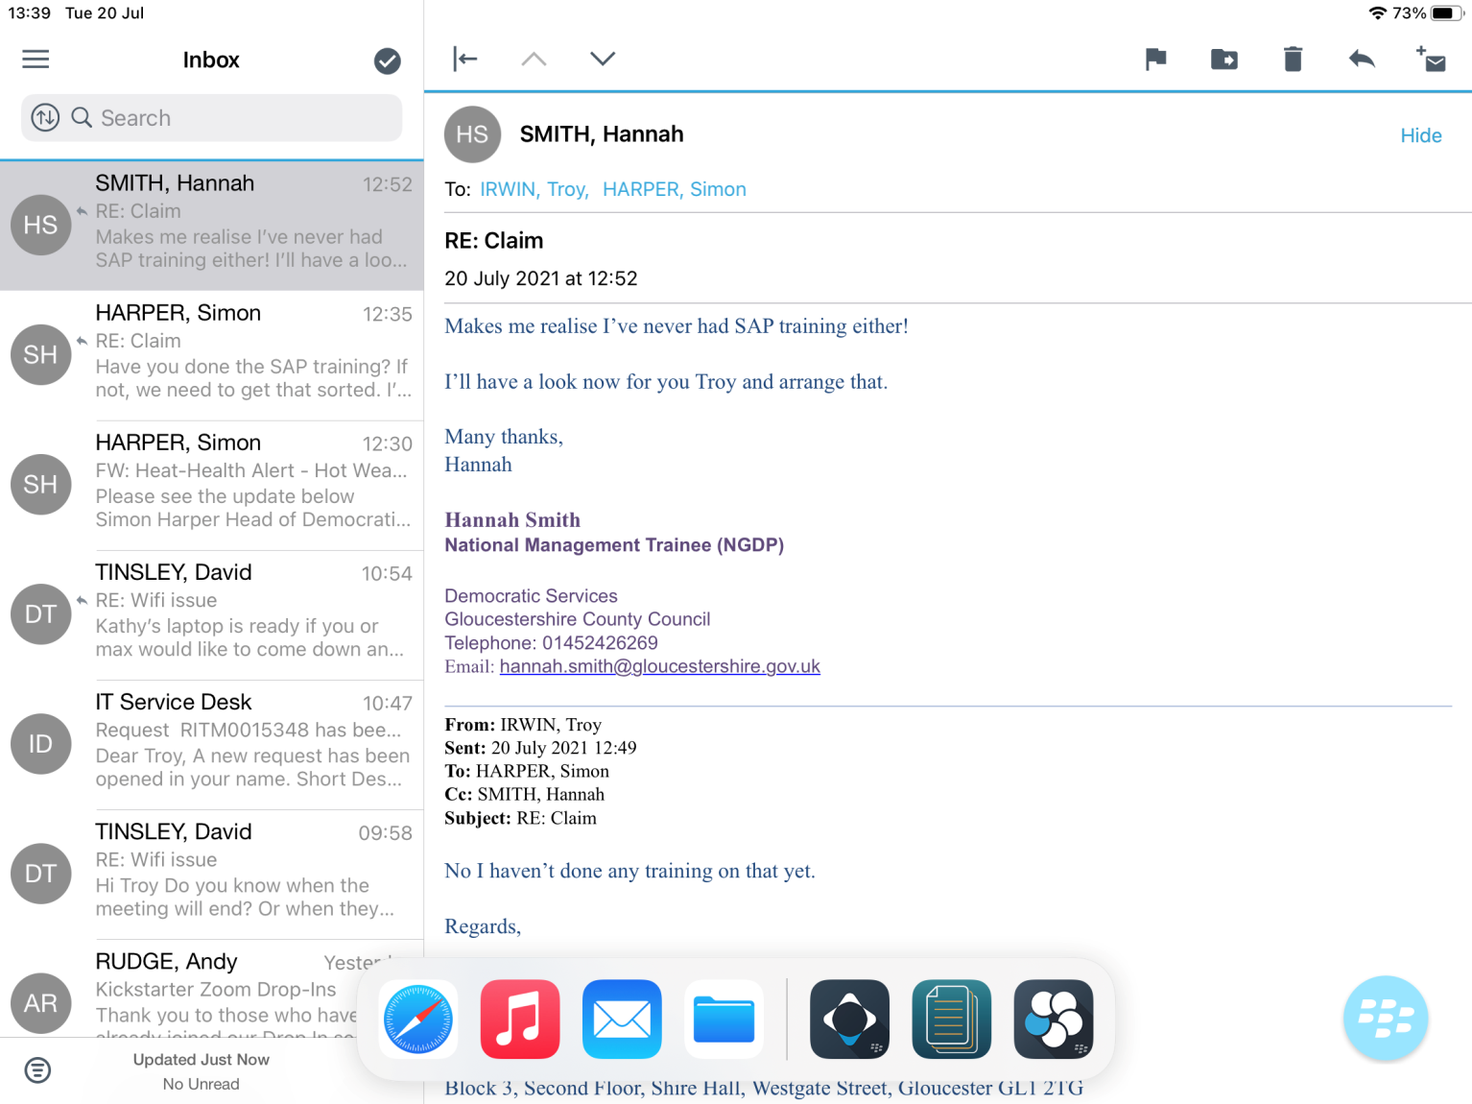
Toggling between Modern.gov and Email
Here you can see the emails on an iPad (information has been censored)
Take your finger/thumb and place it on the very bottom of the screen.
From here swipe your finger/thumb in an upward direction maintaining contact with the screen.

Slide 19
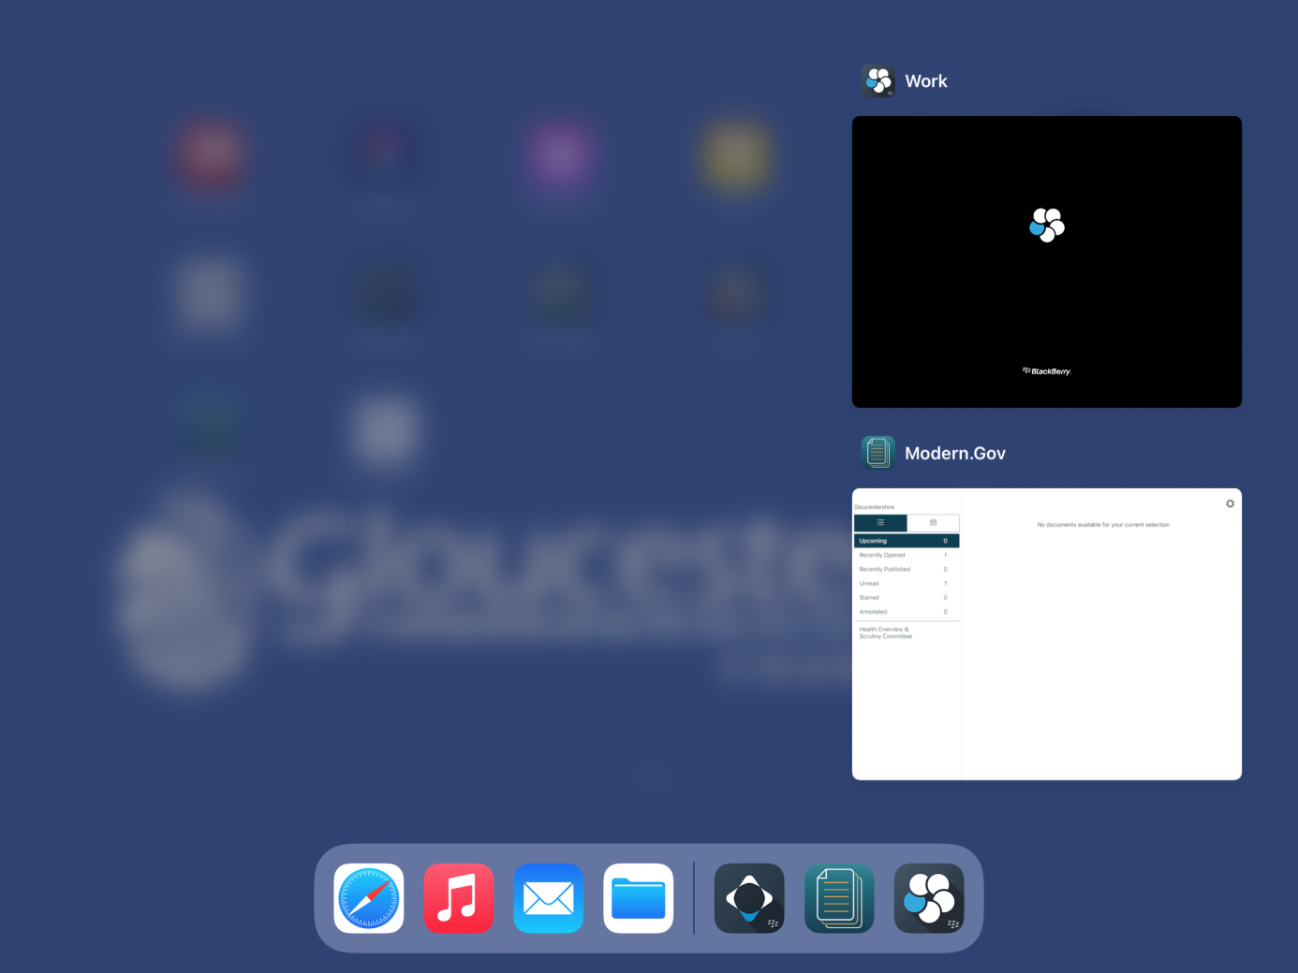
Toggling between Modern.gov and Email
You will then be faced with a screen that looks like this. From here just tap on the Modern.gov tab and it will take you into the app.
This also works in reverse and can be used to switch between any apps that you have open on your iPad.

Slide 20
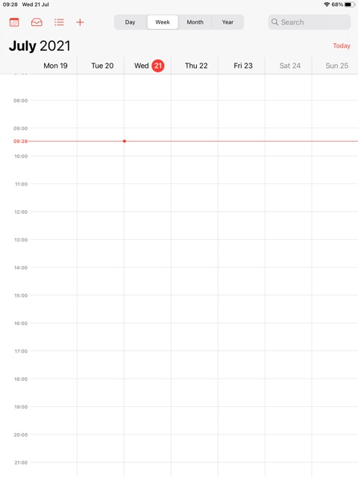
Updating the Calendar
Upon opening the calendar, you will see something like this (it might be different if yours has events in it).
If you would like to add an upcoming event, you will need to press this icon.

Slide 21
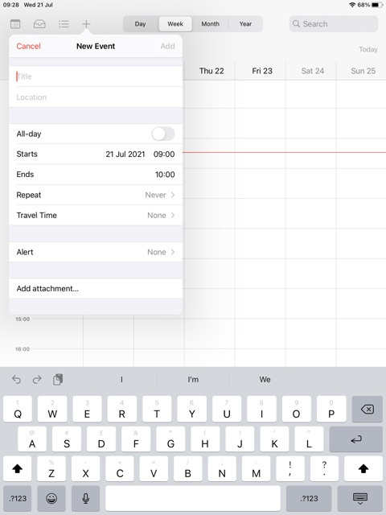
Updating the Calendar
When you have pressed this, a pop up will show asking for the details of the event that is upcoming.
Event name
Location (shire hall or other locations, you can also put the room the event is in here
Start date and time
When it ends

Slide 22
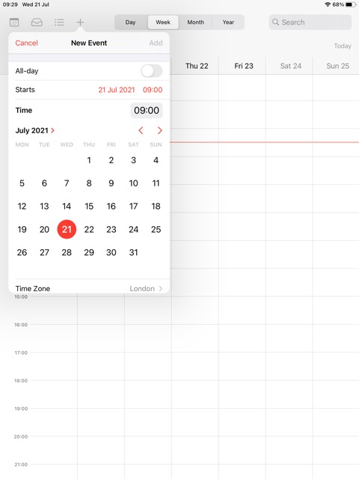
Updating the Calendar
When you select start date and time, the pop up will show this, from here select the date of the event.
You will also need to click on the time and adjust it accordingly

Slide 23
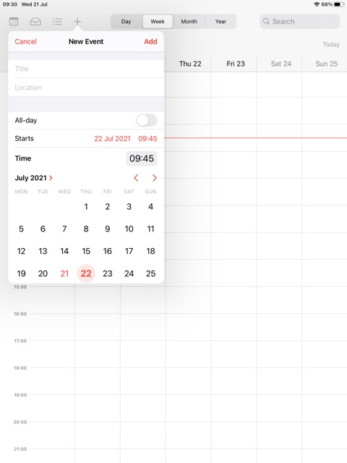
Updating the Calendar
For this example, I have chosen the next day and set the start time to 09:45
When you are happy that you have correctly selected the dates and times of the event, click “Add” too add this to your calendar.

Slide 24
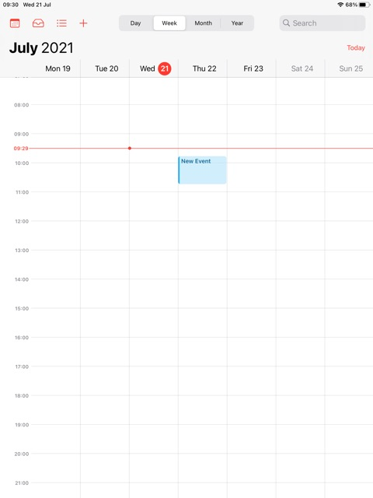
Updating the Calendar
You will now see the event you just made in your calendar

Slide 25
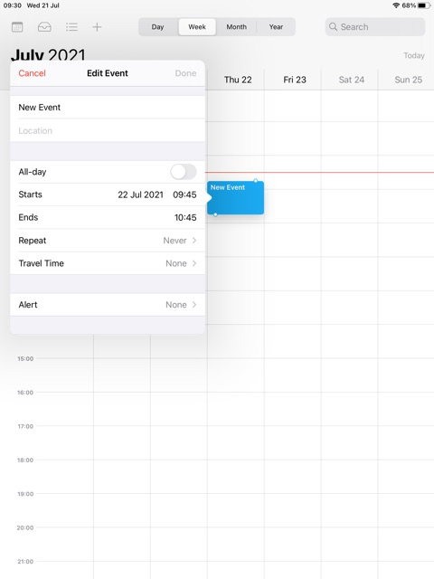
Updating the Calendar
Clicking on this event will bring up a pop up with the meetings information.

Slide 26
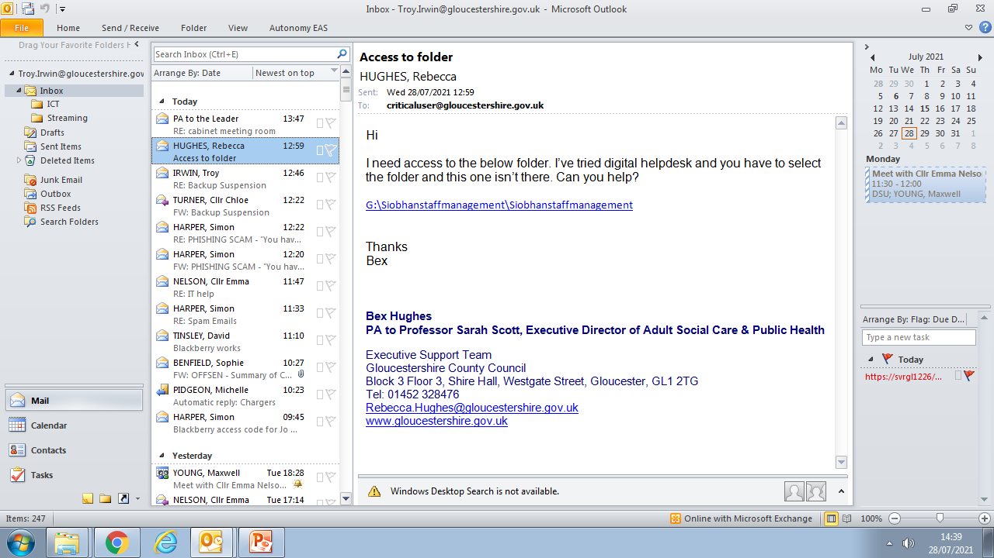
Updating the calendar: adding calendars
On the outlook page, first click on the calendar tab.

Slide 27
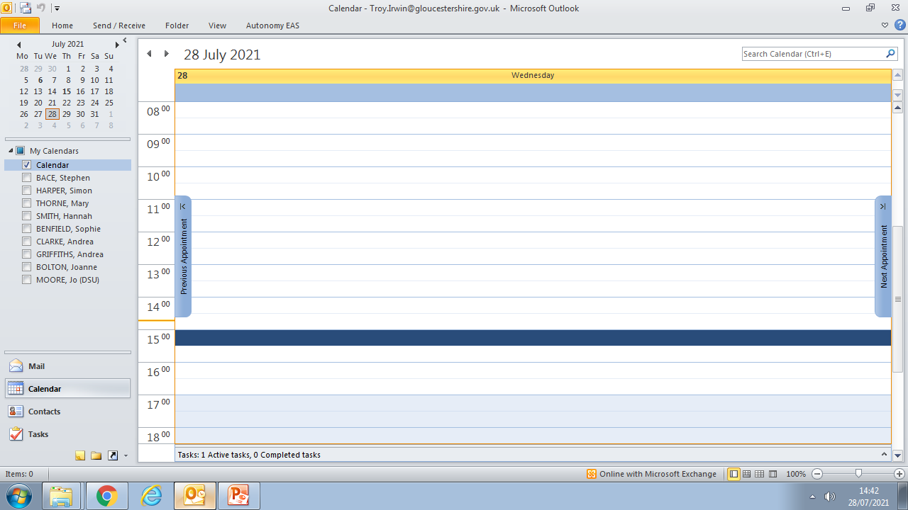
Updating the calendar: adding calendars
You will then be taken to a page like this, ass you can see I have a number of peoples calendars along side mine. To do this, right click on “My Calendars”

Slide 28
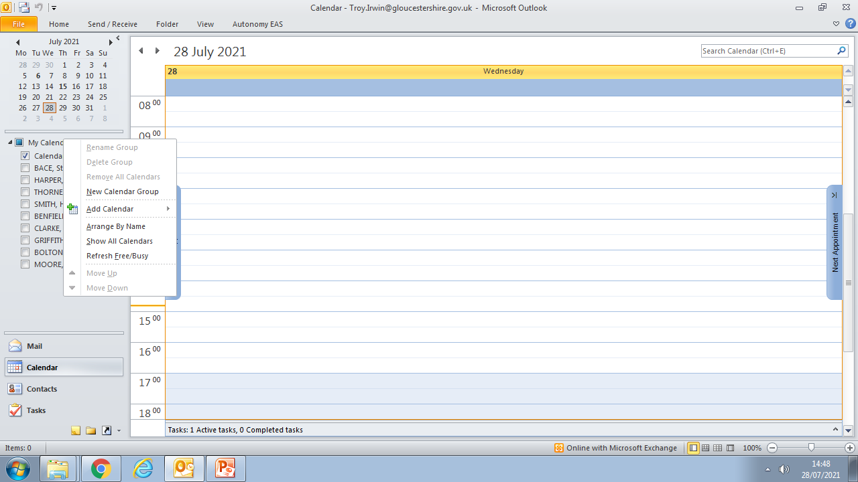
Updating the calendar: adding calendars
Then click “Add Calendar”

Slide 29
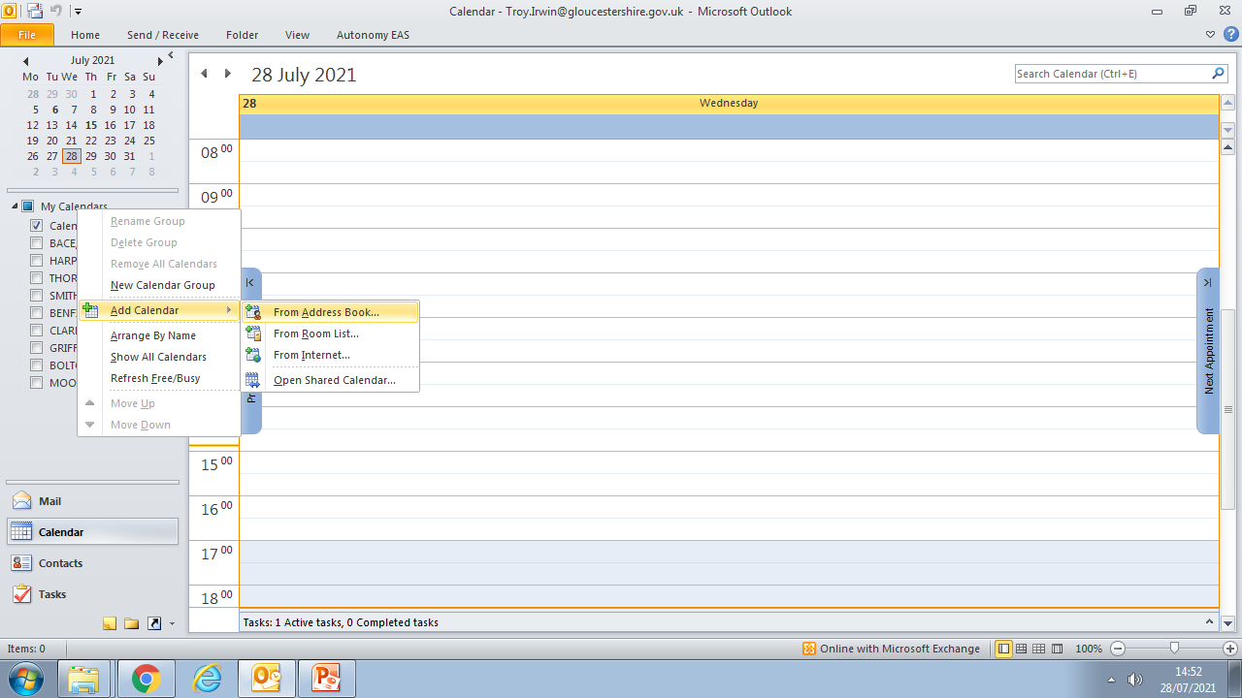
Updating the calendar: adding calendars
Then click “From Address Book”

Slide 30
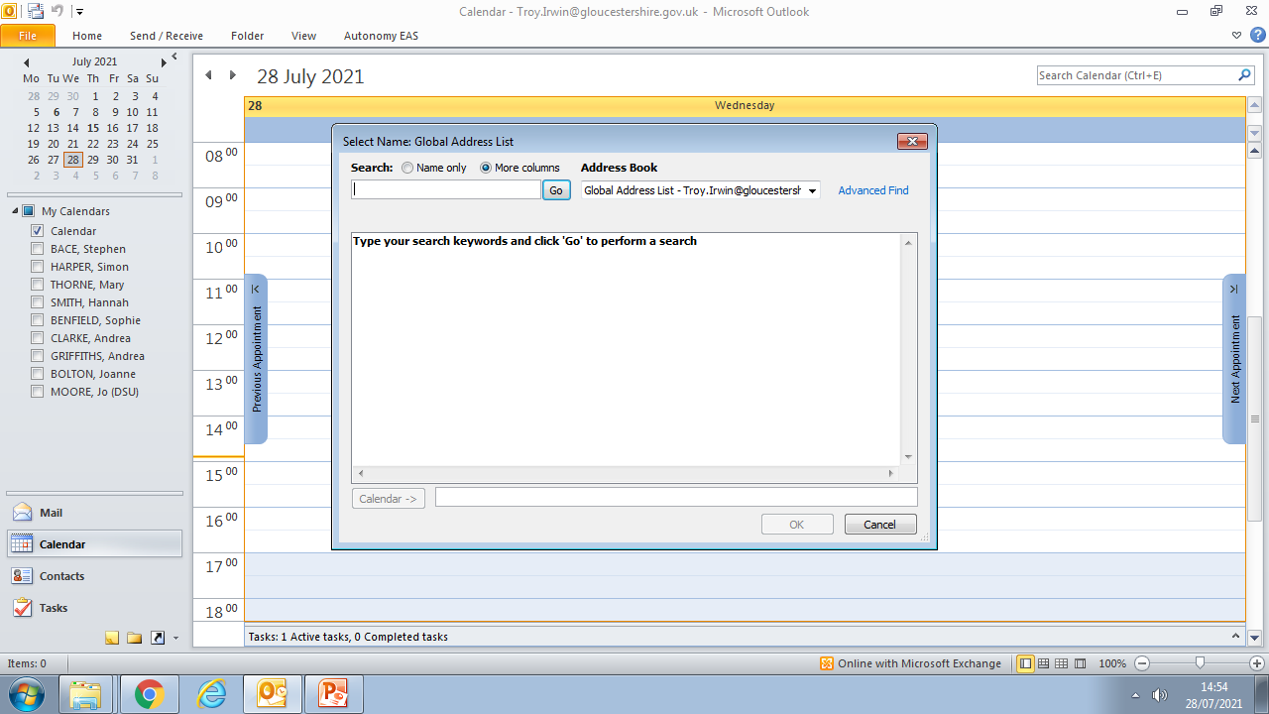
Updating the calendar: adding calendars
You can now search for the individual who’s calendar you wish to access
*NOTE YOU MAY HAVE TO REQUEST ACCESS TO CERTAIN PEOPLE*

Slide 31
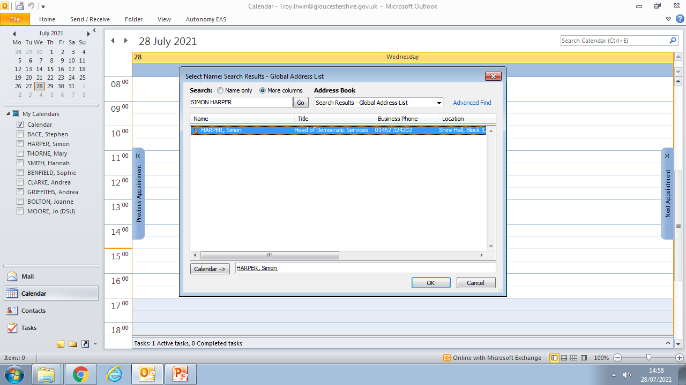
Updating the calendar: adding calendars
Now double left click on this person, make sure you see the name in the bottom bar and click “OK” – I’m using Simon as an example

Slide 32
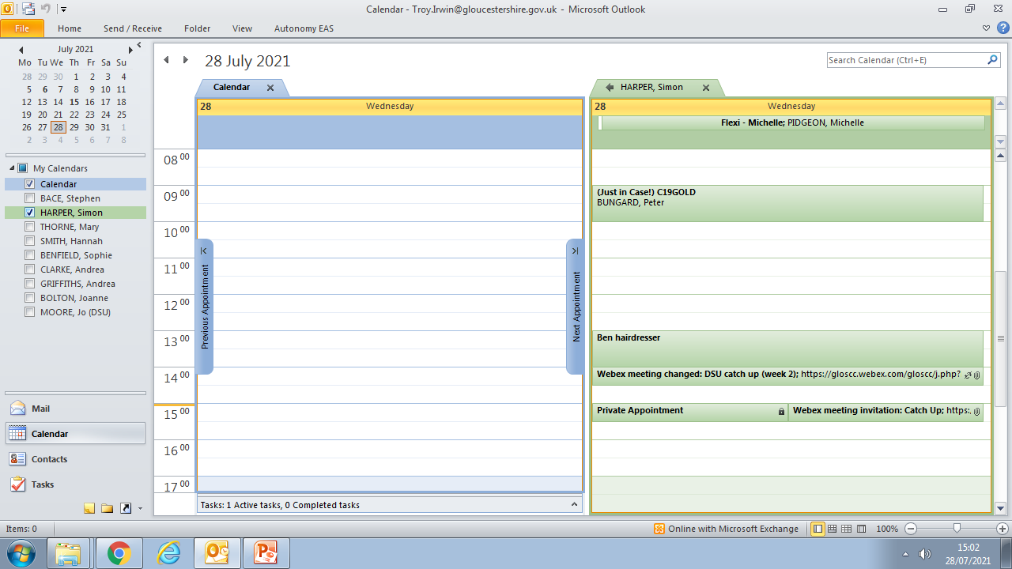
Updating the calendar: adding calendars
You will now be able to see the events this person has in their calendar, you can turn any persons calendar off by unchecking this box

Slide 33
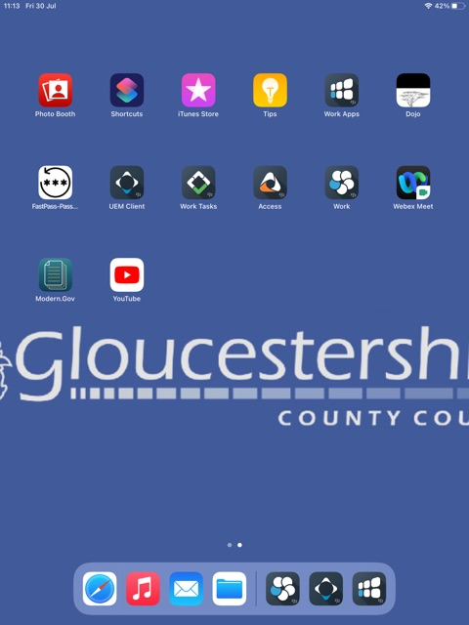
Modern.gov
On the home screen, select Modern.gov. make sure you have “Modern.gov” and not the old application “Mod.gov” if you still have “Mod.gov” please remove this and install “Modern.gov” from work apps.

Slide 34
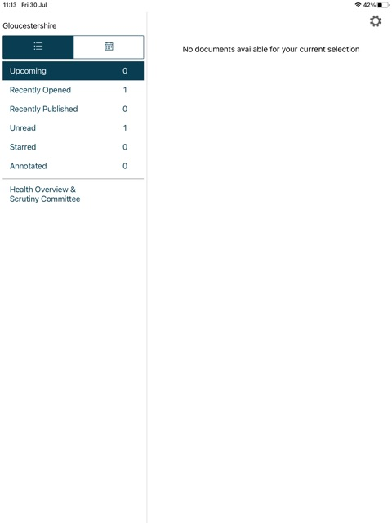
Modern.gov
Upon opening the app, you will be faced with something like this, we are going to select some committees. Click the cog in the top right corner.

Slide 35
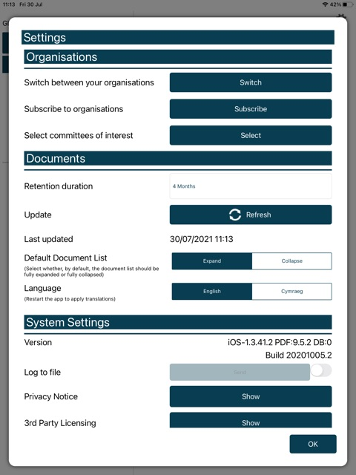
Modern.gov
You will now be faced with a page that looks like this.
Switching organisation will allow you to change between Gloucester, Cheltenham, Stroud etc.
Subscribing is where you can choose which organisations to subscribe to, Gloucester, Cheltenham etc.
Selecting committees is were you can select from your meeting agendas

Slide 36
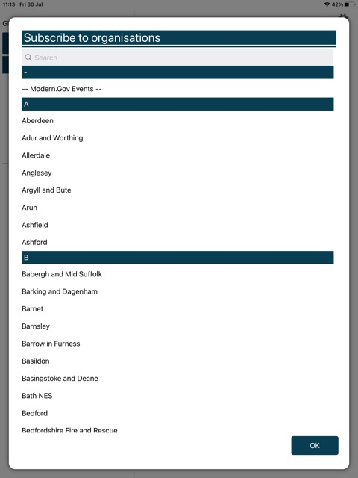
Modern.gov
Upon selection of “Subscribe” you can now choose the areas you wish to subscribe to, you can either scroll to find it or search the first few letters in the bar.

Slide 37
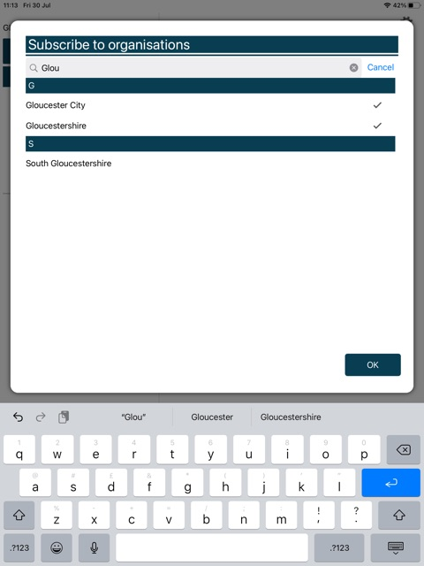
Modern.gov
To select organisation, just tap on the organisations you wish, you can select multiple. You will know when it is selected because there will be a tick on the right hand side. Then select ok when you have the ones you want.

Slide 38
Modern.gov
You will then need to select your committees, to do this, click on the “Select” option

Slide 39
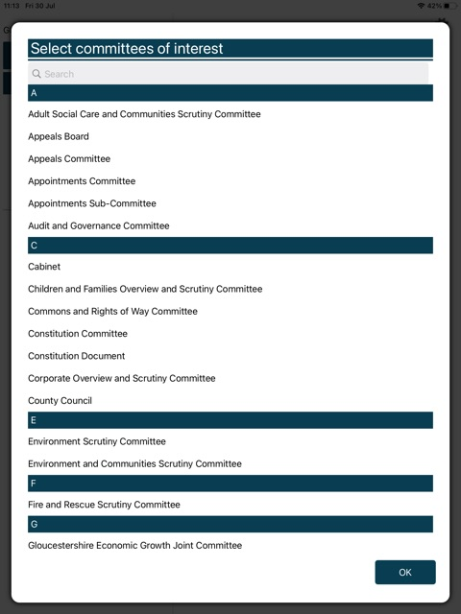
Modern.gov
You will now see all of the committees, once again you can select multiple. You can also search to make selection quicker. Once you have selected the committees of interest select “OK”

Slide 40
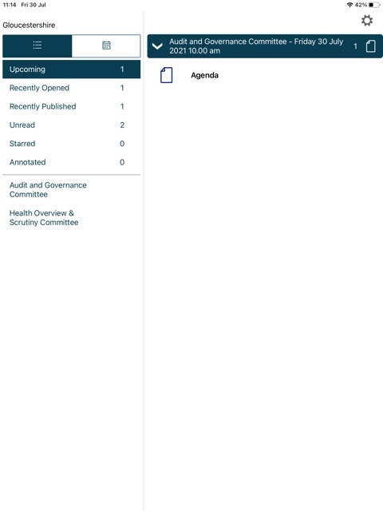
Modern.gov
You will now see your upcoming agendas. When you select the “agenda” all of the information should open.

Slide 41
Further Assistance
If further assistance is required please contact myself - Troy.Irwin@gloucestershire.gov.uk
Or - Maxwell.Young@gloucestershire.gov.uk

