Slide 1
Corporate Parenting
All Councillor Development Session
Gloucestershire County Council
Su Turner LGA Governance Associate
20th and 27th April 2023
www.local.gov.uk

Slide 2
Through the non-exec Councillor lens
All councillors and officers are Corporate Parents
As a ward Councillor you play a valuable role in:
‘Caring for and caring about’ children in care and care leavers
Advocating on behalf of these children and young people to ensure they get the support they need to achieve the best outcomes
Holding services to accounts and challenging any poor practice.
It’s not about knowing the children or where they live - the Ward Councillor’s role is in being the eyes and ears of the community
Today you will explore:
A brief introduction to Corporate Parenting and legislation
The Corporate Parenting Framework – roles and responsibilities
Your role as a Corporate Parent through your different roles
Discuss how you can be a better Corporate Parent

Slide 3
Corporate Parenting
Overview and what good looks like

Slide 4
What is a Corporate Parent?
“a shared responsibility with all officers and members of the local authority to act as effective and caring corporate parents for looked-after children, with key roles in improving their educational attainment, providing stable and high quality placements and proper planning for when they leave care”
DfE 2013, Director and Lead Member for Children’s Services – Roles and Responsibilities
Notes:
Is key to improving the outcomes for children in care;
Must offer everything that a good parent would including stability; but its not about forming personal relationships
Responsible and accountable for the wellbeing and future prospects of children in care;
Must address both the difficulties which children in care experience and the challenges of parenting;
Should ensure that children have a chance to shape and influence the parenting they receive.

Slide 5
Children in Care and Care Leavers
The Children and Social Work Act 2017 says that when a child or young person comes into the care of the local authority, or is under 25 and was looked-after by the authority for at least 13 weeks after their 14th birthday, the authority becomes their corporate parent.
A child remains a looked-after child until:
They return home;
Are adopted;
Turn 18
Council’s are required to support care leavers until 25
Each child has a Care Plan; which is overseen by an Independent Reviewing Officer - who monitors the care plan and challenges the council

Slide 6
Cared for Children (to March 2021)
80,850 children are cared for in England.
56% males, 44% females
Reasons for being looked after:
66% abuse / neglect
22% acute family distress (illness/death/dysfunction)
3% child disability
3% parental illness or disability
5% absent parents
Only 1% are in care because of their own behaviour.
National Statistics 2021 reporting year
Notes:
2022 data:
82,170 children in care in England
Males account for 56% of children, females account for 44%. At 56%, males are slightly over-represented in the CLA population, compared to 51% in the overall child population.
CLA are predominantly older - 10 to 15-year-olds account for 39% of children, 25% were aged 16+ years, 18% aged 5 to 9 years, 14% aged 1 to 4 years and 5% aged less than 1 year.
Children from Black, Mixed and Other ethnic groups were over-represented in the numbers of children in care. Children of White ethnicity account for 73% of children looked after, 10% were Mixed or Multiple ethnic groups, 7% Black, African, Caribbean or Black British, 5% were Asian or Asian British, 4% other ethnicities and ethnicity was not known or not yet recorded for 1%.
as a result of or because they were at risk of abuse or neglect - 54,270 children (66%) - the most common reason identified
primarily due to living in a family where the parenting capacity is chronically inadequate (family dysfunction) - 10,820 (13%)
due to living in a family that is going through a temporary crisis that diminishes the parental capacity to adequately meet some of the children’s needs (family being in acute stress) - 6,070 (7%)
due to there being no parents available to provide for the child - 5,790 (7%)
due to the child’s or parent’s disability or illness - 4,220 (5%)
due to low income or socially unacceptable behaviour – 1,000 (1%)
The largest change since last year has been in ‘Absent parenting’ which has risen by 1,350 compared to last year, likely due to the increase in UASC who are usually looked after due to ‘absent parenting’.

Slide 7
Outcomes for Cared for Children
Nationally:
The outcomes gap for looked-after children:
4 x more likely to have Special Educational needs
9 x more likely to have a Education Health and Care Plan
Large outcome gaps at GCSE, KS2, KS3 and KS4

Slide 8
Key pieces of Legislation & guidance
Children Act 1989
Care Act 2014
Children and Social Work Act 2017 – defined 7 Corporate Parenting Principles
Children and Family Act 2014
Health and Social Care Act 2012
Children and Young Persons Act 2008
Children and Adoption Act 2006
Children Act 2004
Adoption and Children Act 2002
Children (Leaving Care) Act 2000

Slide 9
Key Policy and Guidance
Applying corporate parenting principles to looked-after children and care leavers 2018
Putting Children First: Delivering Our Vision For Excellent Children’s Social Care 2016
Keep on Caring: Supporting Young People from Care to Independence 2016
Children and Young People Plan
NICE Quality Standards
Working Together to Safeguard Children 2018
Safeguarding procedures
Ofsted

Slide 10
Corporate Parenting Principles
The Children and Social Work Act 2017…explains this further with 7 Corporate Parenting Principles
To act in the best interests, and promote the physical and mental health and well- being, of those children and young people
To encourage those children and young people to express their views, wishes and feelings
To take into account the views, wishes and feelings of those children and young people
To help those children and young people gain access to, and make the best use of, services provided by the local authority and its relevant partners
To promote high aspirations, and seek to secure the best outcomes, for those children and young people
For those children and young people to be safe, and for stability in their home lives, relationships and education or work; and
To prepare those children and young people for adulthood and independent living.

Slide 11
Good Corporate Parents?
The Children’s Commissioner tells Children in Care that councils are a good Corporate Parent if they:
Provide stability for children in care;
Give children in care choice;
Plan well for your care;
Take an active role in their lives and care;
Listen and that children feel listened to;
Make children in care feel safe;
Ensure that children in care know their rights;
Ensure that children in care are treated the same;
Show the same level of aspirations and hope for care leavers;
Show that they are ambitious for children in care.
Source: Children’s Commissioner - Young People’s guide to Good Corporate Parents

Slide 12
Ofsted Expectations
Leaders to take corporate parenting very seriously and be highly ambitious for children in care and care leavers.
Senior leaders to have a clear and transformative vision of services to sustainably improve the lives of vulnerable children.
Senior leaders to implement a clear and ambitious vision for all children in care & Care leavers.
Children to be cared for, and cared about.

Slide 13
Signs of effective corporate parenting
Demonstrated a strong cross-party commitment to children in care, by championing their rights, having high aspirations for their achievement, monitoring children’s progress and challenging outcomes;
Clearly understood its role and the responsibilities of the council and partners towards children in care, and planned for and prioritised their needs, resulting in a greater focus on improving outcomes;
Actively engaged with their young people, for example, through the children in care council, and have effective and regular links with senior management and councillors
Notes:
Ofsted observed where CP was good

Slide 14

Gloucestershire's children
864 children in care
69% had a stable long-term home
14% moved 3 or more times in the year
140k children
18.6% of school aged children from minority ethnic groups
12.9% live in poverty
4280 children have a social worker
864 children in care
540 care leavers:
99% in touch
38% NEET
94% Suitable accommodation
(17-21 year olds)
26% OOA 20+
Miles
86%
SDQ
58% boys; 42% girls
47 UASC
11% exit to adoption
12% to SGO
95%
Health assessment
77% white; 4% Asian; 5% Black; 12% mixed ethnicity
69% fostered
21% accommodated;
70% Care Order
From SSDA903 submission 2023
What jumps out that concerns you?
Notes:
Abbreviations –
OOA = children living out of area;
SDQ = Strengths and Difficulties Questionnaire
UASC = unaccompanied asylum seeking child (sometimes termed, unaccompanied and separated child)
SGO = Special Guardianship Order
The number of children in care on 31st March has risen in each of the past nine-years. The increase in 2022/23 was from 840 in the previous year to 864, a difference of 24 children and 3%. The increase in the previous year was 7%. The number of children entering care declined by 12% and the number of children leaving care 3%.
The rate of children in care at the end of 2022/23 increased from 65 in the previous year to 68, compared to 70 for England and an average of 60 for Gloucestershire's Statistical Neighbours (SNs) in the previous year.
Looking at the characteristics of children in care at the end of the year, 58% were boys, compared to 57% at the end of the previous year. 77% of children were white, 4% were Asian (compared to 2.5% the previous year), 5% were Black and 12% were of Mixed ethnicity.
The proportion of children in care at the end of 2022/23 whose legal status was Accommodated (Section 20) was in line with the previous year, at 21% compared to 20%, and remains higher than the England figure of 17%.
The proportion of children on care orders was also in line with the previous year, at 70% compared to 71%, and remains lower than the England figure of 79%. The number of interim care orders decreased by 11% and the number of full care orders rose by 5%.
Factors affecting this include the age at which children enter care, as older children may be more likely to remain Accommodated rather than becoming subject to care orders, and the number of unaccompanied asylum seeking children in the authority, as these will remain Accommodated.
The proportion of children in care at the end of 2022/23 who were placed in foster care is in line with the England figure (Gloucestershire 69%, England 70%) of which 69% are fostered with LA carers. The number of children placed in foster care outside the authority (excluding family and friends carers) increased slightly from 101 children in 2021/22 to 105 in 2022/23.
The number of children placed in children's homes increased from 89 to 99 in 2022/23, a rise of 11%. The proportion of children placed with their parents decreased from 4% to 3%. The proportion of children in supported living (code H5) increased from 10% (89 children) to 11% (99 children) in 2022/23 compared with 7% nationally the previous year.
The proportion of children in care recorded as in long-term foster placements rose from 27% to 31%. The DfE requires an explanation or comment on this because it is not in the range 40% to 60%.
The proportion of children leaving care who were adopted rose slightly from 10%, 32 children, in 2021/22 to 11%, 34 children, in 2022/23; this is in line with the England figure of 10%. The proportion of children leaving care on Special Guardianship Orders fell from 46 in the previous year (15% of children leaving care) to 35 (12%). This is just below the England figure of 13%.
Short-term stability of placements (three or more placements in the year) was 14%, slightly higher than the previous year, when it was 13%, though remains above England (10%) and statistical neighbours (10%).
Long-term stability was similar to the previous year at 69% (68% in the previous year); England and SN are both 71%.
The percentage of children for whom carers completed Strengths and Difficulties Questionnaires rose this year from 79% to 87%, in line with the national figure of 80%. The average SDQ score was 14.0, up very slightly from 13.7 in the previous year. The national and SN scores are 13.8 and 15.8 respectively.
The proportion of children and young people who offended halved this year from 4% (14 young people) to 2% (7 young people). Both the national and SN figures were also 2%.
Performance on health assessments increased significantly from 86% to 95%. This may be partly because Health checked the records before submission, which they have not agreed to do in previous years. England was 89% in 2021/22 and SNs were 83%. Dental checks remained at 83%. SN for last year was 60% and England 70%. Immunisations increased from 88% to 91% (England 85%, SNs 70%).
The proportion of care leavers aged 17-21 in touch with the local authority was 99%, compared to 98% in the previous year; the England figure for young people aged 19-21 (so a slightly different cohort) is 93%. The proportion of care leavers aged 17-21 who were not in employment, education and training decreased from 40% to 38%. The England and SN figures for 2021/22 for young people aged 19-21 were both 38%. The proportion of care leavers aged 17-21 who were in suitable accommodation was 94%, increased from 92% and is above average compared to England and SN for the 19-21 group (England 88%, SN 86%).
47 UASC up from 30 last year – needs to more than double to meet the NTS responsibilities

Slide 15
Gloucestershire's children
Ofsted 2022:
The experience and progress of children in care and care leavers requires improvement to be good
Relevant recommendations:
The suitability of accommodation for care leavers to meet their needs, including to feel safe.
The timeliness with which personal advisers are allocated to children, to best support their transition into adulthood.
Regular reports to Council, Council Motion, Corporate Parenting Strategy

Slide 16
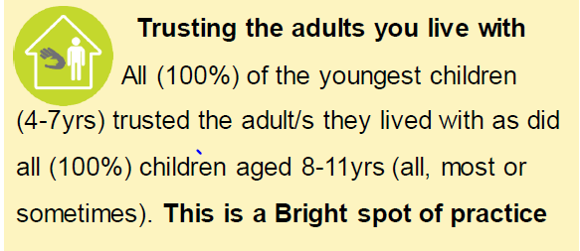
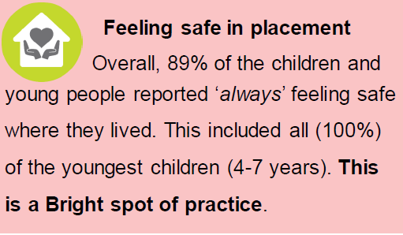
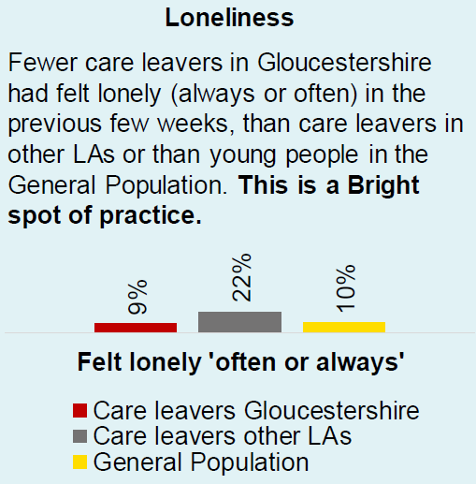
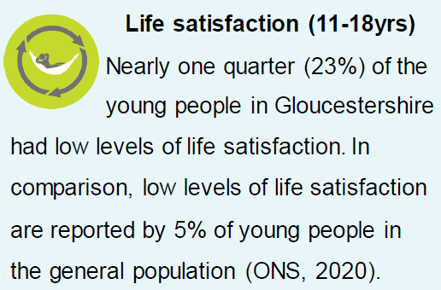
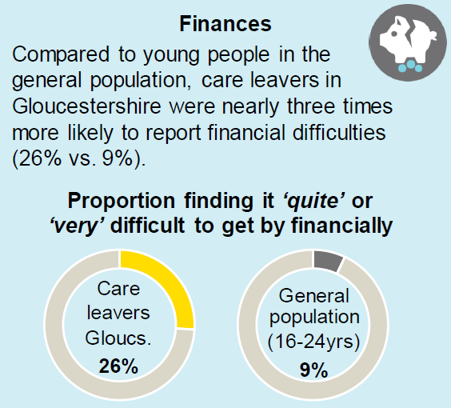
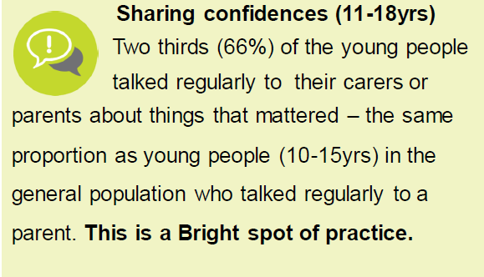
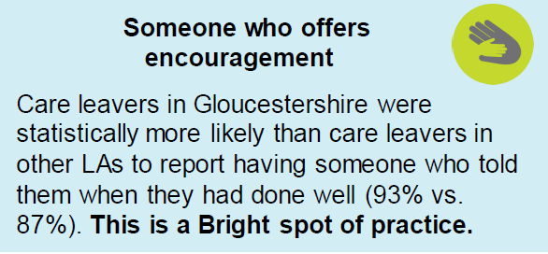
Children and young people’s views
Bright spots survey 2022:
Notes:
One of many ways that children’s views are captured
96% contribute to their review
Also Ambassadors… Big Conversation, Language that Cares, interview, scrutiny, cpg
Mind of my own.
Forums.
Think abut children OOA.

Slide 17
Corporate Parenting
Framework, roles and responsibilities

Slide 18
Everyone’s role
A Council cannot be a good Corporate Parent on its own!
Councillors, Officers and Partners
Corporate Parenting Board
Overview and Scrutiny
Children in Care Council
Frontline roles: Social Workers, Virtual school head, Independent reviewing officer

Slide 19
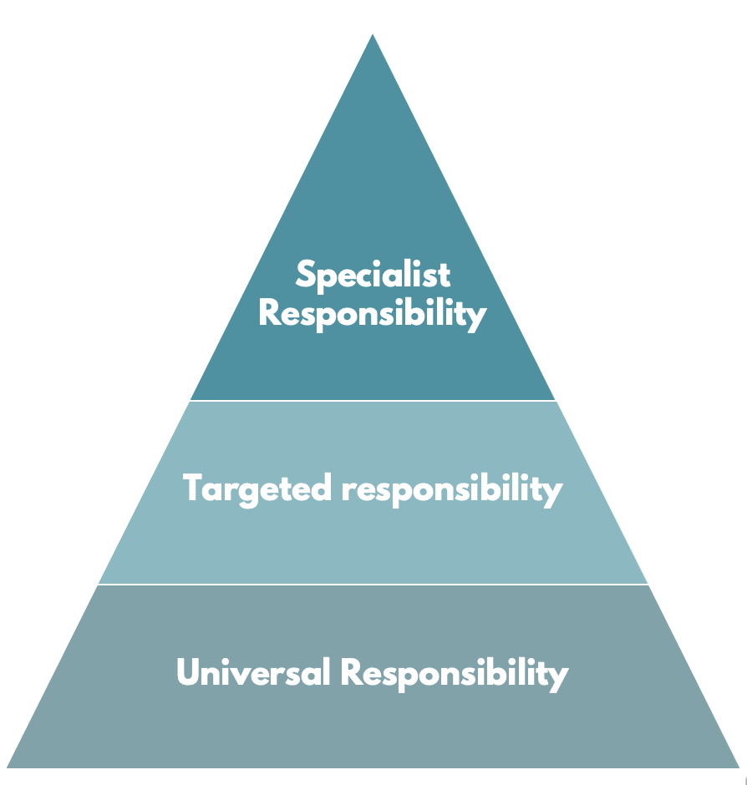

The Corporate Parent – all Councillors and officers
All should:
Understand why children need to be looked after and the legislation that enshrines this;
Understand the governance arrangements for Corporate Parenting;
Be aware of profile and needs of children in care in the authority;
Understand the impact of council decisions on children in care and care leavers;
Be aware of the Pledge, your promises to children and your priorities;
Receive information about quality of care and services for children in care and care leavers;
Champion the needs of children in care and care leavers in their area, ensuring other councillors act as corporate parents
Constantly ask – would it be good enough for my child?

Slide 20
Specialist roles: DCS and Lead Member
Both statutory appointments made by every upper tier local authority under the Children Act 2004
Lead Member for Children’s Services
The LM has delegated statutory responsibility from the Council for local children, young people and families.
Specialist Responsibility
Director of Children’s Services
The senior professional responsible for the operation of children’s services (directly accountable to the Chief Executive).
Targeted responsibility
Universal Responsibility
Notes:
Politically and professionally responsible – should work together to provide strong strategic leadership

Slide 21





Targeted roles…
Cabinet and Executive Councillors
Executive councillors key decision makers for council and community
Corporate Parenting Board
Champion the corporate parenting role across the authority and partners
Scrutiny Councillors and Committees
Champion the corporate parenting role across the authority and partners
Management Team and Senior Officers
Sets the tone of how directorates view the importance of Corporate Parenting
Partners
Children Act 2004, Councils have a duty to promote ‘cooperation’ between ‘relevant partners’, such as Police, the NHS and Education Providers
Notes:
Partners
NHS and healthcare commissioning and provider organisations
Education, schools and governors
Mental health providers
Police and Crime Commissioners
Local Safeguarding arrangements
Children and Family Court Advisory and Support Service (CAFCASS)
Youth Justice
Housing
Adult health and social care

Slide 22
Ann James
Director of Children’s Services
Kirsten Harrison
Director of Education
Paul Shallcross
Director for Safeguarding and Care
Rob England
Assistant Director for Children’s Integrated Commissioning
Andy Dempsey
Director for Strategy and Partnerships
Jane Featherstone
Head of the Virtual School
Amanda Henderson
Head of SEND
Clare Dudman
Head of
Tammy Wheatley
Head of Fostering and Under 11 Children in Care
Mark Bone / Vanessa Catterall
2 x HOS for 11-25 Teams
Caroline Spamer
Head of Placement Commissioning
Jess Glenn
Head of Service
Wendy Gray
Head of Service
RT, KG, JM, NA, JC
5 X district safeguarding HOS
Claire Connolly
Head of Children’s Single Point of Access
Phil Haslett
Head of School Inclusion
Claire Lawton
Head of Quality and Performance
Emma Trigwell
Head of Early Help
Dave Jones
GSCP Business Manager
Sue Hall
Head of DCYPS
Dan Gillingham
Head of Service
Claire Medland
Head of Ed Planning and Infrastructure
Responsibilities to children in and leaving care
Solely responsible to children in and leaving care

Slide 23
Corporate Parent Board
Provides the strategic leadership that drives an ambitious and multi-agency approach to improving outcomes for CiC and CL.
Champions the role of the Corporate Parent – to all councillors, officers and partners.
Works as a board to overcome any barriers to improving outcomes for children in care and care leavers.
Understands the needs of children in care and care leavers, and
Produces a strategy for the improvements needed;
Develops a ‘pledge or promise’ detailing how they will care for and care about them.
Monitors how well the strategy is being implemented and how well services perform
Principle role is leadership

Slide 24
Corporate Parenting Strategy
Should be driven by the CPB, and the strategy should be owned and delivered by all partners. A strategy should:
Listens to the voice of the child
Developing an informed view of council / partner provision and services through a programme of well-planned events and feedback from Board members
Celebrate the successes of children in care and care leavers
Setting higher expectations for children, young people and care leavers
Seek to improve long-term outcomes for all children in care
Ensuring their happiness, wellbeing, educational success and future prospects

Slide 25
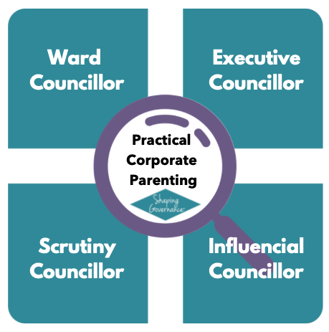
© Insight to Impact Consulting Ltd 2017-2023

Slide 26
Ward Councillors
It’s not about knowing the children or where they live - a Ward Councillor’s role is in being the eyes and ears of the community
Try to understand the issues and challenges facing children in care;
Make sure social workers and foster carers know how to contact you;
Understand what provision is available for foster carers, such as housing;
Promote community understanding and promote fostering;
Understand youth service provision in your ward, taking an interest;
Are there any children’s homes in your ward?;
Know what events and celebrations take place that you can attend;
Monitor and challenge council policy and the impact on children in care;
Constantly asks ‘would this be good enough for my own child?’
Adapted from Insight to Impact Consulting Ltd Practical Corporate Parenting Programme

Slide 27
Executive Councillors
Most decisions that a council makes will have some impact on Children in Care and Care Leavers.
Consider the opportunities for prioritising the needs of children in care and care leavers within the services in your portfolio;
Consider whether the decisions you take have an impact on children in care and care leavers, and ensure appropriate steps are taken to mitigate any adverse effects;
Regularly review whether your decisions did have an impact on them;
Ensure that Cabinet / Executive considers issues affecting children holistically, particularly links between children’s services, leisure, transport, housing policies and any other relevant areas of work
Constantly asks ‘would this be good enough for my own child?’
Adapted from Insight to Impact Consulting Ltd Practical Corporate Parenting Programme

Slide 28
Scrutiny Councillors
All Scrutiny Committees should consider the impact of their work on children in care and care leavers in their work not just the Children’s Scrutiny Committee
How does the work of your scrutiny committee impact on children in care and care leavers
Ensure that the reports you receive have assessed the impact of decisions on children in care and care leavers
Hold the executive to account not just officers
If you’re on children’s scrutiny – how does your work complement that of the Corporate Parenting Board – don’t duplicate
Constantly asks ‘would this be good enough for my own child?
Adapted from Insight to Impact Consulting Ltd Practical Corporate Parenting Programme

Slide 29
Influencial Councillor
As a Councillor you will have strong links to many partners, community groups and charities on your patch. You could:
Sit on a Housing Association Board;
Champion a local youth group – being the voice and champion of children in care;
What opportunities are there to strengthen your partnerships?
If you are involved in groups that provide services for children, are they accessible to children in care?
Do Housing Associations provide suitable stable accommodation?
What more can we do to support children in care?
Constantly asks ‘would this be good enough for my own child?’
Adapted from Insight to Impact Consulting Ltd Practical Corporate Parenting Programme

Slide 30
School Governor
All children in care attend school and deserve a good education. The Virtual School Head oversees this, but as a governor you could:
Find out which member of staff has designated responsibility for the wellbeing of looked after children at your school;
Understand whether there are children in care in your school;
Ensure that the school has high aspirations for looked after children - what strategies there are to support them to do as well as other children;
Is there a gap in performance?
Find out about the statutory obligations of schools towards their looked after children, and is your school meeting these
Ask about training for school staff; is there a good understanding amongst teaching and pastoral staff of the particular issues that looked after children?
Receive regular reports at your board meetings on looked after children and challenge school performance
Ask about the careers advice provided and employment/ work experience
Constantly asks ‘would this be good enough for my own child?’
Adapted from Insight to Impact Consulting Ltd Practical Corporate Parenting Programme

Slide 31
Summary
Being a Corporate Parent is the most important role of a councillor
It’s not about knowing who the children are; but championing their needs in your work;
Legal framework - but a moral duty too to ‘care for’ and ‘care about’ children in care and care leavers;
Think of it as being like a corporate Grandparent caring, one step removed;
Corporate Parenting is a role for all and importantly all of the time
Use your different councillor ‘hats’ to help to improve outcomes for children in care and care leavers
In all you do – constantly ask ‘would it be good enough for your own child?’

Slide 32



LGA Training and resources
Leadership Essentials 2 day courses for councillors providing learning and networking opportunities on specific themes, including Scrutiny and Children’s Services https://local.gov.uk/our-support/highlighting-political-leadership/leadership-essentials
E-Lerning – coming soon
Courses
Corporate Parenting Resource Pack
Your first ten days as a lead member for children's services Includes a glossary of key terms.
LG Inform: benchmarking and data reports generated for your area
Must Know for Lead Members of Children’s Services
LGA Children and young people policy pages
Resources
Peer
mentoring
Peer mentoring for CPB Chairs from an experienced children’s services lead member or scrutiny chair.
Notes:
The following resources can be found on the LGA website:
Your first ten days as a lead member for children's services . Includes a glossary of key terms.
LG Inform: User friendly data reports for your area, comparisons with other areas and nationally.
Must Know for Lead Members of Children’s Services
LGA Children and young people policy pages

