Slide 1
One Gloucestershire’s approach to tackling health inequalities
September 2024
Notes:
The Gloucestershire Health Inequalities Framework was developed by Integrated Care System (ICS) health inequalities leads, and sets out our approach to addressing health inequalities across the One Gloucestershire system. The Framework was adopted by the Integrated Care Board (ICB) Board in February 2024 with the aim of systemising local action to ensure we have the best collective impact on tackling health inequalities in the county. It sets out a simple approach to help us to organise the work we’re doing to tackle health inequalities, to understand the types of activity that are taking place, and the contribution that different parts of the system are making to overall outcomes over time.
We are now launching the Framework, alongside a Strategic Planning and Review Template, which asks system organisations (the ICB, Gloucestershire County Council, Gloucestershire Health and Care NHS Foundation Trust, and Gloucestershire Hospitals NHS Foundation Trust) and partnerships (Clinical Programme Groups, and Integrated Locality Partnerships) who have a statutory duty around health inequalities, to set down their high level commitments towards reducing health inequalities over the forthcoming year or so. This aims to help organisations and partnerships to prioritise those activities that will enable them to best contribute to the wider system's collective efforts to impact on our shared health inequalities outcomes.

Slide 2
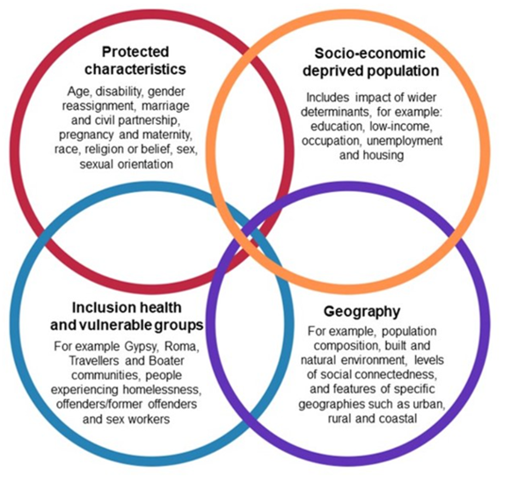
What are health inequalities?
Health inequalities are differences in health status, access to care, treatment, and outcomes between individuals and across populations that are systematic, avoidable, predictable, and unjust.
Inequalities in what?
Experience and quality of care
Access to care
Outcomes
Behaviours
Social conditions
Inequalities between whom?
Protected characteristics
Socio-economic groups
Inclusion groups
Geography
Notes:
Health equity is realised when every individual has a fair opportunity to achieve their full health potential. Differences in health status, access to care, treatment, and outcomes between individuals and across populations that are systemic, avoidable, predictable, and unjust are often referred to as health inequalities (or disparities). These differences occur between people or groups due to social, geographical, biological, or other factors. These differences result in people who are worst off missing out on life chances, experiencing poorer health and having shorter lives.
Inequalities in what?
Experience and quality of care (e.g. patient satisfaction)
Access to care (e.g. availability or location of a service)
Outcomes (e.g. life expectancy, heart disease)
Behaviours (smoking, alcohol use)
Social conditions (e.g. housing, environment)
Inequalities between whom?
Protected characteristics (e.g. sex, disability, ethnicity)
Socio-economic groups (e.g. income or multiple deprivation)
Inclusion groups (e.g. Gypsy Roma traveller, homeless)
Geography (e.g. districts, wards, PCN boundaries)
There are a multitude of inequalities; people experience different combinations of these; as individuals we are not defined by a single characteristic – this is illustrated by the overlapping circles which is the overlapping dimensions of health inequalities. Factors can also interact and the effects of those interactions on health are unique to each individual.
See also: https://www.kingsfund.org.uk/insight-and-analysis/long-reads/what-are-health-inequalities

Slide 3
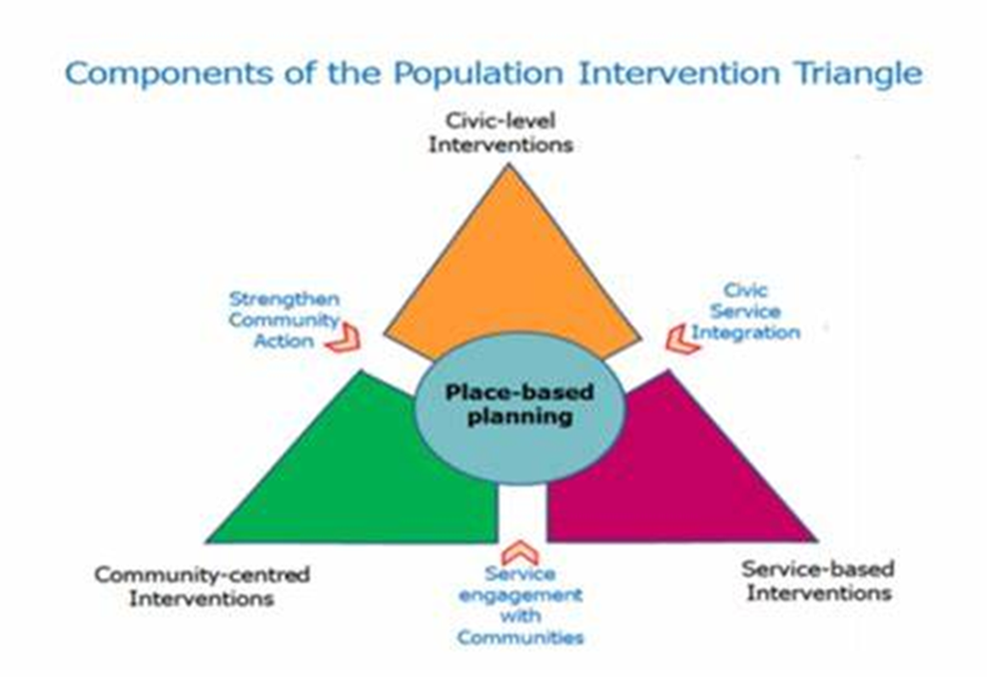
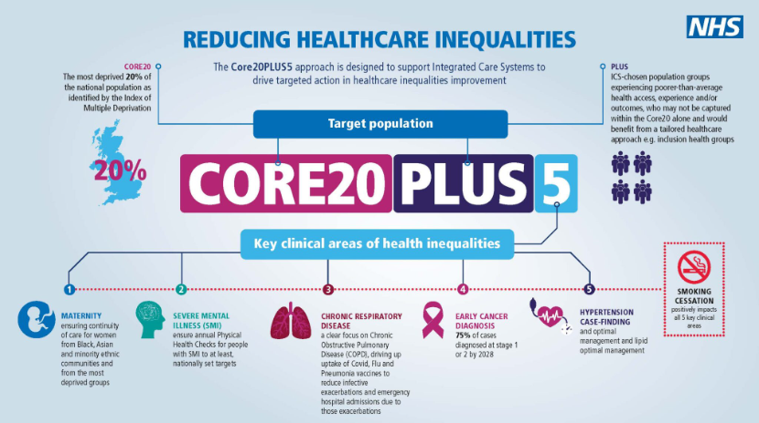
Tackling health inequalities in Gloucestershire: our commitments
Tackling inequalities in outcomes, experience and access, and working towards health equity is one of the fundamental purposes of Integrated Care Systems.
Achieving health equity runs through organisational visions, values and objectives, and filters down into policies, procedures and business as usual.
Our strategies:
One Gloucestershire ICS Interim Integrated Care Strategy December 2022
One Gloucestershire Operational Plan 2023-24
One Gloucestershire Joint Forward Plan 2023-28
Gloucestershire Joint Health and Wellbeing Strategy 2019-2030
Our system commitments:
Improve outcomes in population health and healthcare.
Tackle inequalities in outcomes, experience and access.
Enhance productivity and value for money, and
Help the NHS support broader social and economic development.
Notes:
The ICS has multiple clinical and prevention programmes operating across the Clinical Programme Approach, Partnership Boards and Enabling Active Communities and Individuals' portfolios.
Across all of the core strategies driving the work we do in Gloucestershire there are commitments to prioritising prevention and achieving health equity.
Not going to detail these for this well-informed audience – but these slides are available for positioning the approach and framework to stakeholders.
The population intervention triangle – gives a place focus where the ILPs fit in helps us to understand our place-based role in tackling HI.
The Core20PLUS5 framework - designed to support Integrated Care Systems to drive targeted action in healthcare inequalities improvement – it underpins One Gloucestershire’s approach to addressing Health Inequalities with a focus on place (31 LSOAs); people (ethnicity); and condition/ health need. [The ‘5’ represents 5 clinical priority areas that have been identified to have the greatest impact on Health Inequalities].
One Gloucestershire ICS Interim Integrated Care Strategy December 2022
Achieving equity is one of the three overarching pillars of the Strategy; however prioritising prevention and achieving health equity runs as a golden thread through the strategy and across all three pillars.
One Gloucestershire Operational Plan 24-25 AND Joint Forward Plan 2023-28
Consider how the ICS will continue to narrow health inequalities in access, outcomes, and experience while recovering core services and productivity.
Gloucestershire Joint Health and Wellbeing Strategy 2019-2030
Sets out how the Local Authority and ICB will work together to understand the health and wellbeing needs of the local community and agrees joint priorities for addressing these needs to improve health and wellbeing outcomes and reduce inequalities. Importance of developing a shared understanding and commitment to addressing the wider determinants of health and wellbeing.

Slide 4
A framework for tackling health inequalities in Gloucestershire
A. Contributory activity
B. Targeted interventions to improve health & remove barriers
C. Improving the equity of mainstream service delivery
1. Community building & development
2. VCS infrastructure & support
3. Engagement with communities (inclusion groups & places)
4. Universal offers to create health
5. Creating social value (including health providers as Anchor Institutions)
1. Projects to target health creation for specific groups/places.
2. Projects to support specific groups/places over medium to longer term.
3. Initiatives to promote access to existing services to address identified barriers to entry.
4. Focus on Integrated Care Strategy exemplar themes.
1. Data collection and quality
2. Data analysis
3. Adjustments/redesign of service delivery to recognise inequalities e.g. digital inclusion and quality improvement
4. Adjustments to decision-making process.
5. Workforce development and capacity building
Using data to better target interventions (e.g. through population health management approaches); understanding & evaluating impact – what is working, where and with whom?
Notes:
The HI framework is an attempt to bring some of the ‘how’ together a bit differently by setting out a simple framework to help us organise ourselves – to understand the different types of activity on HI and the contribution different parts of the system are making.
Being referred to as ‘ ‘themes’.
Each theme has a number of sub-categories.
Theme A: Contributory activity – things we need to have in place in the system because they underpin and make a fundamental contribution to improving equity. Refers to HOW we do things – our ways of working. However, we can’t necessarily directly attribute outcomes to these activities. Many of the activities under this theme also contribute to the prevention agenda.
Theme B: Targeted interventions to improve health and remove barriers – intervention might be targeted by place, people or condition.
This is where we currently focus most of our time and effort as a system. These interventions are important but only part of the overall approach needed to make a difference.
Theme C: Improving equity within mainstream services and activities – this theme includes the fundamental underpinning things that we need on top of individual services. This theme is currently underdeveloped and is about changing/ tweaking how we do the basics.
There are many examples of good practice in addressing health inequalities in the county. However, as a system we tend to focus more of our time and effort on targeted interventions (‘theme B’) with less emphasis on themes A and C, where the real transformational change is likely to happen. So, if we are to maximise our collective impact as a health and care system, we need to challenge ourselves to stretch a little further – and to do some of our mainstream activities a bit differently.

Slide 5
What are we currently doing to tackling health inequalities?
A. Contributory activity
B. Targeted interventions to improve health and remove barriers
C. Improving the equity of mainstream service delivery
Community building/development
Establishment of Gloucestershire Race Collective as a racially minoritized infrastructure organisation
Friendship Café core funding
Gloucester Community Building Collective
Workplace health and wellbeing.
Inner City Gloucester PCN recruitment of a Polish, Czech and Slovak speaking stop smoking advisor.
Targeted cancer awareness raising sessions.
West Cheltenham Health Inequalities project.
Forest of Dean pre-diabetes Kickstart sessions.
Linked health and social care data set
Review of waiting & treatment lists: elective & cancer pathways
Digital Hubs
Workforce Race Equality Standard data
Prevention and Health Inequalities Hub
Proportionate universalism approach to service design
Using data to better target interventions (e.g. through population health management approaches); understanding & evaluating impact – what is working, where and with whom?
Joint Strategic Needs Assessment (JSNA)
Reporting dashboards & outcomes frameworks
Insights, feedback, case studies, storytelling.
Notes:
NOTE: this slides gives examples of some of the work that Gloucestershire ICS are doing to tackle health inequalities. There are many more! We have attempted to record these over the last year or so in our prevention and health inequalities mapping but difficult to capture everything that is happening.
Theme A
Community building/development e.g. Community Connectors - Funding to allow young people to have paid roles that will work with services to break down barriers to access and encourage uptake of support.
Gloucestershire Race Collective aiming to become the VCSE infrastructure organisation for racially minoritized communities across Gloucestershire.
Friendship Café core funding – a local VCS Anchor organisation in one of the most deprived wards in Gloucester City.
Gloucester Community Building Collective – a voluntary sector organisation placing community builders in the most deprived wards in Gloucester City.
One Gloucestershire Citizens’ Panel – recruitment of 1000 local residents who are representative of the Gloucestershire population, including those who live in priority areas of the county where people experience greater health inequalities. Panel will give anonymous feedback on health and care services and support.
Patient Participation Groups – working with General Practices to help ensure the best experience for its patients.
Gloucestershire Maternity Voices Partnership – gather and understand feedback and experiences from women, birthing people and their families who are currently or have recently used maternity, neonatal and health visiting services in Gloucestershire.
Healthwatch Gloucestershire.
Information bus activities – supports active community involvement across Gloucestershire; enables us to reach local communities and visit events across the county.
Insight Manager – ED&I – establishing trusting links with underrepresented communities; discussing and raising awareness of health and wellbeing issues that matter to that community.
Joining Up Insights in Gloucestershire (JIG) – an online ‘library’ where all insight is kept together in one place e.g. research papers, engagement and consultation reports, patient stories, survey responses.
Sharing the Power – increasing diversity in research in Gloucestershire. Working with Friendship Café, Music Works, Inclusion Glos, NIHR and UoG.
Community-led participatory research development to tackle mental health inequalities in Gloucestershire – aims to build trust and improve engagement with Gloucestershire’s Minority Ethnic communities whilst providing insight into the wider factors that impact on health and wellbeing, in particular mental health.
Workplace health and wellbeing.
Theme B
Prevention and health inequalities intervention mapping.
Inner City Gloucester PCN white board recruitment of a Polish, Czech and Slovak speaking stop smoking advisor.
Acute Respiratory Hubs in two PCNs in two main city areas of deprivation. Clinics include access to GP’s, ANPs, Paramedics and other health professionals including Social Prescribing Link Workers and Stop Smoking Nurses, allowing a wholistic assessment and treatment in one appointment.
Maternity Support Workers in areas of high deprivation and non-English speaking communities, providing additional safeguarding support, increased antenatal education, and booking interpreters and ensuring access to translated resources.
Targeted cancer awareness raising sessions. including: information bus travelling to communities to raise awareness; events at the Friendship Café with the Asian community; events with the Afro Caribbean community at their community venue; skin cancer awareness and prevention events for rural communities at the farmers market.
A dedicated Social Prescriber for High Intensity Users living in the most deprived deciles within Cheltenham, Tewkesbury and Gloucester City.
West Cheltenham Health Inequalities project - aims to understand existing health inequalities and barriers to healthy lifestyles through community engage.
Targeted Lung Health Check pilot project being launched in Gloucestershire’s most deprived PCN population (Gloucester City).
Funding for Exemplar Themes through section 256 arrangement (blood pressure, employment and smoking).
Theme C
Business Intelligence.
Health Inequalities Intelligence Group - intended to build the intelligence around health inequalities, ensure a coordinated approach to health inequalities analysis and to reduce duplication, identify areas of health inequalities improvement and work collaboratively to address these.
PHM Delivery Working Group and PHM Project Board- ICS commitment to embed PHM into business as usual across the system. Group works collaboratively to understand, plan, manage, deliver and drive forward actions and work streams to help embed PHM into practice.
Linked health and social care data set- including social care and healthcare data to predict health outcomes, identify inequalities and inform interventions and clinical pathways.
Review of waiting and treatment lists across elective and cancer pathways – to identify variation in access and waiting times. Also starting a piece of work around improving access and reducing DNAs to cancer screening and treatment for groups who experience health inequalities.
Health Inequalities cancer toolkit - looks at cancer screening uptake and variation across the county by communities that experience health inequalities to enable a targeted approach to be taken to improving access for these communities.
Digital Hubs - offer free, tailored support via specially trained Community Builders with the aim of increasing digital inclusion across Gloucestershire.
Workforce Race Equality Standard data - indicated that staff working in (GHFT) from an ethnic minority experienced race inequalities at work suggesting there is scope for learning and improvement across the maternity pathway to support our service users and staff.
Prevention and Health Inequalities Hub – an online resource including information and practical tools to help people better understand and take action to improve health equity in their areas of work. Being rolled-out system-wide.
Workforce ED&I training – e.g. systemwide Allyship programme launched which aims to raise awareness of inclusivity and what it means to be an ally.
Primary Care health inequalities fellowships – offered in a number of practices in areas in areas of deprivation to attract new salaried GPs e.g. Severnside Medical Practice, Rosebank Health, Gloucester Health Access Centre, Kingsholm Surgery.
Health inequalities fellowships for dental practices – to aid retention and recruitment in Core 20 areas initially. Key objective is to inspire and support Dentists in these settings to develop skills to address local health inequalities for patients within their practice.
MECC training e.g. enabling health and care professionals to empower healthier lifestyle choices and improve access to relevant and appropriate services. Future MECC training to be targeted towards training peer supporters in areas of deprivation.
Proportionate universalism approach to service design e.g. Healthy Lifestyles Service, Children and Young People’s Weight Management Service.

Slide 6
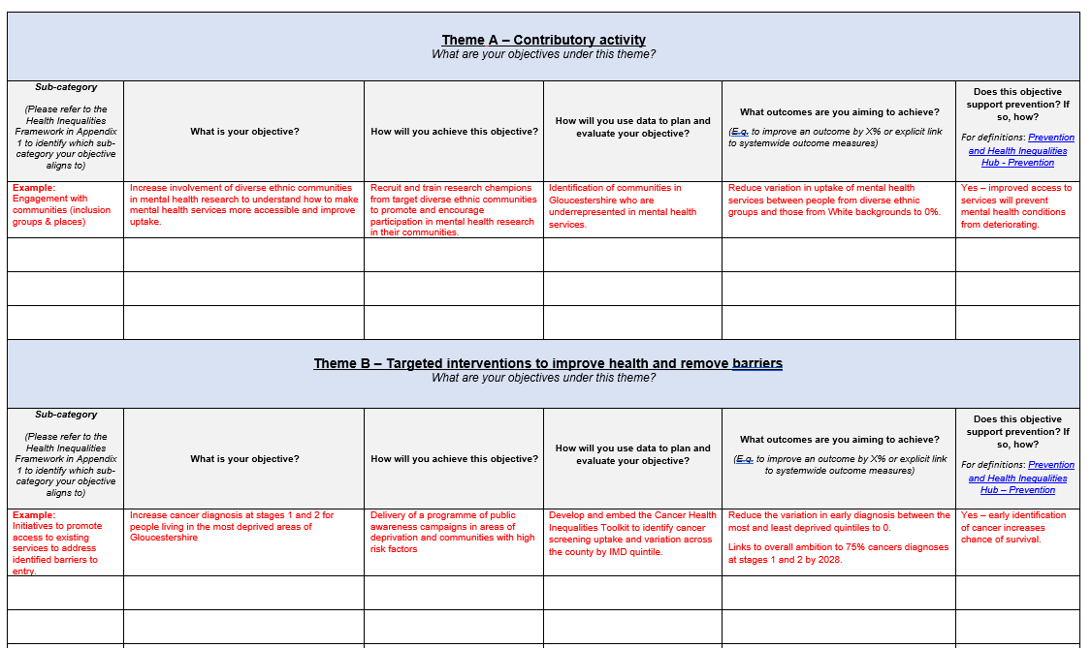
Collective monitoring of overall outcomes
Purpose
Assess and understand contribution to the wider system approach for addressing health inequalities.
Reflect on progress in operationalising the Health Inequalities Framework.
Provide assurance to Board that each part of the system is contributing to the Heath Inequalities Framework.
Identify where progress is being made and where there are opportunities to stretch further.
Notes:
To help us to operationalise the Health Inequalities Framework, we have developed a strategic planning and review template, and process to be used by system partners and organisations, including ICB, GHFT, GHC, ILPs, CPGs.
The purpose of this template is:
to enable system organisations and partnerships to self-assess and understand their contribution to the wider system approach (and shared outcomes) for addressing health inequalities.
to support system partners to reflect on their progress in operationalising the ICS health inequalities framework, including objectives under each of the themes.
to provide assurance to the Board that each part of the system has a way of working that enables them to demonstrate how they are systematically contributing to the overall health inequalities framework.
to understand where progress is being made, where there are opportunities to stretch ourselves further, and what themes are emerging regarding system level support needed to have most impact.
The aim of the process is to encourage organisations and partnerships to set objectives to help them to understand their contribution to the wider system approach of tackling health inequalities (high-level outcomes).
Template isn’t about collecting a list of projects that we’ve already done or are currently doing, but to set 4 or 5 key objectives or commitments that organisations and partnerships will focus on each year, where they could make the biggest impact. And these objectives will be in line with the HI framework.
This will allow us to see where progress is being made, where there are gaps or duplication in our collective response to health inequalities, and where we can stretch to go further in the work that we’re doing.

Slide 7
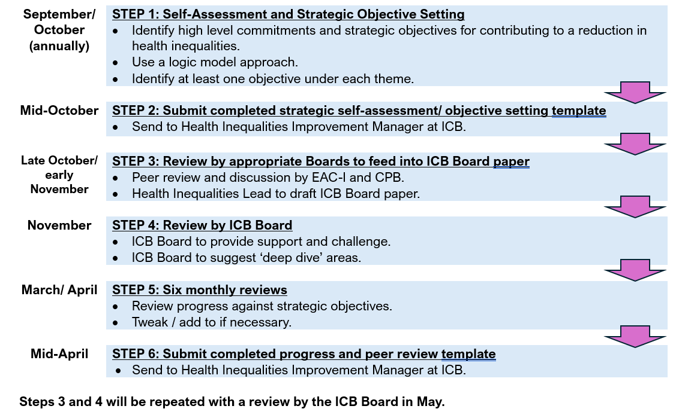
Health inequalities strategic planning and review process
Notes:
There are two stages to the process, and two corresponding sections in the Template (the second section is repeated to take account of there being two 6-montly reviews):
Strategic self-assessment and objective setting - to be completed annually in September/ October to feed into planning rounds
Review of progress and learning - to be completed six monthly in March/April and September/ October
September/ October (annually): STEP 1: Self-Assessment and Strategic Objective Setting
What: Identify high level commitments for contributing to a reduction in health inequalities and set strategic objectives towards delivery
Who: Statutory sector ICS organisations (ICB, GCC, GHFT and GHC) and partnerships (ILPs and CPGs)
How: Recommend using a logic model approach to help describe how your planned activities contribute to system ambitions and high-level shared outcomes. Populate the strategic self-assessment/ objective setting template, ensuring you have identified at least one objective under each of the themes or buckets in the Health Inequalities Framework.
Mid-October: STEP 2: Submit completed strategic self-assessment/ objective setting template
Where: ILPs, CPGs and Organisations to Sarah MacDonald (Health Inequalities Improvement Manger) at Sarah.Macdonald32@nhs.net.
Late October/ early November: STEP 3: Review by appropriate Boards to feed into ICB Board paper
What: ILP, CPG and ICB Health Inequalities leads will review organisational and partnership responses and produce summary reports for peer review and discussion by EAC-I and CPB to identify key themes, risks and recommendations to steer discussion at ICB Board. ICB Health Inequalities Lead to draft ICB Board paper.
November: STEP 4: Review by ICB Board
What: ICB Board to provide support and constructive challenge to organisations and partnerships, help to unblock and influence, identify themes and areas that need system level support, and suggest ‘deep dive’ areas
March/ April: STEP 5: Six monthly reviews
What: Use the process and peer review template to review progress, impacts and challenges against the strategic objectives set in September/ October.
Tweak/ add to strategic objectives if necessary.
Who: Statutory sector ICS organisations (ICB, GCC, GHFT and GHC) and partnerships (ILPs and CPGs).
Where: ILPs, CPGs and Organisations to Sarah MacDonald (Health Inequalities Improvement Manger) at Sarah.Macdonald32@nhs.net.
Mid-April: STEP 6: Submit completed progress and peer review template
Where: ILPs, CPGs and Organisations to Sarah MacDonald (Health Inequalities Improvement Manger) at Sarah.Macdonald32@nhs.net.
Steps 3 and 4 will be repeated with a review by the ICB Board in May.
The process will be repeated each year as follows:
Sept/ Oct – Objective setting and review of previous six months progress and impact
March/ April – Review of previous six months progress

Slide 8
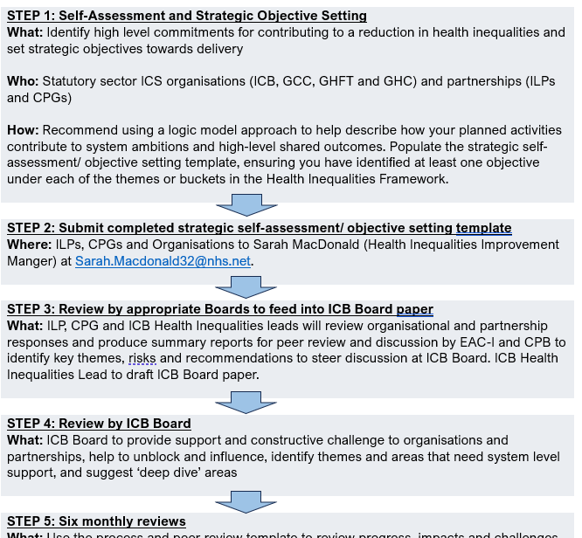
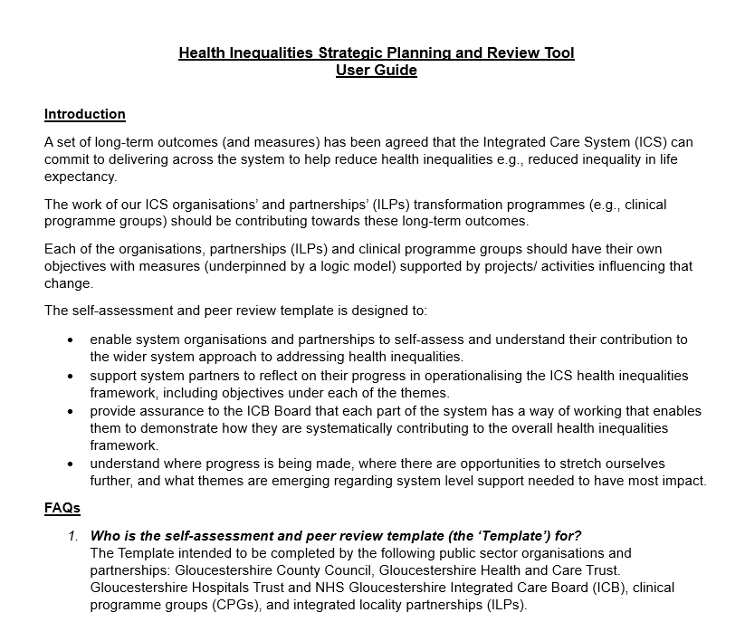

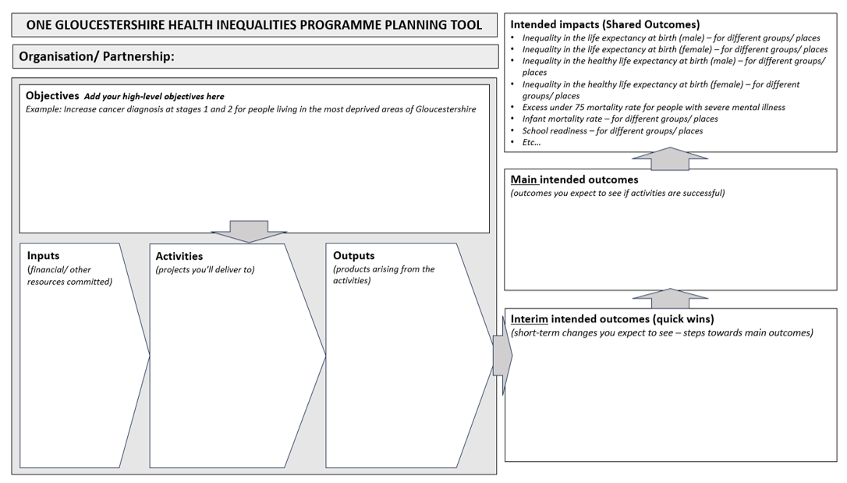
Support for using the strategic planning and review process
Notes:
We have developed a user guide to support you in completing the strategic planning and review process. This includes:
A flow diagram setting out the steps in the process.
A logic model (optional) to help you to describe how your planned activities contribute to system ambitions and high-level shared outcomes relating to health inequalities.
FAQs e.g.
What is the role of the VCSE sector in the self-assessment and peer review process?
How will the voice of the VCSE sector be fed in / integrated into the overall picture of Gloucestershire’s approach to tacking health inequalities?
There are no expectations on VCSE organisations (or District Councils) to complete the Template. The self-assessment and review processes are aimed at public sector organisations who have a statutory duty around health inequalities, to help them to get their own house in order; it is not intended to burden VCSE organisations with bureaucracy.
The work that VCSE organisations are doing in partnership with statutory organisations will feed into the self-assessment and peer review process via the Templates completed by these organisations, ILPs and CPGs.
VCSE organisations will also be invited to be part of a wider community of practice, which will be an opportunity to highlight key pieces of work, share good practice and learn from one another about what is working well, key challenges and opportunities. More information on this will be circulated in the early Autumn.

Slide 9
Health inequalities: our approach
No additional programme boards, project groups or meetings
A shared framework to pull together the sum of our parts
Collective monitoring of overall outcomes
With review, challenge and encouragement to ensure ambition
Development of a Community of Practice to share good practice, learning, and highlight key pieces of work.
Notes:
In summary, this is a relatively simple bit of reframing for organisations/ partnerships to add some ambition and sustainability and a way to track overall outcomes over time.
We sought feedback at the ICS leadership event in June and from EAC- I (plus others) to help firm up before implementation.

