Slide 1

Member Presentation
Friday 10 May 2024
David Owen – Director of Economy & Environment
Ben Watts – Team Manager Economy and Strategic Planning

Slide 2



Gloucestershire’s new economic
Driven by Innovation, Built on Heritage
On 15 May 2024 Cabinet will be asked to approve the adoption of the new Gloucestershire Economic Strategy & delegate authority to lead the implementation of its Action Plan.
This follows the LEP integration into GCC from 1 April 2024 & demonstrates GCC new strategic leadership role on the economy.
The strategy supersedes all previous economic strategies.
It introduces a new 2050 vision to achieve a greener and more inclusive economy and has been shaped by four strategic Priorities.
Notes:
On 15 May 2024 Cabinet will be asked to approve the adoption of the new Economic Strategy and delegate authority to the Executive Director of Economy, Environment and Infrastructure to lead the implementation of the Economic Strategy’s Action Plan.
Following the LEP’s integration into the County Council from the 1 April this new long-term strategy supersedes previous economic strategies for the county and demonstrates that County Council’s commitment to providing strategic leadership on the economy.
The strategy introduces a new long-term vision - Gloucestershire 2050 - which provides a clear statement of intent to achieve a greener and more inclusive economy. It has been shaped by four strategic priorities that builds upon the foundations established through the GFirst LEP’s Local Industrial Strategy

Slide 3

Gloucestershire’s new long-term vision
Notes:
The vision outlines our ambitions to support key business sectors whiles preserving our rich cultural and natural heritage.
It also outlines our place in the western of England and a commitment to deliver a stronger, more sustainable economy that benefits the whole county.

Slide 4

Strategic Priority – Sustainable Growth
This priority is underpinned by three inter-connected propositions:
Spatial Development Strategy: produce a county-wide strategy to ensure the viability of new developments and support the transition to a carbon-neutral society.
Gloucestershire City Region – Central Economic Growth Corridor: ensure long-term investment, which is coordinated, stable, and adaptable to local needs within the emerging City Region.
Infrastructure Delivery Plan: ensure a robust evidence base is produced to inform the planning and delivery of the infrastructure across Gloucestershire.
Notes:
Sustainable growth in the context of this strategic priority refers to the viability of future development to positively contribute towards Gloucestershire’s future growth needs and to help support a strong, responsive, and competitive economy.
The strategy has identified the need to do this through the development of a county-wide Spatial Development Strategy and an associated infrastructure plan.

Slide 5
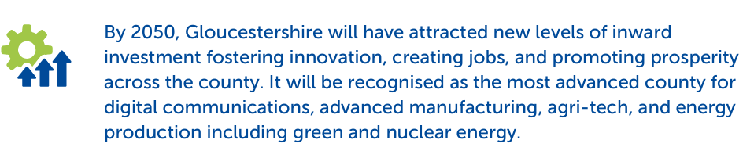
Strategic Priority – Inward Investment
This priority is underpinned by two propositions:
Strengthening key sectors: to build on Gloucestershire’s strengths in emerging technologies to drive investment.
Additional opportunities to attract investment: to consolidate a world-class inward investment offer that continues to successfully promote investment from outside the county as a driver for growth.
Notes:
Inward investment, or the investment from external companies or individuals into a particular area, is a key component for prosperity and growth in an open economy.
The LEP were very successful in attracting investment into the county and this will continue as we promote the county’s diverse economic base and key sectors, including digital communications, advanced manufacturing, agri-tech, and green and nuclear energy, while preserving our rich cultural and natural heritage.

Slide 6

Strategic Priority – Skills & Employment
This priority is underpinned by three propositions:
Seamless access to skills and employment to reduce economic inactivity: to drive down economic inactivity and improve productivity by identifying skills need and ensuring all residents can access relevant training opportunities.
Support businesses to develop the county’s talent: to ensure that businesses have access to a local workforce with the skills they need to flourish.
Anticipate future skills needs for a Greener Gloucestershire: to ensure that Gloucestershire’s workforce has the skills needed for the future, including bridging the green skills-jobs mismatch.
Notes:
A strong local workforce is an essential element in the delivery of long-term economic growth.
To enable this, it is important for residents to have access to the skills and development opportunities that will allow them to reach their potential.
Providing this will contribute towards the county’s ambition to improve productivity levels and ensure residents have fulfilling careers through a variety of job opportunities.
Essential to this is identing existing skill need & provide access to training opportunities – ensuring local business can access a skilled local workforce & future proofing this by identifying future skills need.

Slide 7
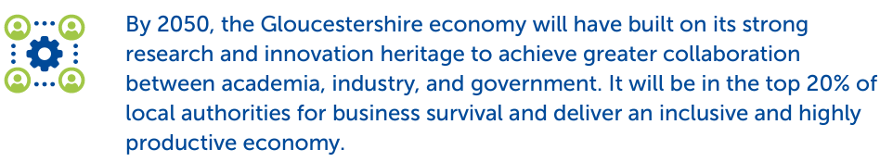
Strategic Priority – Business Innovation & Support
This priority is underpinned by three propositions:
Driving innovation: to maintain and strengthen Gloucestershire’s reputation as an innovative county.
Business support: to provide a strengthened level of relevant and appropriate business support which is fit for the needs of businesses today and in the future.
The future voice of business: to foster and enhance a dynamic forum where businesses can connect, collaborate, contribute to, and shape the needs and priorities of the county.
Notes:
Gloucestershire possesses a well established and robust business support ecosystem, from GFirst LEP’s Growth Hub and business groups, to the business membership organisations such as the Federation of Small Businesses, Chambers of Commerce, Circle to Success, Business West and the county library network.
We want Gloucestershire to be in the top 20% of local authorities for business survival will look at ways to support attracting innovation funding by creating a local innovation plan with partners across employment sectors, higher and further education providers, to map their specialisms and identify shared business needs.

Slide 8
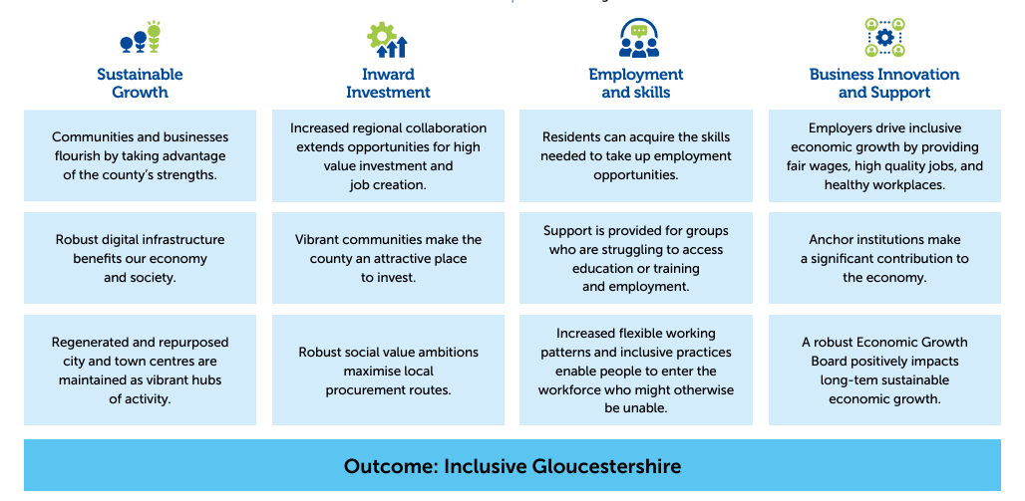
Strategy Outcomes
Notes:
On 15 May 2024 Cabinet will be asked to approve the adoption of the new Economic Strategy and delegate authority to the Executive Director of Economy, Environment and Infrastructure to lead the implementation of the Economic Strategy’s Action Plan.
Following the LEP’s integration into the County Council from the 1 April this new long-term strategy supersedes previous economic strategies for the county and demonstrates that County Council’s commitment to providing strategic leadership on the economy.
The strategy introduces a new long-term vision - Gloucestershire 2050 - which provides a clear statement of intent to achieve a greener and more inclusive economy. It has been shaped by four strategic priorities that builds upon the foundations established through the GFirst LEP’s Local Industrial Strategy

Slide 9
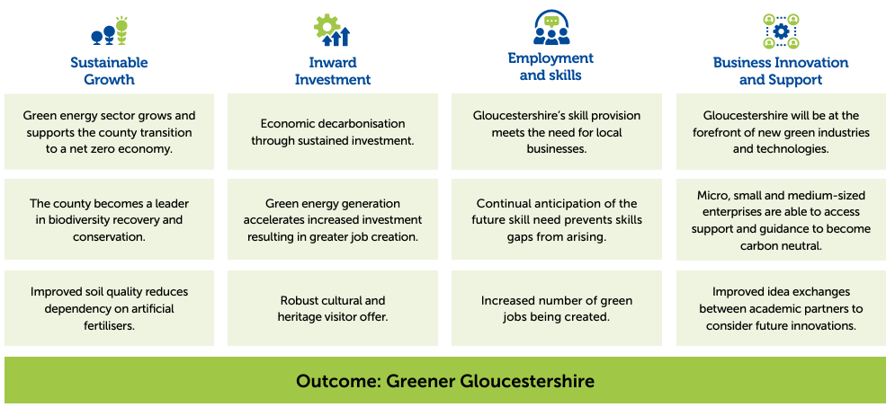
Strategy Outcomes

Slide 10



Delivery Priorities
The accompanying Action Plan outlines how each proposition will be delivered.
Where GCC is the lead authority this will inform service plans for the following service areas:
Growth & Enterprise Hub
Skills & Employment Service
Economy & Strategic Planning Team
Transport Planning Team
An annual implementation report will be produced, and the Action Plan needs to be considered a live document.
Notes:
The separate Strategy Action Plan outlines each set of actions identified to support the delivery of the Strategic Priority Propositions
Each action has a unique reference number and has an explanation about the action will include.
It also includes who the lead authority is, what stakeholders will be involved supporting its delivery, if funding has been secured and an expected delivery timeframe.
Where GCC is the lead authority this will inform service plans from the following areas: Growth & Enterprise Hub, Skills & Employment Service, Economy & Strategic Planning Team & the Transport Planning Team.
Progress against the delivery of the actions will be monitored and reported on. An annual report will be produced to document this and update the action plan accordingly.
It needs to be considered a live document.

Slide 11
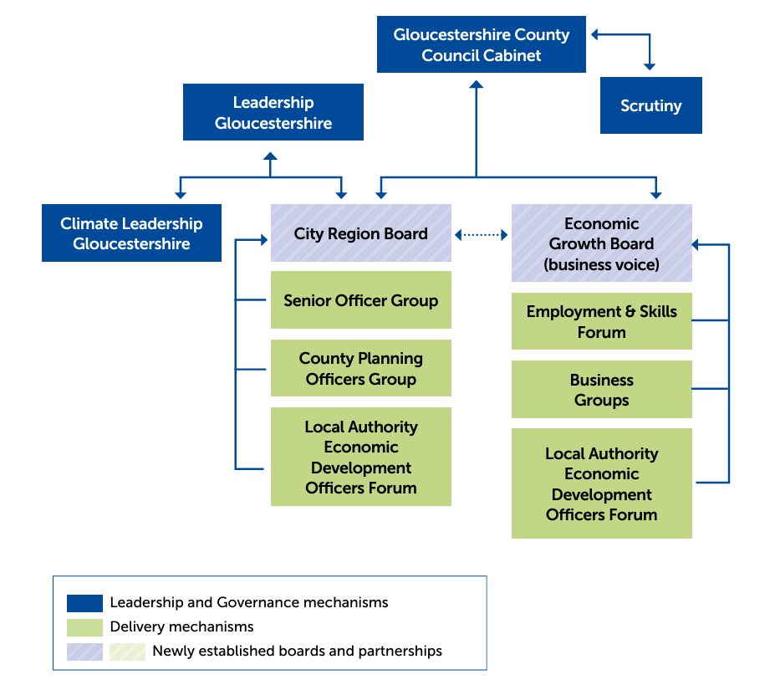
Governance
Notes:
Cabinet remains ultimately responsible for delivering the Economic Strategy.
But in recognition of the partnership approach to delivery of the priorities outlined in this Economic Strategy, oversight of the delivery plan will sit with the newly formed City Region Board, which reports into Leadership Gloucestershire.
The City Region Board will be responsible for ensuring that the actions outlined in the strategy are delivered within the timescales identified in the action plan.
It will include elected members from each of Gloucestershire’s seven local authorities and supported by senior officers.
District council partners, including chief executives and economic development officers, will be involved in the delivery of the strategy, through the City Region Board and engagement through Leadership Gloucestershire.
The county council’s Economy Team will be responsible for coordinating the activity required and ensuring actions are delivered.

Slide 12
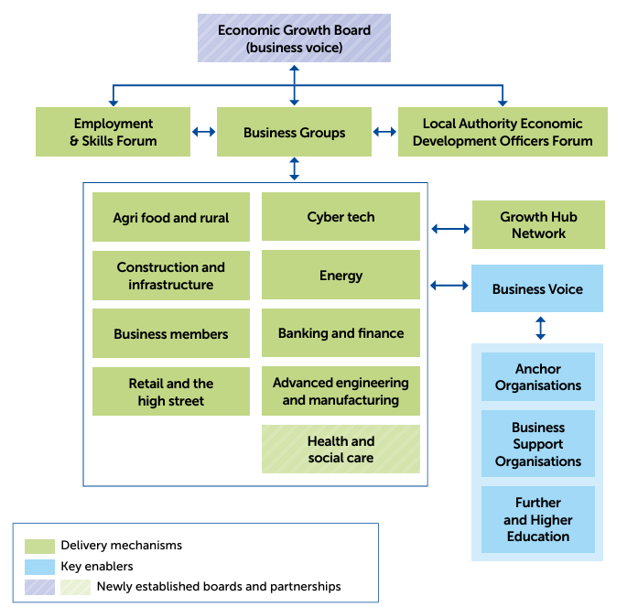
Governance
Notes:
Supporting the City Region Board will be a newly established Economic Growth Board.
This board will provide an independent business voice, from a broad base of Gloucestershire businesses. It will also offer strategic advice across the delivery of the economic strategy.
Updates on the delivery of the Acton Plan will be provided to both the City Region and Business Boards. Through the existing and new structures, including the Growth Hub, business groups, the voice of business will be integrated within the delivery of the strategy.

Slide 13
Metrics
Sustainable Growth Value of Planning Agreements signed for provision of Highways & Education/Libraries (£000) No. of new dwellings and new dwellings as a percentage of total dwelling stock. Ratio of median house prices to median workplace earnings Average monthly rents 4G coverage from at least one operator or 5G coverage from at least one operator. % of population who live over 45 minutes away from a key employment site using public transport | Skills and Employment Unemployment - Rates for 16-64-year-olds. Employment rate - Rates for 16-64-year-olds. Economic Inactivity - Rates for 16-64-year-olds. Job density - Ratio of jobs to people of working age. Job postings - Numbers and trends and recruitment implications. Percentage of students who left 16 to 18 study and are in sustained education, employment, or training. Apprenticeships – Completions
Inward Investment Carbon emissions by source (industrial, commercial, public sector, transport or domestic). Value of exports from Gloucestershire | Business Innovation and Support Number and rate of business births. Number and rate and ratio to business births. Business Survival Rates – 1-5 years. Rate of high growth businesses. Total floorspace. Productivity – GVA per hour worked. GVA – Total GVA
Notes:
A new set of metrics will be used to understand the impact of the strategy. This will be formally report annually as part of the Annual Implementation Plan.

Slide 14





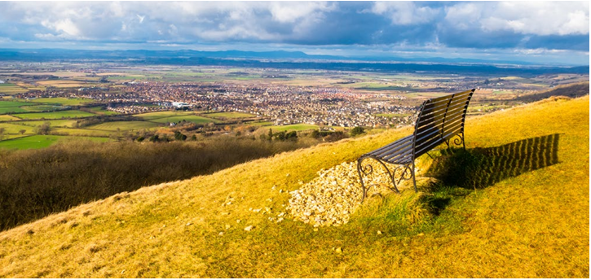
Does anyone have any questions?
For more information:
Ask the Economy and Strategic Planning Team by emailing economy@gloucestershire.gov.uk
The detailed Evidence base which informed the strategy is available on INFORM: www.gloucestershire.gov.uk/inform/economy/overview/

