Slide 1


Child Death Review Process Reporting Forms

Slide 2
Contact details for the CDRT
For all questions or queries regarding child death’s and process please contact the Team via email -
cdop@gloucestershire.gov.uk

Slide 3
Reporting Form
If you have been identified as a professional involved in the child’s life you will receive a request for information from the CDRT via an email from Holistix eCDOP.
This is a Statutory requirement and you are expected to complete the form within the timescale (21 days). You will receive automatic reminders until the form is completed and you may be contacted by the SRC directly to assist you in completing the form.
The Reporting Form will contain different sections depending on the category of death (SUDI, Infection, Trauma). You may not know the answers to all questions in the form. You are not expected to know everything about other professional involvement. Only complete what you know as an agency, your own involvement and multi agency working.
If you feel you are unable to do this for any reason please talk to your manager and if you still have an issue contact the CDRT and let them know. They will be able to support and advise you further.
Once all Reporting Forms have been received they will be consolidated into one form. This is where any areas not known by you will be provided from the other agencies forms.

Slide 4
Reporting Form
If you have not been involved in the Child Death Process previously or have only received this request on older cases from our Bristol colleagues you will receive an email from Holistix eCDOP Gloucester asking you to confirm your login details and change your password. You will not be able to complete the Reporting Form until you have done this.
Older cases and old links
Bristol and Gloucestershire sites are now independent of each other – any old links (in old emails) you may have for Gloucestershire cases will not work if they have CMAU in them. You will need to request the updated link via cdop@gloucestershire.gov.uk . Please include the four digit case reference number

Slide 5
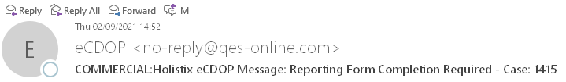
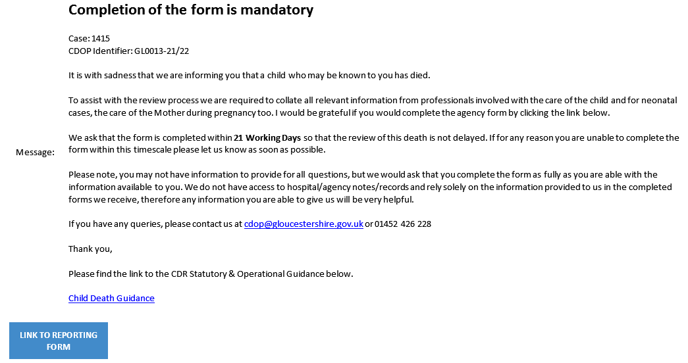
Reporting Form
This is what the email will look like. The link to the Reporting Form is the blue button at the bottom of the email

Slide 6
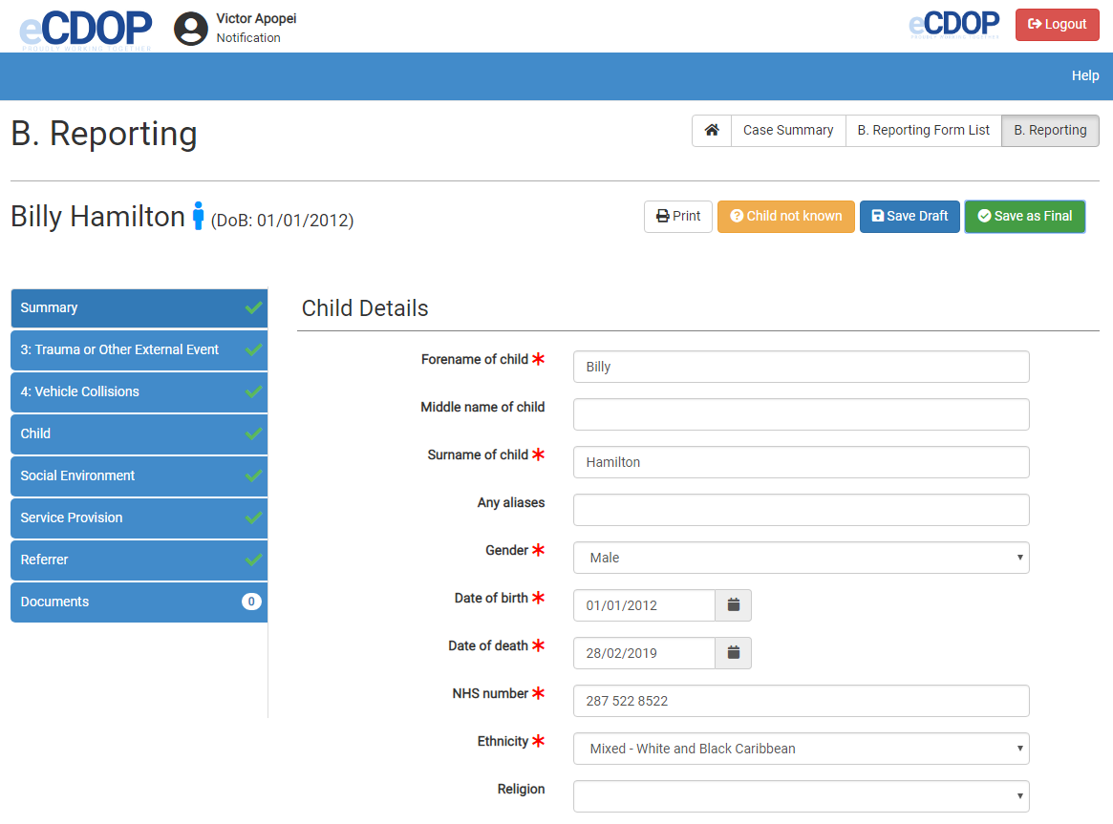
Reporting Form
After clicking on the blue button link to Reporting Form you will be taken to this page.
NOTE - This is not a real case or child.

Slide 7
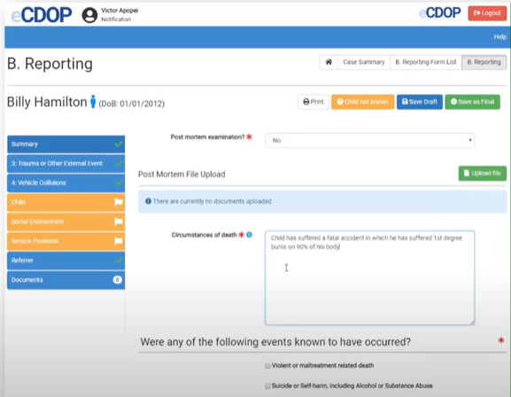
Reporting Form
Enter as much information as possible. You will need to enter information into every box that has a red star You will not be able to complete the form if you leave any of these fields blank. If you do not know the correct information for any of the fields you must put ‘Not known’ or ‘N/A’. Please do not guess.

Slide 8
Reporting Form
Each section must have a green tick before you can finalise the document.
You can save as draft and come back to the form at a later time.
Once you have completed the form you can save as final.
The form has an automatic save function but please do not rely on this.

Slide 9
The eCDOP administrators can only see your form once it has been completed.
They cannot see any of your entries whilst the form is in draft or while you are entering into the system.
If you need help completing the form or do not think you should have received the form please email and let us know before hitting the Child Not Known button. There may be a reason you have been sent the form (a colleague has left the role, your name was given by a colleague as a supervisor etc.). We will advise if this has been the case and confirm if you are still required to complete the form.
cdop@gloucestershire.gov.uk

