Slide 1
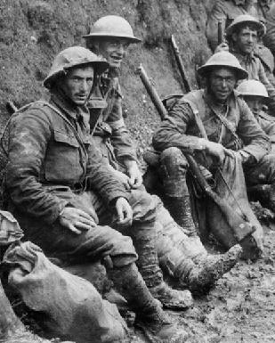
SO WHAT WAS IT REALLY LIKE ON THE FRONT LINE?
Notes:
Stacked, 3-D text at dramatic angle
(Intermediate)
To reproduce the text on this slide, do the following:
On the Home tab, in the Slides group, click Layout, and then click Blank.
On the Insert tab, in the Text group, click Text Box, and then on the slide, drag to draw the text box.
Enter text in the text box and select the text. On the Home tab, in the Font group, select Impact from the Font list, and then change the font size of each line so that the text is approximately the same width. For example, if you entered “FIRST” on one line, “SECOND” on the next line, and so on (as shown on the slide), do the following:
Select the first line of text, and then on the Home tab, in the Font group, enter 100 in the Font Size box.
Select the second line of text, and then on the Home tab, in the Font group, enter 70 in the Font Size box.
Select the third line of text, and then on the Home tab, in the Font group, enter 94 in the Font Size box.
Select the fourth line of text, and then on the Home tab, in the Font group, enter 75.5 in the Font Size box.
Select all of the text. On the Home tab, in the Font group, click Character Spacing, and then click More Spacing.
In the Font dialog box, on the Character Spacing tab, in the Spacing list, select Expanded. In the By box, enter 2.
On the Home tab, in the Paragraph group, click Center to center the text in the text box.
Under Drawing Tools, on the Format tab, in the bottom right corner of the WordArt Styles group, click the Format Text Effects dialog box launcher. In the Format Text Effects dialog box, click Text Fill in the left pane, select Gradient fill in the right pane, and then do the following:
In the Type list, select Radial.
Click the button next to Direction, and then click From Corner (second option from the left).
Under Gradient stops, click Add gradient stop or Remove gradient stop until two stops appear in the slider.
Also under Gradient stops, customize the gradient stops that you added as follows:
Select the first stop in the slider, and then do the following:
In the Position box, enter 0%.
Click the button next to Color, and then under Theme Colors click White, Background 1, Darker 15% (third row, first option from the left).
Select the last stop in the slider, and then do the following:
In the Position box, enter 100%.
Click the button next to Color, and then under Theme Colors click White, Background 1, Darker 50% (sixth row, first option from the left).
Also in the Format Text Effects dialog box, click 3-D Rotation in the left pane. In the right pane, click the button next to Presets, and then under Perspective click Perspective Heroic Extreme Left (third row, second option from the left).
Also in the Format Text Effects dialog box, click 3-D Format in the left pane, and then do the following in the right pane:
Under Bevel, click the button next to Top, and then under Bevel click Cool Slant (first row, fourth option from the left).
Under Depth, in the Depth box, enter 70 pt.
Also in the Format Text Effects dialog box, click Shadow in the left pane. In the right pane, click the button next to Presets, and then under Perspective click Perspective Diagonal Upper Right (first row, second option from the left).
To reproduce the background on this slide, do the following:
Right-click the slide background area, and then click Format Background. In the Format Background dialog box, click Fill in the left pane, select Gradient fill in the right pane, and then do the following:
In the Type list, select Linear.
Click the button next to Direction, and then click Linear Down (first row, second option from the left).
Under Gradient stops, click Add gradient stop or Remove gradient stop until two stops appear in the slider.
Also under Gradient stops, customize the gradient stops that you added as follows:
Select the first stop in the slider, and then do the following:
In the Position box, enter 64%.
Click the button next to Color, and then under Theme Colors click Black, Text 1 (first row, second option from the left).
Select the last stop in the slider, and then do the following:
In the Position box, enter 100%.
Click the button next to Color, and then under Theme Colors click Black, Text 1, Lighter 35% (third row, second option from the left).

Slide 2
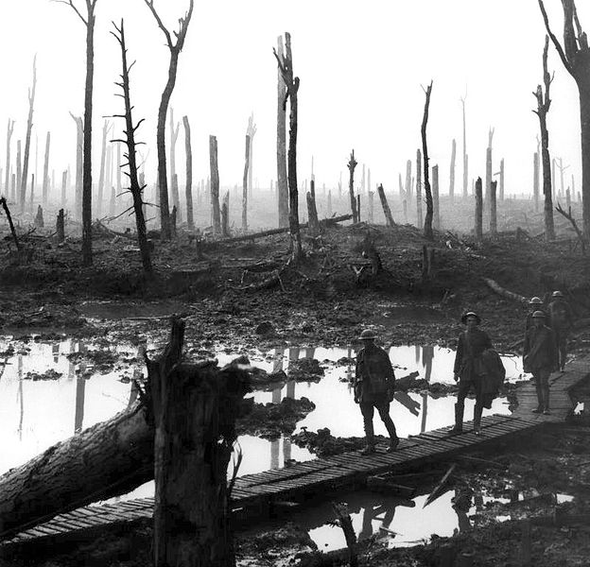
The landscape was unrecognisable with blasted and broken trees, shell craters filled with stagnant water and miles and miles of mud in which you might easily drown. Lines of razor-sharp barbed wire were set up in No Man’s Land making it impossible to cross with ease.

Slide 3
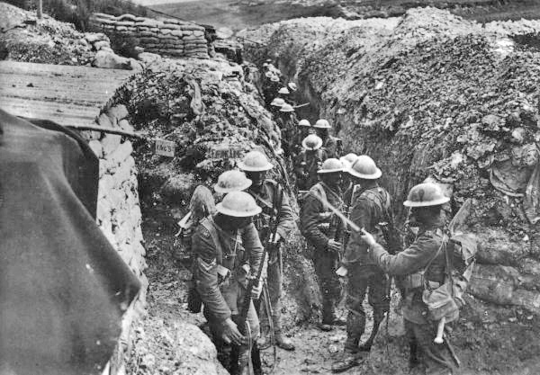
Soldiers lived in filthy open trenches that stretched for miles. They were cut deep into the ground and quickly filled up with sludgy rainwater, rats and other unpleasant things!
Trenches froze in winter and stank in summer. Mud and debris rained down into them with each exploding shell.

Slide 4
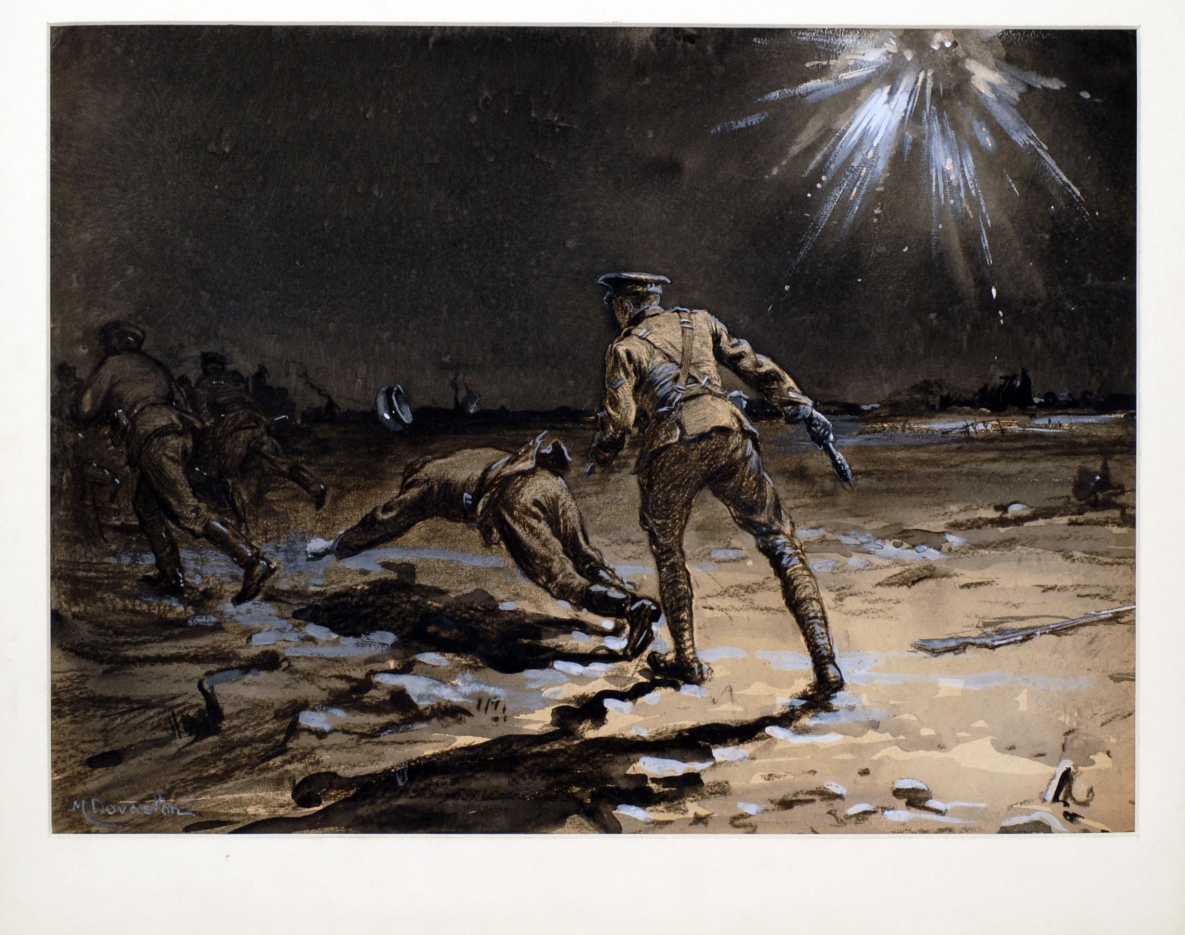
Even at night, sounds of artillery fire and ‘whizz-bangs’ continued. It stopped only briefly and resumed at first light. Flares lit up the darkness like terrible green fireworks. A truly dreadful experience.

Slide 5
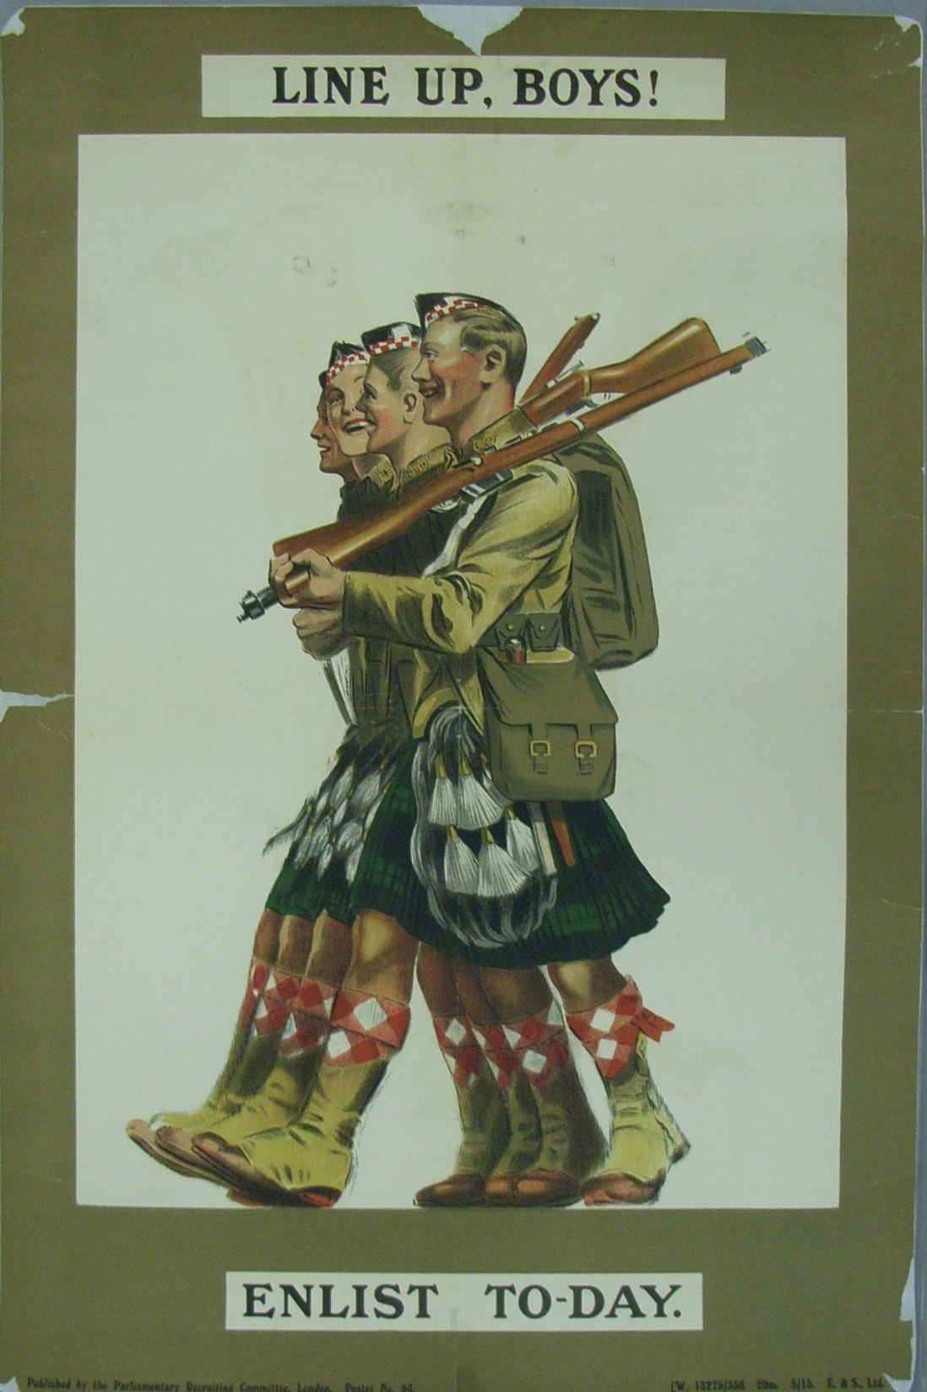
Have a look at this recruitment poster.
How would you describe the way the soldiers look?
What does it suggest army life will be like?

Slide 6
How does this image compare to the recruitment poster?

Slide 7
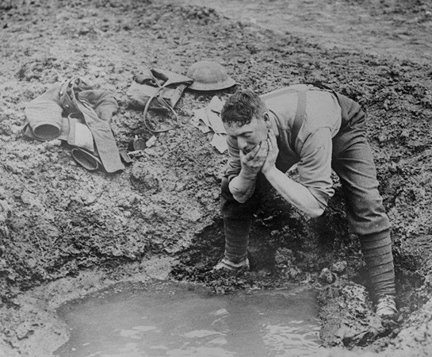
I Want To Go Home
I want to go home, I want to go home,
I don't want to go in the trenches no more, Where whizz-bang and shrapnel they whistle and roar. Take me over the sea, Where the alleyman* can't get at me;
Oh my, I don't want to die, I want to go home.
These lyrics are from a sad little song in Joan Littlewood’s musical play ‘Oh! What a Lovely War.’ It shows how many servicemen were feeling at the time. Watch and listen to it at:
http://www.ww1photos.com/IWantToGoHomeVideo.html
*’Alleyman’ was a nickname for German soldiers used by Tommies. Men serving in France, with little understanding of the French language, mispronounced the French word ‘Allemagne’ (meaning Germany) as Alleyman - as you see in the song.

Slide 8
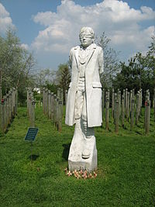
Not everyone was cut out to be a soldier and the terrible experience was just too much for some. Many young men’s nerves were shattered and they tried to escape.
Some tried to deliberately injure themselves so they could be sent home. Some simply ran, only to be captured, court-martialled and convicted of desertion of duty. Most were then shot for cowardice.
This picture is of a memorial entitled ‘SHOT AT DAWN.’ It is dedicated to all those men who were killed because they were just too traumatised to serve as soldiers. You can visit it at The National Memorial Arboretum near Alrewas in Staffordshire.
Image: CC3 Noisette

