Slide 1

The Role Of Cycling In Our Economy

Slide 2
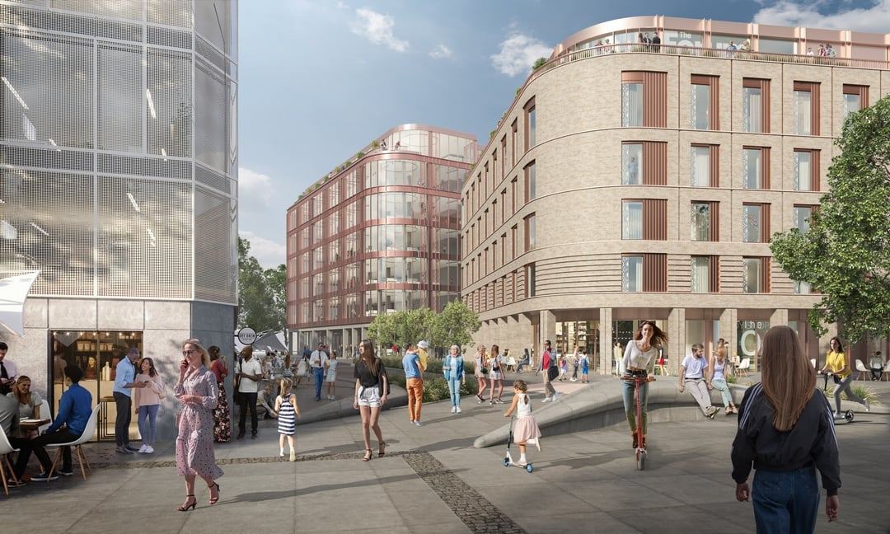
Objectives
From the Draft LIS 2019 (to be updated in 2023 as the Gloucestershire Economic Strategy)
We need more young people to build their lives here in Gloucestershire to support our existing industrial strengths, such as advanced engineering, and help us exploit new opportunities – in cyber-tech, agri-tech and green technology in particular.
But currently, over 66% of young people we surveyed plan to leave the county within 5 years. We need to move the dial on this.
We need more 18-40 year-olds with high level qualifications choosing to live and work here.
The Forum Gloucester

Slide 3
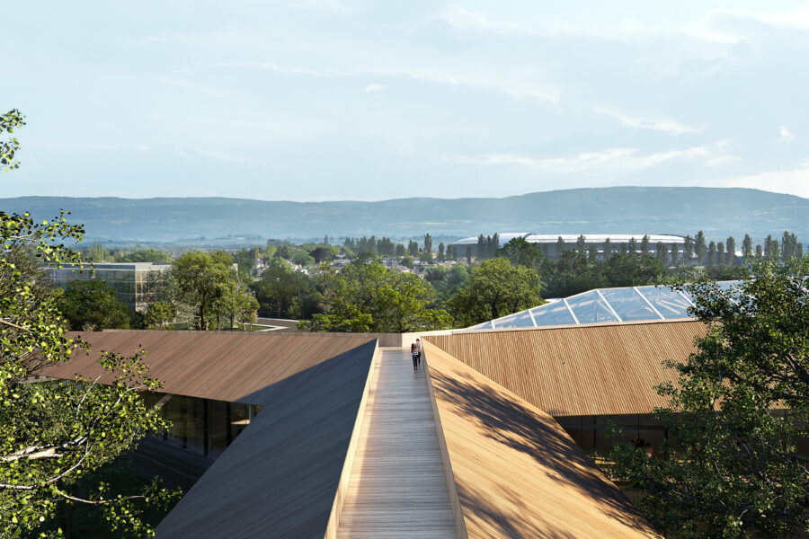
Objectives
A fundamental element of the LIS is our desire to become a ‘magnet county’, by which we mean:
Ensuring that the environment, the arts, heritage and culture, creativity and active living are central to our vision of a healthy, productive county that attracts and retains young talent and supports all its residents to live life to the full.
To position Gloucestershire as:
‘the most flexible place to work’ in the UK so that everyone, young and old, and those currently struggling to get a job, can work in a way that enables them to make their best contribution to society.
the greenest place to live and work in England.
Net Zero by 2050.
Cyber Central Cheltenham

Slide 4
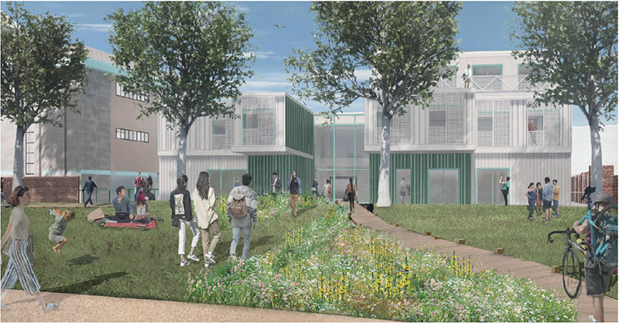
Why Cycling?
Essential to attract young talent - Over 60% of young people surveyed believe that more cycle lanes are needed to help address climate change
Attractive to inward investors, particularly in the tech sectors
Influences Strategic Decision Makers
In our consultation with 5000 young people for the LIS, the landscape and natural environment emerged as important attributes connecting young people to Gloucestershire, with the word ‘Countryside’ appearing most often in response to what young people like most about living in the county.
Over 58% of those surveyed say that ensuring the environment is well looked after for everyone to enjoy now is ‘very important’ to make Gloucestershire a ‘magnet county’.
Minster Exchange Cheltenham

Slide 5
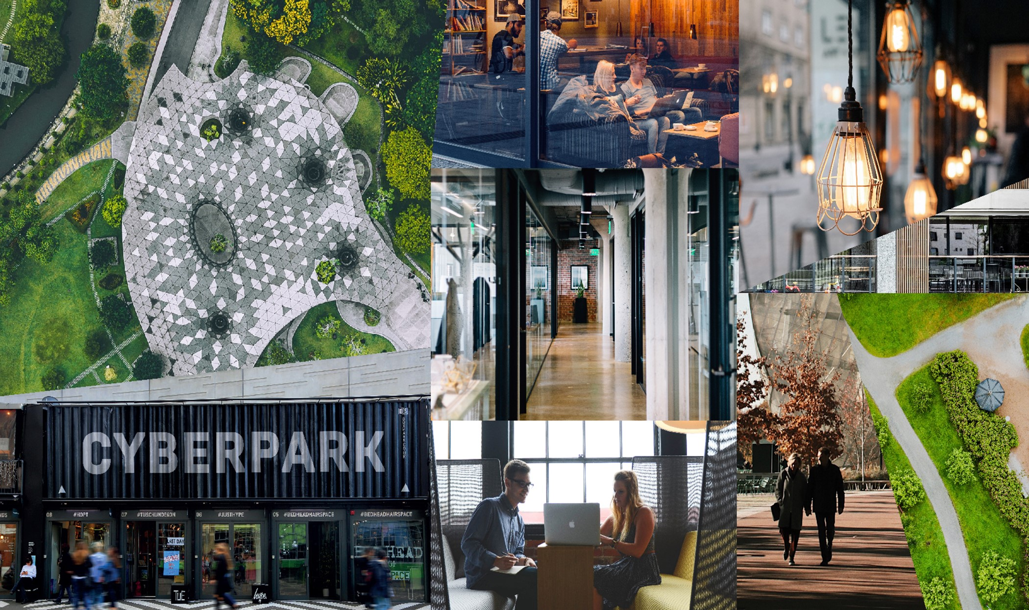
Why Cycling?
Central Gloucestershire City Region (Gloucester – Cheltenham conurbation)
City Regions/density drive Growth and Prosperity
We need Green Growth, cannot be car driven!
Cycling (and Scootering ?) Infrastructure is key – E-Bikes are the paradigm shift?
Business Opportunities – Our strong AE&M sector, Green Innovation, Mini-Holland etc
Golden Valley Cheltenham

