Slide 1


Child Death Review Process Notification

Slide 2
Notification
Gloucestershire Child Death Review Team and CDOP must be informed of every death of a child that occurs in Gloucestershire. This means -
Every child that is a resident of Gloucestershire
Any child that is visiting the county that is not normally a resident of Gloucestershire e.g. on holiday, in a placement or hospital setting, visiting for the day or travelling through.
The CDRT must also be informed of any Gloucestershire resident children that die elsewhere -
that die in other hospitals.
on holiday elsewhere in the country.
on holiday abroad.

Slide 3
Notification
Q - Who is responsible for making a Notification of a child death?
A - Everyone
Whether you are a Consultant/doctor, GP/Practice Manager, Nurse, Secretary/Administrator, Teacher/DSL, Health Visitor, Midwife, Police, Head of Service/Director, anyone can complete the Notification via eCDOP.
When you are having that initial conversation with your professional colleagues about a death ask if the notification has been made. If you are unsure - do it yourself. It takes less than ten minutes.
The CDRT need that official notification as soon as possible after death and would prefer to have five from different people than none at all. The CDRT are limited in what they can do until they receive that notification.
As a bare minimum, if you are unable to do this via eCDOP, send an email. Let us know and we can talk you through the process.

Slide 4
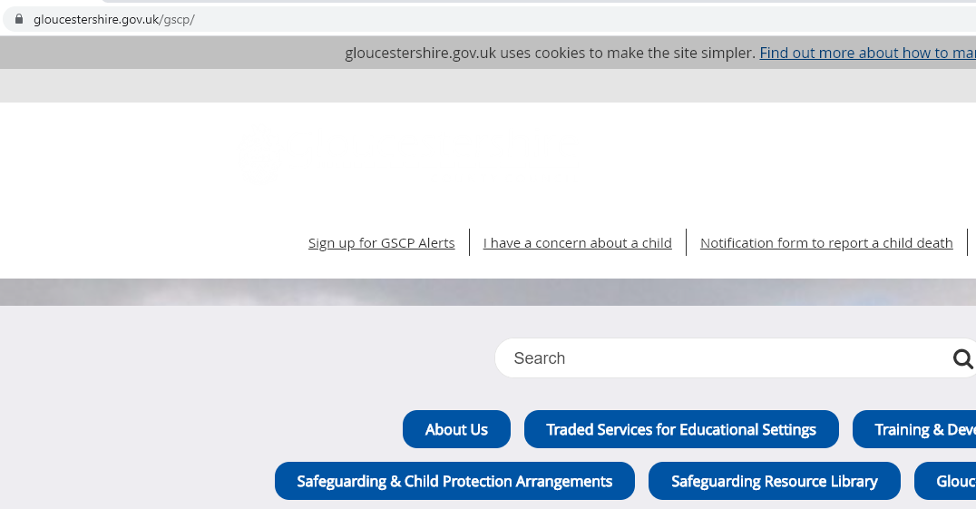
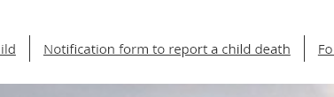
How to make a Notification
GSCP Website
Your Intranet
The link for notification can be found on the GSCP website front page
All our Partner agencies are required to have this link on their own intranet site.
Some may link back to the GSCP website
If you cannot find it – ask your manager.

Slide 5
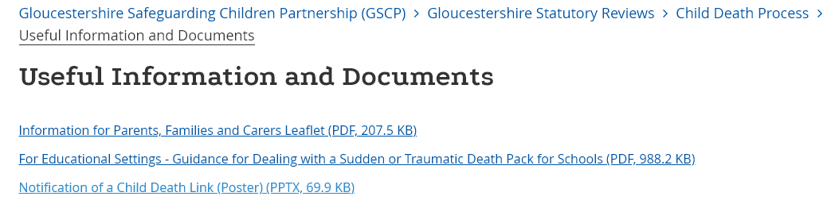
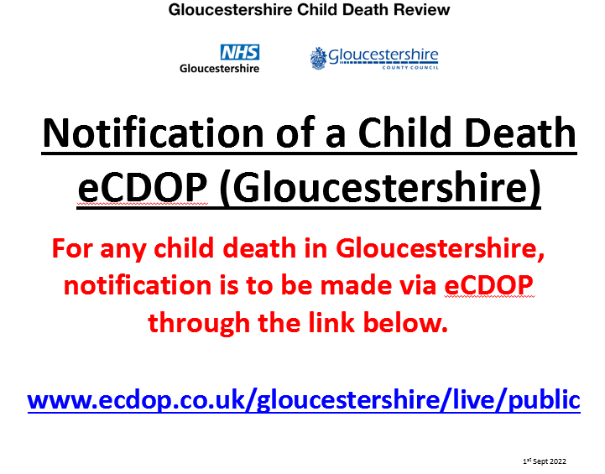
How to make a Notification
Download the poster from our website

Slide 6


How to make a Notification
Once you click the link you will see this screen –
You do not need a user name or password to make a Notification. Just click on the green button

Slide 7
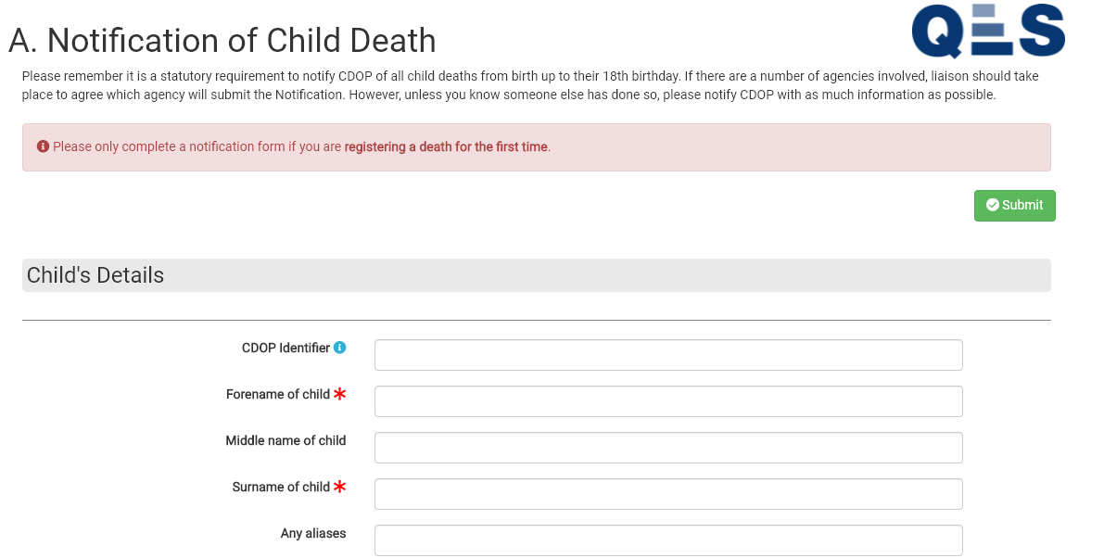
How to make a Notification
You will then see this page.
Enter as much information as possible. You will need to enter information in every box that has a red star You will not be able to complete the Notification if you leave any of these fields blank. If you do not know the correct information for any of the fields you must put ‘Not known’ or ‘N/A’. Please do not guess.
Once you have completed the form click on the green ‘Submit’ button.
This is not the whole form

Slide 8

