Slide 1
Member Induction: Your Role as a Corporate Parent
2nd June 2021

Slide 2
Welcome and Introductions
Chris Spencer, Director of Children’s Services

Slide 3
National Context: Good Practice Examples
Claire Burgess, DfE Advisor for Gloucestershire County Council

Slide 4
The National context – what is a Corporate Parent?
The Children & Social Work Act 2017 says when a child comes into the care of the LA, or is under 25 and was looked-after by the LA, the LA becomes their ‘Corporate Parent’ and sets out 7 Corporate parenting principles:
To act in the best interests, and promote the physical and mental health and wellbeing, of those children and young people
To encourage those children and young people to express their views, wishes and feelings
To take into account the views, wishes and feelings of those children and young people
To help those children and young people gain access to, and make the best use of, services provided by the local authority and its relevant partners
To promote high aspirations, and seek to secure the best outcomes, for those children and young people
For those children and young people to be safe, and for stability in their home lives, relationships and education or work; and
To prepare those children and young people for adulthood and independent living.
“Would this be good enough for my own child, grandchild, niece, nephew…………..”

Slide 5
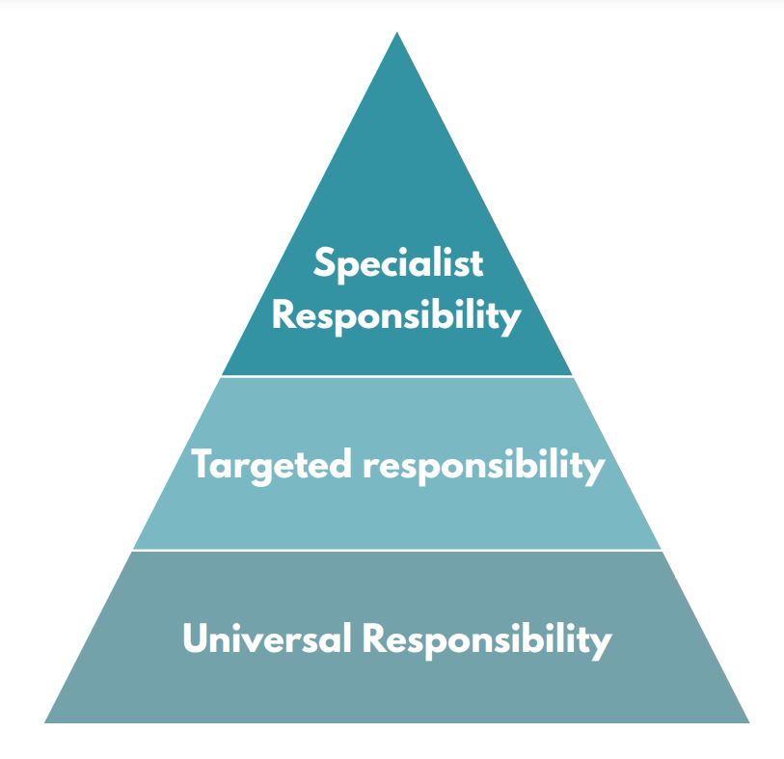
Who is a corporate parent?
Universal: Every Councillor and Officer of the Local Authority
Targeted: Corporate Parenting Boards and Scrutiny Committees have additional responsibilities
Specialist: Lead Members and Directors of Childrens Services
Partners with a duty to cooperate:
NHS
Police
Schools

Slide 6
Why does it matter?
Children in care are likely to be the most vulnerable children in your council area
They are likely to have experienced significant harm and trauma before coming into the care of the LA
Statistically, they are more likely than their peers to be:
Sexually or criminally exploited or victim of modern slavery
To go missing from home
Have additional learning needs or missed out on education
Experience mental health problems
To have lower educational attainment and be unemployed or go to prison as an adult

Slide 7
How can you support – less Corporate and more Parent
All Councillors
You have a shared responsibility for meeting the needs of children in care and care leavers;
Be aware of the profile and needs of your children in care and young people leaving care;
Understand the impact of council decisions on children in care and care leavers;
Receive information about the quality of care and support and services;
Champion the needs of children in care and care leavers in your area
Focus on well-being and development;
Show the same interest in children in care and care leavers as you would for a child in your family;
Ensure that the system of support around children in care and care leavers is of good quality and is effective.

Slide 8
Your role as:
A Ward councillor – eyes and ears of your community
Councillor as decision-maker – most decisions that a council makes will have an impact on children in care & care leavers
School governor – how are children in your care supported
Community representative – inclusion and support
An influencer – as public servants you will have strong links to many partners agencies and local businesses – how can they support

Slide 9
A few good practice examples
Councillors as mentors – matching skills to needs
Care leavers in the family business – ring fenced opportunities that lead to permanent work in the Council and with partners – starting early with work experience
Business/community events with potential employers
Free bus passes and access to leisure – Plus 1 approach
No care leavers are made intentionally homeless and accommodation is of a high standard – no use of B & B
Accommodation offer – range of properties - deposits and rent for 1st month

Slide 10
A few more….
Council tax exemption – across boundaries
Supported to engage in education and training – mentoring & financial incentives
Young people co-chairing the Corporate Parenting Board – standing members
Assistance over and above the leaving care grant
Access to emotional health and well-being support and child adolescent mental health services at the time of need

Slide 11
Safeguarding our Children and Young People
Gail Hancock, Interim Director for Children’s Safeguarding and Care

Slide 12
Framework for Safeguarding children in care and care leavers
Children in Care and Care Leavers are some of the most vulnerable children and young people in Gloucestershire and we continue to have a statutory duty to safeguard and promote their welfare whilst they are in our care and we are supporting them.
There is a comprehensive framework of legislation, statutory guidance, policies and procedures setting out the local authority’s duties, including:
Primary legislation: Children Act 1989
Statutory guidance: Working Together 2018
Policies: Gloucestershire Safeguarding Children’s Partnership (GSCP)
Procedures: South West Regional Child Protection Procedures

Slide 13
Concerns about a Child In Care or a Care Experienced Young Person
All Children in Care will have an allocated Social Worker or a Personal Advisor for Care Experienced Young People.
The allocated Practitioner is the Key Worker for the named child / young people and should be the single point of contact
If anyone is concerned about the safety or welfare of a child or young person in Gloucestershire please contact:
The child or young person’s allocated social worker or personal advisor; or,
The Helpdesk for Children and Families on 01452 426 565 from Monday to Friday 9am to 5pm ; or,
The Emergency Duty Team out of hours on 01452 614 194; or,
If there is a concern about the child or young person’s immediate safety call the Police on 101

Slide 14
Children Act 1989 Principles
There’s no single piece of legislation but the 1989 Act is the most comprehensive governing the State’s relationship with families and the key principles are:
Paramountcy principle
Welfare Checklist
S17 Children in Need of support
S47 Duty to undertaken child protection enquiries
Parental responsibility

Slide 15
Working Together 2018
Statutory framework
Parents / Carers
DCS and Lead Member for Children’s Services
Local Authority Duties

Slide 16
Gloucestershire Safeguarding Children’s Partnership (GSCP)
Children Act 2004 (amended by Children & Social Work Act 2017) strengthens the relationship between statutory partners, including:
Gloucestershire Constabulary
Clinical Commissioning Group (CCG)
Local Authority
Statutory ‘shared and equal duty’
GSCP Executive and Sub Groups
GSCP Aim

Slide 17
Child Protection Procedures
South West Regional approach
Core Procedures:
Types of child protection concerns
Strategy Discussions and Meetings
S47 - Child Protection Enquiries / Investigations with Police
Initial and Review Child Protection Conferences and Child Protection Planning
Safeguarding Practice Guidance
High Risk Planning Meetings for Children in Care and Care Experienced Young People

Slide 18
Safeguarding Children in Care and Care Experienced Young People - some themes and issues
Adverse Childhood Experiences and the impact of significant harm
Family time
Section 20 accommodation
Public Law pre-proceedings
Court care proceedings and court orders
Professional supervision

Slide 19
Introducing Our Ambassadors

Slide 20
Who are the Ambassadors and what’s our role
Team of 15 young people employed by GCC to improve services
Aged 16-25, all have received support from Children’s Social Care
Share our experiences and help other young people have a voice
Support the development of services and influence strategic planning

Slide 21
Introducing Em, Leah, Becca, Barley & Toyah

Slide 22
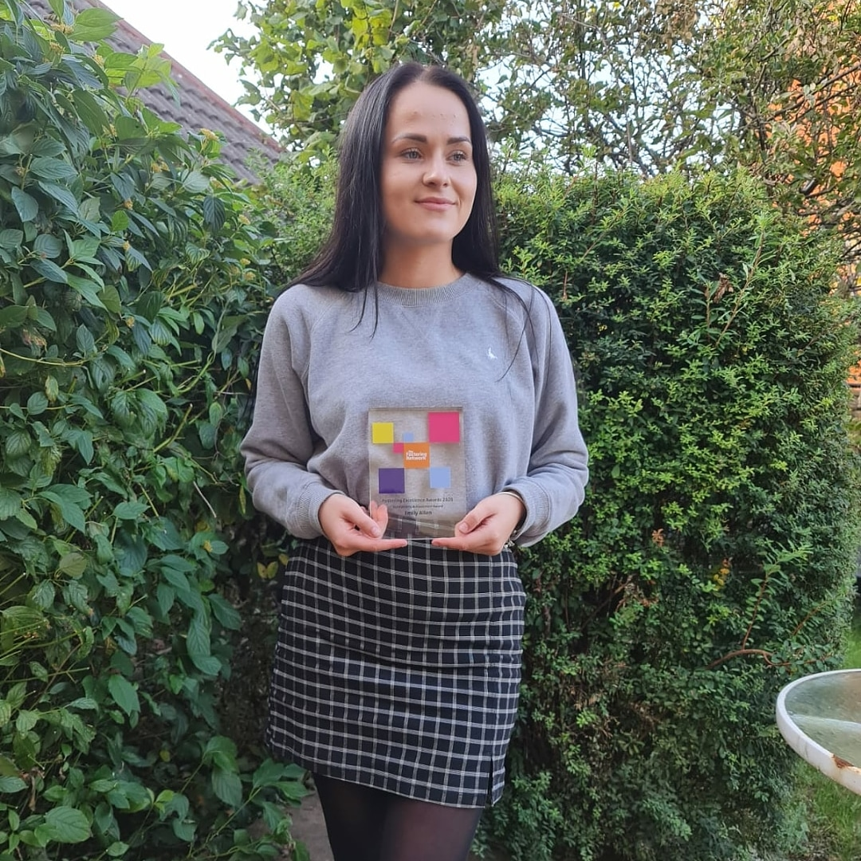
Introducing EM!
Ambassador for Vulnerable Children and Young people for 4 years
I am an Ambassador because I am passionate about improving services for children
I am care experienced and am now a care leaver
My favorite project is mentoring Chris Spencer
I regularly attend CPG meetings
I am studying BSC (hons) Social Work
I won the national fostering excellence award for outstanding achievement

Slide 23
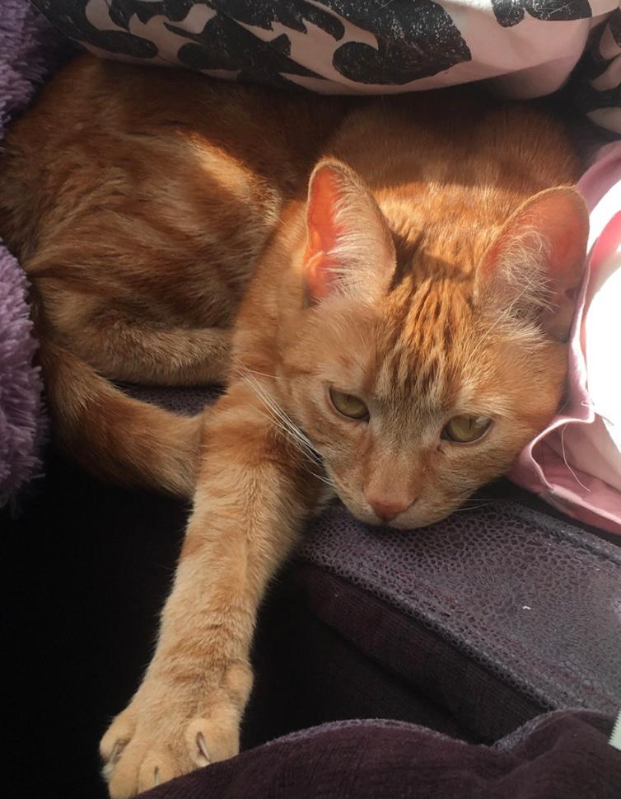
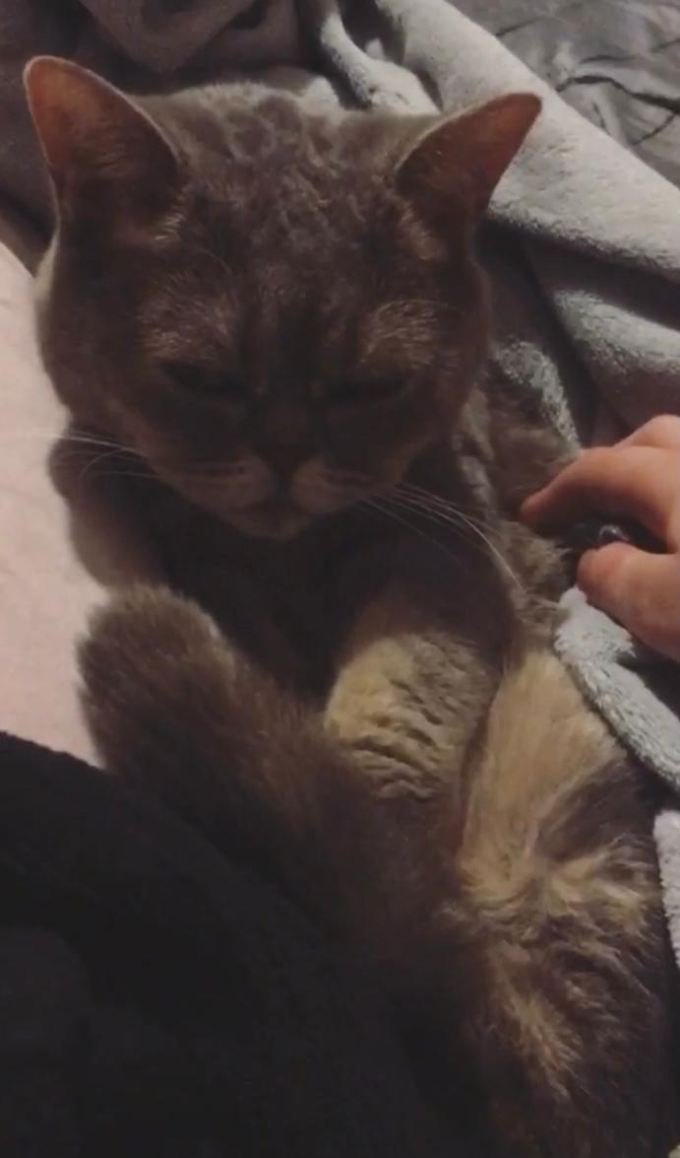
Introducing Barley!
22 Years old
Care experienced
Came into residential care at 16
Ambassador since September 2020 ☺

Slide 24


Introducing Leah!
Hello I am Leah and I’m 16 years old. I study health and social care at college and I want to become a paediatric nurse I am hoping to go to university and get my nursing degree.
I wanted to become an ambassador so I could use all my negative experiences to help other people and to make them positive. I love being an ambassador and helping others to have a more positive experience than I had. I am one of the new ambassadors and have been an ambassador now since August. I am starting to feel more confident and be able to talk a bit more in front of other people however this is something I am still working on. This job is the first job I have had. Before starting as an ambassador I was quite shy and had never done anything such as being interviewed or being on an interview panel. I first came into care when I was 4 days old and was then adopted at 10 months old. I then returned into care when I was 13. Being in care has been very challenging but has made me appreciate all the good things in my life and has changed my attitude towards certain things. I have also had the support to be able to change my behaviour and to help improve my mental health. There have been things that aren’t so positive such as having constant meetings and always feeling like I’m different to other children. Also, having people constantly trying to make decisions about me and my life that I didn’t want to happen. I was also involved in too many services which made me feel overwhelmed and this was unnecessary at the time. However, looking back on it now it has helped me rebuild positive relationships with my mum and dad and now I am back at home living with my dad and our relationship has completely changed as it is nothing like it was before.

Slide 25
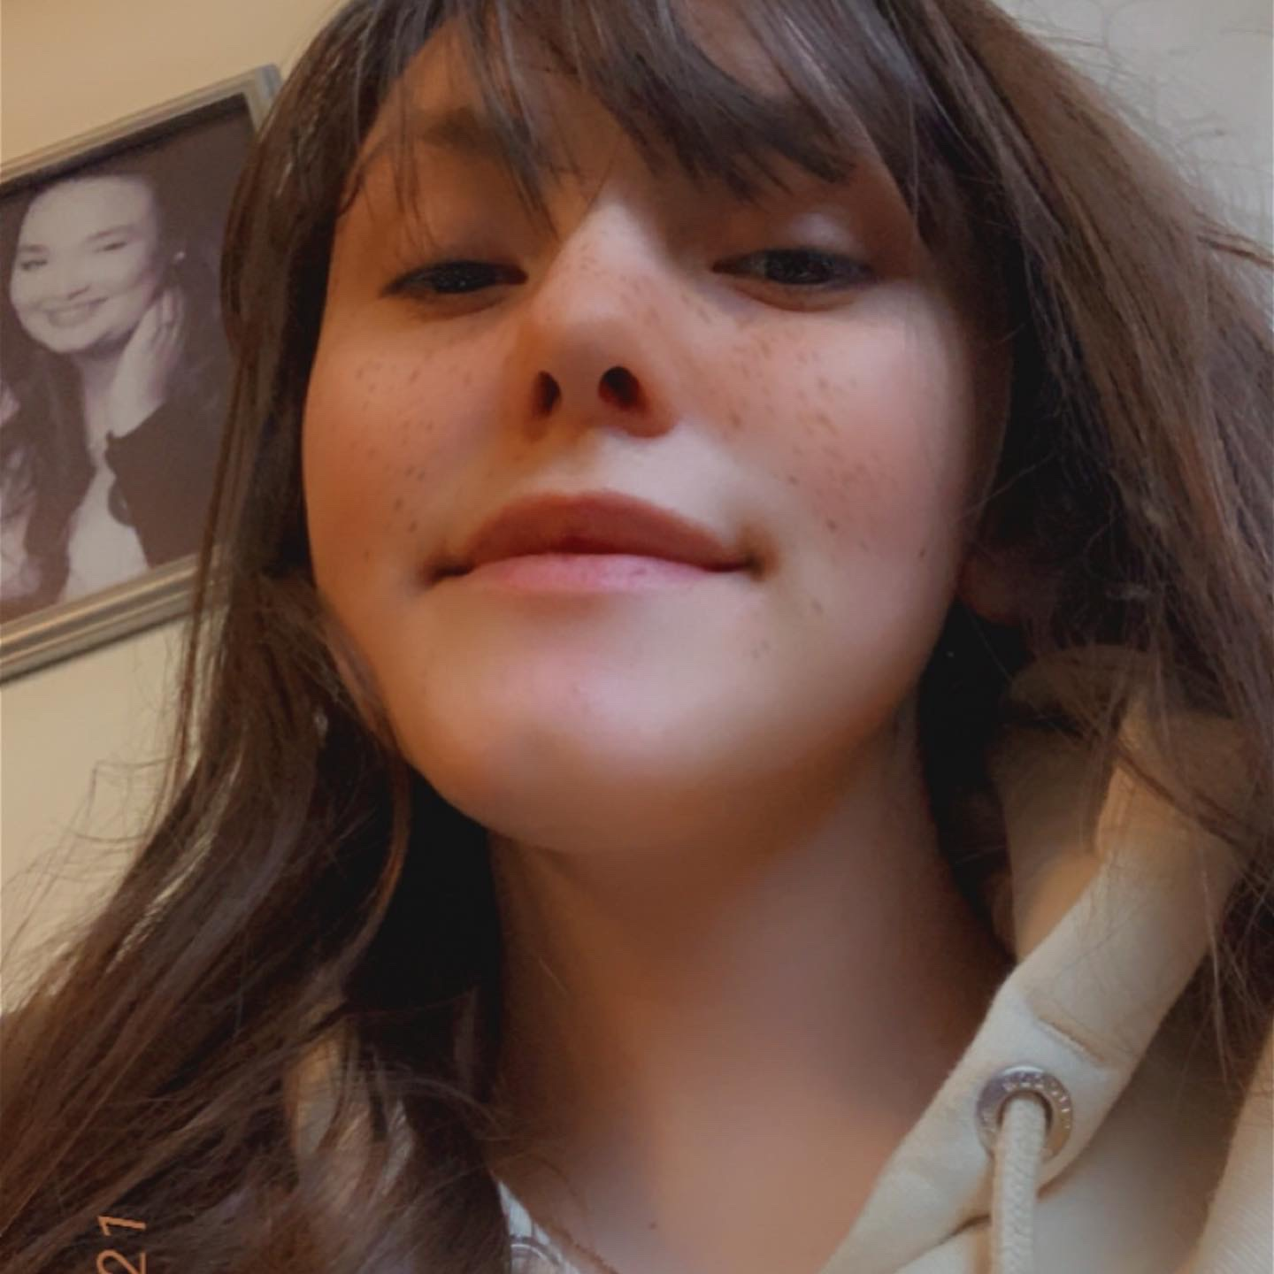
Hi, I'm Toyah
I'm 16 years old and I come from Gloucester but live in Tewkesbury with my foster carers. I love doing water sports and I love being by the water, I also love to do art. I'm studying art at level 3 (a level) in college, and I love it. I came into care when I was 13. Being taken into care did a lot of amazing things for me such as; meeting amazing people being looked after properly and having the support I've never had before. I also got my dream of helping other people like me who are in care or coming into care by becoming and ambassador. Being in care does have a few downs though, you have to come into a new family with people you’ve never met before and being a part of a family you haven’t known since you were a baby It’s hard to bond at times, But I did bond with my carers and foster sisters and brother quickly, so It wasn’t that bad for that long, probably a few weeks. Also, in the beginning being away from the dysfunction was hard as I wasn’t used to it.

Slide 26
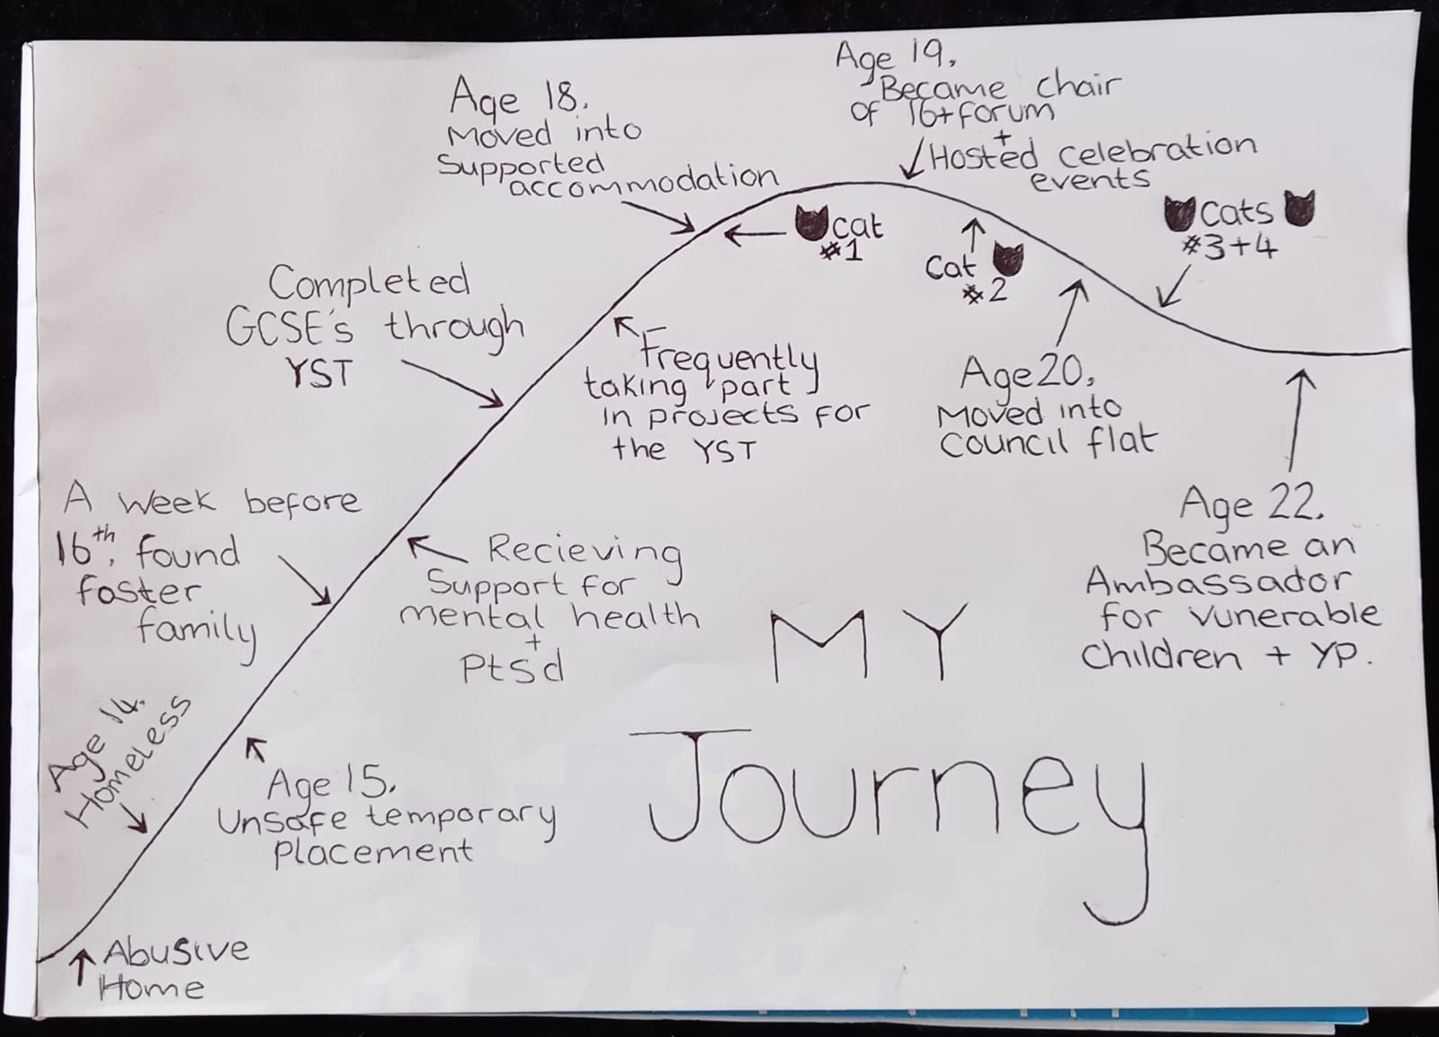

Introducing Becca!

Slide 27
How County Councillors can support Children in Care and Care Leavers
Complete a one page profile telling us what support you can offer, e.g. advice, guidance or connections to support our careers and opportunities for work experience
Attend events and celebrations to get to know us better
Attend Foster Carer Support Groups
Champion us in your meetings and raise our profile in your areas
Tell us about your ideas to support children in care and care leavers living in your ward

Slide 28
How do we hear the voice of other Children in Care and Care Leavers
Forums, events and activities
Mind of My Own app
Surveys e.g. Bright Spots
Engagement events with Corporate Parenting Group

Slide 29
An Overview of Corporate Parenting in Gloucestershire
Gill Horrobin, Interim Strategic Lead, Children in Care

Slide 30
Context: Overview of Children in Care
The number of children in care remains high (788)
Numbers continue to rise and peaked last week reaching 818 (a 33% rise since 2017)

Slide 31
Overview of Children in Care (cont.)
The impact of the increase presents challenges, not least in respect of:
Placement capacity, which in turn affects placement stability for children
Growth in terms of the number of care leavers who require support from us as Corporate Parents (461 care leavers currently with a projected increase to 580 in 3 years time, incl. extended support up to 25yrs)

Slide 32
Composition of the Corporate Parenting Group (CPG) in Gloucestershire
Alongside County Councillors there is representation from:
Ambassadors (supported by The Participation Manager)
Education (Primary, Secondary and Alternative Schools Provision) and The Virtual School
Health
Police
District Councils
Foster Care
Senior Managers within Children’s Social Care

Slide 33
Responsibilities of the CPG
Some examples included within The Terms of Reference for the CPG are as follows:
To monitor the impact of services for children in care and through effective challenge make recommendations regarding the ways in which the council and its partner agencies can improve the life chances of children in care and care leavers;
To maintain a strategic overview of new developments, initiatives, plans, policies and strategies for children in care and drive improved outcomes;
To oversee the Elected Members ‘Pledge’ to children in care;
To listen to the views of children in care, young people and their carers, take account of their views and involve them in the development and delivery of services;

Slide 34
Responsibilities of the CPG (cont.)
To take account of the direct experiences of those carers who look after children in care by inviting them to assist in influencing the improvement of services and policy development;
To maximise opportunities for children and young people through improved educational outcomes, training and career opportunities;
To acknowledge and celebrate the achievements of children and young people in care.
A copy of the full list of responsibilities highlighted within the CPG Terms of Reference will be circulated after this event along with the presentation

Slide 35
Examples of Submissions to the CPG for Consideration
Annual Reports to present management information, work undertaken and forthcoming priorities designed to drive forward ongoing improvements:
VOICE Gloucestershire
Health of Children in Care
The Virtual School Head Teacher Report
Fostering
Adoption
Annual Report of the CPG
Reviewing Service
Children Missing from Care
The Care Leaver’s Strategy and regular Care Leaver Offer updates

Slide 36
Extract from the Corporate Parenting Pledge
All Gloucestershire County Councillors are Corporate Parents and as such, take their role and responsibilities seriously as if they are our own children. The Council will support Members in fulfilling their role by:
Ensuring they are equipped with the knowledge and information about the corporate parenting work of the Council;
Providing them with training opportunities to assist in the development of their role;
Hosting events, facilitated by Ambassadors with care experience and the Children in Care Council (CiCC) to provide contextual information and share the work of the CiCC;
Publishing a schedule of events concerning children in care and care leavers in order that Members can become involved and celebrate their achievements.

Slide 37
The Corporate Parenting Pledge (cont.)
As a County Councillor for Gloucestershire County Council, I understand I am a Corporate Parent for our children in care and I will take my role seriously. I will do my best to attend events and learn more about our children and young people in order that I can champion their needs as appropriate.
I understand I will be provided with an ongoing schedule of events and I will confirm which events I can attend.
Name: ………………………………..
Signature: ………………………… Date: ………………………………

Slide 38
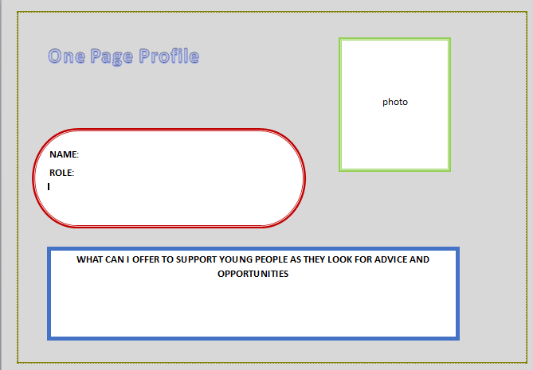
One-page profile

Slide 39
Being an Active Corporate Parent
We all take for granted the contacts and family links that we have in our lives. Children in care have none of these links. They don’t have a parent who can just pick up the phone to get their child in contact with another family member or a friend who can offer advice and guidance on careers and work experience.
We have children in care who have no family and are isolated and unsure about work and their futures and what career choice they should make. You as a corporate parent can help change their life by doing just one small thing that gets them through a door, a door so often closed to them.
So please be an active corporate parent and play a part in changing their lives………….

Slide 40
CPG Meetings
The CPG meets 4 times a year for 2 hours, 15.00-17.00
Forthcoming dates:
14th July 2021
30th September 2021
9th December 2021
24th March 2022
In addition there will be events whereby Corporate Parents are formally invited to meet the Children in Care Council to receive feedback and plan ahead.

Slide 41
Support for care leavers – advice for corporate parents Wednesday 23 June 2021, 10.00am - 11.30am
https://lgaevents.local.gov.uk/lga/frontend/reg/thome.csp?pageID=416408&eventID=1218&CSPCHD=002001000000NxSr5tTQV0rrvnSKTT_yijv_QK7EVyCEwGw7es

Slide 42
Questions and Answers Session

