Slide 1



My street, your street
Unit Plan

Slide 2
Unit Plan
How long should I spend on each section?
This depends on lots of things. For example, you may wish to take longer on your walk, perhaps you need to practice mapping skills, spend more time recording your finding or researching. Older children may want to spend more time on the extra activities too.
We would recommend doing the activities in 30 – 40 minute blocks so that you can fit in all your other work too.
There is a certificate at the end and remember to use the workbook.
Don’t rush! Try to make your finished map as good as it can be!

Slide 3
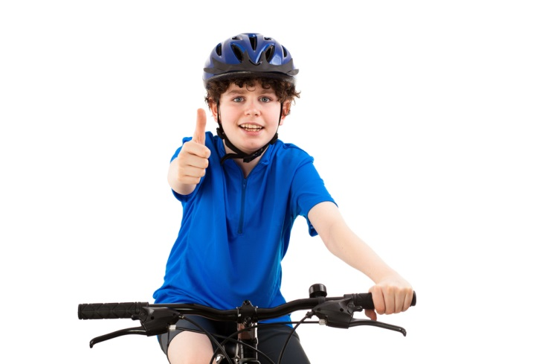
In this unit, you will discover more about the street you live in and those around you, use mapping skills and develop an understanding of what makes a street healthy.
Important words (vocabulary) – click to find out more.
Air Quality
City
Community
Pollution
Road
School Shop
Street Town
Traffic Vehicles
Village
Geography Link:
Local fieldwork
Compass Directions
PE Link:
Active, healthy lives

Slide 4
Thinktravel Big question:
What makes a street ‘healthy’?
What makes a street ‘unhealthy’?
Challenge: in two minutes how many things can you list? Then use My Pack 2 to list or draw as many things as you can.

Slide 5
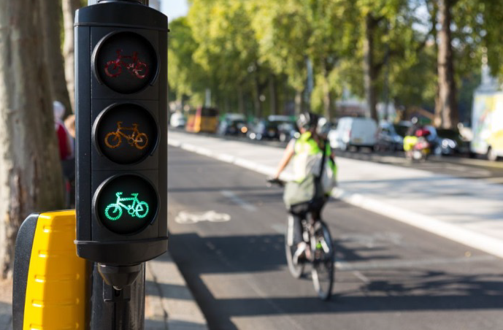
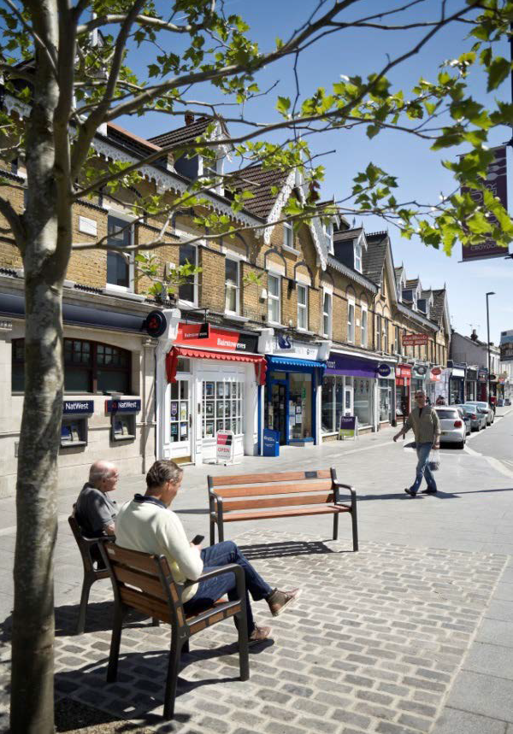
what do you notice In these pictures?

Slide 6
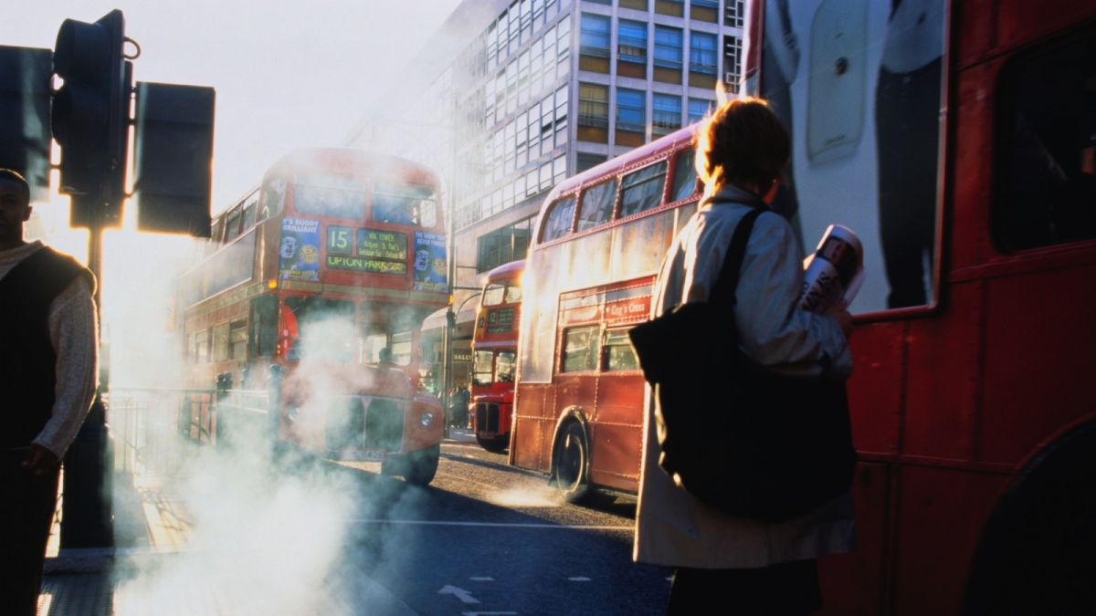
what do you notice In this picture?

Slide 7
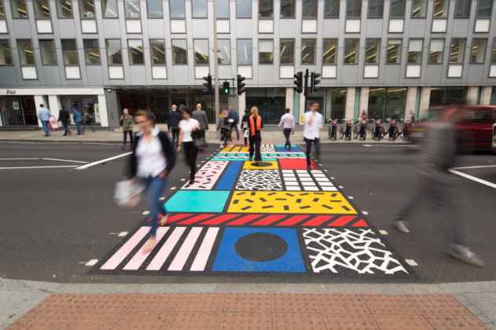
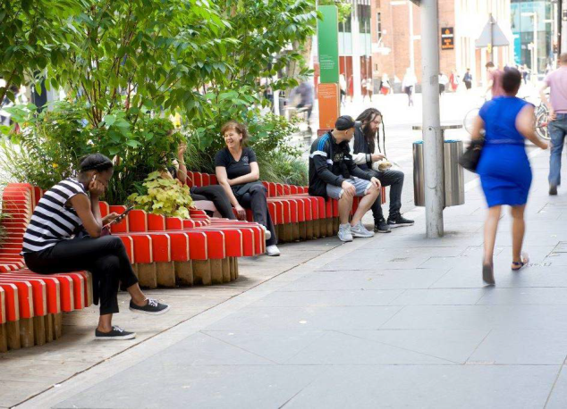
Key stage 2: sort these statements into healthy and unhealthy.
People choose to walk, cycle.
There are pedestrians from all walks of life - the street is for everyone.
There are lots of vehicles (traffic).
It is difficult to cross the road.
The street is quiet and peaceful.
There are places where I can rest.
There is no shade from the sun or shelter from rain.
People feel relaxed and smile lots.
There are things to see and do.
Extension:
Put the healthy statements in order and choose your top 3!
Can you think of your own statements?

Slide 8
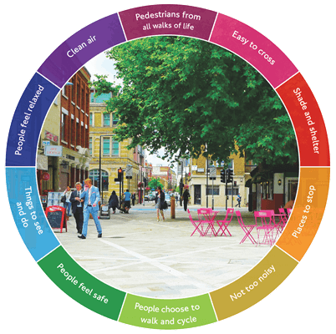
Living Streets: Key Stage 2 Activity
In London, our country’s largest city, Living Streets worked with cyclists to support healthy streets.
Check their website: click here
Use My Pack 5 to write two facts.

Slide 9

STREET TALK: VIDEO FROM A SCHOOL STREET IN SOUTHAMPTON
Courtesy of Sustrans. To view the video make sure you are in Slideshow mode. You can also use this link:
https://youtu.be/ZSdoCh9_eQg

Slide 10
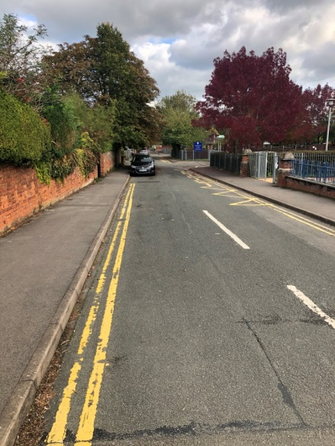
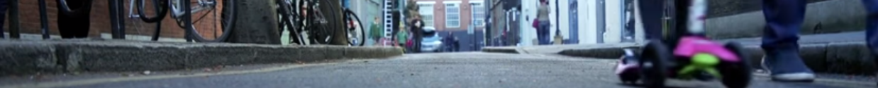
Activity: Observational walk
  Walking is a great activity! An extra 5 minutes a day can add up to a fun way to keep fit and healthy. Being outside is good for you. When out and about why not have a look at the street near you? How does it make you feel?
  Remember to ask permission or walk as a family. Remember to keep safe, keeping an eye open for vehicles, think about the weather and dress accordingly.
  Use the Observational Walk Template My Pack 6 or 7.
Try this!
Create a tally of cyclists, walkers , cars, lorries and buses. What do you notice?
Take a photograph and label this using the checklist.
Ask your mum, dad or carer to send in a photo, your checklist or even a video of your street so we can include this on our blog! They can send these to
Thinktravel@gloucestershire.gov.uk
Note to parent / carer: remember to check advice in your area during the Covid 19 pandemic.

Slide 11

Map skills
Maps are created to help people move around and find places more easily. You can have very simple maps with just the important details you need or very complex maps with more information.
To use a map, you need to know what direction you’re going in. To start with, it’s important to know North, South, East and West. A compass is a tool that can help you although you can also use the direction of the sun (never look directly into the sun though)
Older children may want to add more directions.
For more information have a look at:
BBC Bitesize Key Stage 1. Click here.
BBC Bitesize Key Stage 2. Click here.

Slide 12
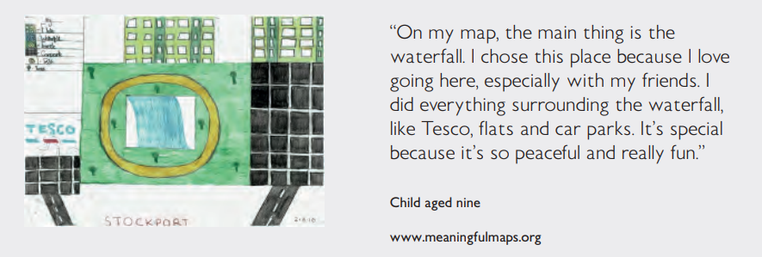
Map skills
Courtesy of Ordinance Survey

Slide 13
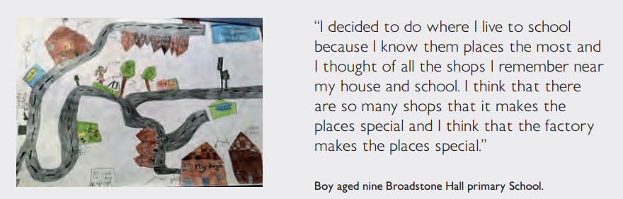
Map skills
Have a look at these maps.
Have a go at creating your own map of the area, plotting things you see, things you like and things you don’t like? You can draw straight onto your map or create a key. Get a grown up to help or look at some examples.
Think Creative!
Use Collage to make map 3D.
Use magazine pictures.
Courtesy of Ordinance Survey
Top Tip
Try different colours for healthy and unhealthy things.

Slide 14
Map skills
Have a go at creating your own map of the area, plotting things you see, things you like and things you don’t like? You can draw straight onto your map or create a key. Get a grown up to help or look at some of the examples below;
Courtesy of Ordinance Survey

Slide 15
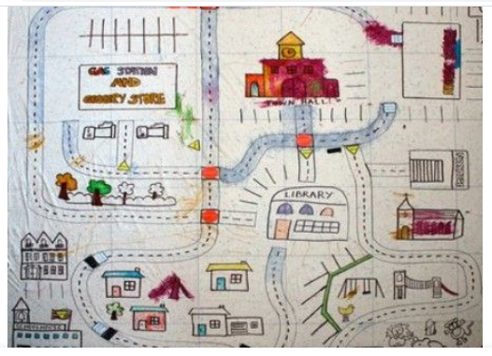
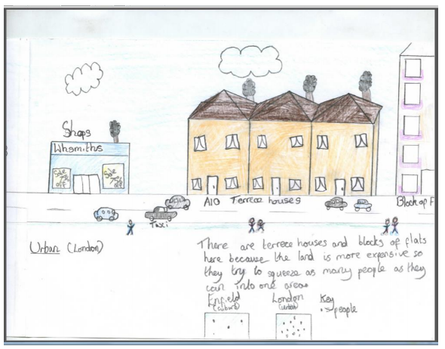
More examples

Slide 16

Our ideal street
As an extension and to show what you have learnt, why not use My Pack activity 7. Get imaginative and have fun creating your ideal street!
Share these with school and ask them to send the ideas to us!

Slide 17
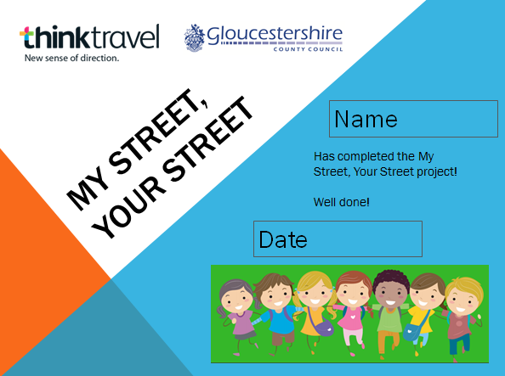
YOUR CERTIFICATE!
Once finished, let your school know!
You can also get your certificate from school.

Slide 18
School streets
School Streets is an exciting initiative, with streets outside school open just for pedestrians, cyclists and scooters at drop off and pick up times.
We’ve started our own trial in Gloucestershire.
Why not get involved and ask your school to set up a question and answer session or group discussion with the Thinktravel team?
Check our website: www.thinktravel.info
There is also a national school streets website: www.schoolstreets.org.uk

Slide 19
Notes for teachers, parents and carers
You could investigate aerial imagery using e.g. OS maps, Google Earth or Bing maps, and talk about the features that can be seen and identified, using geographical vocabulary. 3D junk mapping could be used to build a map of the streets near you while digital mapping could show the route of a walk.
However, getting out and about is the best way to learn. Get your child to really observe closely, take photographs if you can, plot out the walk, use paper maps (often found in local newsagents or supermarkets). It’s also important to use the relevant geographical knowledge and vocabulary to get a greater depth of enquiry and understanding in follow up questions e.g. Why are there so many cars here? How is this place changing and why? Why is the park shut? Why do people cross here?
We would love the school to send us examples of work, photographs or maps. We can publish this on our website !
Thinktravel@gloucestershire.gov.uk

Slide 20
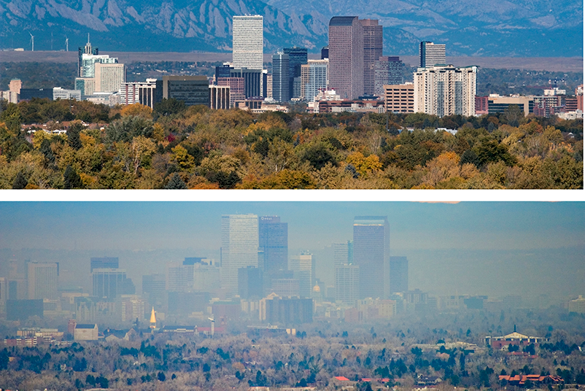

Word definitions A - r
Air Quality - how clean the air is
City - a large town
Community – a group of people who may live in the same place
House - a building where people live.
Pollution – tiny particles in the air that can be harmful to breathe
Road – an area that leads from one place to another for vehicles
Click back

Slide 21
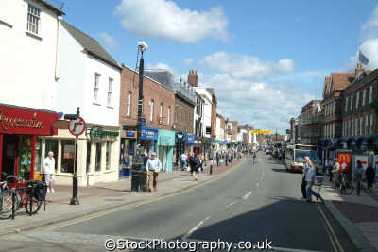
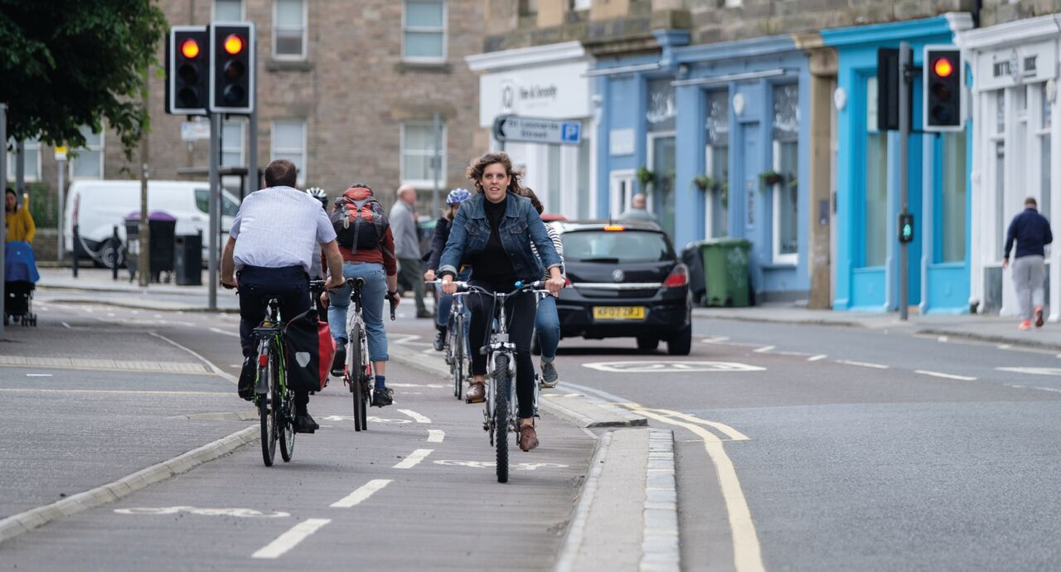
Word definitions S – Z
School – a place or building where children learn
Shop – a building where people buy things
Street – a road usually with houses and buildings either side
Town - a place with lots of buildings where people live and work
Traffic – vehicles moving on a road or street
Vehicles - things that take people of goods from one place to another. A car is a vehicle.
Village - a small place with buildings including houses
Click back

