Slide 1
Gloucester City School Places Review
August 2018

Slide 2
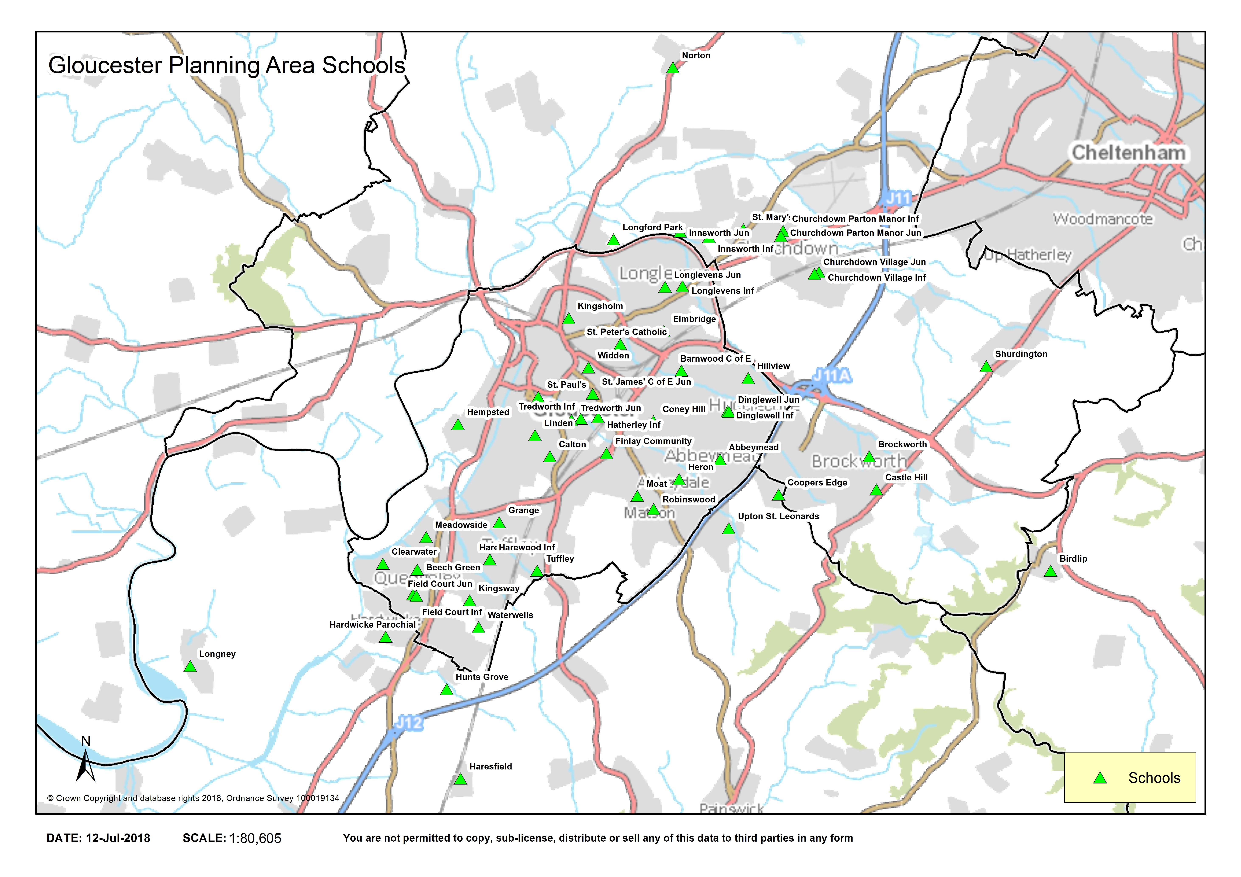
Gloucester Primary Schools

Slide 3
Primary School Places and Demand
Since 2012 we have delivered a programme of additional primary school places through the expansion (permanent and temporary) of existing schools and the provision of new schools.
Based on current projections, further expansions across Gloucester District will meet our basic need requirements up to 2021.
There continues to be demand for more places as a result of new planned housing however S106, has been secured to provide sites and new schools or contributions to expand existing schools to meet this continued need
Notes:
460 temporary places added and 2740 permanent places since 2011

Slide 4
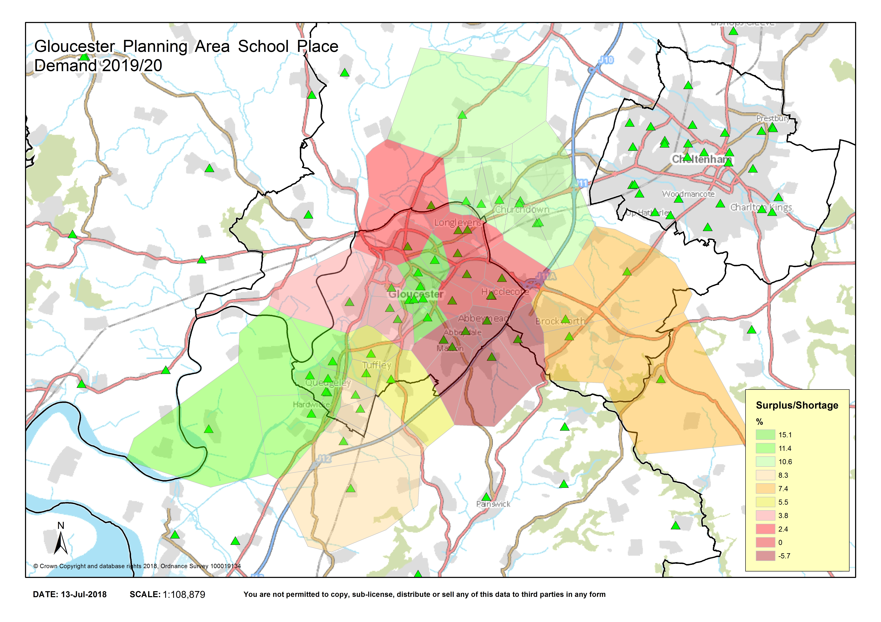
Gloucester Primary Heat Map – 2019 Forecasts
Notes:
Using 2019 forecasts this shows where in Gloucester there is pressure for places – Longlevens, Linden, Barnwood/Hucclecote/Abbeymead Robinswood/ Upton

Slide 5
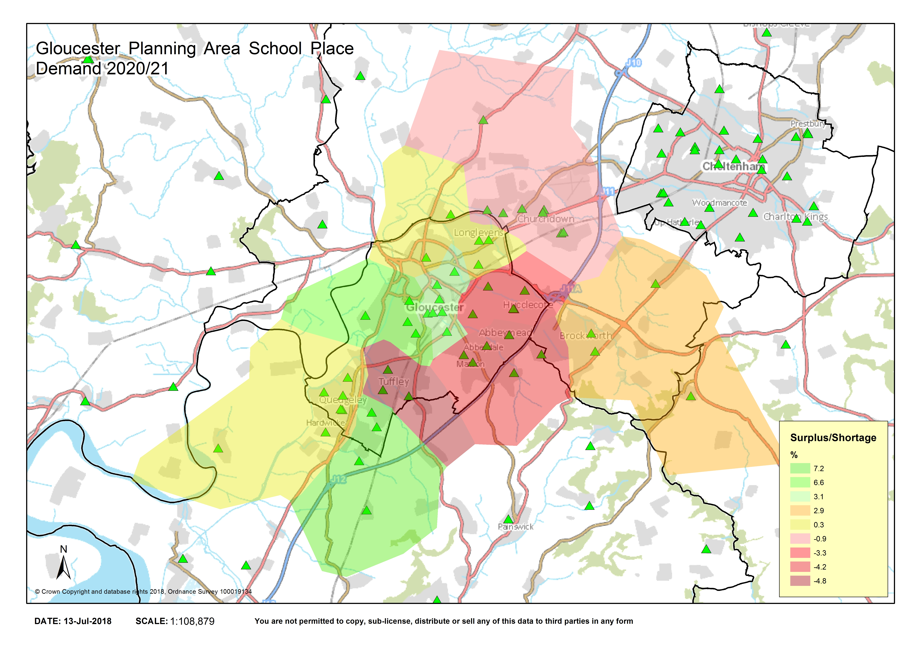
Gloucester Primary Heat Map – 2020 Forecasts
Notes:
By 2020 the map changes slightly to include Tuffley and Churchdown /Innsworth with Longlevens and Linden planning areas having less of an issue

Slide 6
Gloucester Primary Places Conclusion
The strategy adopted to expand existing Gloucester primary schools to meet our need for additional places has worked well, so far.
Two further 1FE Expansions at local schools will meet our need to 2021
Any further growth is likely to be as a result of new housing which will be supported by S106 capital and where appropriate land for new school/s
Notes:
In summary, there is little spare capacity in the city to accommodate further growth or inward migration without the need to identify and secure new sites for primary schools, together with additional capital resources.
Any new housing development proposals in Gloucester District or neighbouring areas will need to consider the provision of new primary school places.
By 2019 there will be 2346 Reception places available
Once all schools reach their full PANs (Clearwater, Hunts grove, ) there will be a total of 2404 Reception places

Slide 7
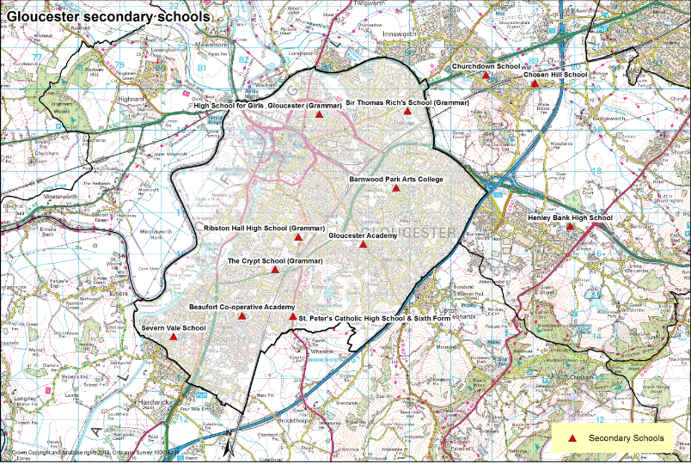
Gloucester Secondary Schools
Notes:
12 secondary schools in the Gloucester Education Planning Areas.
Barnwood Park Arts College (11-16)
Beaufort Academy (11-18)
Churchdown Academy (11-18)
Chosen Hill Academy (11-18)
Gloucester Academy (11 -18)
High School for Girls (11-18)
Millbrook Academy (11-18)
Sir Thomas Richs (11-18)
Ribston Hall (11-18)
Severn Vale (11-16)
St Peters High (11-18)
The Crypt (11-18)

Slide 8
Gloucester Secondary Places The Challenge
In 2020, taking account of the planned PAN increases and planned expansions at Beaufort, Barnwood Park and Severn Vale, there is expected to be a 1FE (30 places) shortfall of Y7 places.
In 2022 the shortfall of Y7 places rises to 4FE (120 places)
In 2023 the shortfall of Y7 places rises significantly to 8FE (240 places)
In 2024 the shortfall drops back to 4FE (120 places)
Notes:
This shortfall of places takes account of pupils already in the system at our primary schools as well as pupils arising from housing developments that have commenced or are known to be commencing but may not include all potential housing sites that have not yet come forward.
It also takes into account a number of known PAN increases at all Gloucester Grammar schools, and the planned 1FE permanent expansions at Barnwood Park,
Beaufort and Severn Vale.
These figures will meet demand but will not apply any surplus capacity as recommended by the National Audit Commission.

Slide 9
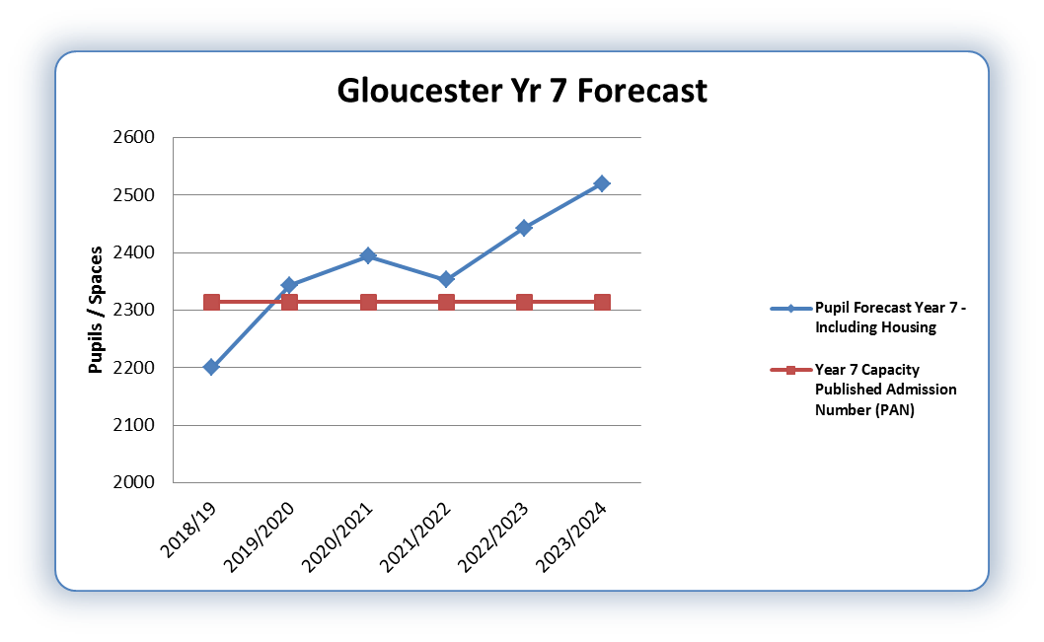
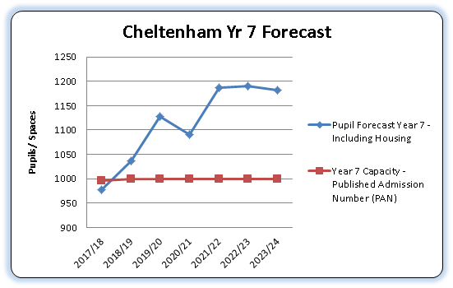
Year 7 Intake Forecast
Notes:
PAN based on 2344 (PAN in 2019) Includes all selective PAN changes with exception to Ribston Hall who are still in consultation.
Based on our 2017 Scap data

Slide 10
What has caused this?
Upward trend in the birth rate, and numbers rolling through from primary.
Significant new housing growth in the south of Gloucester Quedgeley/Kingsway and Coopers Edge to the north of Gloucester.
Significant New housing developments with planning consents as documented in the JCS
Notes:
The growth in the south of Gloucester along the Quedgeley /Kingsway corridor is now being felt by secondary schools as the pupils from new primary schools build to support the new housing begin to transfer to secondary school.

Slide 11
Looking forward
In addition to housing currently under construction or imminently planned such as at Hunts Grove, Quedgeley and St Gobain, Eastern Ave, we need to plan for further children arising from strategic sites that are still waiting to commence or obtain planning consent but that are named in the Strategic Housing (Joint Core Strategy)

Slide 12
Housing sites in the Joint Core Strategy Number of Dwellings
SA3 – South Churchdown (1100)
SA1 – Innsworth (1500)
Twigworth (750)
Perry Brook (1500)
Winnycroft Farm (250 and 420)
Notes:
These sites and yields are not included in our forecasts or Housing trajectories as they have not yet come forward

Slide 13
Secondary Place Planning Strategy
Temporary expansions:
None to date, however we expect some temporary expansions may be required (2019-2021) ahead of any permanent new provision.
Permanent expansions:
2018 Seven Vale, Beaufort and Barnwood Park all admitting an additional 30 Y7 pupils each, resulting in 90 additional places. All four grammar schools have increased their PANs to 150, resulting in 120 additional places.
Notes:
In addition there have been a significant number of schools including all of the Gloucester Grammar Schools who have recently increased their Planned Admission Number (PAN) (Ribston currently consulting)
Some Academies are exceeding their Published Admission Numbers

Slide 14
Opportunities & Options
There is a significant shortfall of places from 2022 and we will need to
Seek a site for a new Gloucester Secondary School
Expand existing schools (where site permits)

Slide 15
Next Steps
Provide a briefing for councillors, primary and secondary head teachers in Gloucester
Investigate opportunities to secure a new secondary school site or Free School solution
Consult with schools on future expansion opportunities
Continue to monitor housing updates with Gloucester City Council and surrounding councils notably Tewkesbury and Stroud
Following analysis of feedback consider options for inclusion in a strategy paper in late Autumn.

