Slide 1

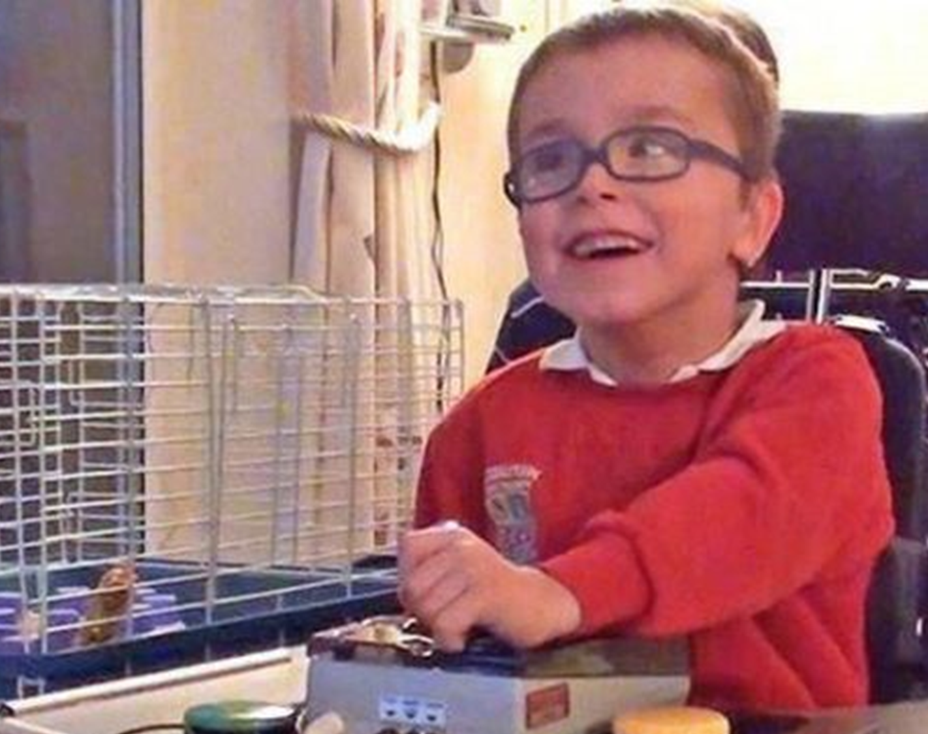

Gloucestershire County Council
Children’s Services – Education
26th June, 2025
Members’ Special Educational Needs and Disability (SEND) Briefing
Ann James – Executive Director of Children’s Services
Kirsten Harrison – Director of Education

Slide 2

Session Overview:
Session supporting materials:
‘SEND Facts’ Booklet – A Guide for Members
SEND Service ‘on a page’
An overview of GCC’s responsibilities for children and young people and their families with SEND
An overview of the Services provided by GCC
An overview of the current challenges facing the local and national SEND arrangements

Slide 3
National SEND Arrangements

Slide 4



National SEND Statutory Arrangements
Children and Families Act 2014
SEND Code of Practice: 0 – 25 years
The Children and Families Act 2014 - aimed at providing greater support and protection for children and their families.
Focused on adoption, special educational needs, and child welfare, consolidating various elements of previous laws into one framework
Key reforms included updates to adoption processes, enhanced rights for looked-after children, and improvements in family justice;
The Act aimed to ensure that vulnerable children received the necessary support and protection under the law.
Statutory Code contains:
details of legal requirements that we must follow without exception
statutory guidance that we must follow by law unless there’s a good reason not to
It explains the duties of local authorities, health bodies, schools and colleges to provide for those with special educational needs under part 3 of the Children and Families Act 2014.
Notes:
Key legislation and national guidance
Statutory partners – GCC Education, GCC Social Care, GCC Education – working in partnership with our partner, Gloucestershire Parent Carer Forum

Slide 5
Local SEND Arrangements

Slide 6
SEND and Inclusion Local Area Partnership Board
SILAP
Partnership Membership
GCC:
GCC Education
GCC Social Care & Disabled Children’s Service
GCC Public Health
GCC Children’s Commissioning
GCC Adult Social Care
GCC Youth Justice
GCC Strategic Lead for Inclusive Employment
Integrated Care Board:
Children Young people and Maternity Services
Adult Mental Health, Advocacy and Autism
Learning and Physical Disabilities
SEND Clinical Officer
Continuing Health Care
Community:
SENDIASS
Gloucestershire Parent Carer Forum
Voluntary & Community Sector Rep
Public Engagement Officers – Young people: FutureMe/Youth Voices
Local Education System:
Primary Headteacher Association
Secondary Headteacher Association
Special School Association
FE Colleges Rep
Alternative Provision
National Agencies:
DfE Gloucestershire SEND Advisor
DfE SEND Case Lead for Gloucestershire
NHSE Regional Representative
Notes:
Key vehicle for delivering and improving local SEND arrangements is the SILAP Board
Overview of the scope and complexity of meeting SEND need

Slide 7
GCC Education
SEND Service Structure

Slide 8
SEND Service Structure
Educational Psychology & Advisory Teaching Services
Operations
Amanda Henderson Head of Service
SEND
SEND Quality Assurance Lead
Specialist Commissioning Manager
EHCP Service
Engagement and Quality Manager

Slide 9
GCC Social Care & Disabled Children’s Services
Structures

Slide 10

GCC Disabled Children’s Service
Sits within Children's Social Care, supporting disabled children who need additional social care support.
Made up of 3 social work teams and 3 early support teams
Early support teams - support less complex children whose parents have direst payments, to employ support to meet their child’s assessed needs.
Work in the CSC front door and provide advice and support, alongside contributions to EHCNAs where there is no social worker allocated.

Slide 11
Local SEND and Inclusion
Landscape

Slide 12
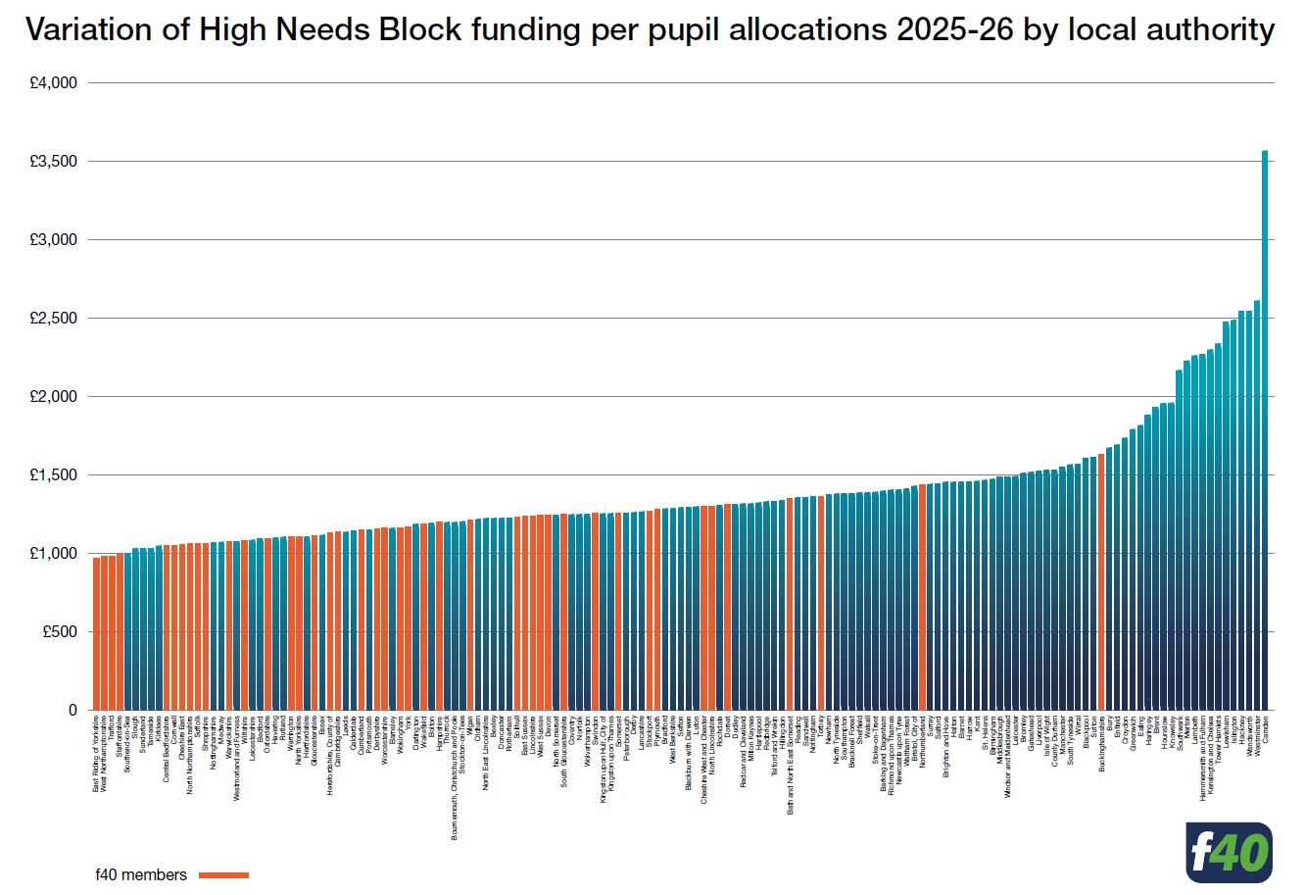
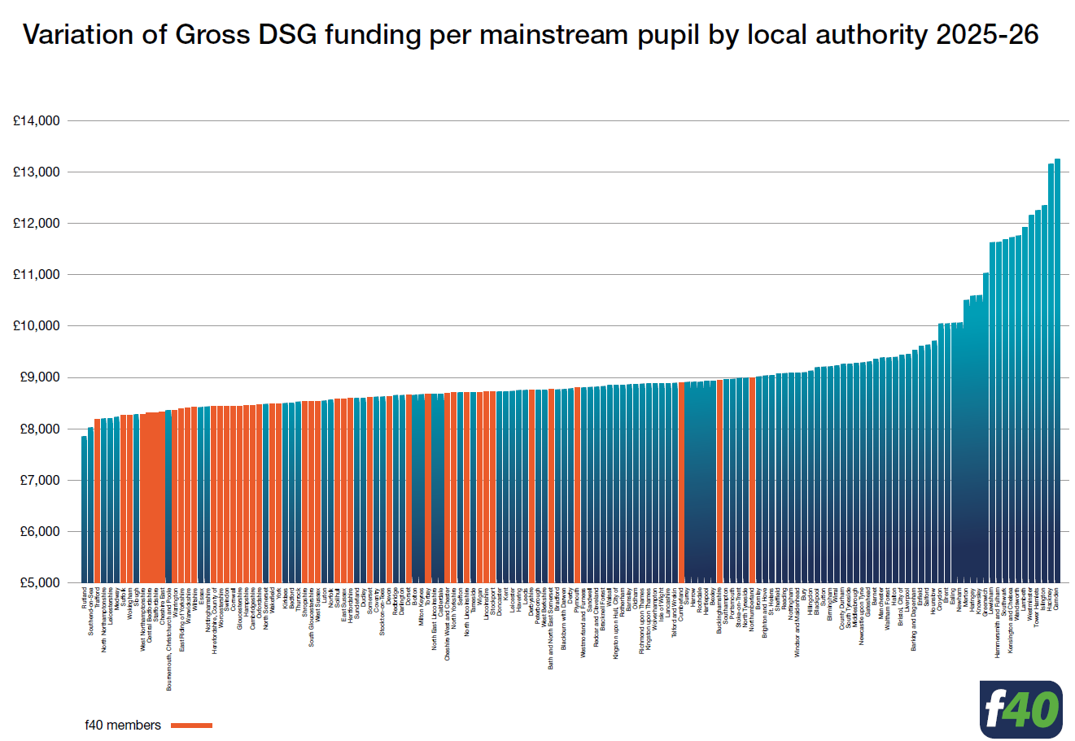
Dedicated Schools Grant:
Gloucestershire is poorly funded
Bottom 20% in both school and high needs funding blocks

Slide 13
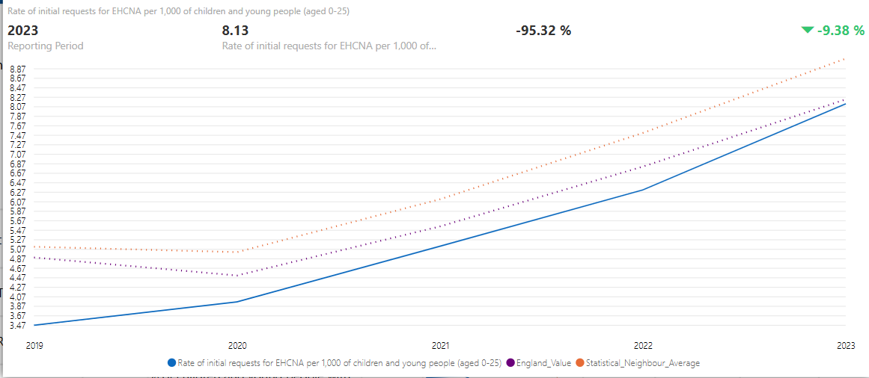
EHCP Demand…….
Notes:
As you can see demand in Gloucestershire has risen more sharply than elsewhere. Rate of EHCPs has always been lower than national and stat neighbours. We anticipate it moving in line in next national data drop.

Slide 14
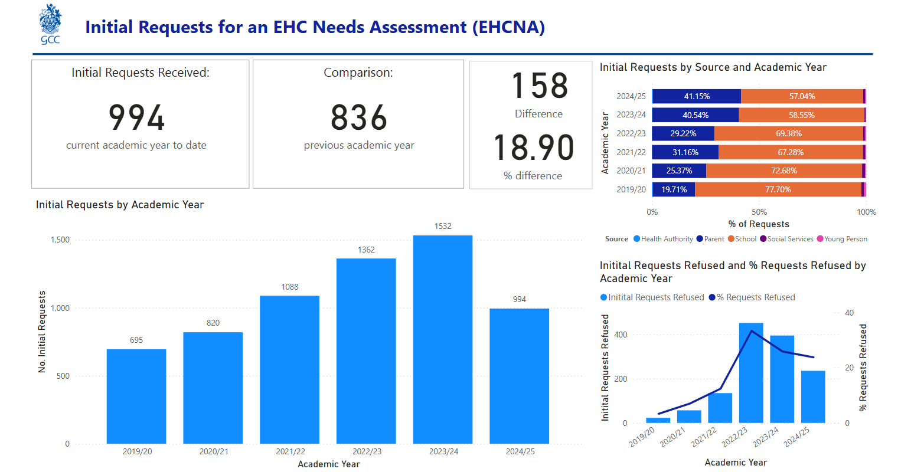
Notes:
Continued growing demand for for EHC needs assessment

Slide 15
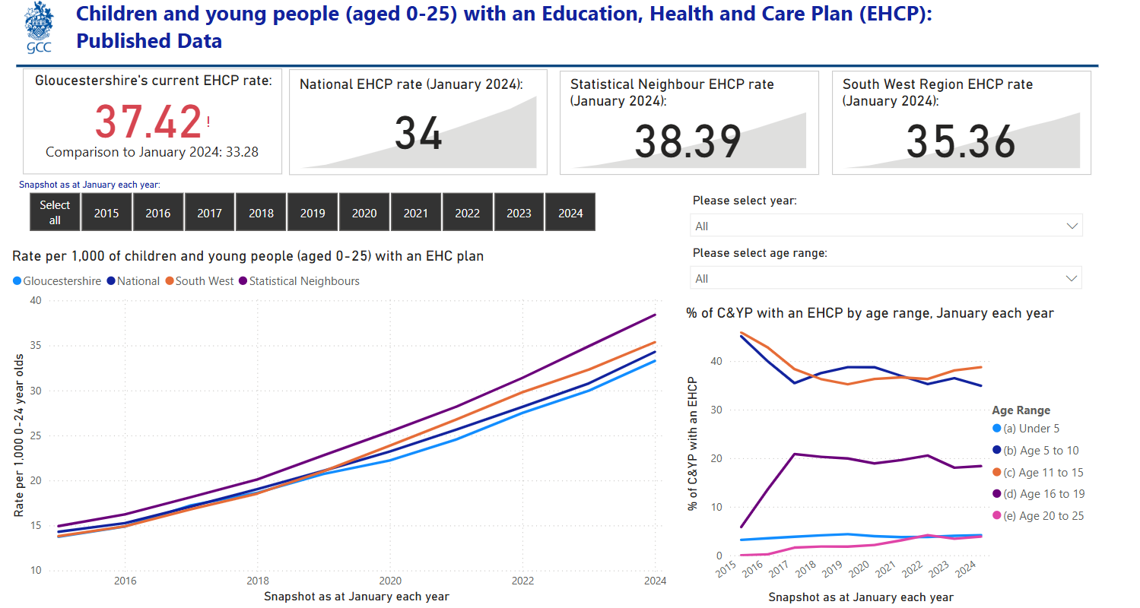
Notes:
Growing numbers of EHCPs – reaching national – on trajectory to join southwest and stat neighbours

Slide 16






Challenges in the Local SEND System
Sufficiency of specialist placements
3 challenges
Health waiting lists
Timeliness and quality of EHCP process
Notes:
3 key areas of focus

Slide 17
Local Area SEND and Inclusion
Improvement Plan

Slide 18
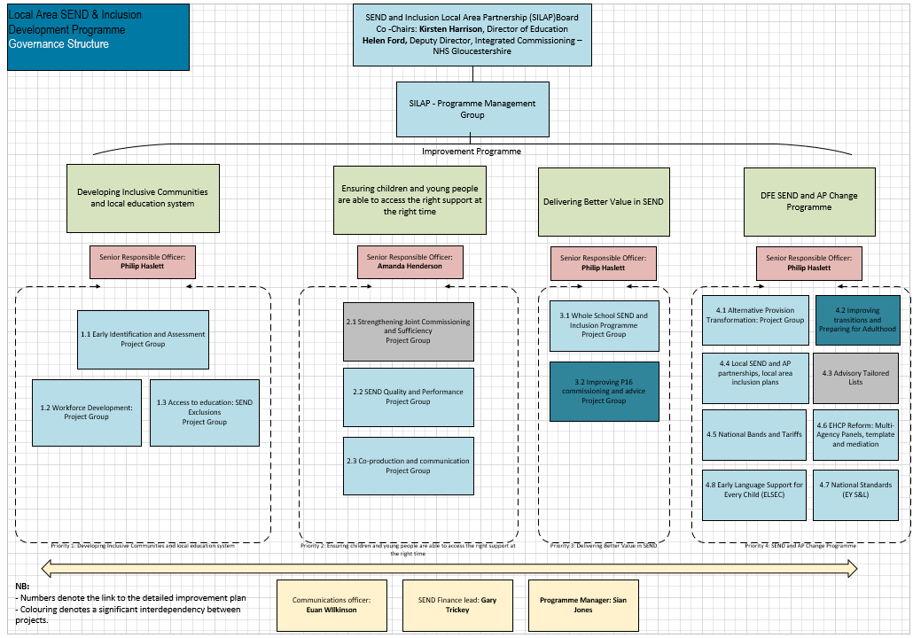
Local governance & improvement workstreams
Ofsted said:
“Leaders across the partnership have a shared vision of excellence.”
“The Local Area’s strategic plans are ambitious and designed to meet the needs of children and young people with SEND in Gloucestershire.”

Slide 19
Overarching Workstreams
Developing Inclusive Communities and an inclusive local education system
Ensuring children and young people are able to access the right support at the right time
Delivering Better Value in SEND
DfE SEND and Alternative Provision Change Partnership Programme – Joint Southwest Lead testing the proposed national SEND Reforms

Slide 20
Working together – Improving Communication
Asking and Listening
Articles in Families in Partnership newsletter – bi-monthly
Social media posts
Co-production opportunity with parent carers, young people
Develop and improve information on the Local Offer; use of video; visuals; clearer and more accessible language etc.
SENCO Clusters
Annual 'You said, we did' report
Sharing and Activity
Responding and Comms
Engagement:
Listen to Me Events – GPCF
Direct engagement activities at events
(Parents & CYP) e.g. SEND Fair, Youth Action Summit
Micro-grants to youth groups (CYP)
Meetings - monthly:
SENDIASS / GPCF / EHCP meeting
Parent Carer & Young Carer co-production group
ELSEC Strategic Meeting
Future Me, GHC Youth Voices (CYP)
Termly:
Local Offer Steering Group
SENDIASS Steering Group
PfA Programme (CYP)
Annual:
Parent Carer Survey
QPC Comms & Co-pro Group
QPC main Group
SENDIASS Steering Group
Local Offer & GlosFamiliesDirectory Steering Group
Direct contact with services to respond
Quality Assurance:
Weekly EHCP Panel – GPCF
EHCP audits – monthly
Community of Practice (CYP)
Co-production
Co-production
Notes:
Examples:
From our monthly meetings we identify articles for FIP – make contact with relevant services and publish FIP every two months – Feb issue due on 6th Feb
SEND Fair on 10th Feb – opportunity to engage, ask and listen to parent carer views on areas of training and awareness they want / would value which will inform our WFD workstream
Wider comms strategy to deliver (now to April) informative videos and articles to explain SILAP and the strategic partnership (MoU) - who it is ,what it is doing and branding so easy to identify and shine a spotlight on Partnership work on speech, language and communication to address needs

Slide 21
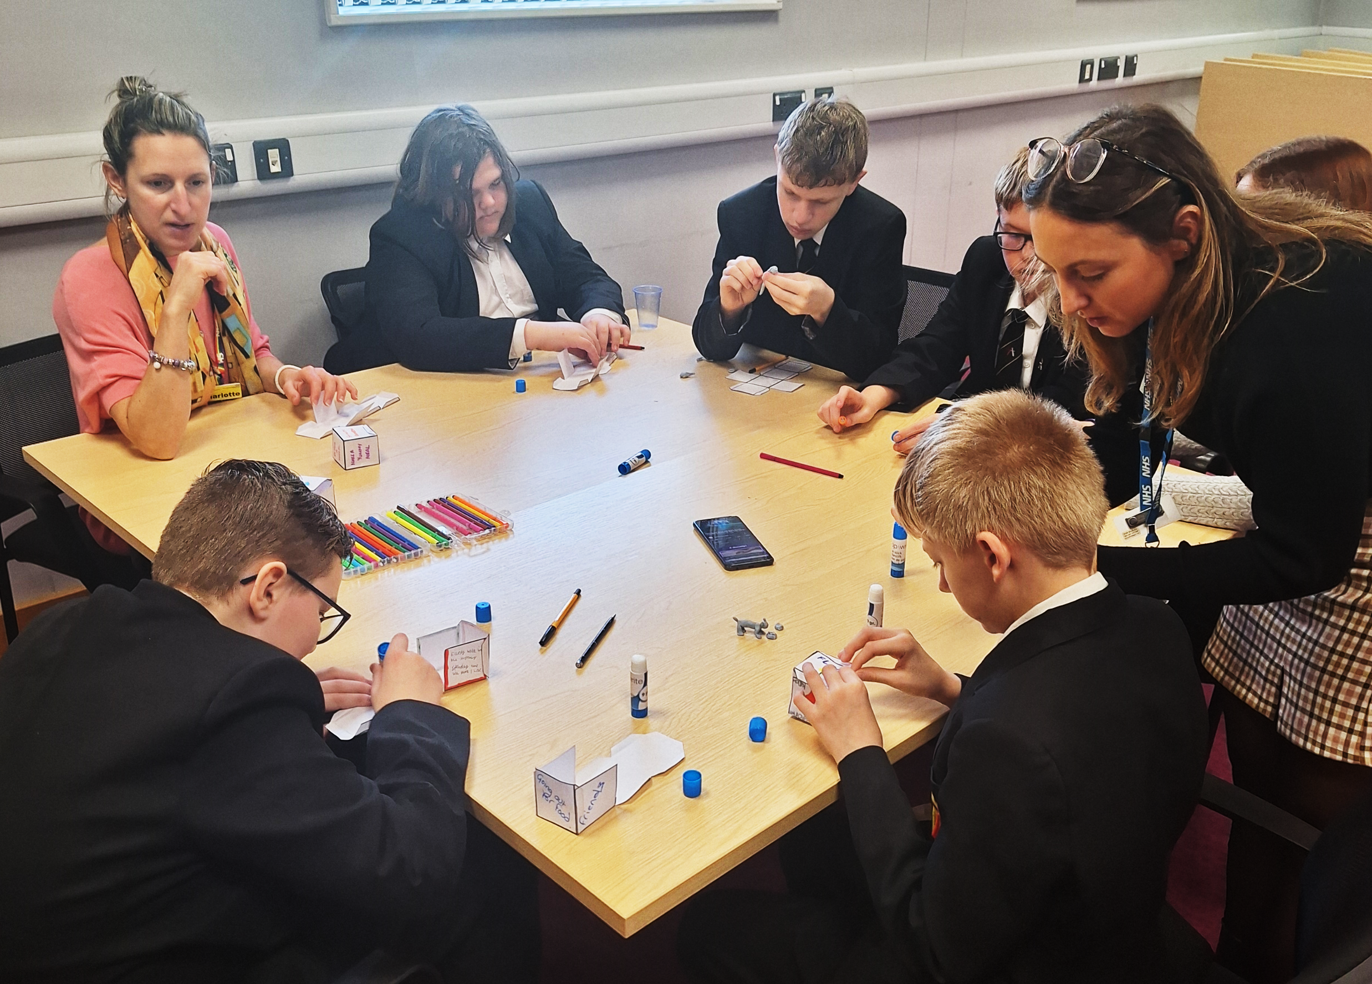
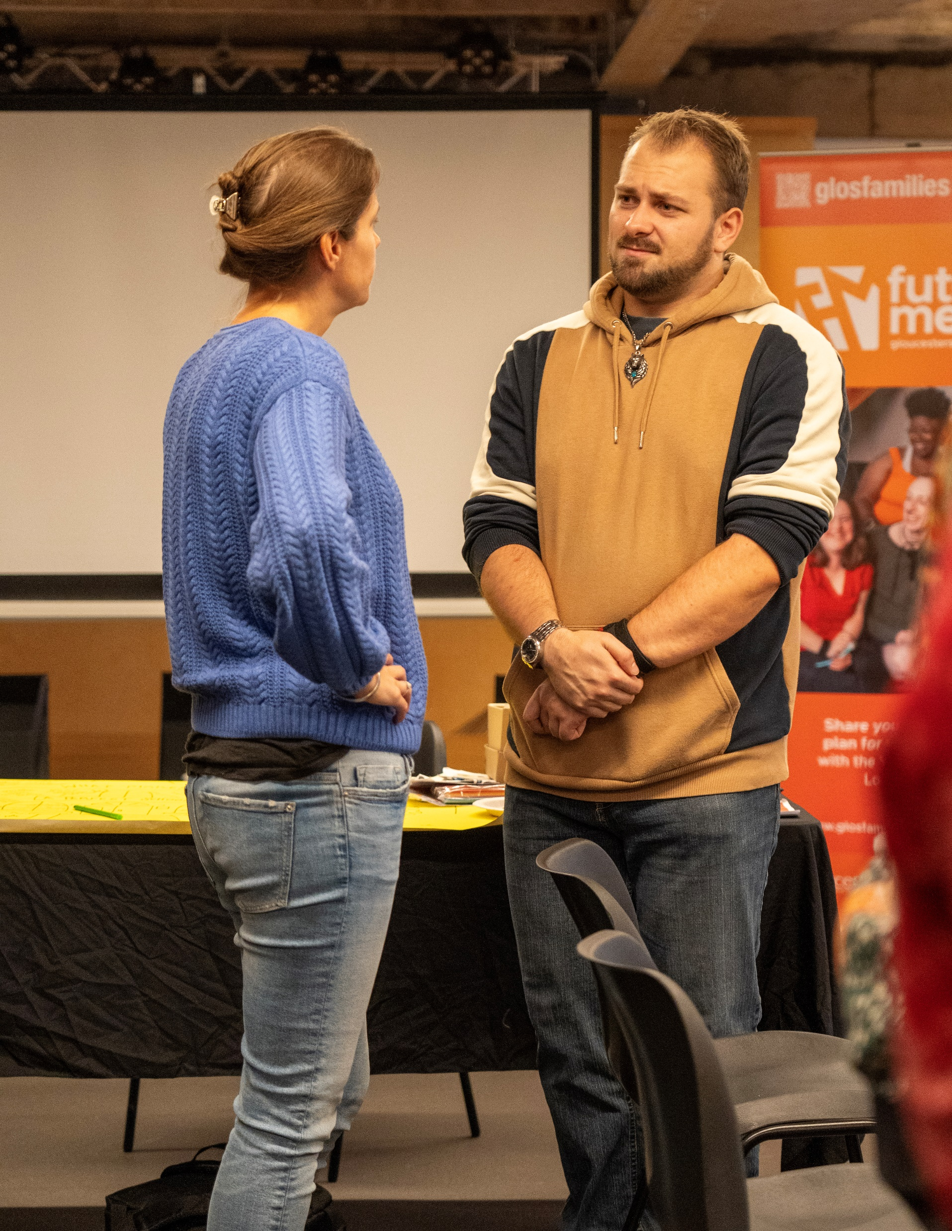
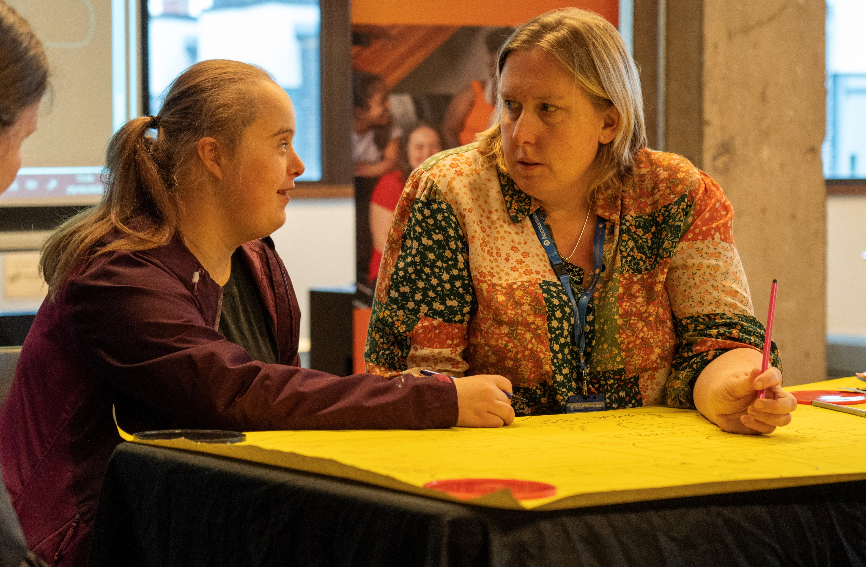
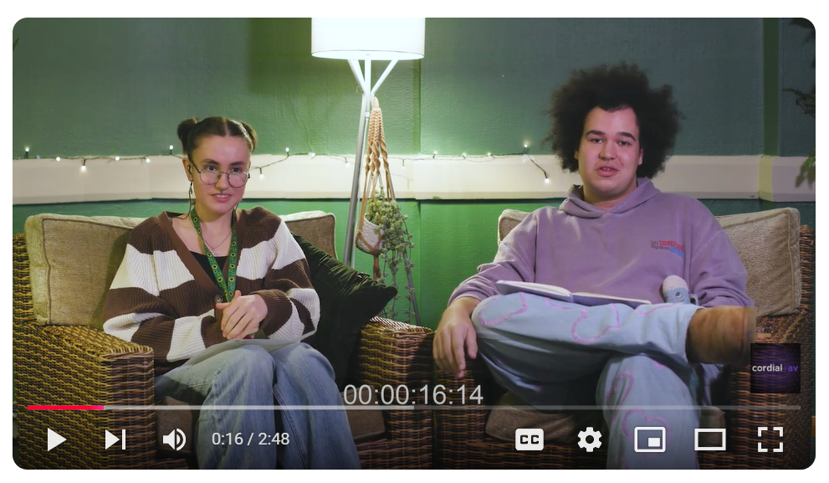


Engagement and Participation with Children and Young people

Slide 22
GCC Disabled Children’s Service
Sits within Children's Social Care, supporting disabled children who need additional social care support.
Made up of 3 social work teams and 3 early support teams
Early support teams - support less complex children whose parents have direst payments, to employ support to meet their child’s assessed needs.
Work in the CSC front door and provide advice and support, alongside contributions to EHCNAs where there is no social worker allocated.

Slide 23
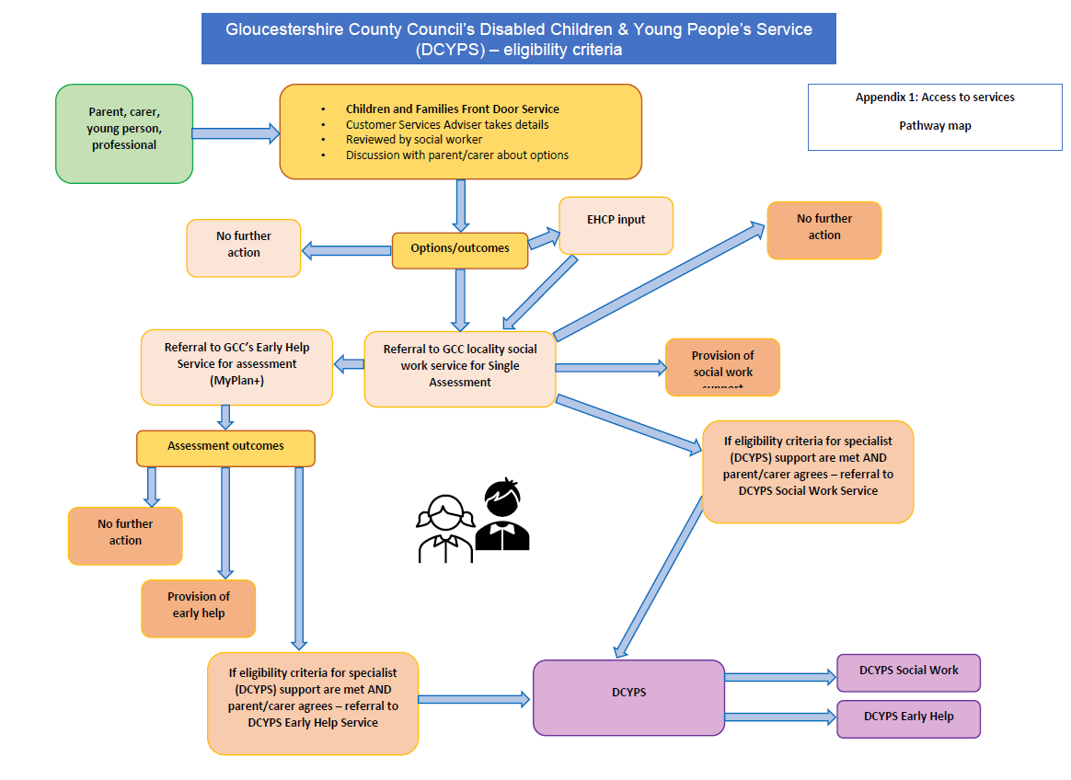
Disabled Children’s Service
Social work teams – support children with complex needs, including those where there are safeguarding concerns, and those who need care away from home.
Work closely alongside colleagues in health to fund and meet need.
Focus on transitions with adult colleagues to ensure smooth transition of care from age 0-25
Support mainstream social work teams where there is a disabled child within the wider family
Operate to clear eligibility criteria

Slide 24


Disabled Children’s Service
Social work teams work closely with parents and carers.
They have created strong links with two key local parents' groups – Gloucestershire Parent Carer Forum and Parent and Carer Alliance.
Teams work in a spirit of co-production – planning and leading services with input from those who use services.

Slide 25

Designated Social Care Officer (DSCO)
Designated Social Care Officer (DSCO) is a key role within the Special Educational Needs and Disabilities (SEND) system
The role focuses on improving outcomes for children and young people with SEND.
DSCOs act as a link between social care, SEND support, and other services like education and health.
They ensure needs are identified early and support is provided in a coordinated manner.
In Gloucestershire, the DSCO role is held by our head of Service for Disabled Children.

Slide 26
Priority Focus of the Local Area Partnership
Sufficiency of specialist placements
3 priorities
Health waiting lists
Timeliness and quality of EHCP process

Slide 27
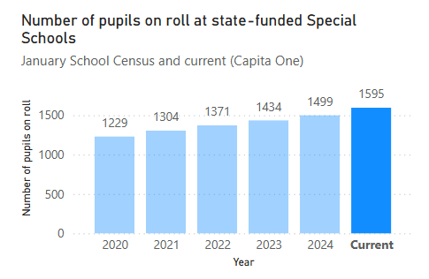
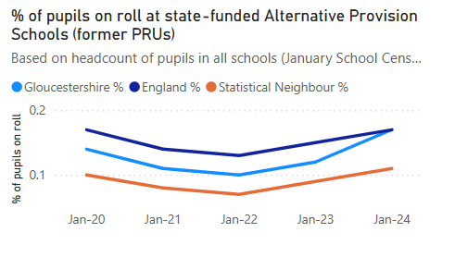
Priority 1: Specialist Placements
Steady increase of places since 2020
Notes:
We have been increasing specialist placements at pace in recent years, in both special schools and Alternative Provision.
We bid for two new ‘free’ schools from the DfE, but were told our need was not high enough, but have managed to progress these with our own funding.
Alternative provision placements have increased, with both the Hospital Education Service and Altus school increasing capacity. At Altus we purchased and converted a new site on Eastbrook Rd to add 40 places.

Slide 28
Priority 1: Sufficiency of Specialist Placements
Delivery Plan
Support the development of mainstream provision
Increase special school estate by a further 470 places
  200 place school opening sept 2026
  Further 200 place school progressing to Cabinet for decision in March 2025
  Expansion of Sladewood School – 70 places
Delivery of additional resource bases, currently assuming 50 places, but could increase significantly with additional capital funding.
Notes:
Sufficiency strategy and plan is in place. The focus is on three key developments:
Supporting mainstream to develop their own internal provision, funded through notional SEND funding, but with Capital support from the LA where needed. Good opportunities here with falling rolls in primary.
Increase special school places – New builds and expansion opportunities are being maximised, but this is a slow process.
Additional resource base places to expand the current offer. Currently planned at 50 places, but we are confident that this could increase significantly with the right capital investment.

Slide 29
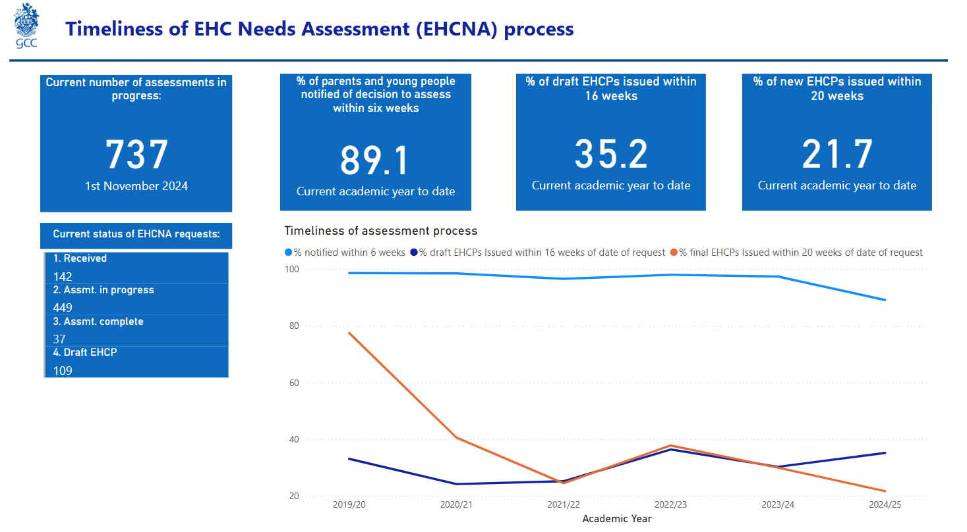
Priority 3: EHCP Timeliness
Notes:
Improvements made in the process but timeliness is still suffering due to demand pressures.

Slide 30
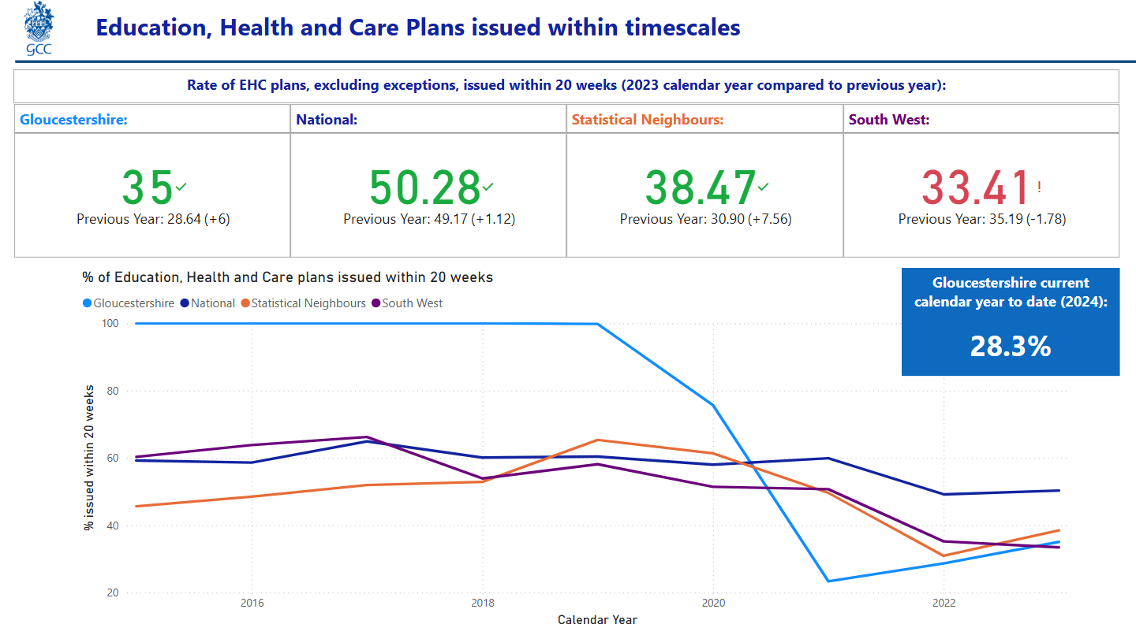
Priority 3: EHCP Timeliness Comparator Data
Notes:
Comparator data showed improvement pathway, but hard to sustain with increased demand.

Slide 31
Priority 3: EHCP Demand…….
Notes:
As you can see demand in Gloucestershire has risen more sharply than elsewhere. Rate of EHCPs has always been lower than national and stat neighbours. We anticipate it moving in line in next national data drop.

Slide 32

Priority 3: Statutory Timeliness – Tackling the Key Barrier
Education Psychology Advices
What have we done and why?
Developed the Assistant Educational Psychology role
Increased the numbers of trainee Educational Psychologists we support
Recruitment and retention of qualified workforce
Changed Educational Psychologist operating model in schools
Educational Psychology advice line
Recognising and responding to the changed landscape of how educational psychologist are working
Modernising- Increasing use of locums and using technology to progress remote assessments
Notes:
AEP- Support to children in schools, support to educational psychologists- development of resources for the service. Offers a years employment to give experience prior to applying to post graduate EP training
TEPs- Increased the numbers of TEPS, support to children in schools, support to EP’s, development of resources for the service- offer a quality training experience to encourage returning to Gloucestershire as qualified EP’s
Recruitment and retention- making Gloucestershire a good places to work for EP’s- and an employer of choice
Many educational psychologists are seeking flexibility and choosing to undertake locum work or work remotely- we are using this workforce to support our capacity and embrace new ways of working.

Slide 33
Designated Schools Grant

Slide 34
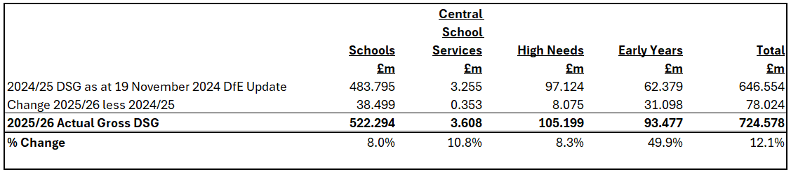
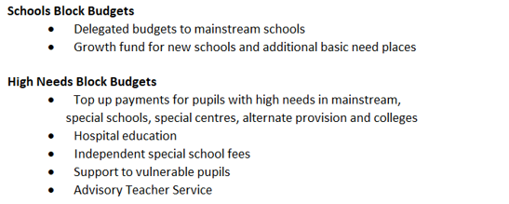
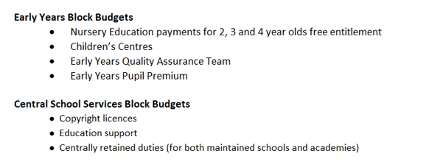
Dedicated Schools Grant 2025/26
Governance and decision making:
Cabinet
Schools Forum

Slide 35
SEND & DSG risks
Delivery of targets for SEND & DSG is not a simple matter of targets, action plan, delivery: the graphic below sets out opposing forces. The reality is that both sets of factors could work in either direction.
Within local control
Good SEND and inclusive practice: preventative services (EY settings, reduce exclusion); good gatekeeping to EHCP / consistent application of legal framework and active pursuit of what is best for each young person.
Good commissioning : getting the right placement for each young person; being vigilant in anticipating sufficiency of available places; and influencing the shape of the market.
Good data: linking activity and finance; comparisons over time, against others and against national benchmarks; all leading to good decisions.
Beyond local control
Demography: Overall population as well as its composition and parental expectation
Statutory guidance : Local authorities are bound to observe the national guidance when making judgements about EHCP, so turning off taps is not an option
Supply and demand: scarcity drives up costs for specialist places
National economic and social context: uncertainty around national policy, increasing deprivation and pressure on the school system is driving demand.
Increased sufficiency: Special school capacity, resource bases and expansion of Alternative Provision, to reduce use of independent schools.
Legal system: Tribunal outcomes are heavily stacked against local authorities with 97% finding in favour of parents

Slide 36
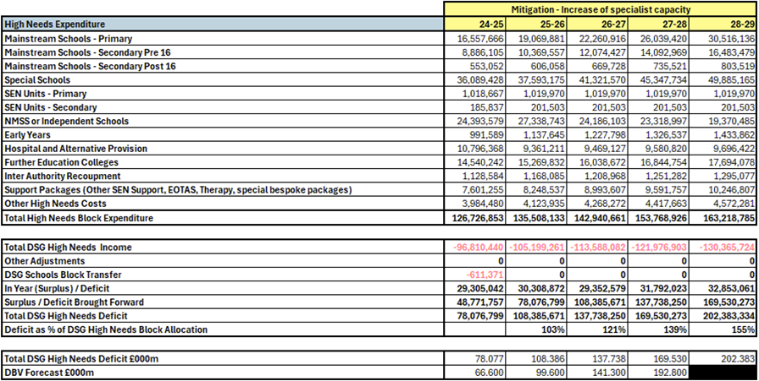
5 Year DSG Plan
Financial mitigations:
Increased sufficiency of specialist places
Reduce the need for statutory support
More children and young people with SEND attend mainstream school

Slide 37


Priorities to tackle the DSG Deficit in summary:
Promoting and supporting mainstream school inclusion, including workforce development
3 priorities
Sufficiency of specialist placements
Changes to the National Funding Formula & national legislative framework for SEND
Notes:
We can seek to reduce cost by 1 and 2 – but 3 is essential but beyond our control – there is no route to addressing the deficit without those changes – not even if we were to undertake large transfers from the Schools Block to the High Needs block – and we would then have a range of impacts that would make the drive for EHCPs stronger not address it – EHCPs seen as a source of funding for schools in a poor funding environment.

Slide 38
Governance & Oversight
Weekly SLT financial recovery meetings
Monthly meetings with Chief Exec, Leader
Quarterly FPR
Schools Forum High Needs working group
DSG cabinet report Jan 25
ED and AP change programme – reporting to SILAP and DfE
DBV plan in place – reporting to SILAP and DfE

Slide 39
Members Support
Responding to SEND Issues Raised by Residents & Settings
Notes:
The SEND system is complex – hard to navigate for all
Into your email box likely to get a range of enquiries for support ranging from:
Refusal to assess decisions
Timeliness for issuing EHCP plans
Annual Review process
Mediation outcomes
Specialist placement requests
Post-16 transport for YP with EHCPs
Disagreements over required provision

Slide 40
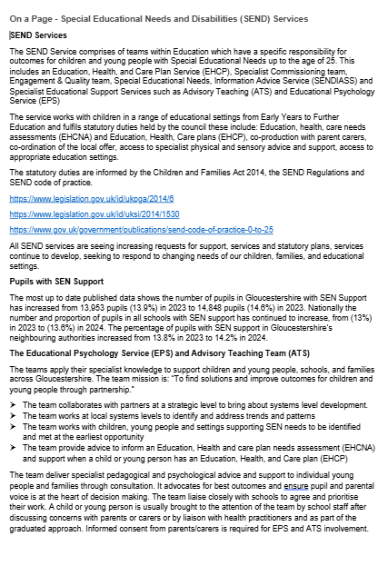

Member Reference Documents:

Slide 41
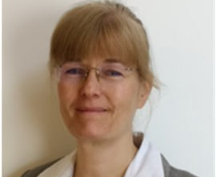
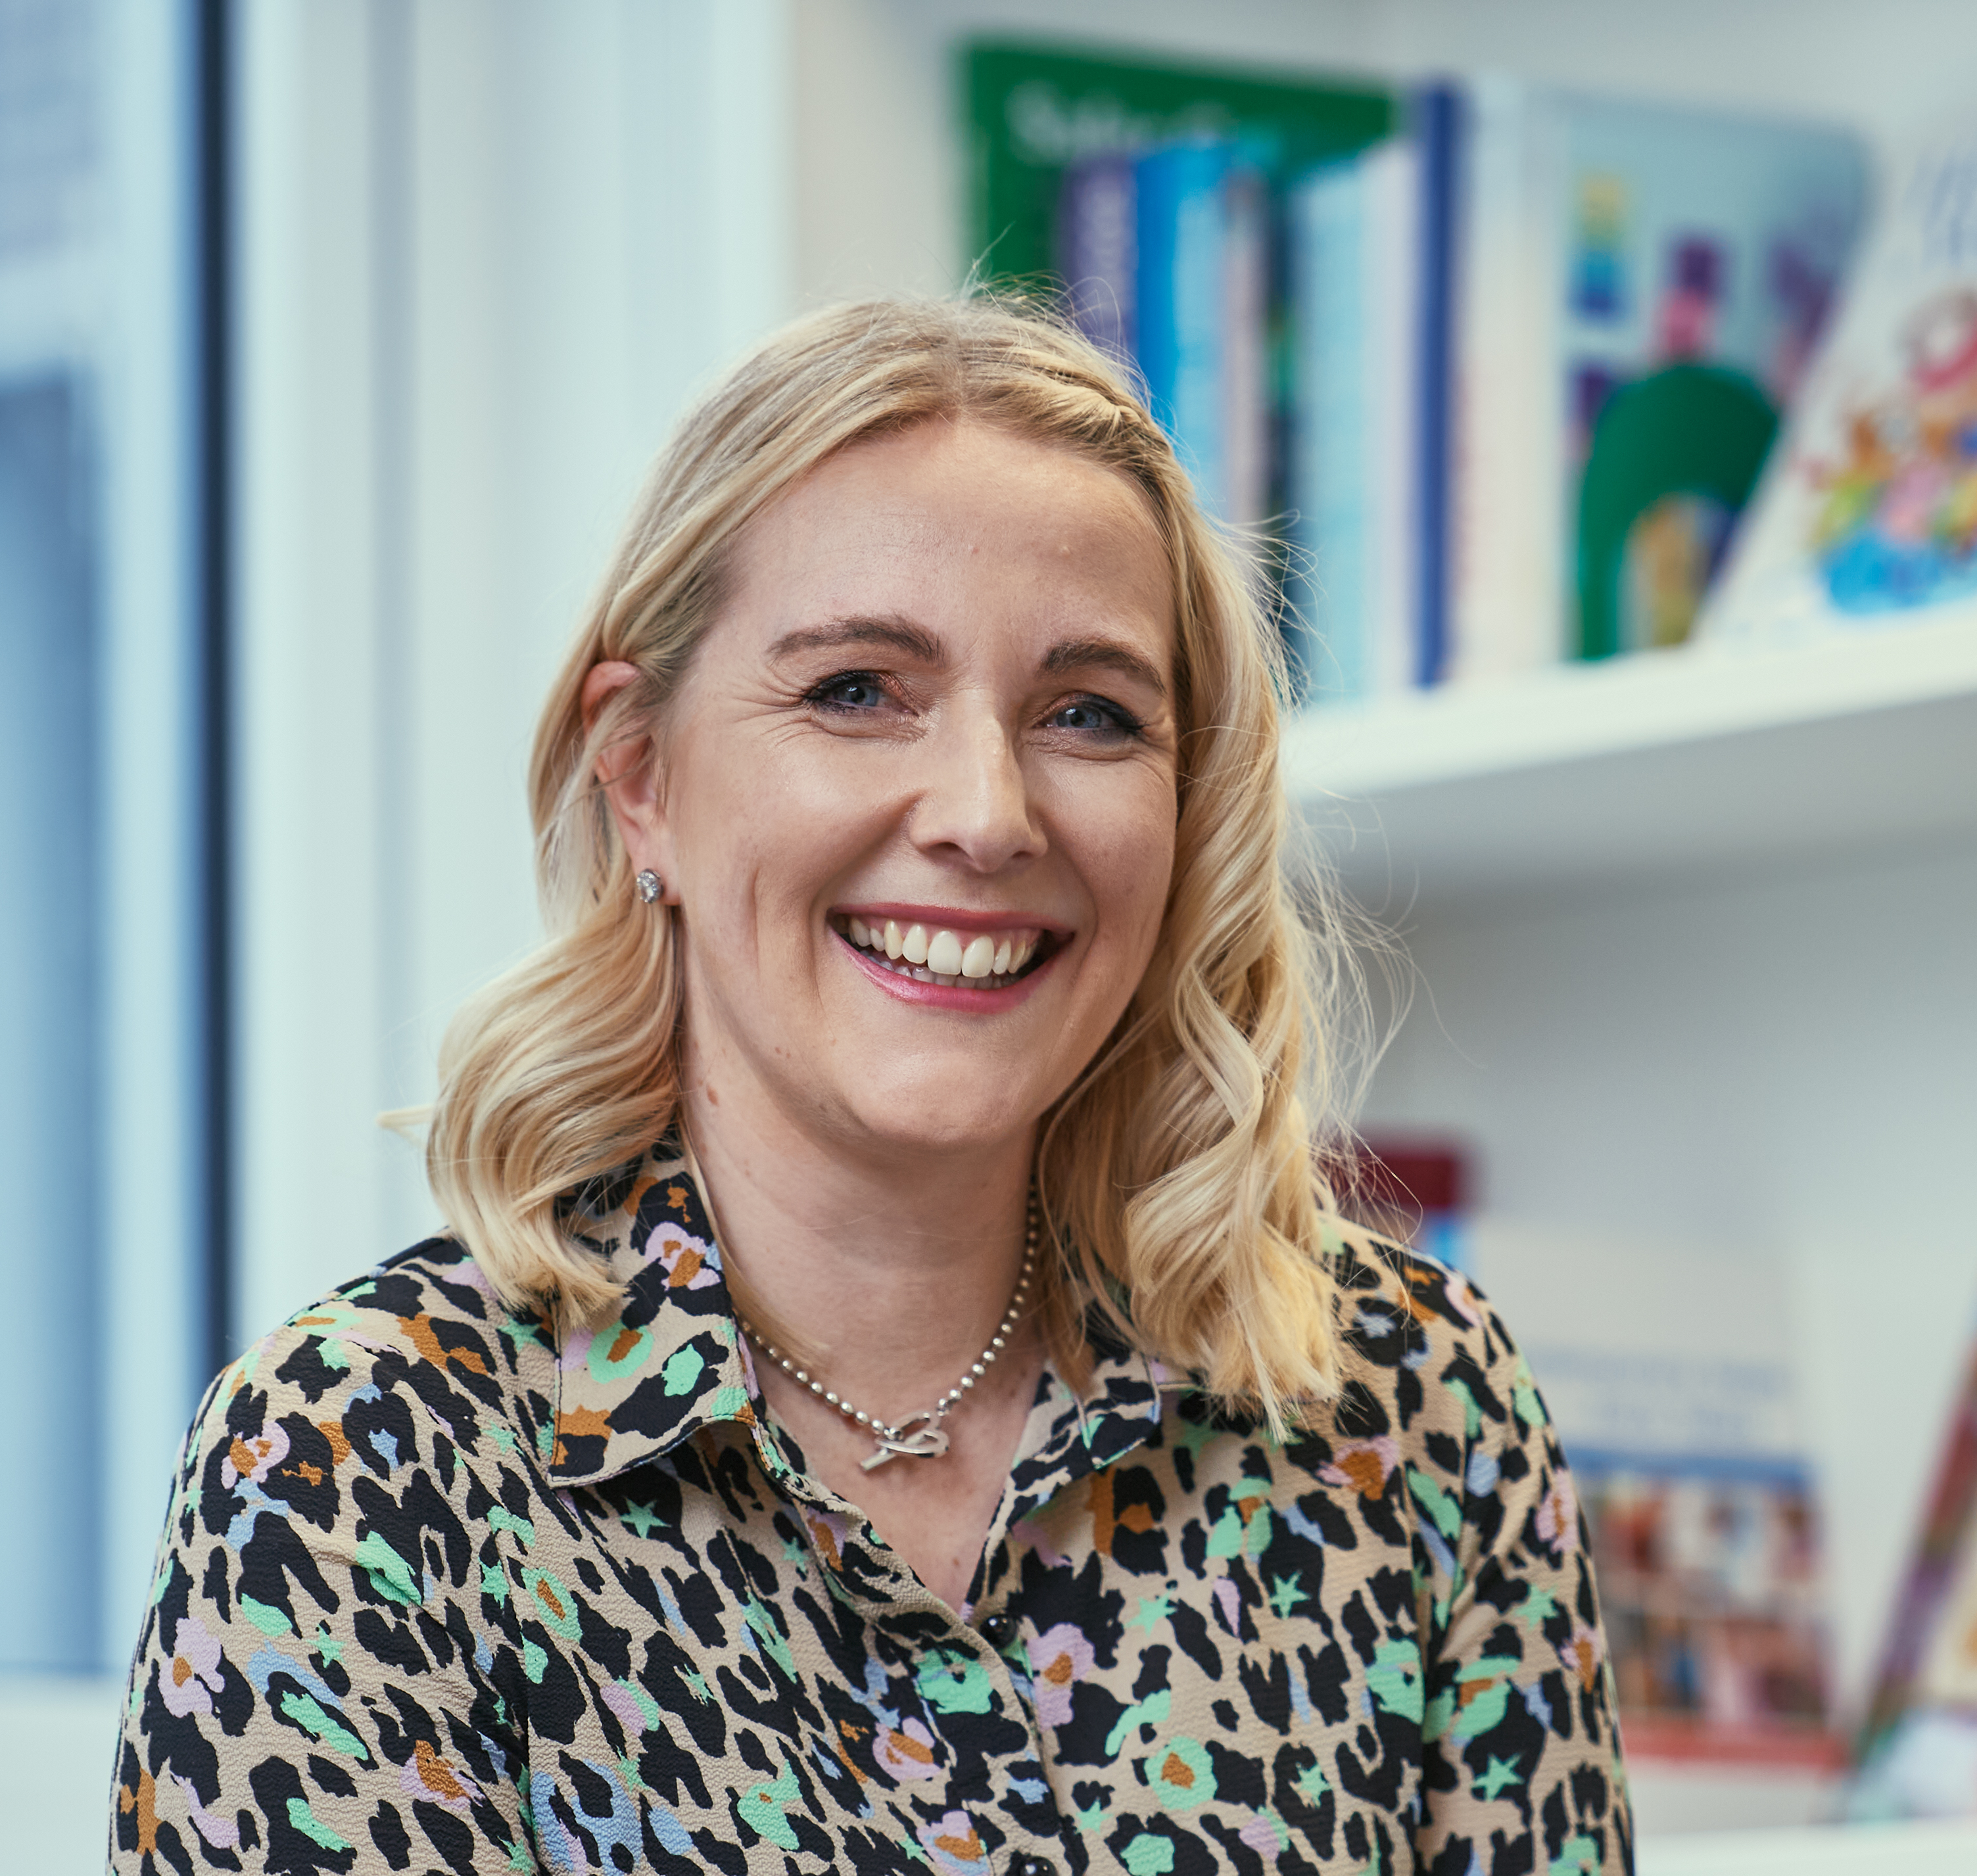
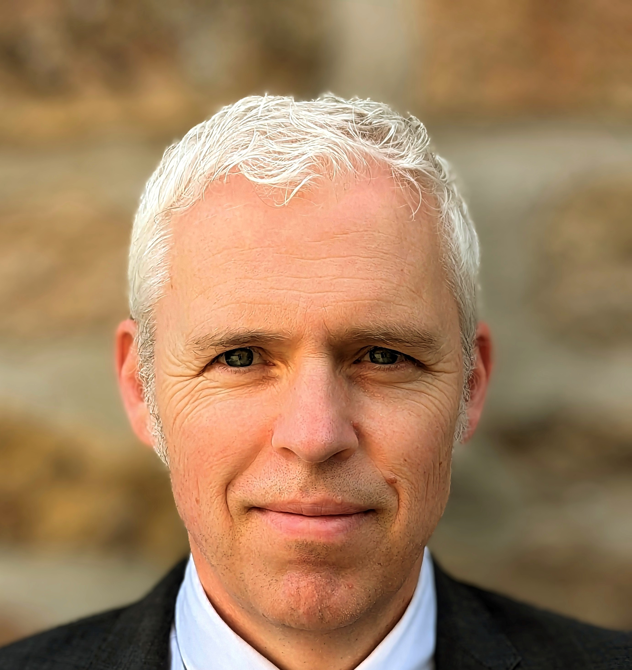
Contacts to raise an Education, Disabled Service or Social Care concern raised by a resident or education setting:
Kirsten Harrison Director of Education
Kirsten.Harrison@gloucestershire.gov.uk
Naomi Adams – Head of Service, Disabled Children
and Designated Social Care Officer (DSCO)
naomi.adams@gloucestershire.gov.uk
Paul Shallcross – Director of Safeguarding and Care
paul.shallcross@gloucestershire.gov.uk

