Slide 1

Year 9

Slide 2

Making choices
Here are some things you need to know, do and think about...
The law says you must stay in learning until the age of 18. This does not mean you have to stay in school.
Learning also includes college, training, or full time work as long as it includes some part time learning e.g. an apprenticeship.
You pick GCSEs options in Year 8 or 9, depending on your school.
You usually pick your next step in Year 11.

Slide 3
Think about:
What are you good at?
What do you enjoy?
What might you want to do until you are 18?
What might you want to do after you’re 18?
There are resources at school which could help you with these decisions. Ask your teachers or the school librarian to help you.

Slide 4
Building on your strengths
Have a go at the quiz to find out what kind of areas you might want to think about building into your subject choices and future career
Total up the number of ticks for each colour.
Are you:
Realistic?
Social?
Enterprising?
Conventional?
Investigative?
Artistic?

Slide 5
GCSEs
GCSEs are your first chance to choose which subjects you want to learn. You may need to pick certain subjects if you have a particular job in mind. Or you may want to carry on with the subjects you really enjoy.
Everyone studies English, Maths and Science. You will need a grade 4 (equivalent of the old grade C) in English and Maths to get a place on most courses after GCSEs, like A-Levels.
Your school will tell you which subjects you can choose. Subjects might include: Art, Design & Technology, Geography, Drama, History and Music.
Top tip
If you are not sure what to study after turning 16 or what job you want, keep your options open and try to study a variety of subjects.

Slide 6
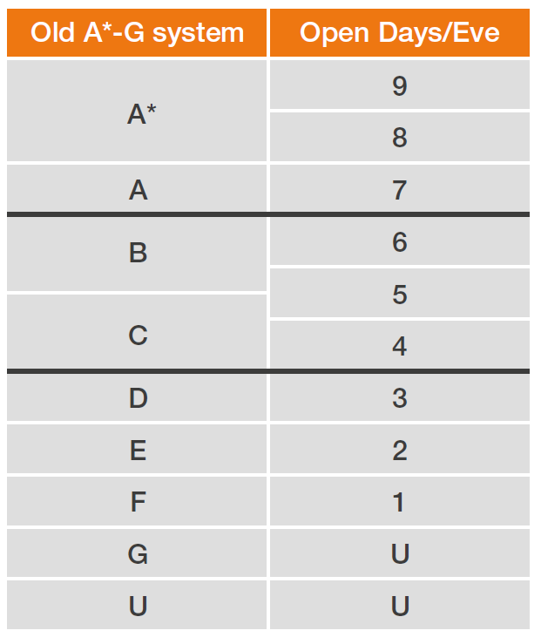
GCSE grades are changing
The grades used for GCSEs have been changing since September 2016.
New GCSEs are now graded 9 - 1, rather than A* – G.
English Language, English Literature and Maths are the first subjects to use the new system, with your other subjects using numbers by 2019.
Eventually all GCSEs taken in England will be marked with grades
9 - 1.
This should give you an idea of how the new grades compare to the old ones:
Old grades New grades

Slide 7
Alternatives to school
University Technical College (UTC) or Studio School.
You could move at the end of Year 9 (or Year 11) to a UTC or Studio School.
+ For 14-19 year olds of all abilities to study subjects linked to specific industrial sectors like STEM ( Science, Technology, Engineering, Maths).
+ They closely involve universities and employers and are designed to be like the workplace.
+ Follow a “9 to 5” day and don’t have the same terms as schools.
+ Offer a range of academic and vocational qualifications including GCSEs in English, Maths and Science.
+ Offer work placements linked directly to employment opportunities in the local area.
Your local UTC is in Berkeley, Gloucestershire
For further information visit: www.berkeleygreenutc.org.uk/about, www.studioschoolstrust.org or www.utcolleges.org

Slide 8
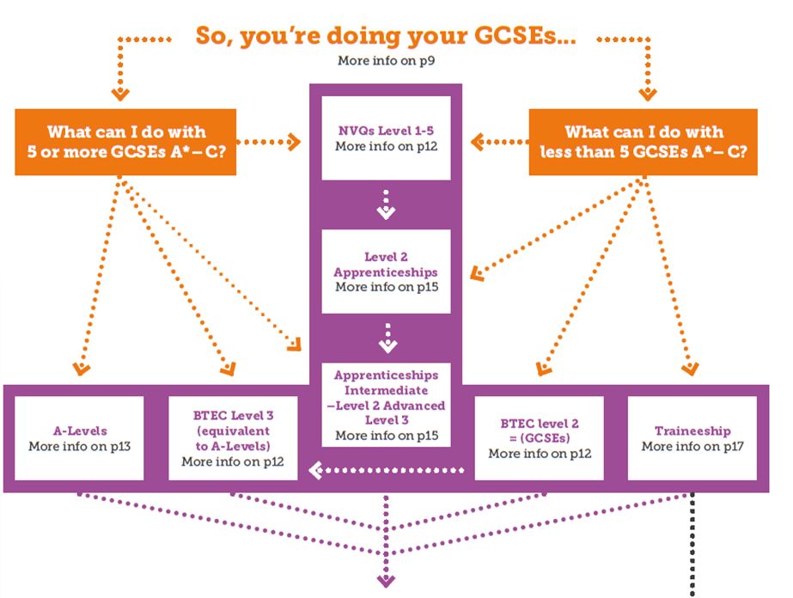
What’s next?
Once you’ve finished your GCSEs you will have more decisions to make…
Have a look at your What’s Next booklet for more info on choices after GCSEs.

Slide 9
Getting ready for work
You may feel ready to start full-time work when you are 18, or you may
want to work part time while you study. Here are some things to think about to
improve your chances of getting a job.
Work Experience
Work experience is a great way to test out whether you like a job/sector. It also shows employers that you’ve thought about what you want to do and have a realistic idea of what working life is like.
+ You’ll do work experience with your school or college but you can also arrange your own experience during school holidays or at weekends.
+ Part-time work while you study is also a great way to get experience and learn skills – as long as your education comes first!
You might want to take a look at Job Market Information on the National Careers Service website:
https://nationalcareersservice.direct.gov.uk

Slide 10
Getting ready for work
Volunteering
+ Gain skills that employers are looking for
+ Develop confidence
+ Find out more about what you’re good at
+ Feel valuable
+ Get work experience for your CV
+ Learn new skills and get extra qualifications
+ Support a good cause
+ Meet people
+ Have fun!
To find local volunteering opportunities visit:
www.volunteerglos.org.uk
You can also register for National Citizen Service (NCS) ww.ncsyes.co.uk
NCS is an opportunity for 15 to 17 year-olds to learn new skills, volunteer
and have an adventure.

Slide 11
Getting ready for work
Writing a CV and covering letter
CVs and covering letters are a great way to show your skills and experience. They are the first impression employers get of you. They can be daunting to write at first, but these tips are a good starting point:
+ CVs should be no longer than two
sides of A4.
+ If there’s a job description, read it
+ Write three sentences about your skills and personality
+ List your education and qualifications including what you are studying at the moment
+ List any work experience and volunteering, and what tasks you did
+ Include a bit of information about your skills, hobbies and interests
+ Have a smart and professional layout
+ Remember to include your contact details.
+ A covering letter should be
no longer than one page of A4.
+ One line saying why you are writing
+ A few lines about you and your skills
+ A paragraph about your experience
and what you would bring to the
organisation or role
+ A paragraph about why you want
to work for this organisation and
in this role
+ A few sentences to summarise.

Slide 12
Getting ready for work
How to impress at interviews
Make a good first impression
+ Be on time or if you can, a bit early. It shows you are keen.
+ Dress appropriately for your interview, don’t worry about being too smart.
+ Turn your phone off.
+ Give a firm handshake.
+ Take a deep breath, smile and speak calmly and clearly.
+ Research the role and company – do you understand what they do and what you’ll need to do?
+ Be interested in your job – ask questions about what your employer expects of you.
+ Keep eye contact throughout the interview.
+ Ask the employer some questions
at the end of the interview..
Employers want to see that you can:
+ Work well in a team
+ Solve problems
+ Use a computer (basic Word and Email skills)
+ Turn up on time
+ Motivate yourself
+ Stick with tasks
What are you like at these? Employers often say that it is your willingness to work (your attitude) is every bit as important as your skills and
qualifications. Are you ready for work?

Slide 13
Tips for dealing with stress
Choosing options and taking exams is stressful
Need to relax?
These tips can help:
+ Have a bath to relax
+ Do exercise – it’ll burn off stress and release endorphins
+ Pop bubble wrap! It’ll help calm you
+ Eat some dark chocolate – it releases endorphins
+ Take a break and get outside for some fresh air and hopefully sunshine
+ Spend time with animals – research
shows they reduce stress
Feeling really stressed out?
These tips can help:
+ Take a break from revision
+ Talk to friends and family about
how you’re feeling
+ Talk to a range of people and
teachers about your decision
+ Don’t be embarrassed to ask
for help
+ Try not to procrastinate
– you’ll just feel worse afterwards
Finally:
Remember it’s okay to not
know what you want to do.
If you’re really struggling
and feel really down, talk
to your GP immediately.
There’s a new website for young people in Gloucestershire to find out about mental health and wellbeing:
www.onyourmindglos.nhs.uk

